Slide 1




Slide 2


Distant Past
The history of Pasig dates back over 3,000 years, proven by two polished jade adzes of the late New Stone Age found in Pasig Rizal near the church tower in the early 1920s, dated around 1000–1200 B.C.
This shows that Pasig was a center of human habitation for at least 3,000 years.

Slide 3



Who are these people and where did they come from?
According to H. Otley Beyer, an American pioneer anthropologist in the Philippines, the earliest settlers in the Rizal area (including Pasig) were groups of diverse cultures and races.
These people migrated to the Philippines in waves between 25,000–30,000 years ago and continued arriving up to as late as the lith century A.D., as shown by archaeological evidence.

Slide 4







Native Noble
Kalangitan mean heavenly, perhaps because of her beauty, for a beautiful woman, indeed, is
always heavenly
she was a Reyna in pre-colonial nakshi nya Rajah Salalila
bebe nya Gat Lontok

Slide 5


Pasig used to be very vast (malawak)
Pasig used to be much bigger than it is now.
It stretched from Montalban in the North all the way to the shores of Laguna de Bai in the South (that’s over 50 kilometers wow galeng)

Slide 6

Tower Bell of Pasig City
Some artists, architects, and writers (including Galende) note that the Pasig bell tower is unusually large and tall for its church, built for functionality so its bells could be heard in distant chapels (visitas).
Augustinian historian Castro claimed that Pasig once housed the oldest and biggest bell in the Philippines, cast in 1573. With minimal noise pollution at the time, these bells could be heard far away, even across Laguna de Bai.
What is now Marikina was formerly a Jesuit hacienda called Jesus de la Peña and was part of an old barrio of Pasig named Maybunga.
The town’s original patron was the Visitation of Our Lady, but this was changed to the Immaculate Conception in 1587 for unknown reasons.

Slide 7

THE NAME OF PASIG

Slide 8
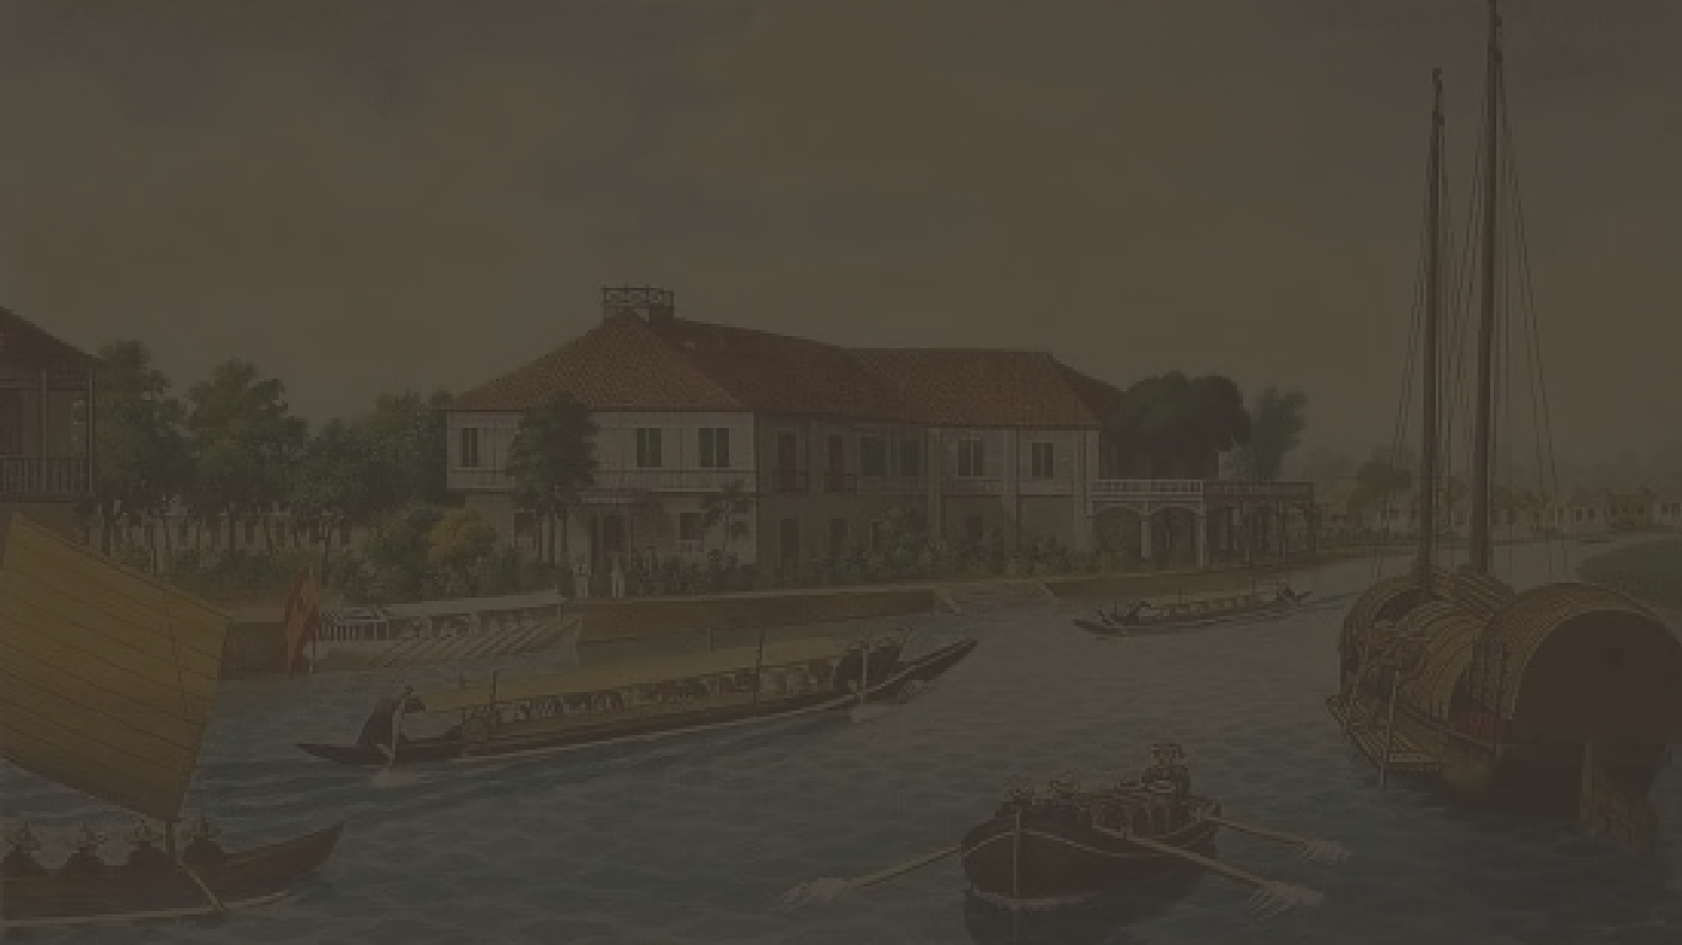
The name of Pasig has been variously spelled.
In the Chapters of the Augustinians of 1575 and 1580, it was referred to as "Pasi" in 1584, "Pasic" in 1587, "Pasi" in 1593, "Passi" or "Passic" and finally, in 1596, "Pasig."
These variations could have arisen from the inability of foreign tongues to pronounce with ease the sounds of the local languages.

Slide 9

Origin of the name "Pasig."
Rizal mentions the story of Paz and Virgilio going boating one evening in the river when their frail banca capsized and Virgilio, a Spaniard who did not know how to swim, gasped, "Paz, sigue me (fol-low me) ... Paz, sigue me... until, unable to finish the sentence as he began to sink, he Virgilio gasped, “Paz sig...” still calling his beloved in the throes of death.

Slide 10
Another Version
A slight variation of this legend changes the name of the man to Igme, who, like the first tale, went boating one evening with his lover Paz, and whose boat, again! cap- sized, and as the lovers began to be separated and sink in the strong current, the man called, "Paz" and the girl, "Igme," until unable to swim any longer, they sank calling to each other and the people along the banks heard the lovers calling, Paz... Ig. gave the name to the river, from which the town got its name.

Slide 11

The name Pasig has been used to designate, at least the river, before the coming of the Spaniards as shown in documents, for example, the grant of the Pasig encomienda to Captain Juan de la Isla.
Another speculation is that Pasig comes from the Sanskrit "passir" which means sand. But then every community on the edge of river, lake or sea would be sandy and would thus be called Pasig, or some variations thereof.
A variation of this is the word "pasigan" which means river shore.
Encyclopedia Universal Ilustrada Europeo-Americana de Espasa presents an interesting, if capricious, hyphothesis, which says that "El Pasig" is a perfect anagram of Legazpi, insinuating again that that the name is of Spanish origin, when the fact is that Pasig has existed long before the coming of the Spaniards.

Slide 12
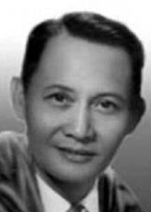
Most Accepted Theory
“Pasig” is from Old Sanskrit
This theory is from Dr. Jose Villa Panganiban, a famous Filipino language expert.
Sabi nya, “Pasig” comes from an old Sanskrit word that means ‘a river that flows from one body of water to another.’”
This fits perfectly with what the Pasig River does
It flows from Laguna de Bay (a big lake) To Manila Bay (a saltwater bay)

Slide 13

British Occupation of Pasig
lagowt :(

Slide 14

Pasig figured prominently during the British invasion of the Philippines during the 18th century.
An old account of the British occupation of Pasig which began on
November 8, 1762.
Simon de Anda sought to dislodge the British from the fallen city (of Manila) by starving them. The main source of supply was the Pasig River traffic of boats from the Bai towns. Anda occupied Pasig with a force under Bustos, and thereby cut off the flow of foodstuffs into Manila.
General Draper of the British had to take a countermeasure; he sent
Lt. Thomas Blackhouse to reopen the Pasig river to boats. At Maybunga, a basin of Pasig, the British and the Spanish forces met. The Spaniards fared badly and Bustos retreated to Mariquina. (Marikina now)

Slide 15

Round the church and convent of Pasig, trenches have been dug and all possible sorts of defenses set up, backed by about 10,000 natives armed with all kinds of weapons. The British with 500 soldiers attacked Pasig and quickly dispersed the native defenders. About 1,500 of both sexes of all ages were killed, part of them with guns and cannons, and part drowned in the Pasig River.
The English stationed a detachment in Pasig and occupied the town till the end of the war. One offshoot of the British occupation was the order of the British Commissary of Artillery that all church bells of Pasig (among other towns) be surrendered to them as spoils of war. Thus the oldest bell of Pasig today is San Hilarion, cast in 1793 or about 28 years after the British left.

