Slide 1
TRANSPORTATION PROBLEM

Slide 2
Transportation problem
Transportation problems are a type of linear programming problems that involve determining the optimal allocation of goods or resources from a set of supply points (e.g., factories, warehouses) to a set of demand points (e.g., customers, distribution centers) while minimizing or maximizing certain objective functions, typically cost or profit.
Transportation problems are relevant in various industries, including logistics, supply chain management, and operations research. They can help organizations optimize their transportation networks, minimize costs, maximize profits, and improve overall efficiency. By solving transportation problems, companies can make informed decisions regarding the allocation of resources, route planning, inventory management, and capacity utilization.

Slide 3
Key Components of Transportation Problems
Supply Points: These represent the sources of supply, such as factories, warehouses, or production facilities. Each supply point has a specific capacity or supply limit.
2. Demand Points: These represent the destinations or demand locations, such as customers or distribution centers. Each demand point has a specific demand requirement.
3. Transportation Costs (or Profits): These represent the cost of transporting a unit of goods from a supply point to a demand point. The costs can vary depending on the distance, mode of transportation, tariffs, or other factors. In maximization problems, these costs may be replaced with profit values.
4. Objective Function: The objective function defines the goal of the transportation problem, either to minimize transportation costs or maximize profits. The objective is usually achieved by optimizing the allocation of goods.

Slide 4
Common Techniques to Solve Transportation Problems
North-West Corner Method: This initial allocation method starts from the top-left corner and allocates goods in a "north-west" direction until the supply and demand constraints are satisfied. It is a simple and quick method but may not always yield an optimal solution.
2. Least Cost Method: This method selects the cell with the lowest transportation cost and allocates goods to that cell until the supply and demand constraints are met. It provides a more optimized initial solution compared to the North-West Corner Method.

Slide 5
Common Techniques to Solve Transportation Problems
3. Vogel's Approximation Method (VAM): VAM is an improvement over the Least Cost Method as it considers the difference between the two lowest costs for each row and column. By selecting the cell with the largest difference, it aims to provide a better initial solution.
4. Optimality Methods: Once an initial solution is obtained, optimization methods like the Stepping Stone Method or the Modified Distribution Method can be used to iteratively improve the solution and find the optimal allocation that minimizes costs or maximizes profits.

Slide 6
Advantages of using Excel for Transportation Problems
Excel is a widely used spreadsheet software that offers several advantages for solving transportation problems:
Accessibility: Excel is readily available and familiar to many users, making it easily accessible for modeling and analysis.
Flexibility: Excel provides a flexible platform for creating transportation models, allowing users to customize their spreadsheets based on specific problem requirements.
Solver Add-in: Excel's Solver add-in is a powerful tool that can be used to solve optimization problems, including transportation problems, by applying linear programming techniques.
Data Manipulation: Excel's data manipulation capabilities enable users to organize and manipulate the transportation data efficiently, including costs, supply and demand quantities, and constraints.
Sensitivity Analysis: Excel allows for sensitivity analysis by changing input values and observing the impact on the solution, which is useful for exploring various scenarios and assessing the robustness of the optimal solution

Slide 7
Example 1: Transportation Problem with Minimization Objective
Consider a company that needs to transport goods from three factories (A, B, and C) to three distribution centers (X, Y, and Z). The transportation costs per unit are given as follows:
The supply and demand constraints are as follows:
Transportation Cost | Distribution Center (X) | Distribution Center (Y) | Distribution Center (Z)
Factory A | 40 | 47 | 80
Factory B | 72 | 36 | 58
Factory C | 24 | 61 | 71
Supply from A: 100 units
Supply from B: 200 units
Supply from C: 300 units
Demand at X: 200 units
Demand at Y: 200 units
Demand at Z: 200 units

Slide 8
To solve this transportation problem using Excel, you can create a spreadsheet with the following columns:
Factory (A, B, C)
Distribution Center (X, Y, Z)
Quantity (to be determined)
Unit Cost (given)
Total Cost (calculated as Quantity multiplied by Unit Cost)

Slide 9
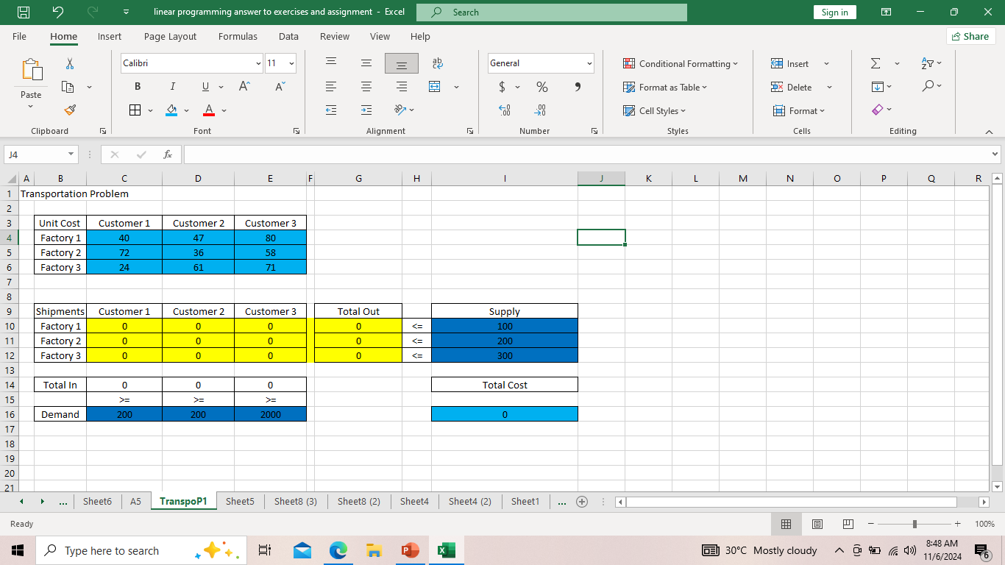
Use the solver in Excel to find the number of units to ship from each factory to each center that minimizes the total cost.
1. Formulate the Model
The model we are going to solve looks as follows in Excel.

Slide 10
A. To formulate this transportation problem, answer the following three questions.
a. What are the decisions to be made? For this problem, we need Excel to find out how many units to ship from each factory to each customer.
b. What are the constraints on these decisions? Each factory has a fixed supply, and each customer has a fixed demand.
c. What is the overall measure of performance for these decisions? The overall measure of performance is the total cost of the shipments, so the objective is to minimize this quantity.
B. To make the model easier to understand, create the following named ranges.
Range Name | Cells
UnitCost | C4:C6
Shipments | C10:E12
Totalln | C14:E14
Demand | C16:E16
TotalOut | G10:G12
Supply | I10:I12
TotalCost | I16

Slide 11
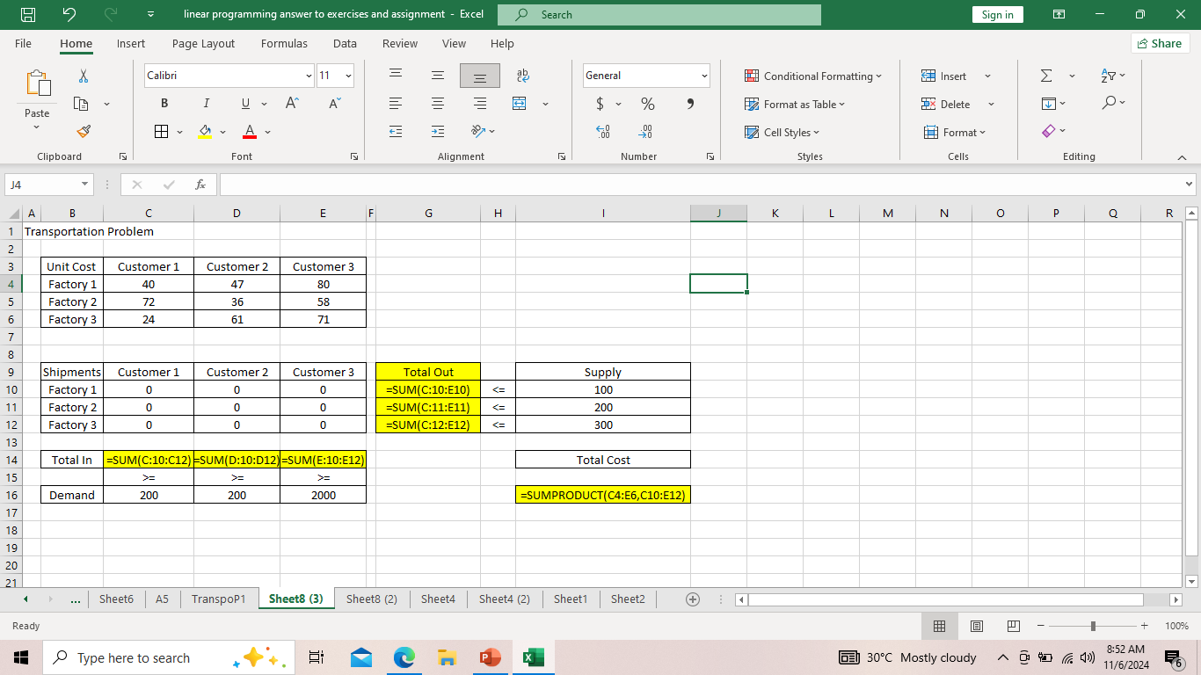
2. Insert the following functions
Explanation: The SUM functions calculate the total shipped from each factory (Total Out) to each customer (Total In). Total Cost equals the sumproduct of UnitCost and Shipments.

Slide 12
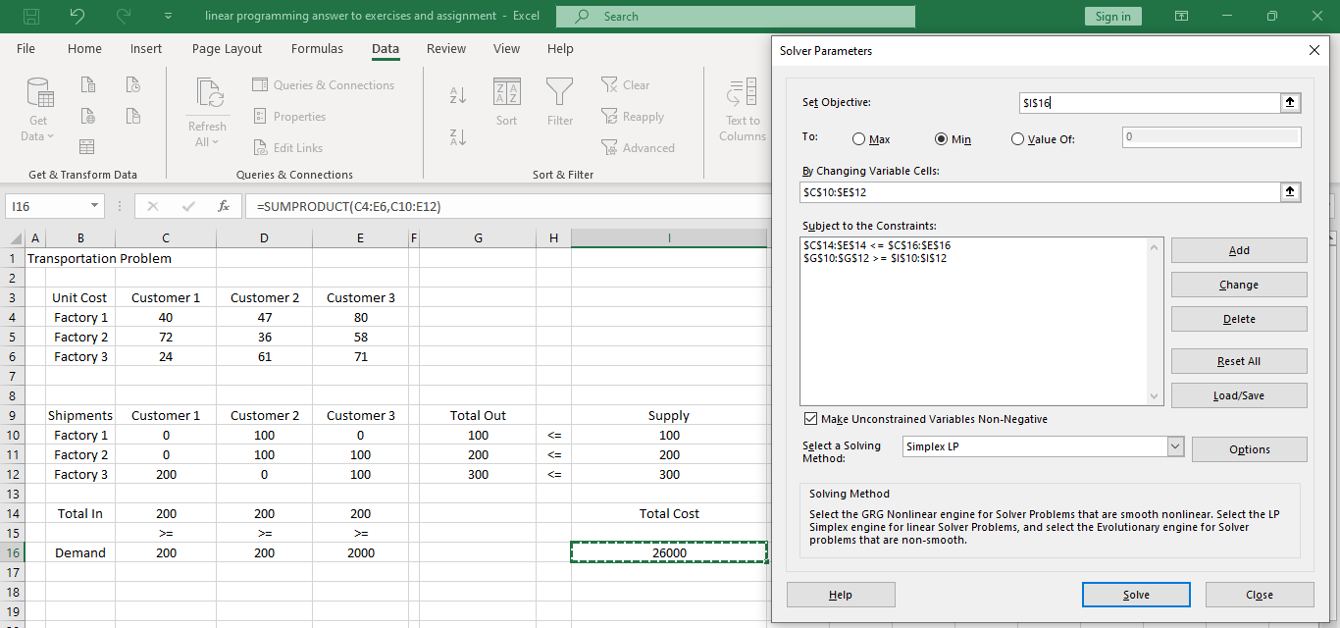
3. Solve the Model
To find the optimal solution, execute the following steps.
Enter the solver parameters (read on). The result should be consistent with the picture below.

Slide 13
4. Conclusion
It is optimal to ship 100 units from Factory 1 to Customer 2, 100 units from Factory 2 to Customer 2, 100 units from Factory 2 to Customer 3, 200 units from Factory 3 to Customer 1 and 100 units from Factory 3 to Customer 3. This solution gives the minimum cost of 26000. All constraints are satisfied.

Slide 14
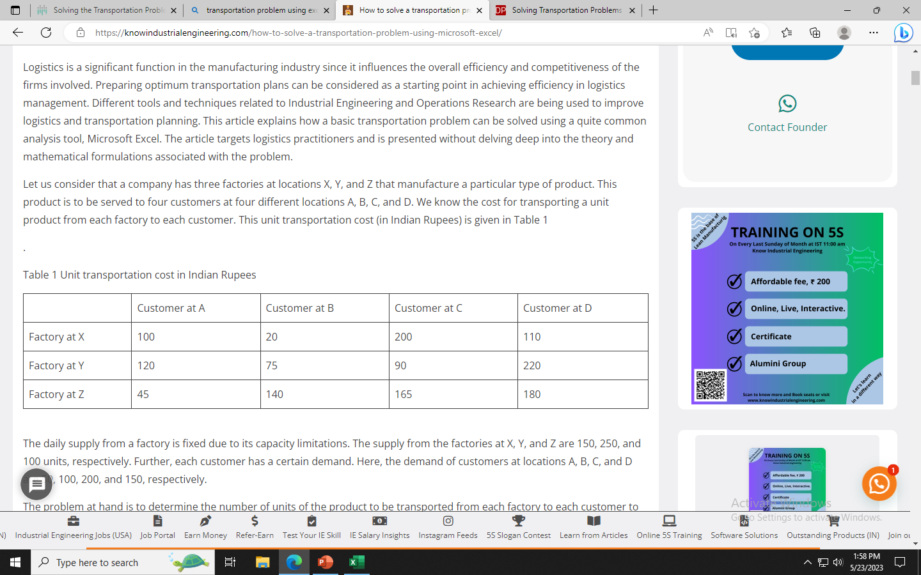
Example 2. A company has three factories at locations X, Y, and Z that manufacture a particular type of product. This product is to be served to four customers at four different locations A, B, C, and D. The cost for transporting a unit product from each factory to each customer is given in Table 1
.
Table 1 Unit transportation cost in Philippine peso
The daily supply from a factory is fixed due to its capacity limitations. The supply from the factories at X, Y, and Z are 150, 250, and 100 units, respectively. Further, each customer has a certain demand. Here, the demand of customers at locations A, B, C, and D are 50, 100, 200, and 150, respectively.
The problem at hand is to determine the number of units of the product to be transported from each factory to each customer to minimize the total transportation cost. Here, we assume that the total supply from different factories and the total customer demand are equal.

Slide 15
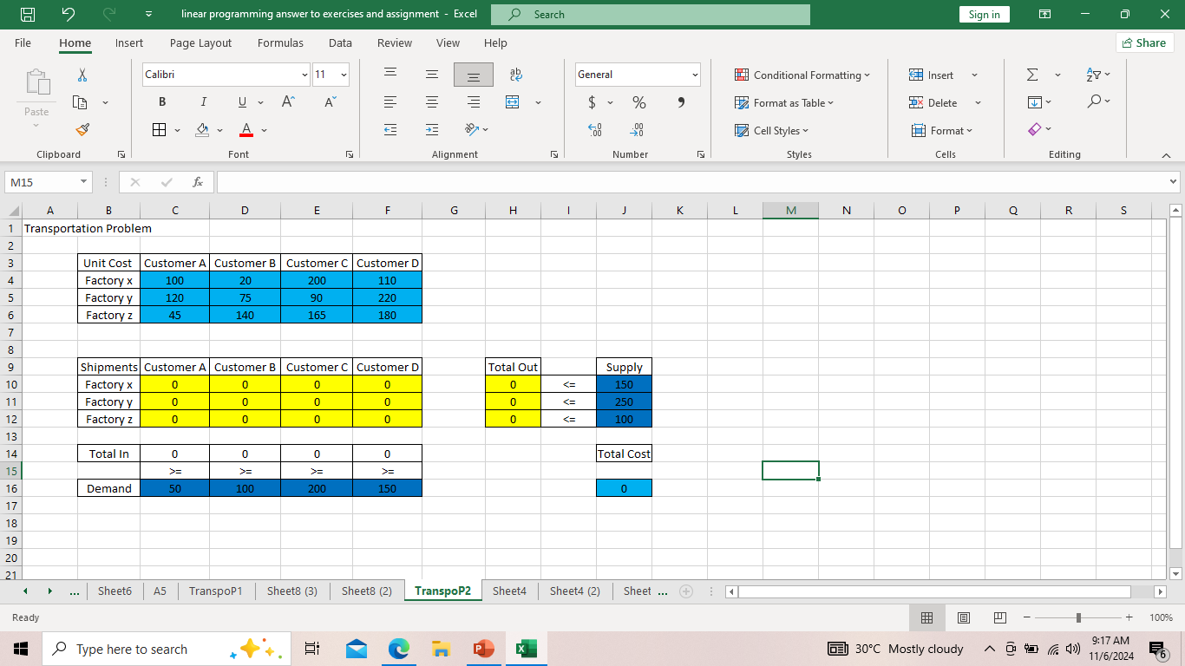
Solution: Use the solver in Excel to find the number of units to ship from each factory to each center that minimizes the total cost.
1. Formulate the mode
The model we are going to solve looks as follows at Excel

Slide 16
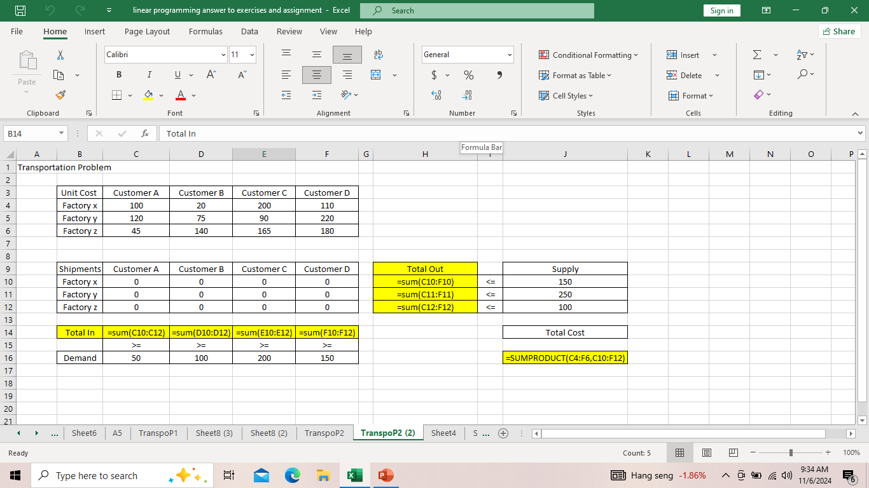
2. Insert the following functions:

Slide 17
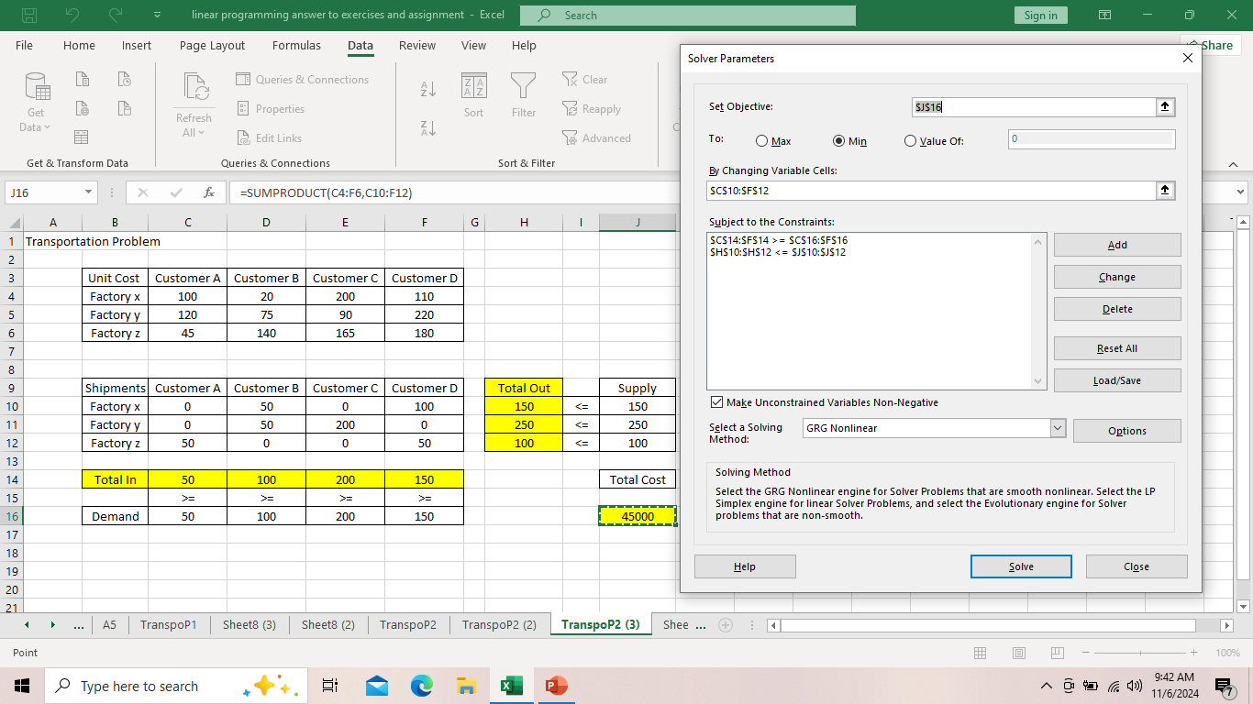
3. Solve the model:

Slide 18
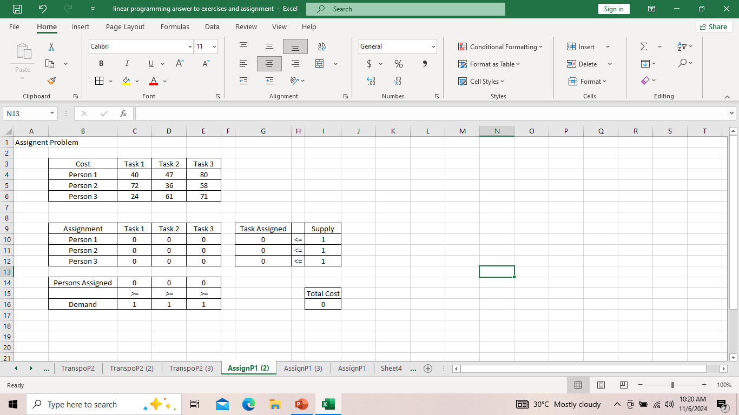
Assignment Problem
Use the solver in Excel to find the assignment of persons to tasks that minimizes the total cost.
Formulate the Model
The model we are going to solve looks as follows in Excel.

Slide 19
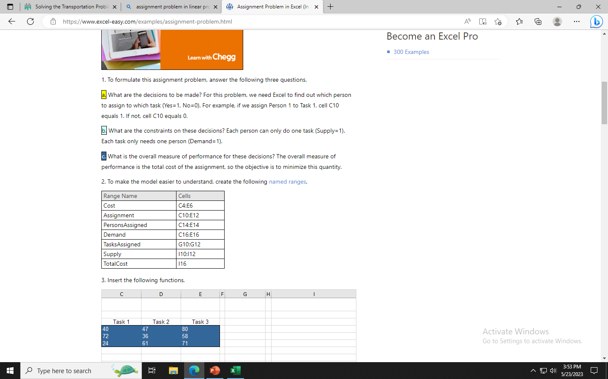
To formulate this assignment problem, answer the following three questions.
a. What are the decisions to be made? For this problem, we need Excel to find out which person to assign to which task (Yes=1, No=0). For example, if we assign Person 1 to Task 1, cell C10 equals 1. If not, cell C10 equals 0.
b. What are the constraints on these decisions? Each person can only do one task (Supply=1). Each task only needs one person (Demand=1).
c. What is the overall measure of performance for these decisions? The overall measure of performance is the total cost of the assignment, so the objective is to minimize this quantity.
2. To make the model easier to understand, create the following named ranges.

Slide 20
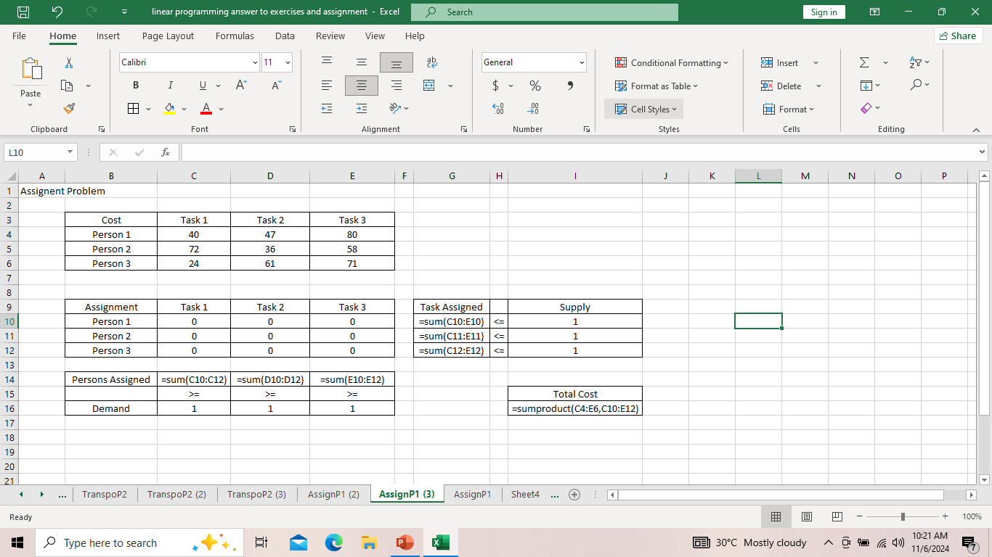
3. Insert the following functions.

Slide 21
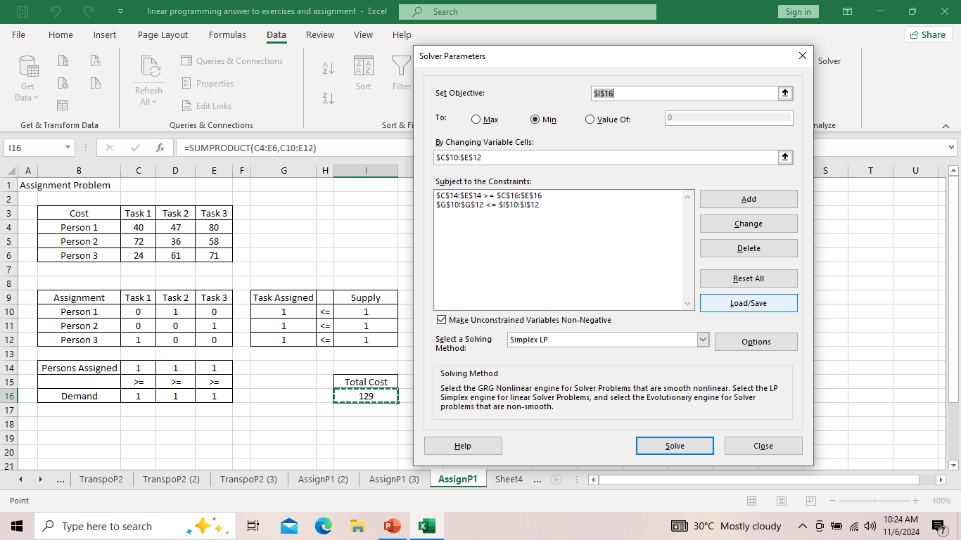
The Optimal Solution
Conclusion: it is optimal to assign Person 1 to task 2, Person 2 to Task 3 and Person 3 to Task 1. This solution gives the minimum cost of 129. All constraints are satisfied.

Slide 22
Exercises
A company has three factories (F1, F2, F3) and three distribution centers (D1, D2, D3). The transportation costs per unit and the supply/demand quantities are given as follows:
Supply from F1: 70 units
Supply from F2: 80 units
Supply from F3: 90 units
Demand at D1: 80 units
Demand at D2: 80 units
Demand at D3: 80 units
Unit Cost | D1 | D2 | D3
F1 | 3 | 6 | 7
F2 | 5 | 9 | 8
F3 | 2 | 7 | 6

Slide 23
Exercises
2. A company has four warehouses (W1, W2, W3, W4) and four customers (C1, C2, C3, C4). The profit per unit of goods shipped and the supply/demand quantities are given as follows:
 | C1 | C2 | C3 | C4
W1 | 10 | 12 | 5 | 11
W2 | 13 | 9 | 7 | 8
W3 | 6 | 5 | 11 | 9
W4 | 9 | 14 | 9 | 6
Supply from W1: 60 units
Supply from W2: 70 units
Supply from W3: 80 units
Supply from W4: 60 units
Demand at C1: 60 units
Demand at C2: 70 units
Demand at C3: 80 units
Demand at C4: 60 units

Slide 24
Exercises
3. A company has five employees (E1, E2, E3, E4, E5) and five tasks (T1, T2, T3, T4, T5). The efficiency of each employee in performing each task is given as follows:
 | T1 | T2 | T3 | T4 | T5
E1 | 7 | 3 | 5 | 2 | 1
E2 | 2 | 6 | 4 | 5 | 3
E3 | 3 | 4 | 2 | 6 | 2
E4 | 5 | 2 | 3 | 4 | 1
E5 | 4 | 1 | 5 | 3 | 2
The goal is to assign each employee to a task in a way that maximizes the total efficiency.

Slide 25
Exercises
A company has three factories (F1, F2, F3) and three distribution centers (D1, D2, D3). The transportation costs per unit and the supply/demand quantities are given as follows:
Supply from F1: 70 units
Supply from F2: 80 units
Supply from F3: 90 units
Demand at D1: 80 units
Demand at D2: 80 units
Demand at D3: 80 units
Unit Cost | D1 | D2 | D3
F1 | 9 | 5 | 8
F2 | 7 | 9 | 4
F3 | 3 | 11 | 6

Slide 26
Exercises
2. A company has four warehouses (W1, W2, W3, W4) and four customers (C1, C2, C3, C4). The profit per unit of goods shipped and the supply/demand quantities are given as follows:
 | C1 | C2 | C3 | C4
W1 | 11 | 9 | 9 | 11
W2 | 8 | 4 | 5 | 8
W3 | 7 | 12 | 11 | 9
W4 | 9 | 12 | 3 | 6
Supply from W1: 60 units
Supply from W2: 70 units
Supply from W3: 80 units
Supply from W4: 60 units
Demand at C1: 60 units
Demand at C2: 70 units
Demand at C3: 80 units
Demand at C4: 60 units

Slide 27
Exercises
3. A company has five employees (E1, E2, E3, E4, E5) and five tasks (T1, T2, T3, T4, T5). The efficiency of each employee in performing each task is given as follows:
 | T1 | T2 | T3 | T4 | T5
E1 | 8 | 3 | 5 | 2 | 1
E2 | 1 | 6 | 1 | 5 | 2
E3 | 3 | 4 | 2 | 6 | 2
E4 | 6 | 5 | 3 | 9 | 1
E5 | 4 | 2 | 5 | 3 | 2
The goal is to assign each employee to a task in a way that maximizes the total efficiency.

