Slide 1
AMARANTH · TRAINING
Amaranth Newsroom — Staff Training
Step by step for writers, editors, managers and the Salingkusog team
Version 1.0 · 2026-10-19
Amaranth v2 · Staff Training
1
Notes:
Welcome to the newsroom training. In the next half hour we will sign in, write and submit an article, review and publish, use the media library, and, for the Salingkusog team, keep scores and confirm medals.

Slide 2
Your role
Role | You can
Staff writer / Contributor | Write drafts, submit for review
Section editor | + review, edit and feature your sections
Business Manager | Write and publish
Managing Editor | + publish, front page, statistics, team
Executive Editor / Super admin | + staff, roles, settings
Amaranth v2 · Staff Training
2
Notes:
Find your role here. Everyone can write drafts and submit them. Section editors review their sections. The Business Manager, Managing Editor, Executive Editor and Super admin can publish. Staff can also be given publishing access individually.

Slide 3
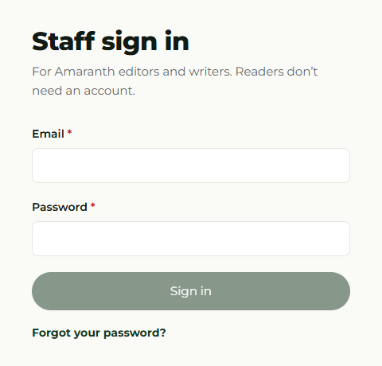
1. Sign in
Go to /admin/login
Email + password → Sign in
Forgot password? Use the email link
“Access pending” = ask the Executive Editor
Amaranth v2 · Staff Training
3
Notes:
Open the site, go to slash admin slash login, and sign in with the email you were invited with. If you forget your password, use Forgot password and follow the link in your email. If you see Access pending, your account is not active yet.

Slide 4
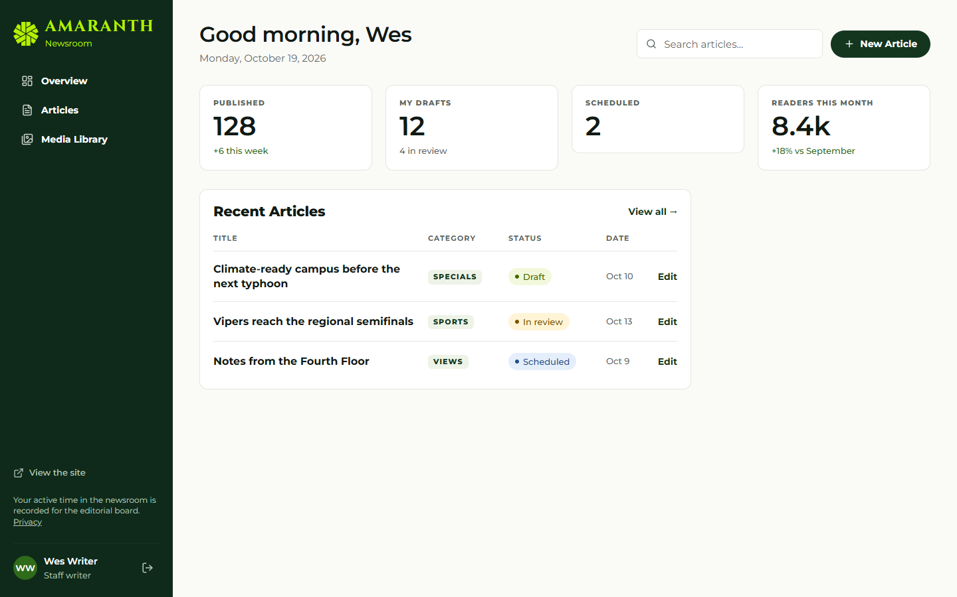
2. The newsroom
Dashboard and menu; you only see what your role allows
Amaranth v2 · Staff Training
4
Notes:
The menu on the left shows the parts of the newsroom you can use. The dashboard shows your drafts and recent articles. Managers see more counts and the submission queue.

Slide 5
3. Write a draft
Articles → New article
Choose a category; write title and body
Add cover photo, tags, summary, SEO
Autosaves every 2.5 seconds
Amaranth v2 · Staff Training
5
Notes:
To write, open Articles and choose New article. Pick the category first, because it sets the section. Write the title and the body, then fill the side panels: cover photo and caption, tags and summary, and search and sharing. You never need to press save; it autosaves.

Slide 6
4. Submit for review
Click Submit for review (add a note)
Locked while waiting
Return to draft to withdraw
Read your editor’s notes in Notes & activity
Amaranth v2 · Staff Training
6
Notes:
When you are done, choose Submit for review and add a note if helpful. The article is locked while the editor looks at it, but you can withdraw it with Return to draft. Feedback appears under Notes and activity.

Slide 7
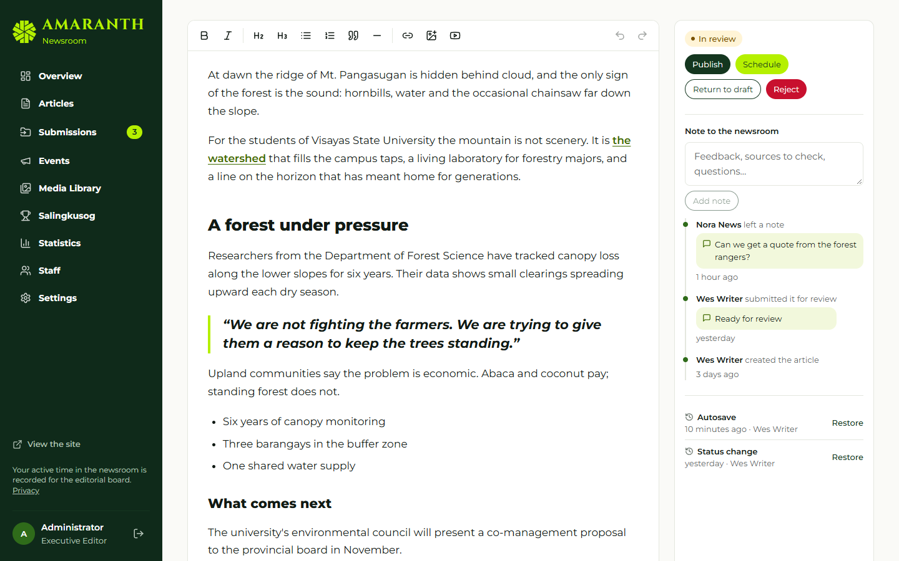
5. Review (Section editors)
Start review → Return to draft / Reject (note required) / Publish / Schedule
Amaranth v2 · Staff Training
7
Notes:
Section editors open Needs review, choose Start review, and then return the article with a note, reject it with a required note, or, with publishing access, publish or schedule it. The buttons shown are exactly those your role allows.

Slide 8
6. Publish and schedule
Publish = live now
Schedule = pick a future time; goes live by itself
Archive = take it off the site
Not allowed? The newsroom says why
Amaranth v2 · Staff Training
8
Notes:
Publishers can publish now, schedule for a future time, or archive. Scheduled articles go live automatically. If you try something your role does not allow, the system explains it; this is enforced by the database, not just hidden in the interface.

Slide 9
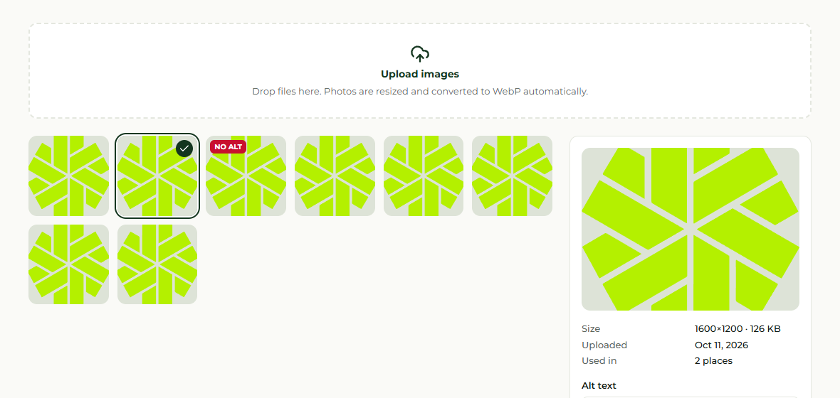
7. Media library
Upload images (auto-compressed) and always add alt text
Images in use cannot be deleted
Amaranth v2 · Staff Training
9
Notes:
The media library compresses images automatically into web sizes. Please always add alt text so readers using screen readers understand the image. An image used in an article cannot be deleted until it is replaced.

Slide 10
8. Moderation (editors)
Settings → Comments: approve, reject, spam
Settings → Inbox: contact messages
Submissions / Events: review, decline, convert
Turn into an article → draft opens
Amaranth v2 · Staff Training
10
Notes:
Editors moderate comments, which stay hidden until approved, handle the contact inbox, and review story submissions and event reports. A good submission can be turned into a draft article in one step.

Slide 11
9. Managers only
Staff → Accounts: roles, activation, Can publish
Settings → Front page: lead story, folio, ticker
Statistics: readers, top articles, sources
Salingkusog → Team: who enters scores
Amaranth v2 · Staff Training
11
Notes:
Managers have a few extra screens: staff accounts, including publishing access; the front page and ticker; statistics; and choosing the Salingkusog team.

Slide 12
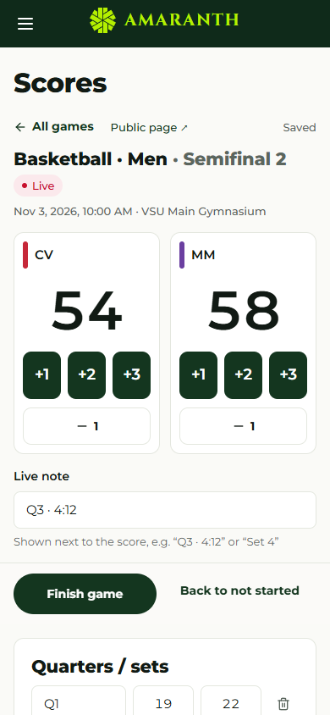
10. Salingkusog scorekeeping
Scores → pick the day → open the game
Start game, tap scores, Finish game
Reopen to fix a mistake
Contests: enter times or places
Amaranth v2 · Staff Training
12
Notes:
For the Salingkusog team: open Scores, choose the day and the game, press Start game, tap the scores, and Finish game at the end. Use Reopen to fix a mistake. For contests, type each result or place and then Finish contest.

Slide 13
11. Confirm medals
Results & medals → “Ready to confirm”
Check places 1–3; choose athletes if individual
Save results
The medal tally updates everywhere
Amaranth v2 · Staff Training
13
Notes:
After an event’s last game, open Results and medals. Events that are complete say Ready to confirm. Check the suggested places, choose athletes for individual events, and save. The medal tally updates for everyone immediately.

Slide 14
Messages you may see
Message | What to do
This article is locked… | Wait for the editor or withdraw
Category reserved for editors | Pick another category
Pick a future time to schedule | Choose a later time
A knockout game needs a winner | Add the tiebreak to the score
Enter every result first | Fill results or mark DNS/DNF/DQ
Amaranth v2 · Staff Training
14
Notes:
These are the most common messages. Each one tells you what to do next. If something else goes wrong, take a screenshot and send it to the technical lead.

Slide 15
You are ready
Manuals: AMR-DOC-11a (managers) · 11b (editors and staff) · 11c (Salingkusog team)
Amaranth v2 · Staff Training
15
Notes:
That is everything you need to start. The user manuals have every step with screenshots. Thank you, and welcome to the newsroom.

