Slide 1
AMARANTH · FOR STAKEHOLDERS
Amaranth v2
A modern newsroom and live sports-results platform for VSU’s official student publication
Version 1.0 · 2026-10-19 · [TO CONFIRM: audience and date]
Amaranth v2 · Executive Pitch
1
Notes:
This short presentation is for the administration and other stakeholders. It explains what Amaranth version 2 delivers, why it matters, what it costs and what we need next.

Slide 2
Why it matters
The publication now runs its whole editorial process online
Readers get fast, accessible news on their phones
Salingkusog results are live and official
Built for accountability and privacy
Amaranth v2 · Executive Pitch
2
Notes:
Amaranth now runs its whole editorial process in one system with clear responsibilities. Students and the community get fast, accessible news on their phones. Salingkusog results are live and computed automatically, and the system was designed with accountability and data privacy in mind.

Slide 3
What was delivered
12
7
74
100
site sections with their own layouts
staff roles enforced by the database
Salingkusog 2026 events set up
accessibility score (Lighthouse)
Amaranth v2 · Executive Pitch
3
Notes:
Concretely: twelve site sections each with its own layout, seven staff roles whose permissions are enforced by the database, seventy-four Salingkusog events already configured for the 2026 games, and an accessibility score of one hundred.

Slide 4
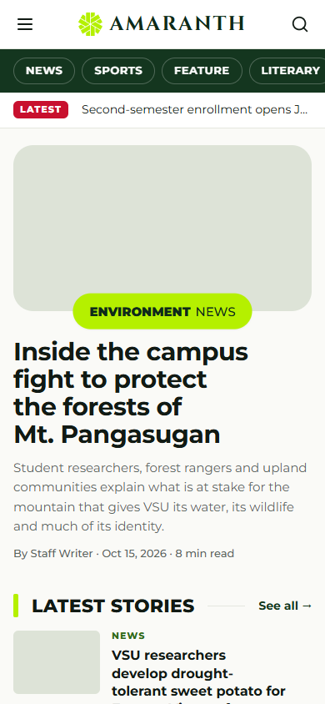
For readers
News, features, literary, opinion, sports
Search and archives
Submit stories and report events
Follow Salingkusog live
Amaranth v2 · Executive Pitch
4
Notes:
Readers get a modern news site that works well on phones, with search and archives, safe forms to submit stories and report events, and live Salingkusog results.

Slide 5
For the newsroom
Draft → review → publish with notes and history
Only authorised people publish — audited
Media library, moderation, statistics
Staff trained with manuals
Amaranth v2 · Executive Pitch
5
Notes:
For the newsroom, every article follows a clear review path with notes and history, only authorised people can publish, and every change to access is recorded. Editors have a media library, moderation tools and privacy-friendly statistics.

Slide 6
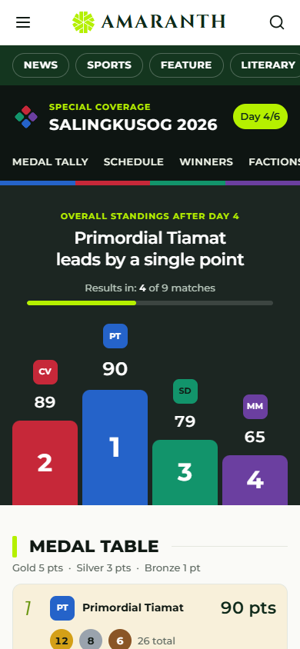
For Salingkusog
Brackets fill in automatically
Live scores from phones
Official medal table, computed
Staff confirm every medal
Amaranth v2 · Executive Pitch
6
Notes:
For the intramural games, brackets fill themselves in, scores come live from scorekeepers’ phones, and the medal table is computed by the system. Every medal is confirmed by a person before it counts, which protects the official result.

Slide 7
Costs and resources
Item | Cost
Hosting (Vercel) and database (Supabase) | [TO CONFIRM plan]
CAPTCHA (Cloudflare Turnstile) | Free
Software libraries | Open source, free
Domain | [TO CONFIRM]
People | Student developers, editorial board, adviser
Amaranth v2 · Executive Pitch
7
Notes:
The system runs on managed cloud services with free or low-cost tiers, and all libraries are open source. Exact plan costs and the domain are to be confirmed. The main resource is people: student developers, the editorial board and the adviser.

Slide 8
Risks and safeguards
Permissions enforced by the database
Automated tests: 255 + 278 checks passing
Backups and a runbook for incidents
Privacy: minimal athlete data, no reader tracking cookies
Amaranth v2 · Executive Pitch
8
Notes:
Risks are managed: permissions are enforced by the database, more than five hundred automated checks pass, there is a runbook for backups and incidents, and data privacy is respected by collecting only minimal athlete data and using no tracking cookies.

Slide 9
Next steps — what we need
Step | Owner
Privacy notice for athletes; photo consent process | Editorial board, organisers
Two-factor sign-in for administrators | Technical lead
Confirm hosting plan, domain and backups | Administration
Continuous testing pipeline | Technical lead
Handover to next year’s staff | Adviser
Amaranth v2 · Executive Pitch
9
Notes:
We ask for support on five next steps: a privacy notice and consent process for athletes, two-factor sign-in for administrators, a confirmed hosting plan and backups, a continuous testing pipeline, and a handover plan so next year’s staff can maintain the system.

Slide 10
Thank you
Amaranth v2 — ready for Salingkusog 2026 and beyond.
Questions and support?
Amaranth v2 · Executive Pitch
10
Notes:
Thank you. Amaranth version 2 is ready for the Salingkusog 2026 games and for the years ahead. We welcome your questions and your support for the next steps.

