Slide 1
AMARANTH · VISAYAS STATE UNIVERSITY
Amaranth v2
The newsroom and publishing system of Amaranth, the official student publication of VSU — with live Salingkusog results
Visayas State University · Baybay City, Leyte · Version 1.0 · [TO CONFIRM: team, adviser, date]
Amaranth v2 · Main System Defense
1
Notes:
Good morning. We present Amaranth version 2, the web newsroom and publishing system we built for Amaranth, the official student publication of Visayas State University. It runs the editorial process for staff, the public news site for readers, and the Salingkusog intramurals results, all in one system.

Slide 2
Agenda
Problem and objectives
Solution and architecture
Key features and live demo
Database, security and privacy
Testing and results
Limitations, future work, Q&A
Amaranth v2 · Main System Defense
2
Notes:
This is our flow. We start with the problem we found in the old site and the objectives we set. Then we show the architecture and features, do a short live demo, explain the database, security and privacy design, show how we tested it, and finish with honest limitations and our roadmap.

Slide 3
The problem
What the v1 site could not do
Amaranth v2 · Main System Defense
3
Notes:
Let us start with the problem: what the first version of the site could and could not do for the publication.

Slide 4
Problems in the old site (v1)
Problem | Consequence
Pre-compiled CSS export, no styling tool | New styles could not be added safely
15 near-identical section pages | Every change made 15 times
No lint, type-check or tests | Regressions went unnoticed
Helpers exposed in the API; open file deletes | Security risks
No workflow, revisions, moderation, invites | Newsroom ran outside the system
Mobile performance 56, accessibility 91 | Slow on campus mobile data
No intramurals results online | No live scores or official standings
Amaranth v2 · Main System Defense
4
Notes:
These came from our audit of the first website. The styling was a frozen export, each section page was hand-copied, there were no tests, some database functions were exposed to the public API, and there was no editorial workflow at all. Lighthouse measured 56 for mobile performance and 91 for accessibility. And Salingkusog results were not managed online.

Slide 5
Objectives
OBJ-1
OBJ-2
OBJ-3
Run the whole editorial workflow in the system
Enforce every permission in the database
Fast, accessible, mobile-first public site
OBJ-4
OBJ-5
OBJ-6
Safe public submissions and comments
Run Salingkusog: schedules, live scores, results
Compute medals and rankings automatically
Amaranth v2 · Main System Defense
5
Notes:
We set six main objectives. Run the editorial workflow inside the system; enforce permissions in the database, not only in the interface; give readers a fast accessible site; accept public input safely; run the Salingkusog games end to end; and compute the medal table and rankings automatically. Two more objectives cover privacy-friendly statistics and maintainable code.

Slide 6
Stakeholders and roles
Stakeholder | Role in the system
Executive Editor | editor_in_chief
Technical administrator | super_admin
Managing Editor | managing_editor
Business Manager | business_manager
Section editors | section_editor
Writers and contributors | staff_writer, contributor
Salingkusog team | any staff in sk_team
Readers | anonymous
Amaranth v2 · Main System Defense
6
Notes:
These are the people the system serves. There are seven account roles stored in the database enum app_role, a Salingkusog team group that any staff member can be added to, and anonymous readers who need no account.

Slide 7
The solution
One system: public site, newsroom, Salingkusog
Amaranth v2 · Main System Defense
7
Notes:
Now the solution: one system that combines the public site, the newsroom and the Salingkusog module.

Slide 8
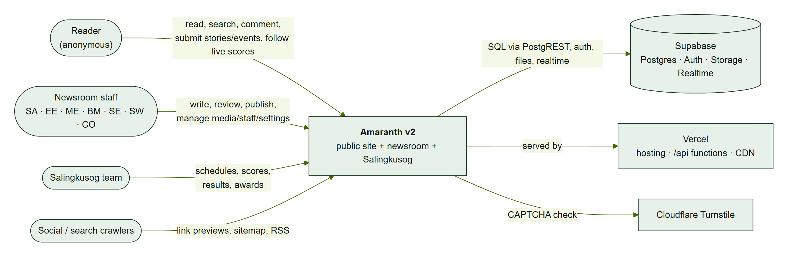
System context
CTX-1: readers, staff and the Salingkusog team use one web app backed by Supabase and Vercel
Amaranth v2 · Main System Defense
8
Notes:
This is the context. Readers, newsroom staff and the Salingkusog team all use one web application. Data, authentication, files and realtime updates live in Supabase. Vercel hosts the app and runs a few small server functions. Cloudflare Turnstile protects the public forms.

Slide 9
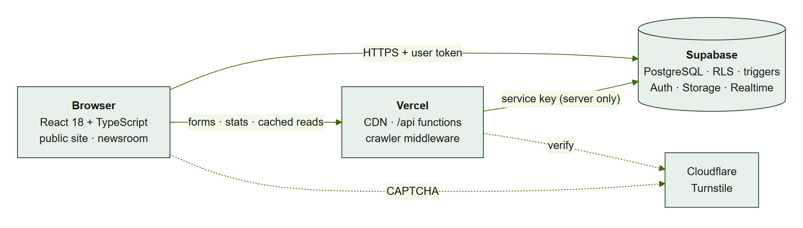
Architecture
React app talks directly to Supabase with the user’s token
Database rules decide everything (RLS, triggers)
Thin Vercel layer only for secrets, caching and SEO
Amaranth v2 · Main System Defense
9
Notes:
The architecture has five layers. The React app calls Supabase directly using the signed-in user token. Because every table has row level security and triggers, the database is the security boundary, so bypassing the interface does not help an attacker. Vercel functions exist only where secrets or caching are needed.

Slide 10
Why this stack
Choice | Reason
React + Vite | Client-rendered app; fast builds; team familiarity
Supabase (PostgreSQL) | Relational data, RLS, Auth, Storage, Realtime, free tier
Vercel | Zero-ops hosting, CDN, functions, middleware
TanStack Query | Caching and refresh with little code
TipTap 3 | Maintained rich-text editor (replaced Quill)
Cloudflare Turnstile | Free, privacy-friendly CAPTCHA
Amaranth v2 · Main System Defense
10
Notes:
Each choice has a reason. Supabase gave us a real relational database with row level security, plus authentication, storage and realtime in one free tier. Vercel removed server operations. TipTap replaced the unmaintained Quill editor. Turnstile stops bots without tracking readers.

Slide 11
Key features
Newsroom · public site · Salingkusog
Amaranth v2 · Main System Defense
11
Notes:
Next, the key features, grouped into the newsroom, the public site and Salingkusog.

Slide 12
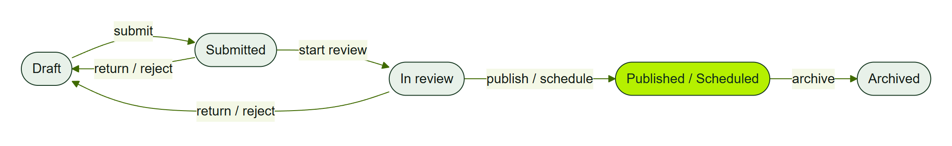
Editorial workflow
Every transition checked by a database trigger
Autosave every 2.5 s; 50 revisions kept
Notes and activity history
Scheduled articles go live by themselves
Amaranth v2 · Main System Defense
12
Notes:
The editorial workflow is a state machine enforced by a database trigger. Writers draft and submit; section editors review, return or reject with notes; publishers publish now or schedule for later. Scheduled articles go live by themselves when the time passes. The editor autosaves and keeps the last fifty revisions.

Slide 13
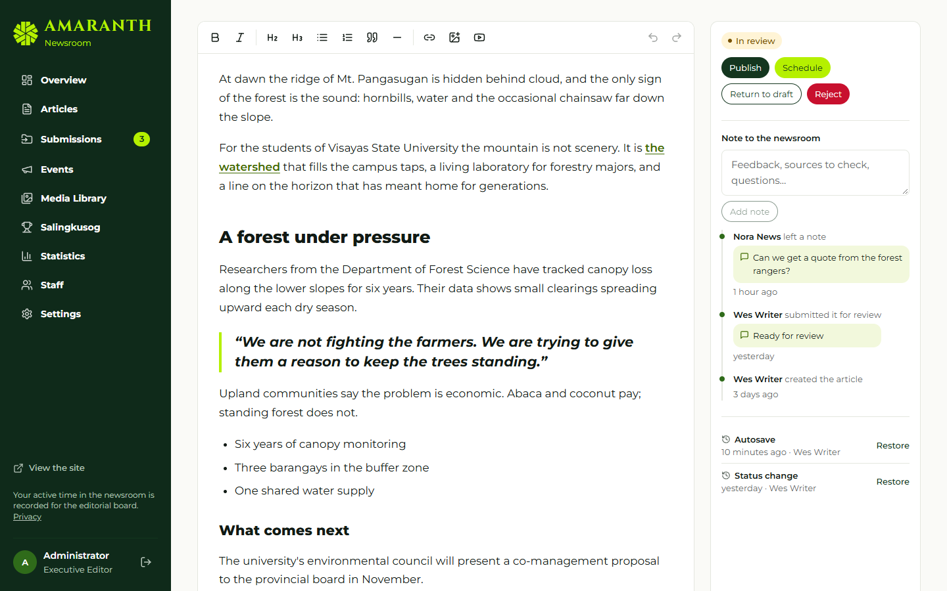
The newsroom editor
Body on the left; status actions, notes and revisions on the right (fictional data)
Amaranth v2 · Main System Defense
13
Notes:
This is the editor. The workflow panel on the right shows only the actions the current user is allowed to take. Below it are notes, the activity history and revisions that can be restored.

Slide 14
Publishing permissions
Always publish: Super admin, Executive Editor, Managing Editor, Business Manager
Others publish only if granted “Can publish” in Staff
Only SA, EE and ME grant it — audited
Enforced by app.can_publish_articles()
Amaranth v2 · Main System Defense
14
Notes:
The Executive Editor asked that regular staff only draft and submit. So publishing is limited to four roles, plus any staff member explicitly granted access. Only the three managing roles can grant it, every change is recorded in the audit log, and the database function can_publish_articles enforces it.

Slide 15
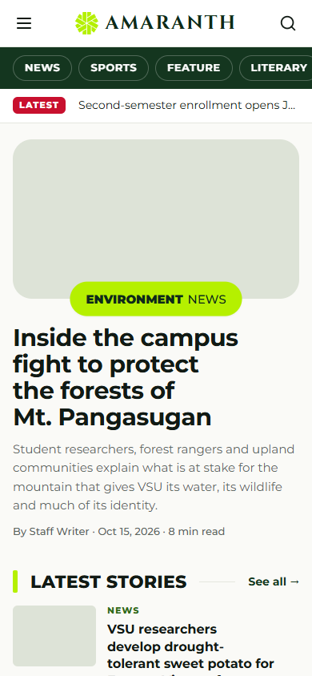
Public site
Home, 12 section landings, article, search, archives
Submit a story, report an event, contact, comments
Brand 2026 approved by the Executive Editor
Works at 375 px phones
Amaranth v2 · Main System Defense
15
Notes:
For readers there is the home page, twelve sections with their own layouts, articles, full-text search and archives, and forms to submit stories, report events and contact desks. The look follows the Brand 2026 design approved by the Executive Editor, and every screen works on a 375 pixel phone.

Slide 16
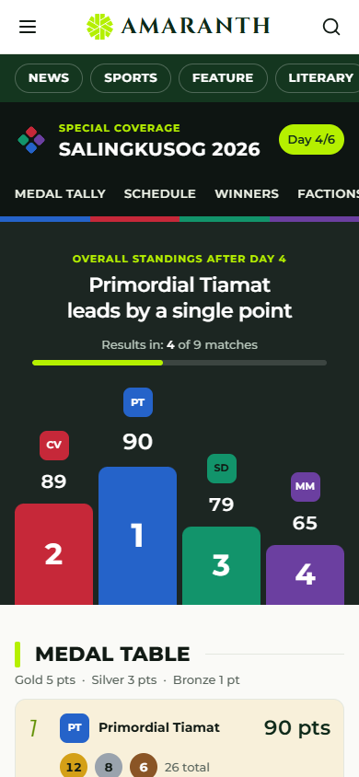
Salingkusog live results
Build brackets and round robins once
Live scores from phones, pushed in real time
Contests for dance, swimming, athletics
Medal table and points race computed
Amaranth v2 · Main System Defense
16
Notes:
Salingkusog is the intramural games. The team builds brackets or round robins once and only enters scores; winners move on by themselves. Contests handle events where all factions compete together. Scores reach readers in real time and the medal table and points race are computed by the database.

Slide 17
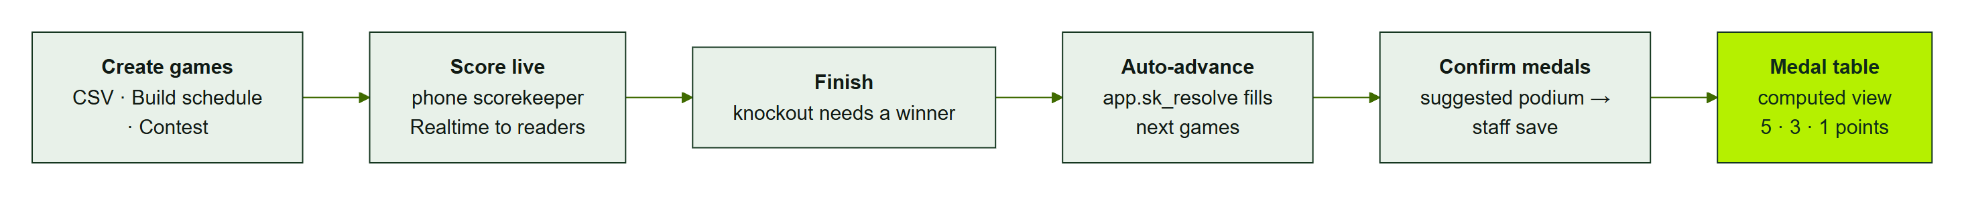
From a score to the medal table
Games from CSV, Build schedule, or a contest
Finishing a game fills the next games automatically
Staff confirm the suggested podium
The medal table recomputes for everyone
Amaranth v2 · Main System Defense
17
Notes:
This activity diagram shows the full flow. Games come from a CSV import, Build schedule, or a contest. The scorekeeper starts, scores and finishes a game; a trigger fills the next games. When an event is complete the system suggests the podium, staff confirm it, and the medal table updates for everyone.

Slide 18
Live demo (≈ 8 minutes)
Writer drafts and submits — cannot publish
Editor returns with a note; Managing Editor publishes
Scorer finishes a semifinal on a phone — the final fills in
Contest times, then medals confirmed — tally updates
Amaranth v2 · Main System Defense
18
Notes:
We will now demonstrate four flows using fictional test accounts on a demo edition. If the network fails we have the offline fixture screens and screenshots ready. Please watch especially how the final fills itself in and how the medal tally changes only after staff confirm the medals.

Slide 19
Database, security and privacy
Amaranth v2 · Main System Defense
19
Notes:
Now the technical foundations: how the database is designed and how security and privacy are built in.

Slide 20
The database in numbers
50
448
97
tables
columns
RLS policies
76
40
6
functions
triggers
computed views
Three re-runnable SQL files: schema.sql, salingkusog.sql, stats.sql
Amaranth v2 · Main System Defense
20
Notes:
The database has fifty tables and four hundred forty-eight columns. Ninety-seven row level security policies and forty triggers enforce the rules, and six views compute things like the medal table. The schema is delivered as three re-runnable SQL files, which our test runner applies twice to prove they are safe to re-run.

Slide 21
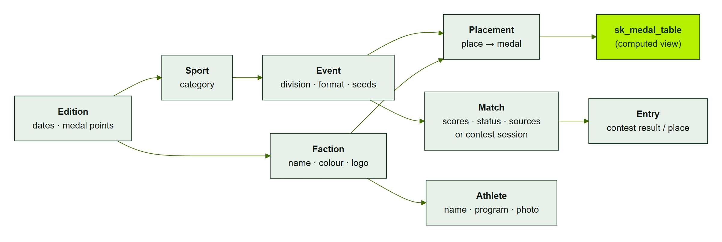
Salingkusog data model
Simplified from ERD-3 (generated from the SQL; full diagram in AMR-DOC-05)
Amaranth v2 · Main System Defense
21
Notes:
This entity relationship diagram is generated from the SQL. Everything hangs off an edition. Matches can be two-sided games or contest sessions with entries. Placements are the official places, and the medal table is computed from them, never typed.

Slide 22
Security by design
Threat | Control in the code
Writer publishes via API | Workflow trigger refuses the transition
Self-promotion to admin | Invite-only roles; profiles_guard trigger
Form spam, storage flooding | Turnstile, signed uploads, rate limits
Stored XSS | DOMPurify with embed allow-list
Secrets leaking | Service keys only in /api functions
Clickjacking, downgrade | X-Frame-Options, HSTS, CSP
Amaranth v2 · Main System Defense
22
Notes:
We used a STRIDE threat model. Every major threat maps to a control in the code. The most important point: permissions are enforced by the database, so a writer calling the API directly is refused exactly like in the interface. Public forms go through a server gateway with CAPTCHA and signed uploads.

Slide 23
Privacy and RA 10173
Athletes: name, program, optional photo — nothing more
Statistics: no cookies, no IP stored, daily-rotating hashes
Emails visible to editors only
Open: athlete section in /privacy, photo consent, retention
Amaranth v2 · Main System Defense
23
Notes:
For the Data Privacy Act we practise data minimisation. Athletes have only a name, program and optional photo; no birth dates or student numbers are stored. Statistics use no cookies and never store IP addresses. We are honest about open items: the privacy page needs a section on athletes, photo consent, and retention rules for form data.

Slide 24
Testing and results
Amaranth v2 · Main System Defense
24
Notes:
How do we know it works? Here is how we tested the system and what the results are.

Slide 25
Test results (2026-10-19)
255 / 255
278 / 278
115
unit and component tests passed
database checks passed
requirements traced; 98 automated
100
53
0
Lighthouse accessibility
screens swept, 0 issues
npm audit vulnerabilities
Amaranth v2 · Main System Defense
25
Notes:
All 255 unit and component tests and all 278 database checks pass as of October 19. Our traceability matrix covers all 115 requirements: 98 have automated tests and 17 have manual cases that are scheduled but not yet run. Accessibility scored 100 on production, and a sweep of 53 screens found no layout issues.

Slide 26
Limitations
No CI pipeline and no end-to-end browser tests yet
No MFA; CSP still report-only
Straight finals only; one entry per faction
Needs internet; no email notifications
Amaranth v2 · Main System Defense
26
Notes:
We want to be honest about limitations. Tests run locally, not in a CI pipeline, and we have no browser end-to-end tests yet. Multi-factor authentication is not enforced and the content security policy is still in report-only mode. For sports we support straight finals and one entry per faction, and the system needs an internet connection.

Slide 27
Roadmap
Priority | Next steps
P1 | Privacy page for athletes, photo consent, MFA, run manual tests
P2 | CI pipeline, enforce CSP, score-edit history, retention jobs
P3 | End-to-end tests, notifications, generated types
P4 | Heats, judges’ score sheets, offline scoring, Filipino UI
Amaranth v2 · Main System Defense
27
Notes:
Our roadmap is prioritised. Before and during the games: the athlete privacy section, photo consent, MFA for admins and running the manual tests. Next: continuous integration, enforcing the CSP, a history of score edits and retention jobs. Later: end-to-end tests and notifications, and eventually heats, judges score sheets and offline scoring.

Slide 28
Thank you
Amaranth v2 — database-enforced roles, live Salingkusog results, privacy by design.
Questions?
Amaranth v2 · Main System Defense
28
Notes:
To summarise: Amaranth version 2 runs the newsroom and the public site with every permission enforced by the database, turns Salingkusog scores into an official medal table automatically and in real time, and treats readers and athletes data with care. Thank you. We welcome your questions.

