Slide 1
AMARANTH · TECHNICAL REVIEW
Amaranth v2 — Technical Deep-Dive
Architecture, data model, RLS and RBAC, the medal computation, real-time updates and deployment
Version 1.0 · 2026-10-19 · [TO CONFIRM: presenters]
Amaranth v2 · Technical Deep-Dive
1
Notes:
This deck is for a technical audience: panel members, the adviser or future maintainers. We go deeper into the architecture, the data model, how permissions are enforced, how the medal table is computed, how real-time updates work, and how the system is deployed.

Slide 2
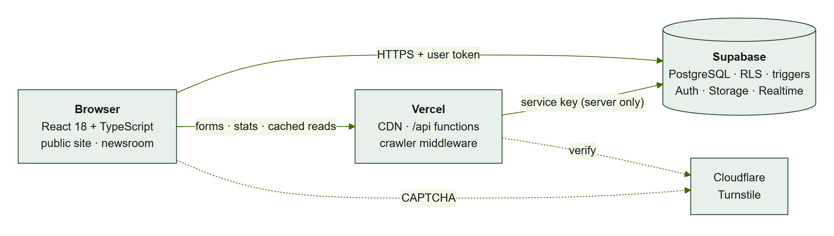
Architecture overview
Thick client: React talks to PostgREST with the user’s JWT
Database = security boundary
Vercel functions only for secrets, cache, SEO
Amaranth v2 · Technical Deep-Dive
2
Notes:
The browser holds the session token and calls Supabase directly. Because the database enforces row level security, a forged request from the browser has no more power than the interface. Vercel functions are used only where a secret key is needed, where edge caching helps, or for crawlers.

Slide 3
Layers and responsibilities
Layer | Contents | Rule
Presentation | React pages, components | Shows/hides only
Client data | TanStack Query hooks, supabase-js | All I/O via hooks
Edge / server | api/*.ts, middleware.ts | Stateless; secrets here
Data and rules | Tables, RLS, triggers, RPCs, views | Source of truth
Platform | Auth, Storage, Realtime, pg_cron | Managed
Amaranth v2 · Technical Deep-Dive
3
Notes:
Each layer has one job. The presentation layer only shows or hides things; data access goes through TanStack Query hooks; the edge layer is stateless and holds the secrets; and the data layer is the source of truth for every rule. Dependencies only point downwards.

Slide 4
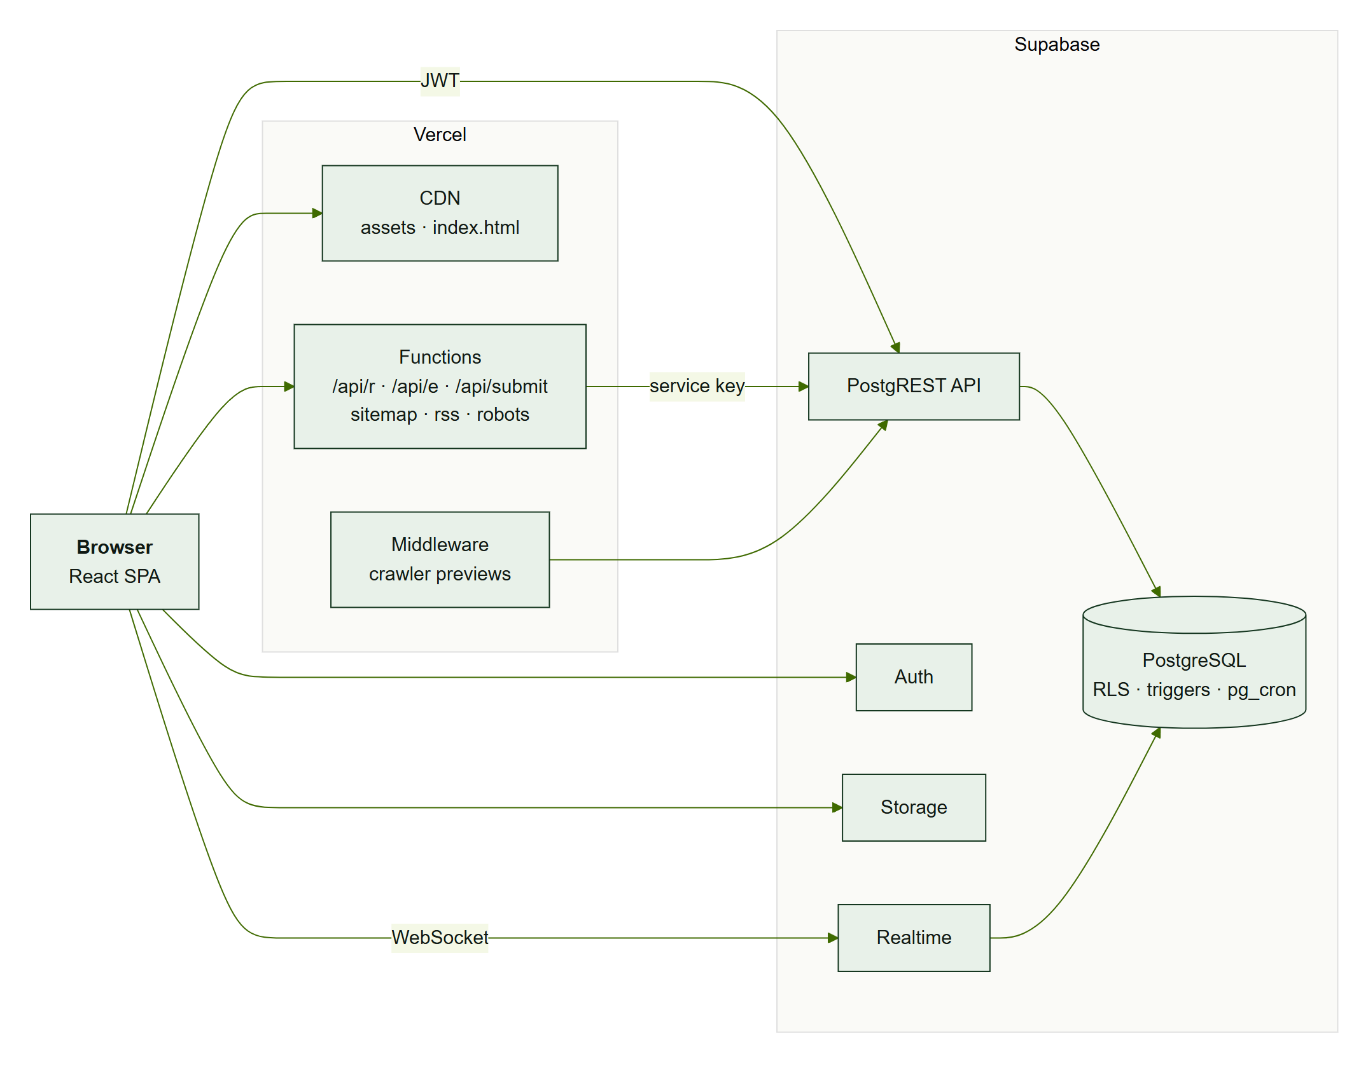
Deployment
Simplified from DEP-1 (AMR-DOC-05): Vercel CDN, functions, middleware; Supabase services
Amaranth v2 · Technical Deep-Dive
4
Notes:
Deployment uses two managed platforms. Vercel serves the static bundle from its CDN, runs six Node functions and the crawler middleware. Supabase provides PostgREST, Auth, Storage, Realtime and the PostgreSQL database with the pg_cron extension for the nightly statistics job.

Slide 5
Data model
50 tables · 448 columns · 6 views
Amaranth v2 · Technical Deep-Dive
5
Notes:
Let us look at the data model, which is where most of the system’s rules live.

Slide 6
Schema at a glance
29
12
9
newsroom tables
Salingkusog tables
statistics tables
19
60
3
enums
indexes
storage buckets
schema.sql · salingkusog.sql · stats.sql — all re-runnable, applied twice in tests
Amaranth v2 · Technical Deep-Dive
6
Notes:
There are twenty-nine newsroom tables, twelve for Salingkusog and nine for statistics, with nineteen enums so invalid states cannot be stored, and sixty indexes for the main access paths. The three SQL files are idempotent; our test runner applies each file twice before testing.

Slide 7
Design principles
3NF for transactional tables; enums for states
Denormalisations maintained by triggers or generated columns
Computed results are views, never stored
Private helpers in schema app with search_path = ''
Amaranth v2 · Technical Deep-Dive
7
Notes:
Transactional tables are in third normal form. Where we denormalise, for example copying the edition id onto Salingkusog rows or deriving the section from the category, the database maintains it with triggers or generated columns and composite foreign keys. Results like the medal table are views. Helper functions live in a private schema.

Slide 8
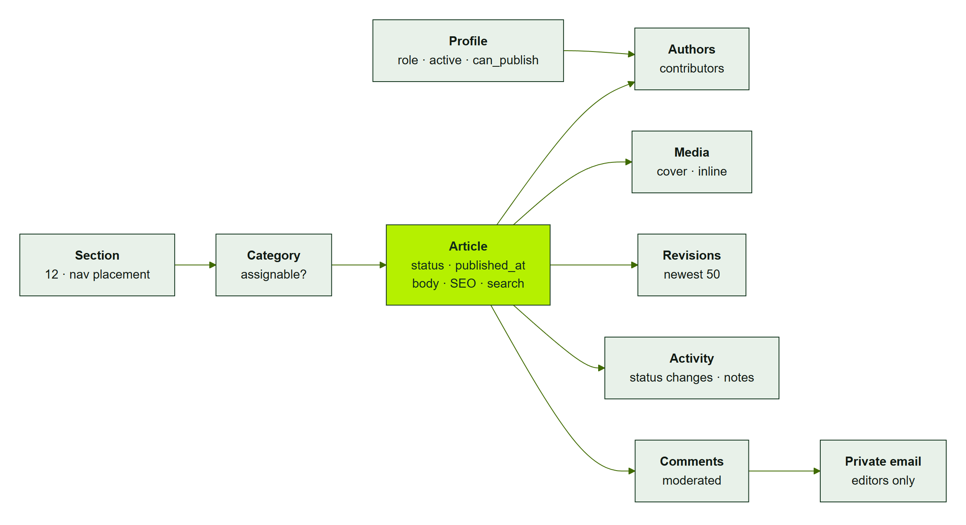
Content core
Simplified from ERD-1 (generated from schema.sql; full diagram in AMR-DOC-05)
Amaranth v2 · Technical Deep-Dive
8
Notes:
This is the content core, generated from the SQL. Articles belong to a category, which determines the section. Authors are contributors through a link table. Revisions and activity give the history, and comments keep the private email in a separate table so row level security can protect it.

Slide 9
RLS and RBAC
97 policies · role helpers · triggers
Amaranth v2 · Technical Deep-Dive
9
Notes:
Now the permission model, which is the heart of the security design.

Slide 10
Role helpers
Helper | True for
is_staff() | any active role
is_admin() | SA, EE
can_publish() | SA, EE, ME
can_publish_articles() | + BM, + granted staff
is_editor() | SA, EE, ME, SE
can_edit_section(s) | can_publish or assigned SE
can_view_stats() | SA, EE, ME
can_edit_sk() | SA, EE, ME + sk_team
Amaranth v2 · Technical Deep-Dive
10
Notes:
Policies never list roles directly. They call helper functions in the private app schema. That is why adding the Business Manager role or per-person publishing access was a one-function change, verified by SQL tests. The helpers are security definer, stable, and use an empty search path.

Slide 11
How a rule is enforced
Layer | Example: “writers cannot publish”
RLS | articles update: owner, co-author or section editor
Trigger | article_before_write: to published requires can_publish_articles()
RPC | transition_article passes a note; RLS applies (invoker)
UI mirror | permissions.ts hides the Publish button
Test | workflow.test.sql: “writer cannot publish own draft”
Amaranth v2 · Technical Deep-Dive
11
Notes:
Here is one rule traced through every layer. Row level security decides which rows a writer can update at all; the trigger decides whether the status change is allowed; the RPC adds the note; the interface hides the button; and a SQL test proves the database refuses it even when called directly.

Slide 12
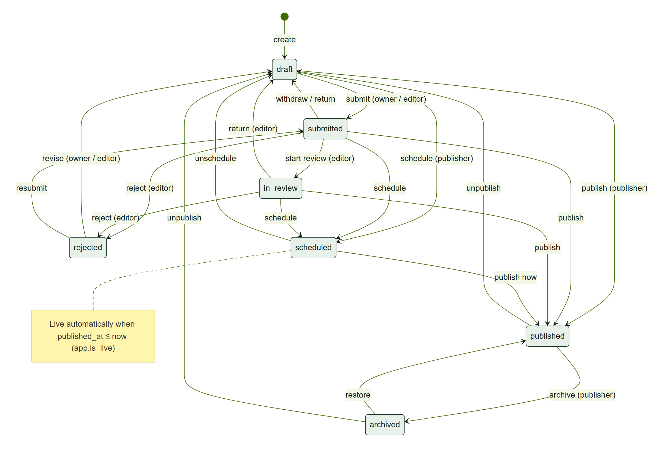
Article lifecycle
STATE-1: enforced by app.article_before_write
Amaranth v2 · Technical Deep-Dive
12
Notes:
This is the complete state machine. Owners and editors move articles between draft, submitted and rejected; editors start reviews; only publishers move into scheduled, published or archived. Scheduled articles become visible when the publish time passes, because public reads filter with is_live.

Slide 13
The medal computation
From placements to rank
Amaranth v2 · Technical Deep-Dive
13
Notes:
Next, how Salingkusog results become the official medal table, and how tied rankings are resolved.

Slide 14
sk_medal_table — worked example (5 / 3 / 1)
rank() over (order by points desc, gold desc, silver desc)
Faction | Gold | Silver | Bronze | Points | Rank
Faction A | 2 | 0 | 1 | 11 | 1
Faction B | 1 | 2 | 0 | 11 | 2
Faction C | 0 | 1 | 2 | 5 | 3
Faction D | 0 | 0 | 0 | 0 | 4
Amaranth v2 · Technical Deep-Dive
14
Notes:
The view counts medals per faction and multiplies by the edition’s points, five, three and one by default. Faction A and B both have eleven points, but A has more golds, so A ranks first. Placements are guarded by a check constraint so a place can only carry its own medal.

Slide 15
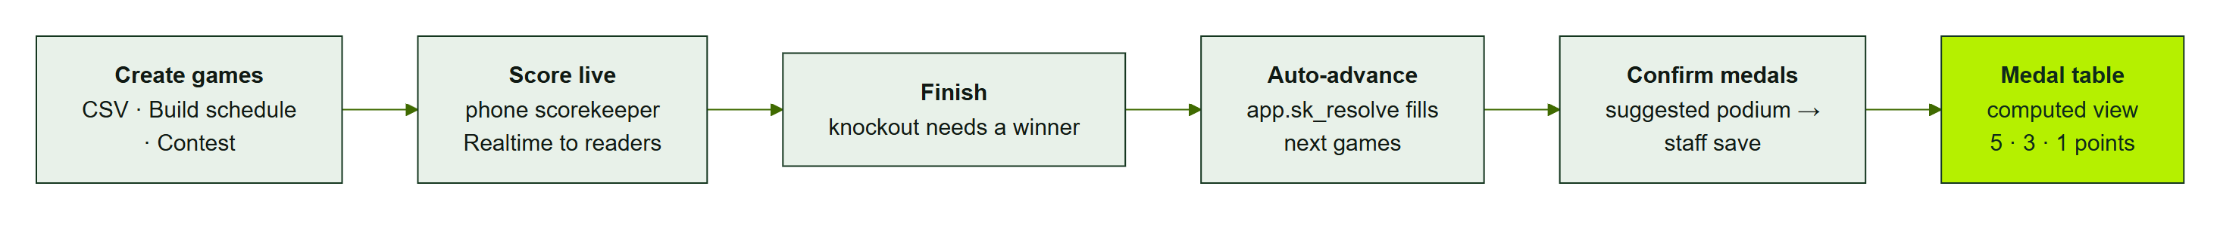
Automatic advancement
Generated games store sources: seed, winner, loser, rank
Trigger → app.sk_resolve recomputes sides idempotently
Started games never change; knockout ties refused
Amaranth v2 · Technical Deep-Dive
15
Notes:
Build schedule creates games whose sides have sources. After any change to a game, a trigger calls sk_resolve for that event, which recomputes every generated side from scratch. It refuses to alter a game that has already started, and a separate trigger refuses to finish a knockout game tied.

Slide 16
Round robin and contests
Standings: wins → difference → head-to-head → points → seed
Same order in SQL (sk_rr_table) and TypeScript
Contest = session row + entries; unit “s” → lowest wins
Medals suggested; staff confirm via sk_set_placements
Amaranth v2 · Technical Deep-Dive
16
Notes:
Round robin standings use the same tie-break order in SQL and in TypeScript, and both are tested. Contests reuse the match table for scheduling and status, with entries holding each faction’s result or judged place. Medals are suggested from the games but only count once staff save them.

Slide 17
Real-time updates
Amaranth v2 · Technical Deep-Dive
17
Notes:
Now how live scores reach readers within seconds, and what happens when the realtime connection drops.

Slide 18
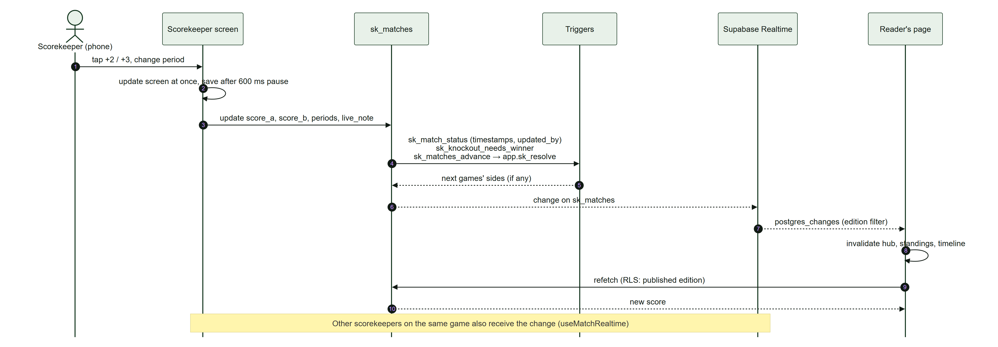
Live score sequence
SEQ-4: scorekeeper → sk_matches → triggers → Realtime → readers refetch
Amaranth v2 · Technical Deep-Dive
18
Notes:
A tap on the scorekeeper updates the screen immediately and saves after a short pause. The update runs the triggers, then Supabase Realtime streams the change to every open page subscribed to that edition. Pages refetch only the affected queries. A sixty-second poll is the fallback.

Slide 19
Edge, forms and statistics
Amaranth v2 · Technical Deep-Dive
19
Notes:
Three server-side pieces deserve a closer look: the edge cache, the form gateway and the statistics ingest.

Slide 20
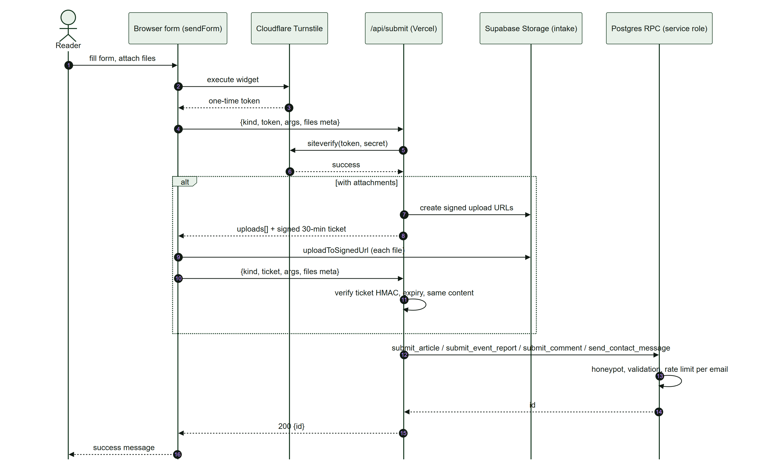
Public form gateway
SEQ-6: Turnstile → signed upload links → HMAC ticket → service-role RPC
Amaranth v2 · Technical Deep-Dive
20
Notes:
Public forms go through slash api slash submit. The server verifies the Turnstile token, issues one-time signed upload links for attachments, and returns a ticket signed with HMAC that binds the form content and expires in thirty minutes. Only then does it call the form RPC with the service key.

Slide 21
Edge cache and statistics
Piece | Design
/api/r | Anonymous GETs of slow-changing tables; CDN 60 s, stale 300 s; live data excluded
/api/e | Batched events; bots dropped; no IP; service-role ingest
stats.sql | Daily-salted hashes; dedupe 30 min; nightly rollup; 13-month retention
Amaranth v2 · Technical Deep-Dive
21
Notes:
The edge cache serves signed-out readers from Vercel’s CDN for up to a minute, which removes a preflight request and protects the database during spikes. The statistics endpoint strips identifying data before calling the database, and the nightly job rolls up and deletes old raw events.

Slide 22
Deployment and operations
main → Vercel production; feature branches → previews
SQL pasted in order: schema → salingkusog → stats → seed
Gates: npm run check + npm run db:test
Rollback: promote previous deployment; re-run old SQL
Amaranth v2 · Technical Deep-Dive
22
Notes:
Production deploys from the main branch through Vercel; every branch gets a preview. Database changes are re-runnable SQL pasted in a fixed order. Before every merge we run the check script and the database tests. Rollback means promoting the previous Vercel deployment and re-running the previous SQL.

Slide 23
Questions on the technical design?
Details: AMR-DOC-03 Architecture · AMR-DOC-04 Database · AMR-DOC-07 API
Amaranth v2 · Technical Deep-Dive
23
Notes:
That concludes the technical deep-dive. The architecture document, the database design with the full data dictionary, and the API reference contain every detail we summarised here. We are happy to take technical questions.

