Slide 1
AMARANTH · SALINGKUSOG MODULE
Salingkusog in Amaranth v2
Live scores, brackets, contests, results, medals and awards for VSU’s intramural games
Version 1.0 · 2026-10-19
Amaranth v2 · Salingkusog Module
1
Notes:
This deck explains the Salingkusog module: how the intramural games are set up, scheduled, scored live, and turned into an official medal table, with a walkthrough using fictional sample data.

Slide 2
Salingkusog 2026 in the system
4
27
74
factions
sports
events
21
169
Oct 26–30
venues
games and sessions
competition days
Live data snapshot, 2026-10-19 (counts only)
Amaranth v2 · Salingkusog Module
2
Notes:
These are the real counts from the live database on October 19: four factions, twenty-seven sports, seventy-four events, twenty-one venues and one hundred sixty-nine scheduled games and contest sessions, for games running October 26 to 30.

Slide 3
Who does what
Who | Can do
SA, Executive Editor, Managing Editor | Everything; choose the team; countdown
Salingkusog team member | Setup, schedules, scores, results, awards
Other staff | View only
Readers | Published edition only
Amaranth v2 · Salingkusog Module
3
Notes:
Access is enforced by the database function can_edit_sk. The three managing roles always have access and choose the team. Team members can be any active staff. Readers see an edition only once it is published.

Slide 4
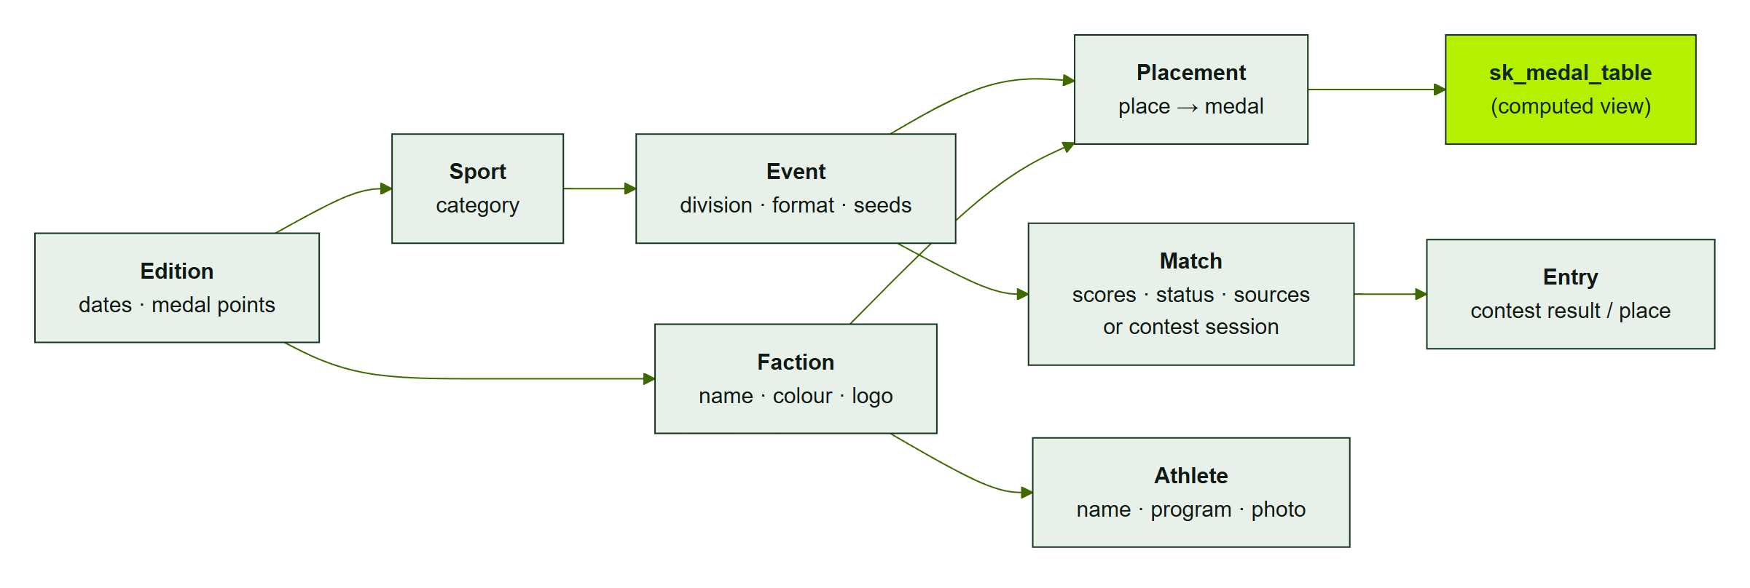
Data model
Edition → factions, sports → events → matches / entries → placements → computed medal table
Amaranth v2 · Salingkusog Module
4
Notes:
Everything belongs to an edition. An event is a sport plus a division and a format. Matches are two-sided games or contest sessions with entries. Placements are the official places, and the medal table is a view computed from them.

Slide 5
Five formats
Format | Used for | How games are made
Bracket | Basketball, volleyball… | Build schedule (seeds, byes, bronze)
Round robin | League play | Build schedule; next round after the last
Round robin + final | Chess, arnis, kyorugi… | Top 2 final, 3rd v 4th bronze
Timed / measured | Swimming, athletics | Create contest; results rank
Judged | Dance, painting… | Create contest; places entered
Amaranth v2 · Salingkusog Module
5
Notes:
There are five formats. Brackets and round robins are built once and advance automatically. Round robin plus final sends the top two to a final. Timed and judged events use contests, where every faction competes in one session.

Slide 6
Step 1 — Setup
Edition: dates, medal points 5 / 3 / 1, map, schedule PDF
Factions, venues, sports and events, athletes
Team members chosen by the managers
Publish the edition when ready
Amaranth v2 · Salingkusog Module
6
Notes:
Setup happens about two weeks before the games. The team enters the edition with its dates and medal points, the factions with colours and logos, venues, sports and events, and athletes with consent for photos. The edition stays unpublished until everything is checked.

Slide 7
Step 2 — Schedule import (CSV)
Validated before import: dates in the edition, known names, different sides, duplicates skipped
date | time | sport | event | round | side_a | side_b | venue
2026-10-26 | 08:00 | Basketball | Men | Semifinal 1 | Faction A | Faction D | Main Gym
2026-10-26 | 2:30 PM | Volleyball | Women | Group A | FA | FB | Annex Court
Amaranth v2 · Salingkusog Module
7
Notes:
The CSV importer accepts these eight columns, with alternative names such as team a and team b. It checks every row against the edition: dates inside the edition, known sports, events, factions and venues, different sides, and it marks duplicates. Only valid rows are imported.

Slide 8
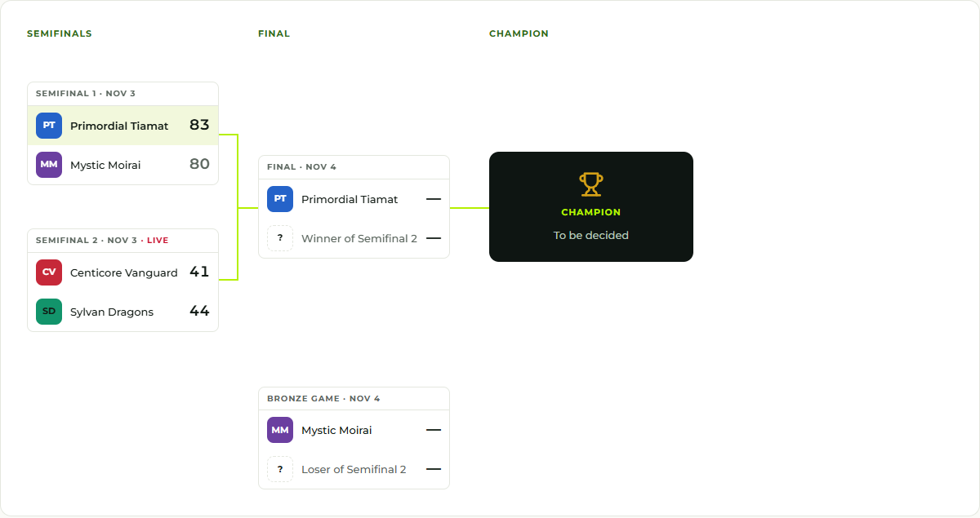
Step 2 — Build schedule
Seeds 1 v 4 and 2 v 3; byes for odd fields
Winners and bronze-game losers filled automatically
Amaranth v2 · Salingkusog Module
8
Notes:
For brackets and round robins the team uses Build schedule once. It creates all games with their times. In this fictional example Semifinal 1 is final, so the final already shows the winner and waits for the winner of Semifinal 2, while the bronze game waits for the loser.

Slide 9
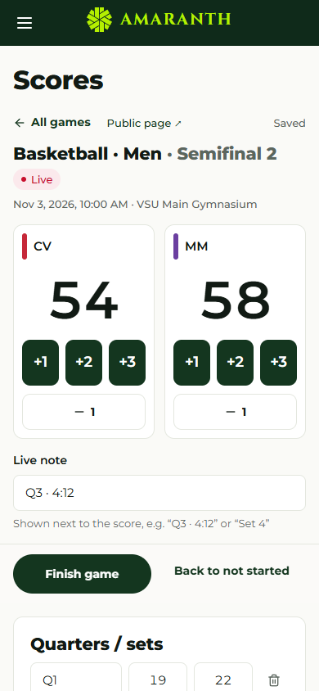
Step 3 — Live scores
Start game → tap +1 / +2 / +3
Saves after a short pause
Readers update within seconds
Finish needs a winner in knockouts
Amaranth v2 · Salingkusog Module
9
Notes:
The scorekeeper is built for a phone. Start the game, tap the score buttons, add periods and a live note. Each change saves after a short pause and reaches readers through Supabase Realtime. A knockout game cannot finish tied.

Slide 10
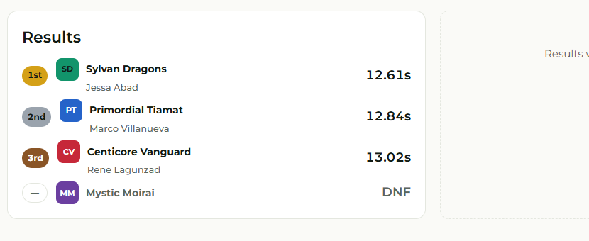
Step 3 — Contests
One session, every faction
Times or distances rank themselves
Judged: enter announced places
DNS / DNF / DQ get no place
Amaranth v2 · Salingkusog Module
10
Notes:
Contests handle events where all factions compete at once. For timed events the scorer types times like 1:02.45 and places update automatically, with ties sharing a place. For judged events the scorer enters the places the judges announce. Entries can be marked did not start, did not finish or disqualified.

Slide 11
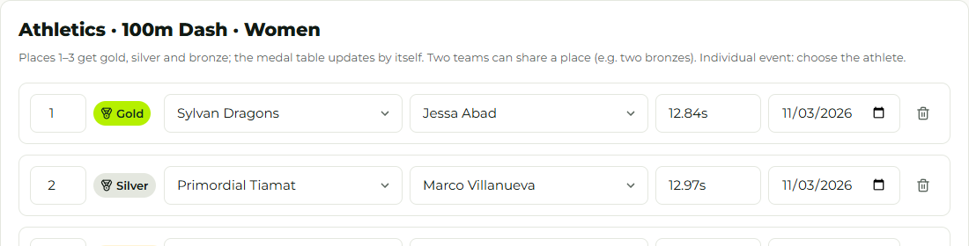
Step 4 — Confirm medals
“Ready to confirm” after the last game; podium suggested
Choose athletes for individual events, then Save results
Amaranth v2 · Salingkusog Module
11
Notes:
When an event’s last game is final, the newsroom shows Ready to confirm and suggests the podium from the final and bronze game, the standings, or the contest places. A person checks it, chooses the athletes for individual events, and saves. Only then do the medals count.

Slide 12
Sample walkthrough (fictional)
Event | Result | Medals
Basketball Men | Final: Faction A 78–71 Faction B; bronze: Faction C | A gold, B silver, C bronze
50m Free Women | Times: B 30.10, A 31.20, C 31.45, D DNF | B gold, A silver, C bronze
Hip-hop | Judges: C 1st, A 2nd, D 3rd | C gold, A silver, D bronze
Amaranth v2 · Salingkusog Module
12
Notes:
Here is a fictional walkthrough with three events. After confirming them, Faction A has one gold and two silvers, which is five plus six equals eleven points. Faction B has one gold and one silver, eight points. Faction C has one gold and one bronze, six points, and Faction D one bronze.

Slide 13
Resulting medal table (5 / 3 / 1)
Rank | Faction | Gold | Silver | Bronze | Points
1 | Faction A | 1 | 2 | 0 | 11
2 | Faction B | 1 | 1 | 0 | 8
3 | Faction C | 1 | 0 | 1 | 6
4 | Faction D | 0 | 0 | 1 | 1
Amaranth v2 · Salingkusog Module
13
Notes:
The medal table computes exactly this. Rank is by points, then golds, then silvers. Nobody types these numbers: if a placement is corrected, every page recomputes. The points race shows how these totals grew over the days or in hour steps.

Slide 14
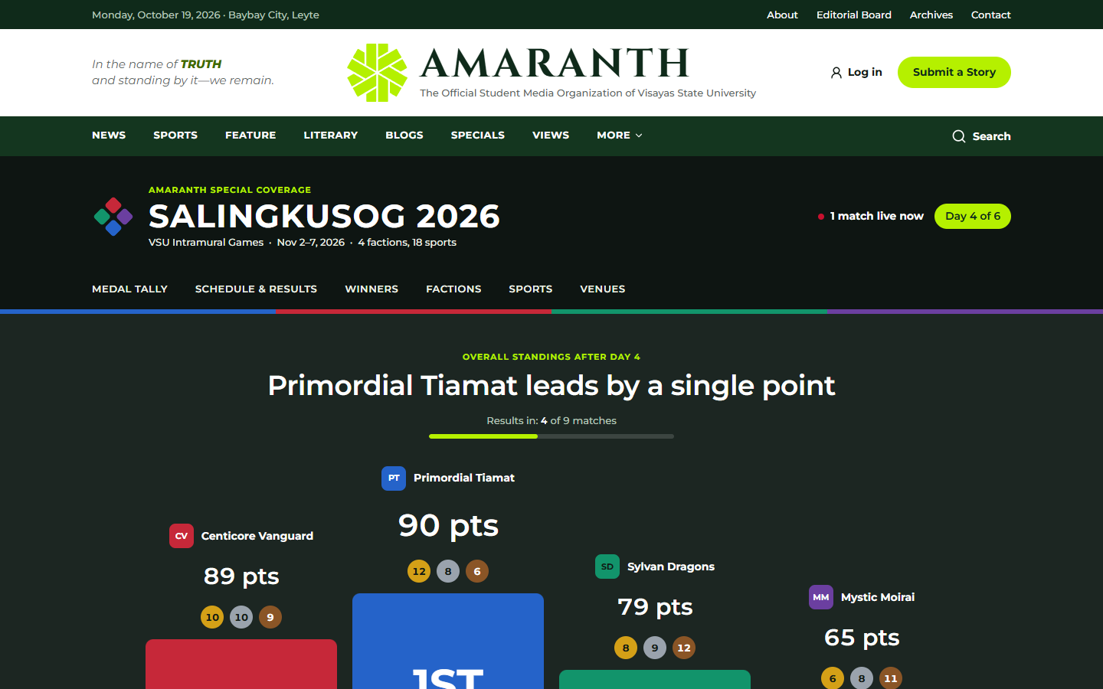
What readers see
Podium, results-in progress, medal table with gold/silver/bronze tints, points race, live and up next
Amaranth v2 · Salingkusog Module
14
Notes:
Readers see the podium, how many matches have results, the medal table with tinted rows for the top three, the points race with a switch for one, three, six or twelve hour steps or day by day, and the live and upcoming games.

Slide 15
Awards and social cards
MVP of the Day, Athlete of the Day, Finals MVP
Stat line and quote
PNG cards: 1080×1350 and 1080×1080
Ready for Facebook and Instagram
Amaranth v2 · Salingkusog Module
15
Notes:
The team records daily awards with a stat line and a quote. The newsroom generates social cards as PNG images in portrait and square sizes, so the social media team can post them straight away.

Slide 16
Safeguards
Started games never change automatically
Knockout ties refused
Medals only count after confirmation
Team changes audited; edition hidden until published
Amaranth v2 · Salingkusog Module
16
Notes:
Several safeguards protect the official results. The database never changes a game that has started, refuses tied knockout games, counts medals only after a person confirms them, audits changes to the team, and hides the edition from readers until it is published.

Slide 17
Questions about Salingkusog?
Team manual: AMR-DOC-11c · Event-week checklist: AMR-DOC-09 §10
Amaranth v2 · Salingkusog Module
17
Notes:
That is the Salingkusog module. The team manual has step-by-step instructions, and the runbook has the checklist for event week. We are happy to answer questions.

