Slide 1
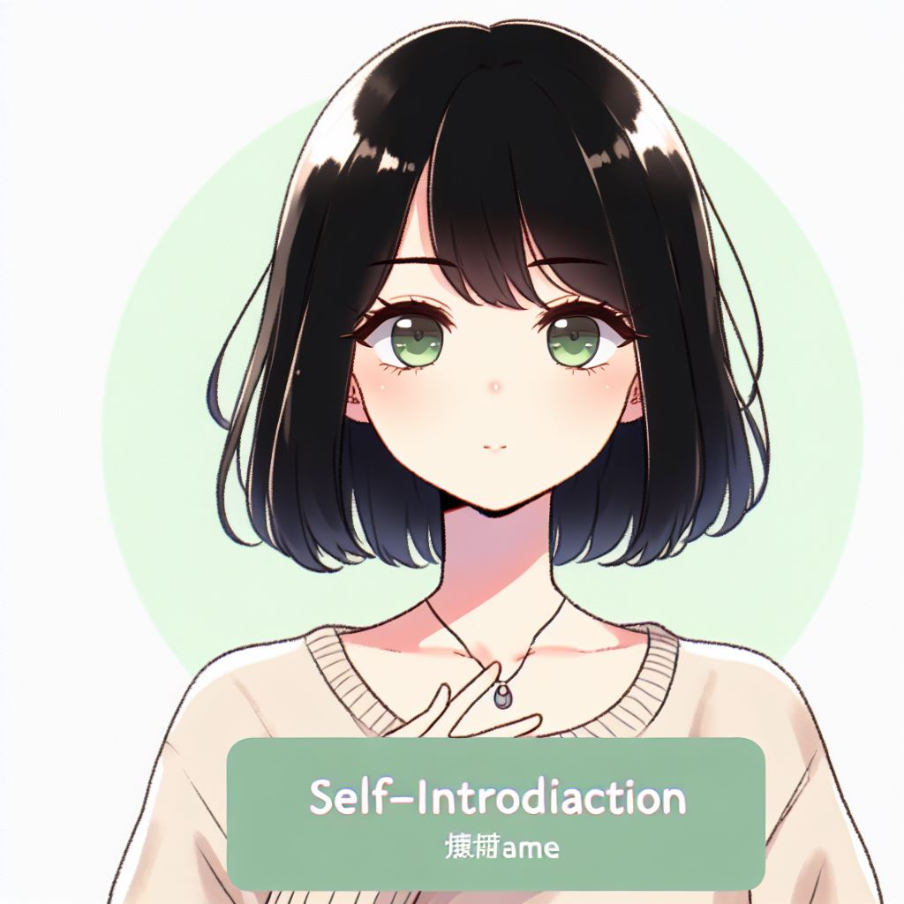
自我介紹
柊青
Notes:
A self-introduction image of a young woman with shoulder-length black hair with bangs and green eyes, wearing casual attire. The drawing should be in the style of Japanese anime.
大家好，我是柊青，我要來簡短地自我介紹一下。

Slide 2

目標
最初的目標是賺很多錢，擁有高薪工作，讓家人過上好生活。
Notes:
A young girl with shoulder-length black hair with bangs and green eyes, wearing a high school uniform. She is a strong and determined character who was raised by her grandparents after her parents divorced. The background should reflect her goal of growing up quickly to earn money. The drawing should be in the style of Japanese anime.
我的父母出車禍離世，因此從小就由祖父母養育長大。我祖父母年紀雖然大了，但他們為了給我良好的生活與教育，每天都努力工作。他們的付出讓我從小就立下了一個目標：我一定要賺很多錢，讓他們可以過上輕鬆的生活，讓他們不再為了經濟壓力而辛苦。

Slide 3
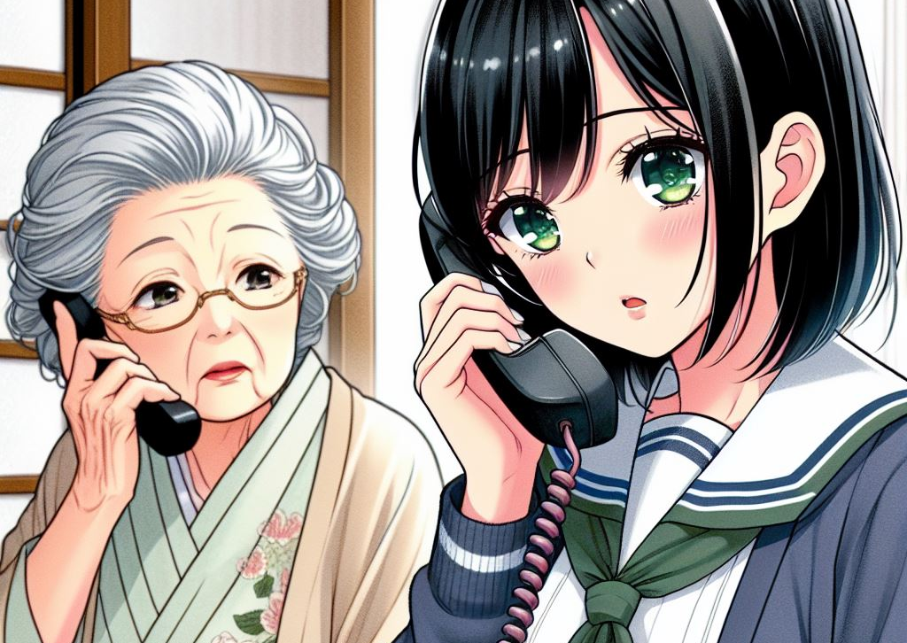
阻礙
祖父重病住院
Notes:
A young girl with shoulder-length black hair and green eyes, wearing a high school uniform. She is receiving a phone call from her grandmother, who is informing her that her grandfather is seriously ill and hospitalized. The grandmother should be depicted in the scene as well. The style should be Japanese manga.
為了實現這個目標，我努力學習，最終來到大城市工作，有了穩定收入後，家裡的經濟狀況開始有所改善。然而，不幸的是，某天我突然接到遠在家鄉的祖母來電，告知我祖父的健康狀況急轉直下

Slide 4
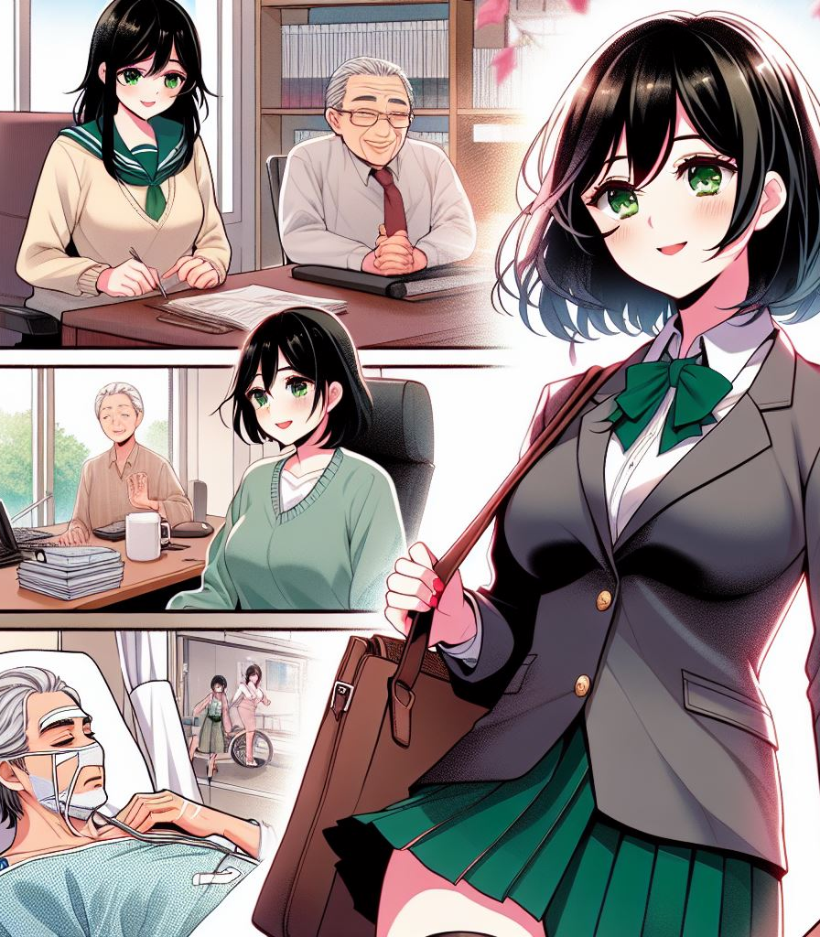
努力
更努力工作
小職員晉升到高階主管
Notes:
A young girl with shoulder-length black hair and green eyes, wearing a high school uniform. She is working hard to increase her income to cover her grandfather's hospitalization and medical expenses. The scene should show her became a senior executive, with her clothing changing to reflect her new position. In the background, her grandfather's condition is worsening, and her grandmother is by his side, taking care of him. The style should be Japanese manga.
醫療費用的壓力讓我更努力工作以爭取加薪的機會。而我的努力，讓我從一個小職員，逐漸變成公司內部的高階主管，讓我負擔得起祖父昂貴的醫療費，並同時能維持生活品質。

Slide 5
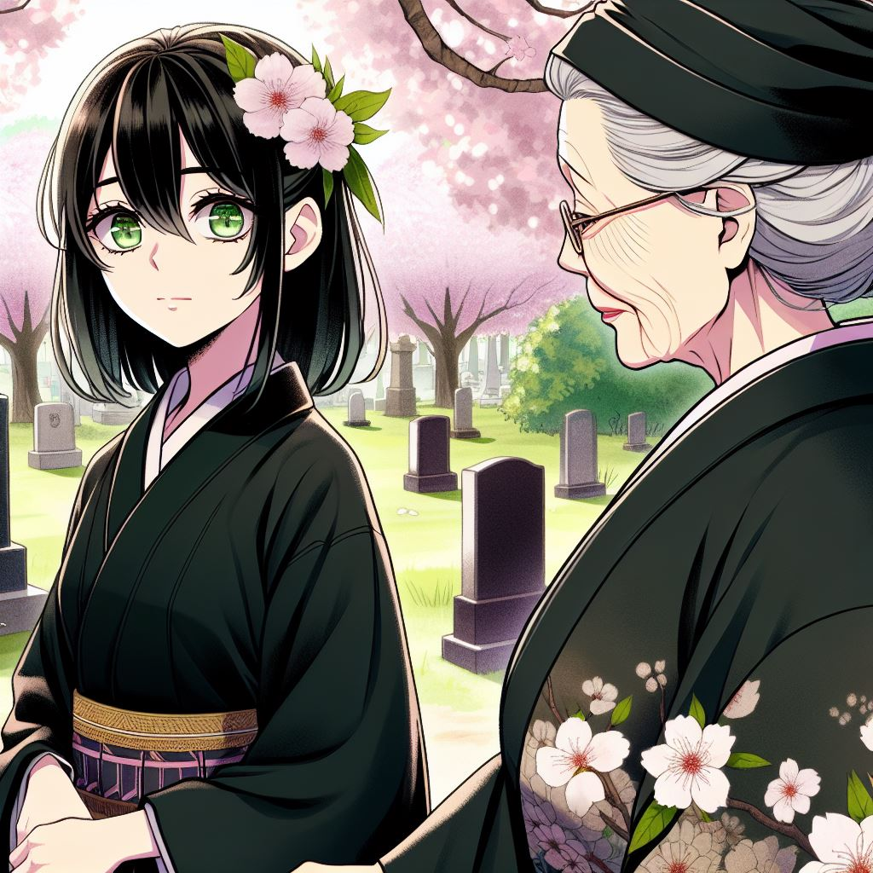
結果
祖父仍然不幸離世
Notes:
A young girl with shoulder-length black hair and green eyes, wearing traditional mourning clothes. She is paying her respects at her grandfather's grave with her grandmother. The style should be Japanese manga.
但最終，我的祖父仍然不幸離世。雖然我賺到足夠的薪水，卻也犧牲與家人相觸的時間，在祖父生病的期間，我為了要提高收入，幾乎很少回家探望祖父。

Slide 6
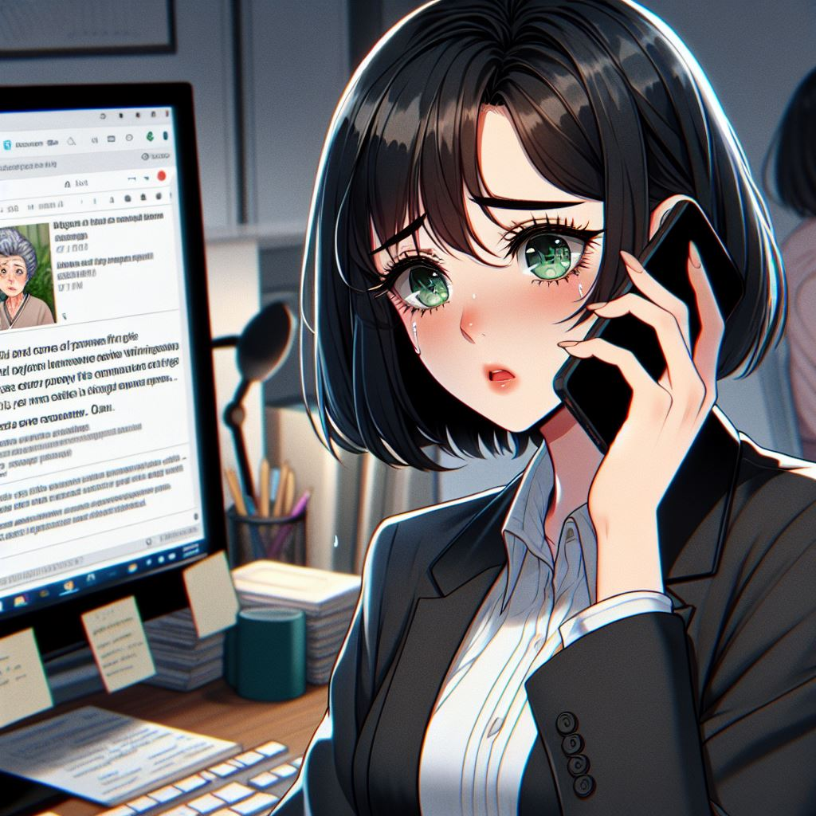
轉折
COVID-19疫情爆發，公司倒閉，失業
祖母身體不適
Notes:
A young woman with shoulder-length black hair with bangs and green eyes, wearing business attire. She is looking at a computer screen with an email notification about the company's closure. At the same time, she is on a phone call with her grandmother, who appears to be unwell. The woman looks worried. The drawing should be in the style of Japanese anime.
祖父辭世沒多久，剛好COVID-19爆發，全球經濟受到嚴重影響。我任職的公司不幸倒閉，當我收到公司關閉、我面臨失業的資訊時，我的祖母也來電告訴我，他最近感覺到身體不太舒服。我感到很擔憂和焦慮，因為祖母對我來說是我僅存的唯一親人，而之前祖父的離開也讓我覺得，我在職涯上的成功，在家人的健康面前根本微不足道。

Slide 7
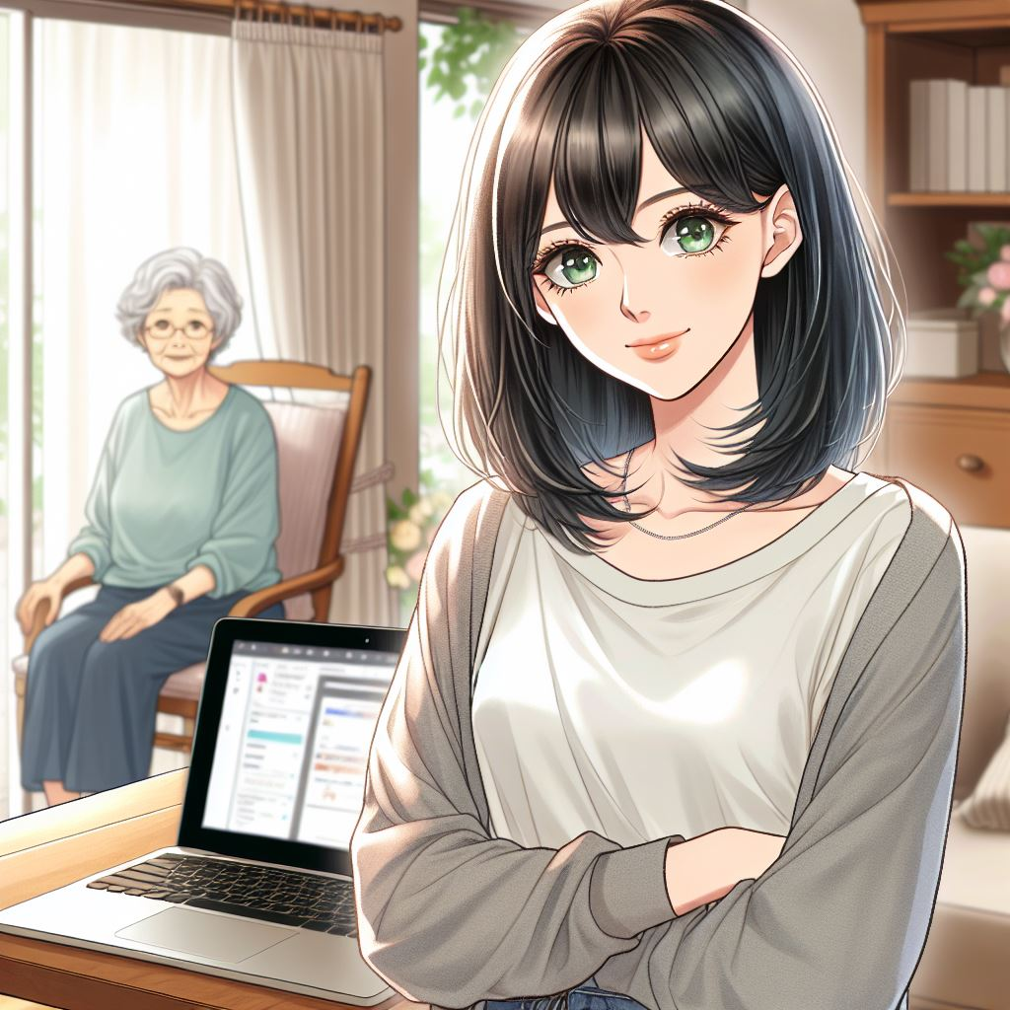
意外
返回家鄉就近照顧祖母
尋找新工作
Notes:
A young woman with shoulder-length black hair with bangs and green eyes, wearing casual attire. She has decided to return to her hometown to take care of her grandmother while looking for a job in her hometown or searching for job opportunities online. The drawing should be in the style of Japanese manga.
所以我決定回家就近照顧祖母並在家裡附近與網路上尋找新的工作，打算在家鄉重新出發。雖然尋找新工作的時候會很焦慮，但我卻也因此有更多時間陪伴家人。而我待業不久，突然發現網路上有開一份遠距工作得職缺，我便嘗試爭取。

Slide 8
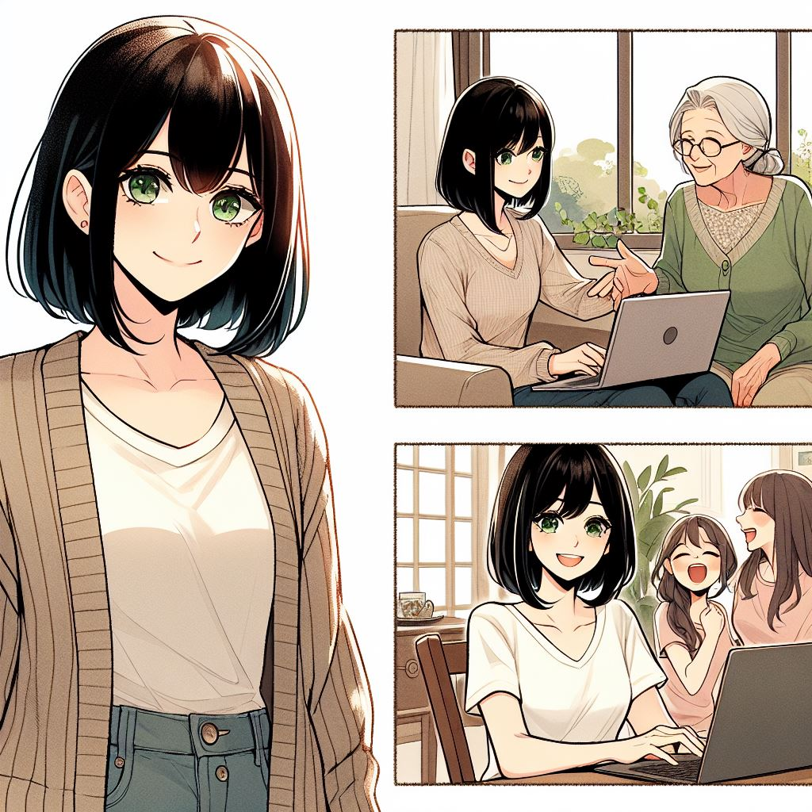
結果
找到新工作
返回家鄉定居
Notes:
A young woman with shoulder-length black hair with bangs and green eyes, wearing casual attire. She has found a remote job opportunity and decided to stay in her hometown to accompany her grandmother. Her life is now more flexible and she has more time to enjoy life. The image should include scenes of the main character walking with her grandmother, having a remote meeting, and going out with friends. The drawing should be in the style of Japanese anime.
最終，我成功得到這一份遠距工作，並決定在家鄉定居。這份工作的收入或許沒有之前公司優渥，但還是足夠維持生活。我逐漸從生活跟工作中取得平衡，我有更多時間陪伴祖母、跟以前的朋友們聯絡、聚會，有更多的私人時間。

