Slide 1
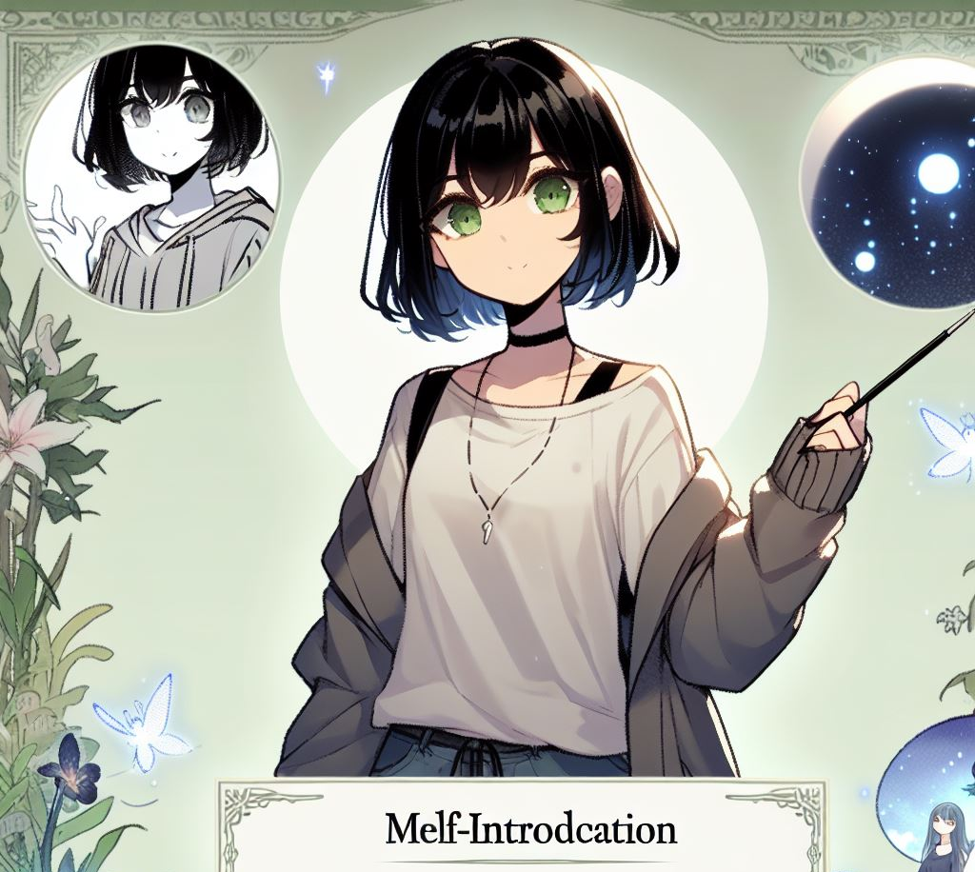
自我介紹
妙麗·格蘭傑
Notes:
A self-introduction image of a young woman with shoulder-length black hair with bangs and green eyes, wearing casual attire. The drawing should be in the style of Japanese anime.
我是妙麗格蘭傑，接下來我要利用故事七步驟來介紹我的故事

Slide 2
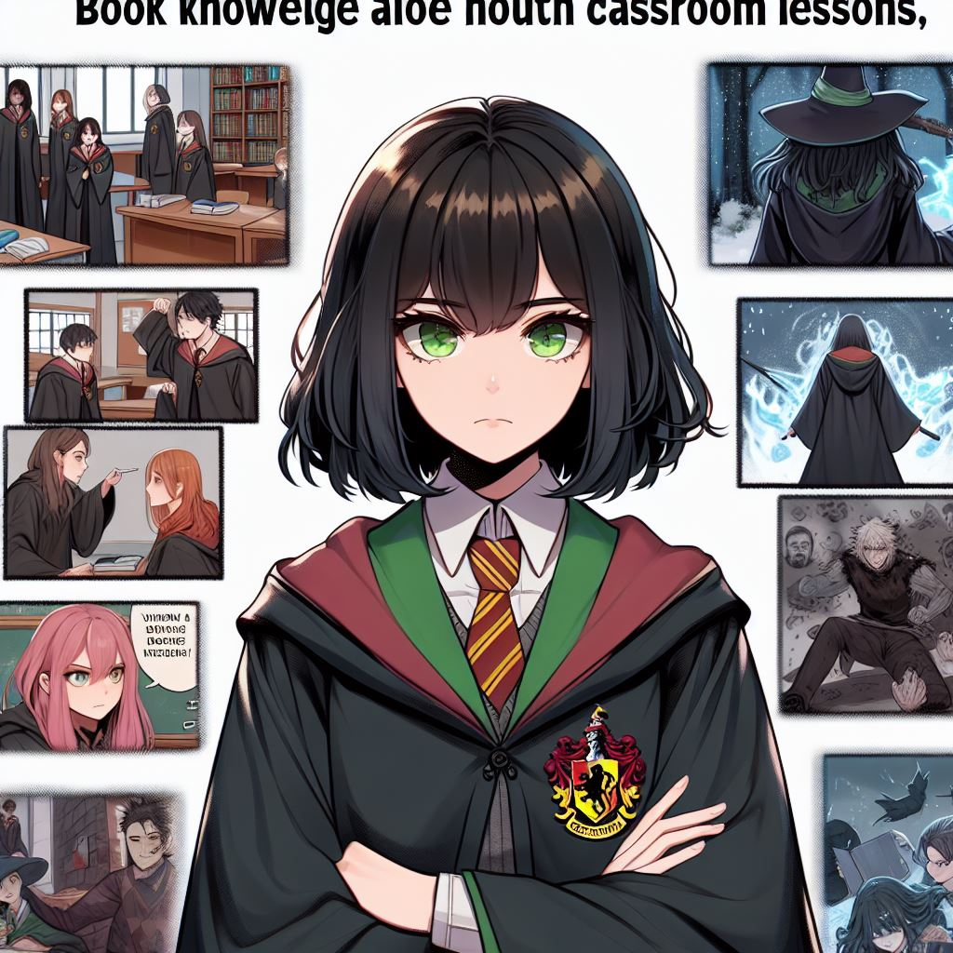
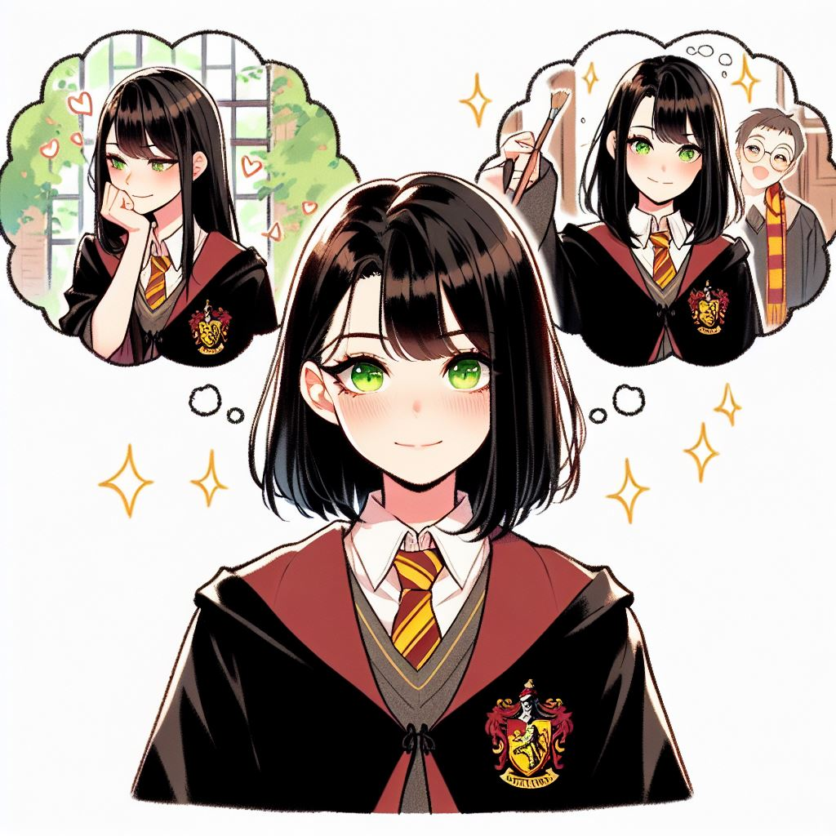
目標
霍格華茲最優秀的學生
Notes:
A young woman with shoulder-length black hair with bangs and green eyes, wearing Gryffindor robes. She is determined to become the best student at Hogwarts. The drawing should be in the style of Japanese anime, and the main character should appear to be imagining herself achieving excellent grades.
從我第一次來到霍格華茲的那一刻起，我就決定成為學校中最優秀的學生。掌握最多的魔法知識，並通過這些知識幫助我的朋友。我堅信，知識就是力量。

Slide 3
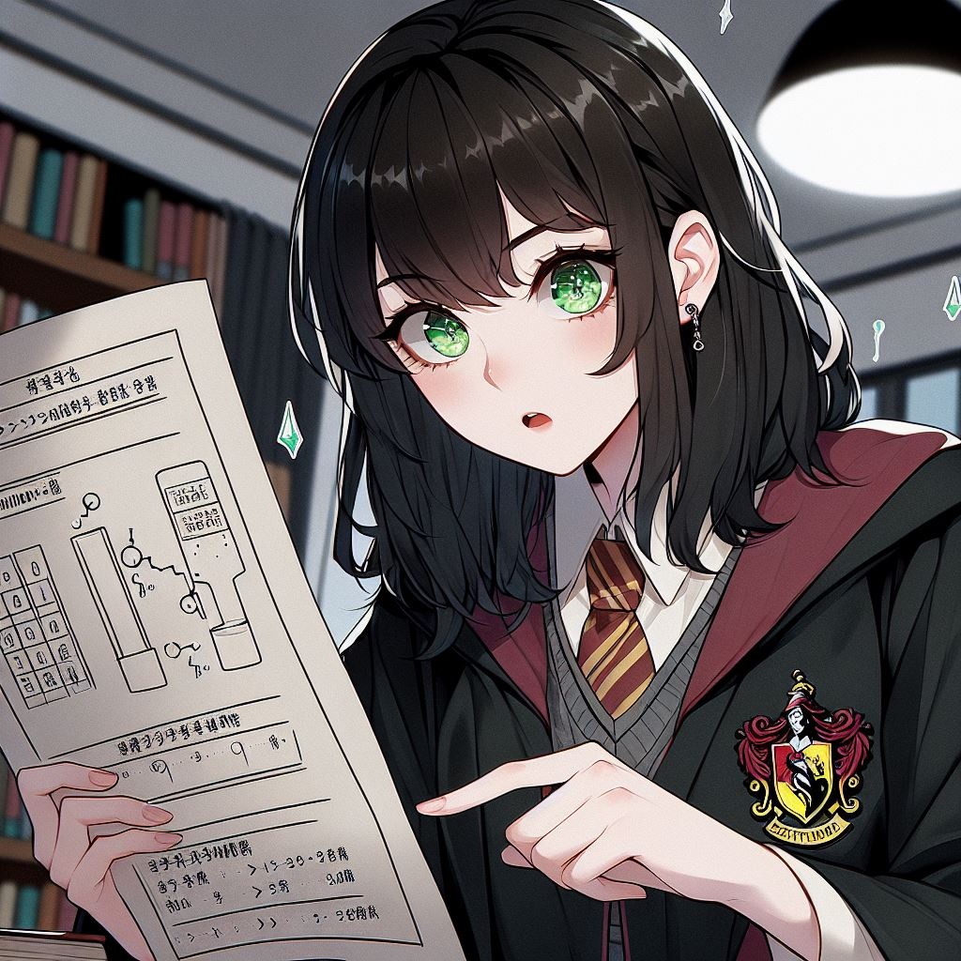
阻礙
麻瓜出身的偏見
危險的黑暗勢力
Notes:
A young woman with shoulder-length black hair with bangs and green eyes, wearing Gryffindor robes. She is facing challenges as a Muggle-born student in the wizarding world, dealing with prejudice and doubts from others. In the process of fighting villains, she realizes that book knowledge alone is not enough, and the dangers in real combat are far more brutal than classroom lessons. The drawing should be in the style of Japanese anime.
不過，這一路上並不容易。作為一個麻瓜出身的學生，我在巫師界受到不少的偏見和質疑，許多人認為我不屬於這個世界。而且在對抗伏地魔的過程，我發現單靠書本上的知識遠遠不夠。實戰中的危險比課堂上的考驗要殘酷得多

Slide 4
努力
積極學習、和朋友一起的行動意外成為實戰經驗
Notes:
A young woman with shoulder-length black hair with bangs and green eyes, wearing Gryffindor robes. She is practicing spells and studying potionology after class with a determined and hardworking expression. The background should have a feeling of studying late at night. The drawing should be in the style of Japanese anime.
面對這些挑戰，我知道我不能退縮。所以我在課業上更努力，每一門課程、每一個咒語我都反覆練習。我學會了如何運用知識解決實際問題，幫助哈利與伏地魔對抗，努力讓自己成為一個不僅僅依賴書本，還能在現實中起作用的人。

Slide 5
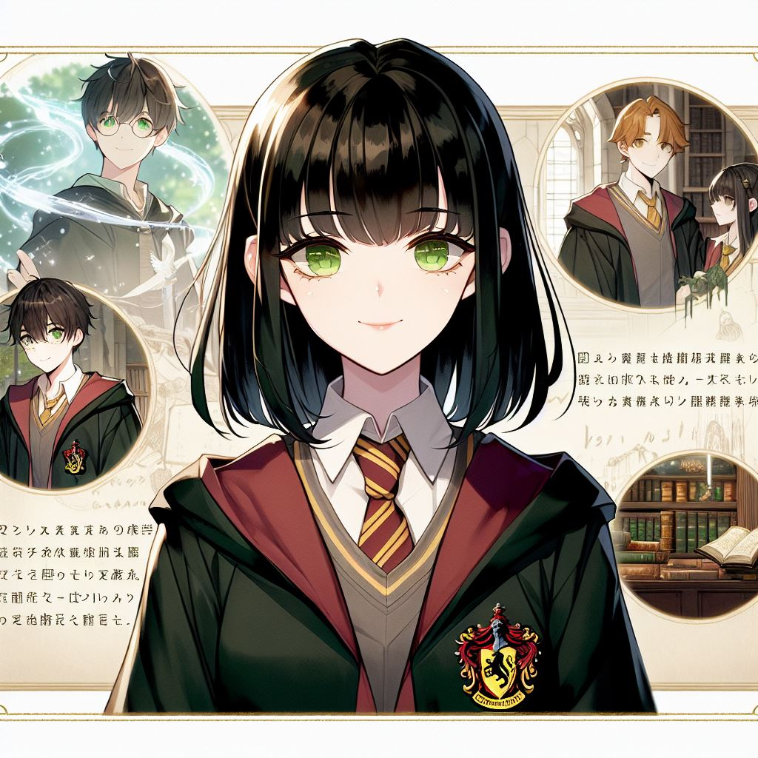
結果
和榮恩、哈利成為好夥伴
Notes:
A young woman with shoulder-length black hair with bangs and green eyes, wearing Gryffindor robes. Her efforts are starting to pay off, and she has become the most reliable support for Harry and Ron, helping them overcome dangers time and time again. She uses her magical knowledge to help decipher many important clues and even saves all their lives at critical moments. The drawing should be in the style of Japanese anime.
我的努力逐漸開始產生效果，我成為了哈利和榮恩最堅實的後盾，幫助他們一次次化險為夷。我運用了所學到的魔法知識，幫助我們破譯了很多重要的線索，甚至在一些關鍵時刻，拯救了我們所有人的生命。

Slide 6
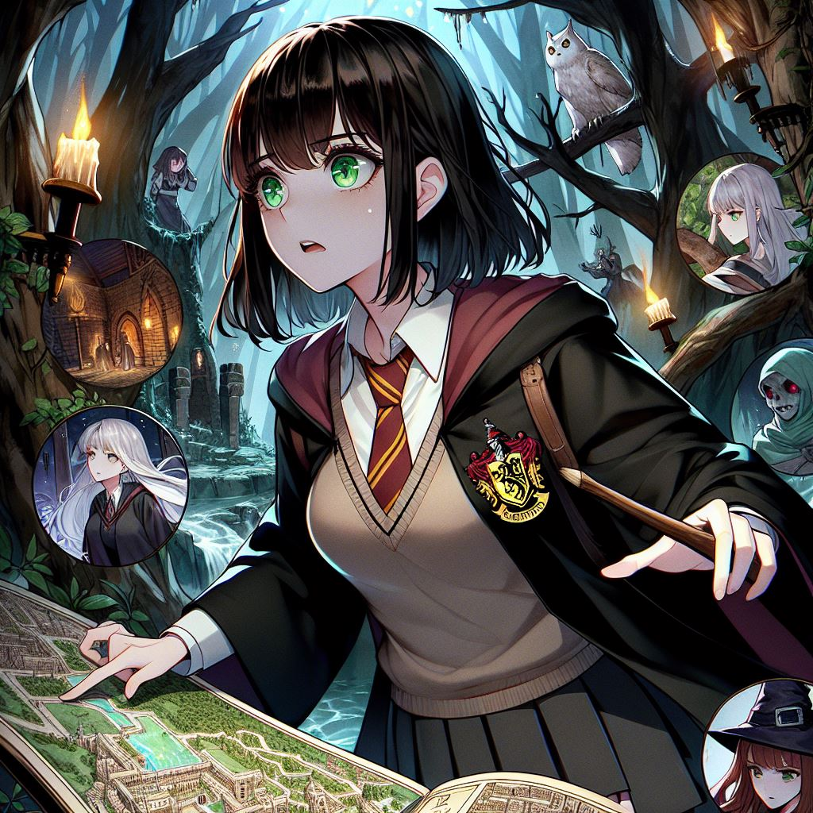
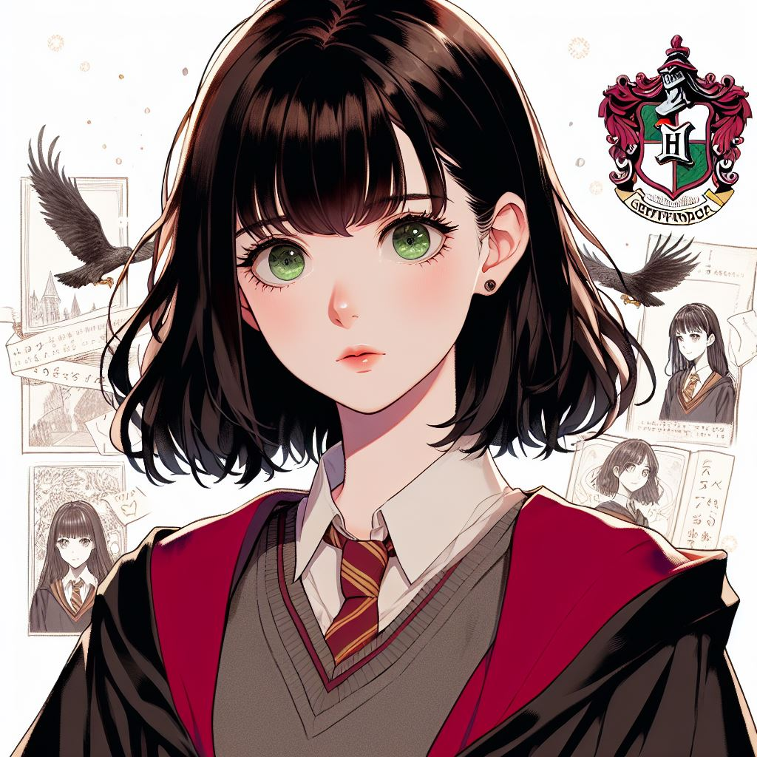
轉折
摧毀分靈體
Notes:
A young woman with shoulder-length black hair with bangs and green eyes, wearing Gryffindor robes. She is growing through the process of searching for and destroying Horcruxes. As they leave Hogwarts and face more dangerous realities, she realizes that knowledge and plans are important, but true courage lies in facing the unknown. She learns to rely not only on books but also on her intuition and emotions. The image should include scenes of dangerous experiences, and the main character does not necessarily have to be the main visual focus of the image. The drawing should be in the style of Japanese anime.
不過，真正讓我成長的是在尋找和摧毀分靈體的過程中。當我們離開霍格華茲，開始面對更加險惡的現實時，我意識到知識和計劃固然重要，但真正的勇氣在於如何面對未知。我學會了不再單純依賴書本，開始相信我的直覺和情感。

Slide 7

意外
友情、勇氣與情感的重要性
Notes:
A young woman with shoulder-length black hair with bangs and green eyes, wearing Gryffindor robes. This journey has made her realize the power of friendship and love. In the face of danger, she sees the unconditional trust and sacrifice between friends, which can never be learned from books. The background should reflect her past experiences. The drawing should be in the style of Japanese anime.
這段旅程還讓我意識到友情和愛的力量。過去的我可能過於理性，總是相信規則和計劃，然而在面對死亡和危險的時候，我看到了朋友之間無條件的信任和犧牲，這是書本裡永遠學不到的。

Slide 8
結果
不止是知識的成長，
Notes:
A young woman with shoulder-length black hair with bangs and green eyes, wearing Gryffindor robes. She is giving a speech and her speech is being reported by a newspaper. The drawing should be in the style of Japanese anime.
最終，我不僅實現了自己最初的學術目標，成為了霍格華茲最優秀的學生之一，但更重要的是，我學會了如何在真正的危機中保持冷靜和堅定。我不再只是一個依賴知識的學者，而是一個能夠在現實中解決問題、保護朋友和捍衛正義的巫師。以上是我的自我介紹，謝謝大家聆聽~

