Slide 1
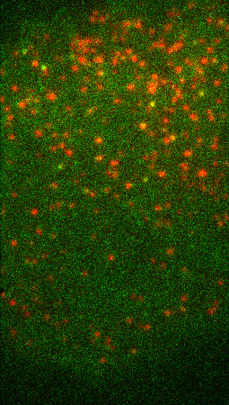
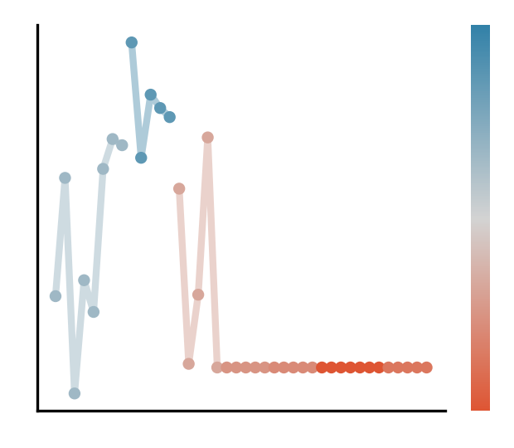
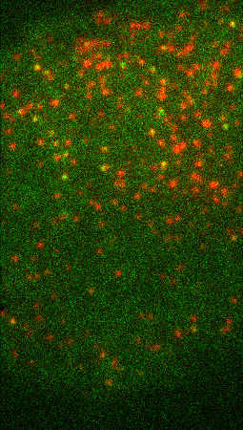
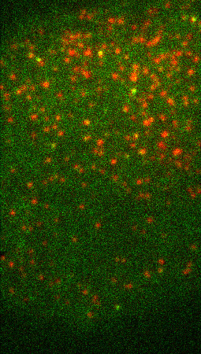
A
B
C
D
E
-
-
If lifetime < 15:
aux-
If lifetime > 161:
aux+
-
-
+
+
-
-
+
Detection + Tracking
Remaining tracks
-
+
+
+
Videos of cells
Lifetime threshold
Neural network
Interpretation

