Slide 1
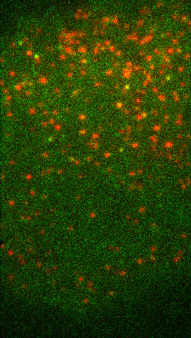
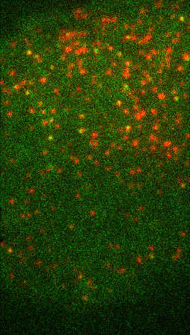
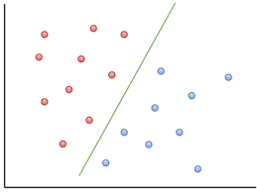
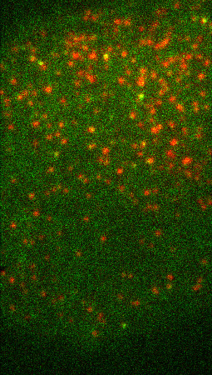
A
B
C
D
If lifetime < 3: aux-
If lifetime > 10: aux+
Detection + Tracking
All tracks
Full model
Difficult tracks
Lifetime threshold
Full model
Videos of cells
Clathrin + Auxilin tracks

