Slide 1
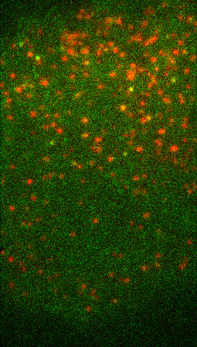
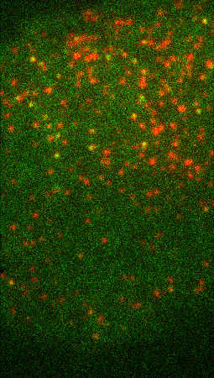
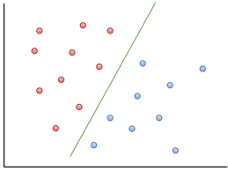
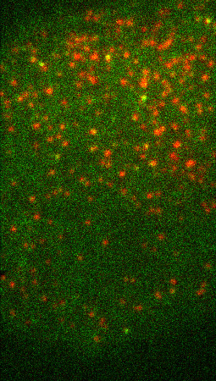
If lifetime < 3: aux-
If lifetime > 10: aux+
If rise < 10: aux-
Detection + Tracking
All tracks
Full model
Difficult tracks
Clathrin + Auxilin Traces
Full model
Videos of cells
Clathrin + Auxilin tracks

