Slide 1
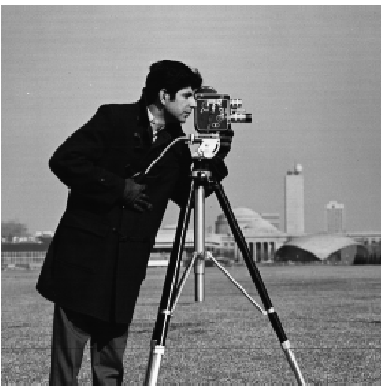
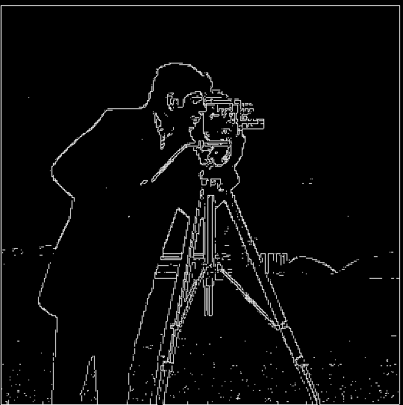
Edge detection
Dx = [[-1, 1]]
Dy = [[-1],[1]]
Ix(x,y) = I(x+1, y) - I(x,y)
Iy(x,y) = I(x, y+1) - I(x, y)
Ix^2 + Iy ^2 >= 3000

Slide 2
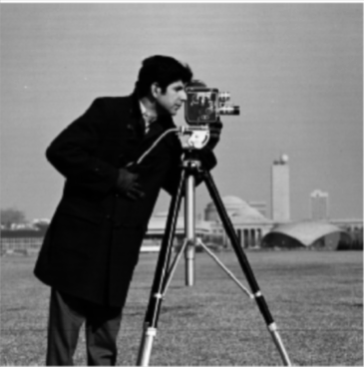
Edge detection
Gaussian blur

Slide 3

Edge detection

Slide 4
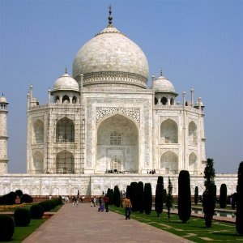
Image Sharpening

Slide 5
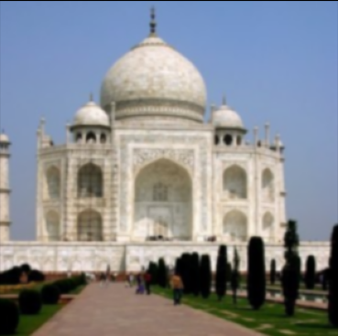
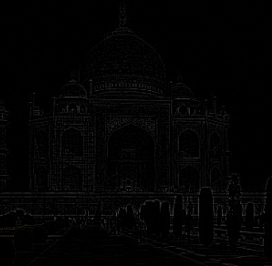
Image Sharpening

Slide 6
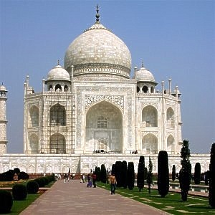
Image Sharpening

Slide 7
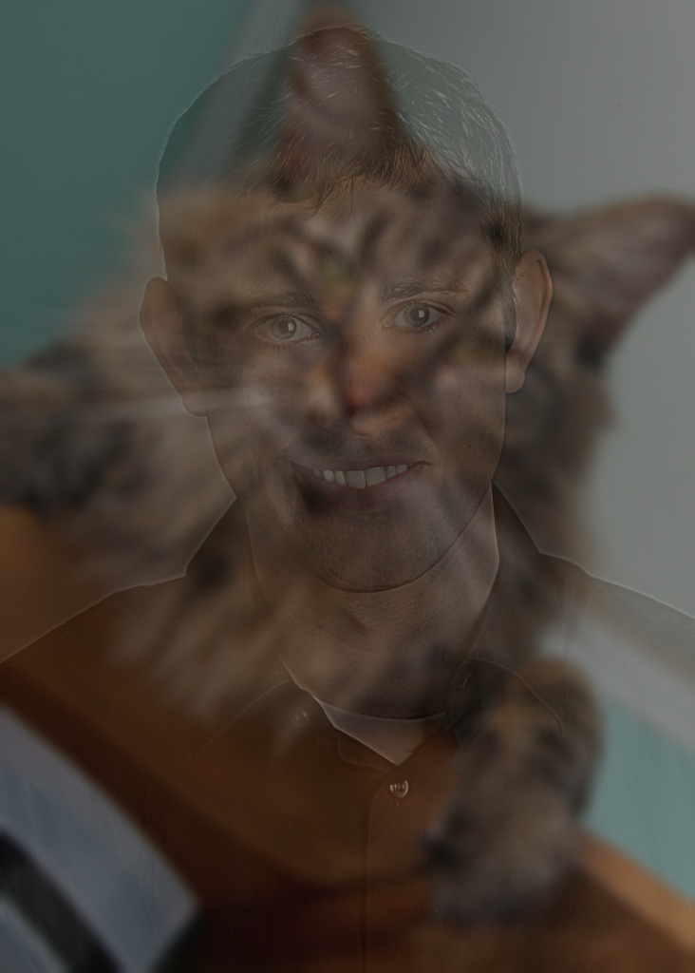
Hybrid Images

Slide 8

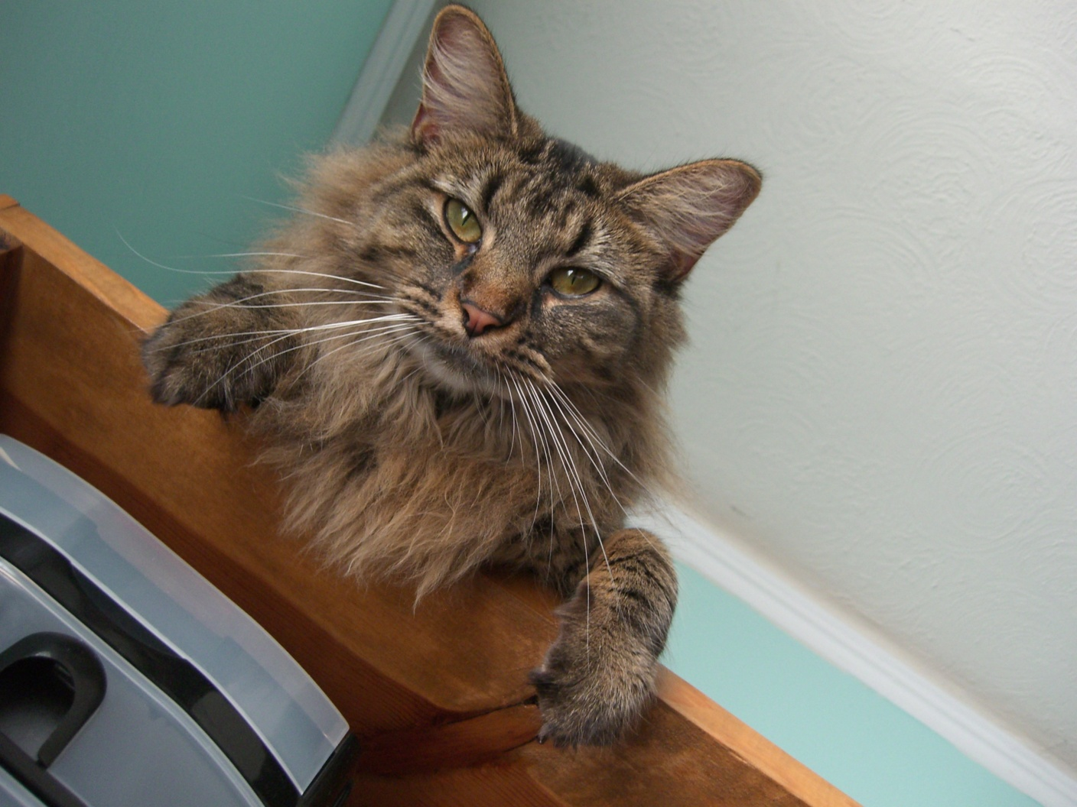
Hybrid Images

Slide 9
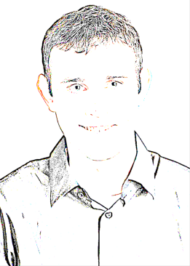
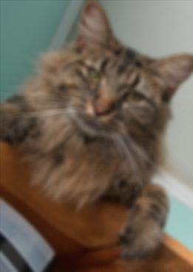
Hybrid Images

