Slide 1
Public Key Infrastructure

Slide 2
Content
Prerequisites
Public key infrastructure
X509 and Openssl
Domain name system
Lab materials
Issuing and Revoking Certificates
Hierarchy of Certificate Authority
Threat to Public Key Infrastructure

Slide 3
Public Key Infrastructure

Slide 4





Symmetric Cryptography

Slide 5
Symmetric Cryptography
Enc_{k}( )
Enc_{k}( )

Slide 6


Asymmetric Cryptography

Slide 7
Symmetric Cryptography
Enc_{pk_A}( )
Enc_{pk_B}( )

Slide 8




Confidentiality and Authenticity

Slide 9
Confidentiality and Authenticity

Slide 10
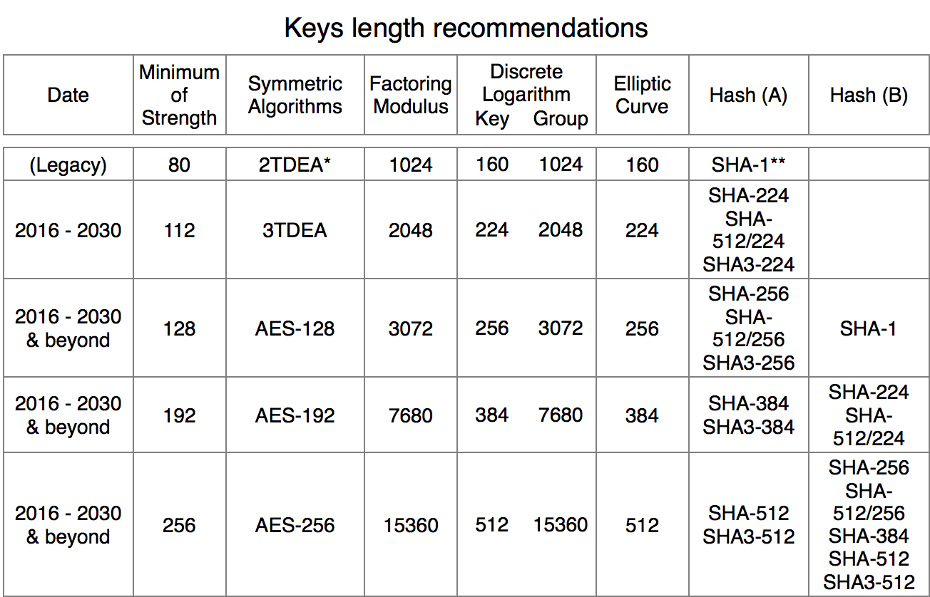
Computational Complexity
Notes:
All key sizes are provided in bits. These are the minimal sizes for security.TDEA (Triple Data Encryption Algorithm) and AES are specified in [10]. Hash (A): Digital signatures and hash-only applications. Hash (B): HMAC, Key Derivation Functions and Random Number Generation. The security strength for key derivation assumes that the shared secret contains sufficient entropy to support the desired security strength. Same remark applies to the security strength for random number generation.It is always acceptable to use a hash function with a higher estimated maximum security strength. When selecting a block cipher cryptographic algorithm (e.g. AES or TDEA), the block size may also be a factor that should be considered. More information on this issue is provided in SP800-38.(*) The assessment of at least 80 bits of security for 2TDEA is based on the assumption that an attacker has no more than 2⁴⁰ matched plaintext and ciphertext blocks.(**) SHA-1 has been demonstrated to provide less than 80 bits of security for digital signatures, which require collision resistance. In 2016, the security strength against digital signature collisions remains a subject of speculation.© 2018 BlueKrypt (http://www.bluekrypt.com) - Version 30.4 - February 23 2017 [1] Recommendation for Key Management, Special Publication 800-57 Part 1 Rev. 4, NIST, 01/2016. [10] Approved algorithms for block ciphers, NIST.

Slide 11

Key Exchange Protocols
I will use the key
Ok

Slide 12
Key Exchange Protocols
Enc_{pkA}( )

Slide 13

Man in the Middle attack
Enc_{pkC}( )
Enc_{pkA}( )

Slide 14

Certificate
Give me your Public key and certificate
is the certificate and public key

Slide 15
Transport Layer Security
client hello, crypto info
server hello, ciphersuite, certificate
Enc_{pkA}(pre_master_key)
Client finished
Server finished
Exchange message

Slide 16






Public Key Infrastructure

Slide 17
x509 and Openssl

Slide 18
x509
Standard format of public key certificates
Used in TLS/SSL, electronic signature
Self-signed or signed by certificate authority
Certificate revocation list
Path validation algorithm

Slide 19









Openssl
CSR
Entities
Private keys

Slide 20

Openssl
CSR
Entities
Private keys

Slide 21

Openssl
CSR
Entities
Private keys

Slide 22
Sample commands
Generate a Private Key and a CSR
openssl req \ -newkey rsa:2048 -nodes -keyout domain.key \ -out domain.csr
Generate a Self-Signed Certificate
openssl req \ -newkey rsa:2048 -nodes -keyout domain.key \ -x509 -days 365 -out domain.crt
Sign a certificate
openssl x509 -req -days 360 -in <CSR-for-the-new-device> -CA <your-intermediate-CA-certificate> -CAkey <your-intermediate-CA-key> -out <your-new-certificate> -set_serial <a random number>

Slide 23
Domain Name System

Slide 24




Domain names and IP addresses
Go ask edu
Where www.cs.jhu.edu exactly is?
root
Go ask jhu
edu
It is XX..XX
jhu

Slide 25



Connect to DNS through DHCP and ARP
Got a DHCP offer, the DNS server is …

Slide 26
Lab Materials

Slide 27
Issuing and Revoking Certificates
Draw topology and reserve resources
Set up LAMP for web application
Set up Certificate Authority
Generate certificate and configurate it
Revoke the certificate

Slide 28
Hierarchy of Certificate Authority
Basically the same as the previous one
Replace a single CA with a chain of CA

Slide 29
Threat to Public Key Infrastructure
Setup DNS server on attacker’s node
Setup web server on server’s node
Install tool-sslsplit on attacker’s node
Connect web server from client
Check whether attacker did intercept messages

