Slide 1
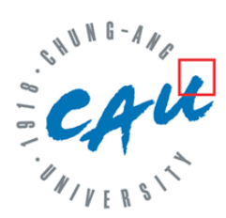
Data Augmentation with LLMs
October 18, 2023
Language Intelligence Lab
Artificial Intelligence Graduate School
Yumin Kim
NLP Research Intern

Slide 2
Contents
1. Data Augmentation
03
2. before/after LLMs
13
3. Model vs. Human
19
Notes:
Data augmentation: Back Translation, EDA
Before/after LLMs: GPT3Mix, SuperGen, AugGPT
Humor Paper (ACL)

Slide 3
Data Augmentation
Text Augmentation:
Methods for perturbing the linguistic space without alerting class labels
Motivation:
Lack of (good quality) dataset for training → Training → sensitive to the few datasets
Purpose:
1. Improve the robustness and generalizability of the downstream models
Notes:
EDA
Back-Translation (https://neptune.ai/blog/data-augmentation-nlp)

Slide 4
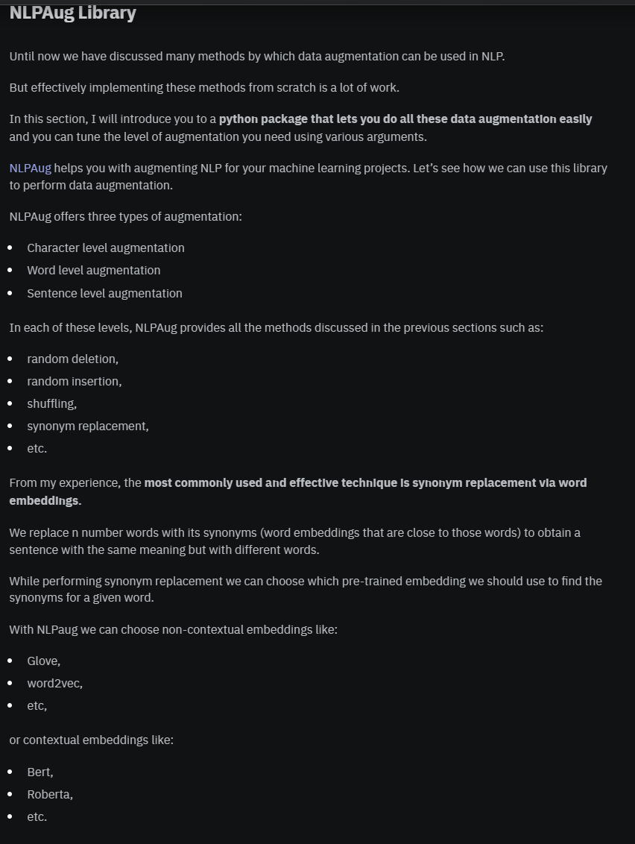
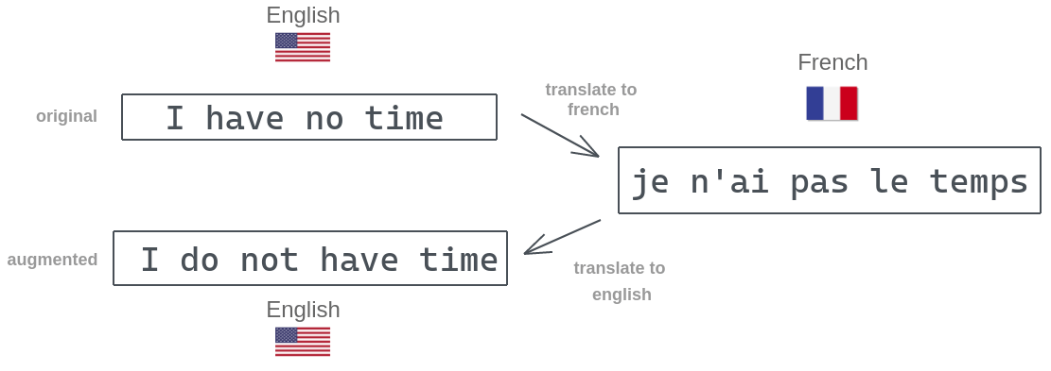
Before LLMs: Back-Translation, EDA
1. Back Translation
https://amitness.com/back-translation/
Notes:
EDA
Back-Translation (https://neptune.ai/blog/data-augmentation-nlp)

Slide 5
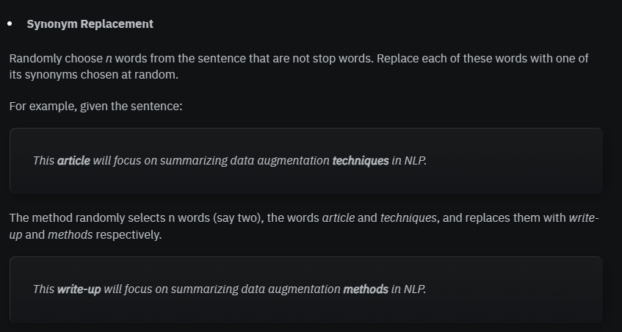
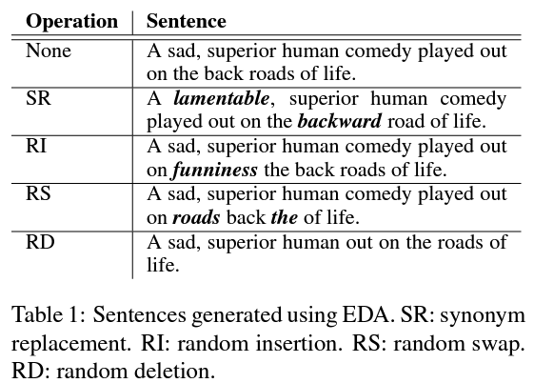
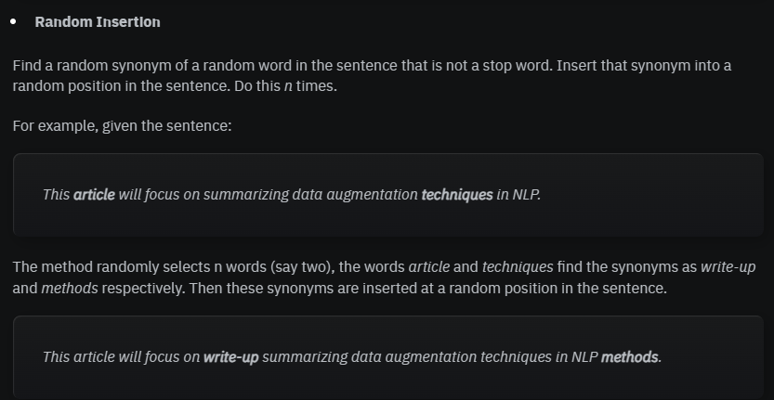
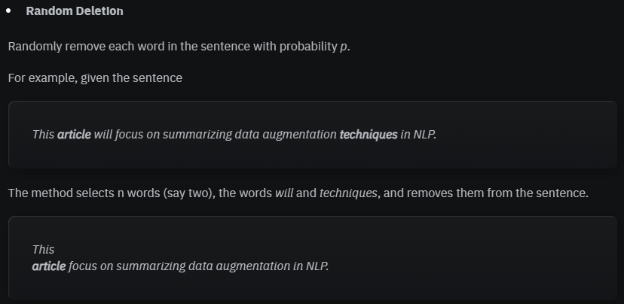
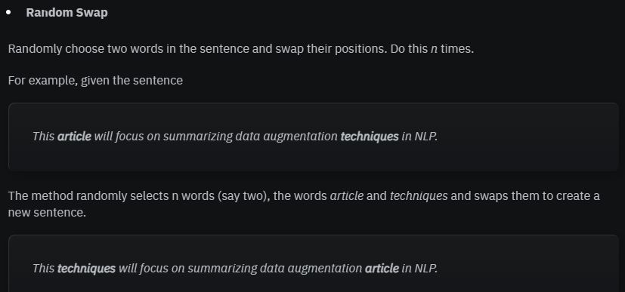
Before LLMs: Back-Translation, EDA
2. EDA: Easy Data Augmentation
Wei, Jason, and Kai Zou. "Eda: Easy data augmentation techniques for boosting performance on text classification tasks." 2019.
Notes:
EDA
Back-Translation (https://neptune.ai/blog/data-augmentation-nlp)

Slide 6
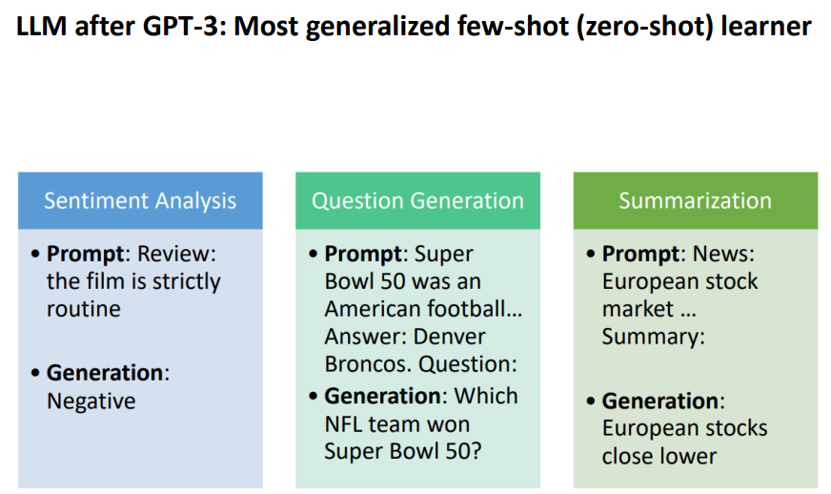
Utilizing LLMs: Zero/few-shot learning
references
Notes:
https://arxiv.org/pdf/2302.13007.pdf
Yoo, Kang Min, et al. "GPT3Mix: Leveraging large-scale language models for text augmentation." arXiv preprint arXiv:2104.08826 (2021).

Slide 7
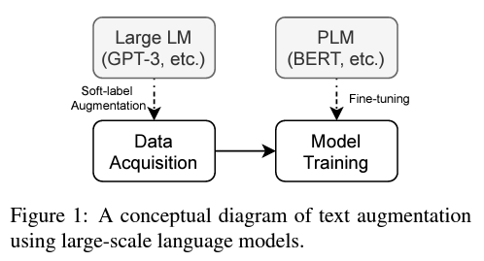
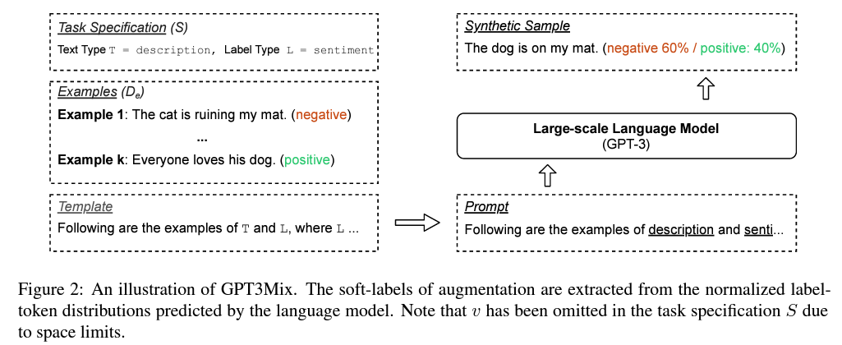
GPT3Mix
Yoo, Kang Min, et al. "GPT3Mix: Leveraging large-scale language models for text augmentation." arXiv preprint arXiv:2104.08826 (2021).
Notes:
https://arxiv.org/pdf/2302.13007.pdf
Yoo, Kang Min, et al. "GPT3Mix: Leveraging large-scale language models for text augmentation." arXiv preprint arXiv:2104.08826 (2021).

Slide 8
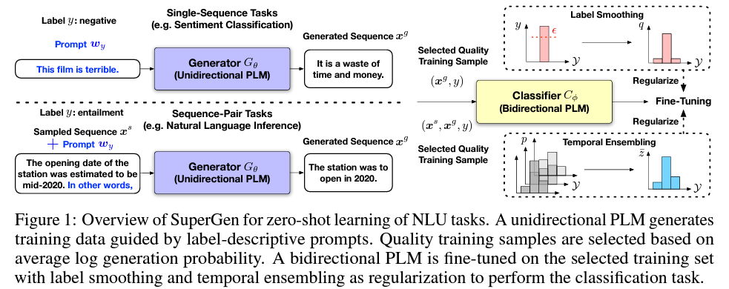
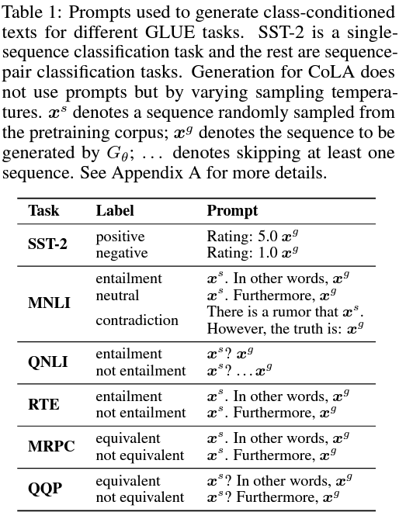
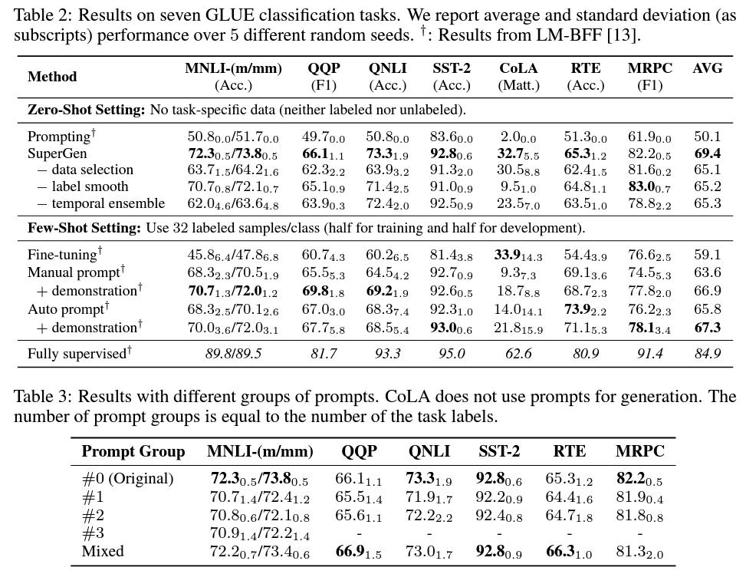
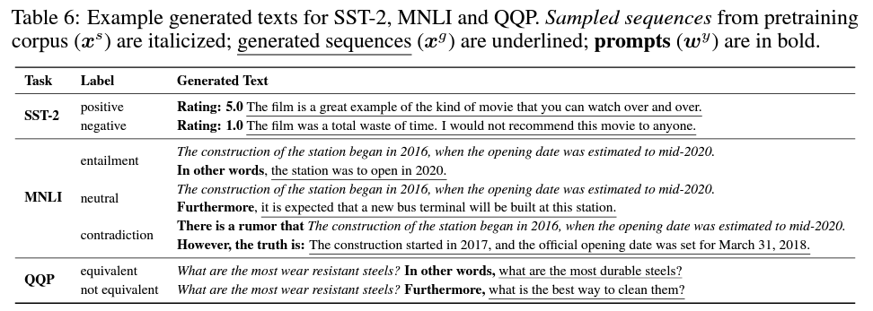
SuperGen
Meng, Yu, et al. "Generating training data with language models: Towards zero-shot language understanding." NeurIPS 2022.
Notes:
https://arxiv.org/pdf/2302.13007.pdf
Dai, Haixing, et al. "AugGPT: Leveraging ChatGPT for Text Data Augmentation." arXiv preprint arXiv:2302.13007 (2023).

Slide 9
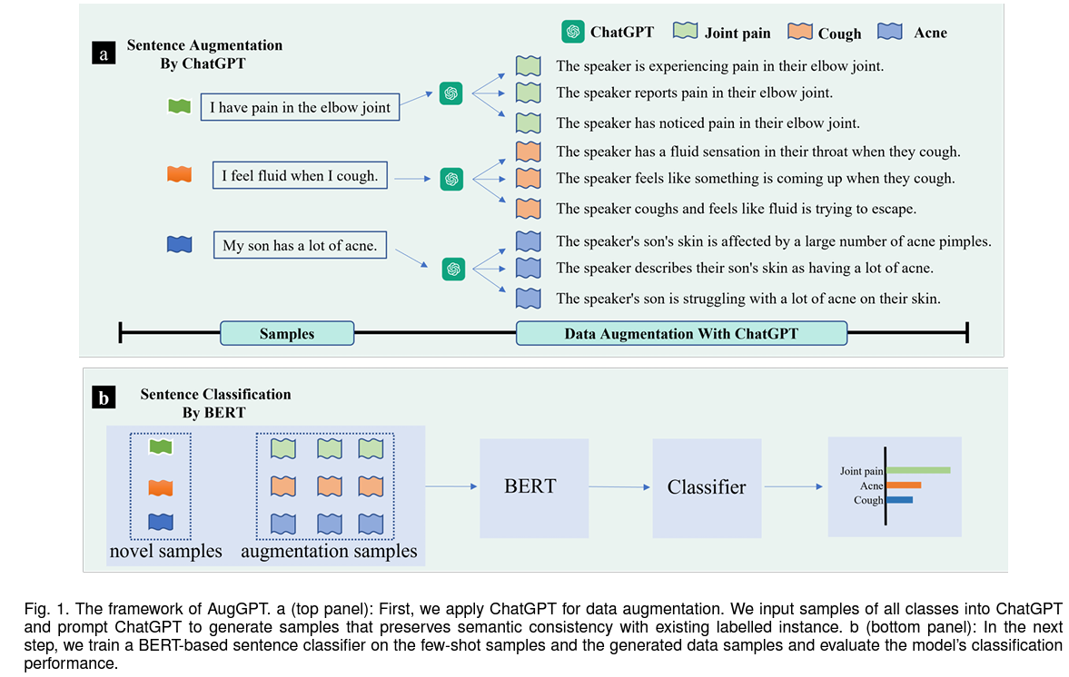
AugGPT
Dai, Haixing, et al. "AugGPT: Leveraging ChatGPT for Text Data Augmentation." 2023.
Notes:
https://arxiv.org/pdf/2302.13007.pdf
Dai, Haixing, et al. "AugGPT: Leveraging ChatGPT for Text Data Augmentation." arXiv preprint arXiv:2302.13007 (2023).

Slide 10
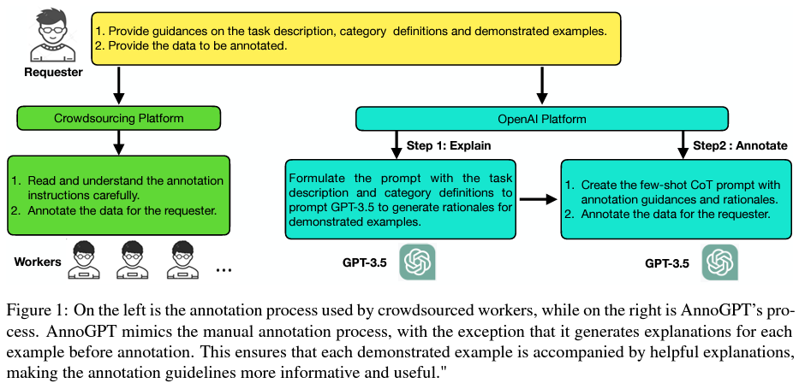
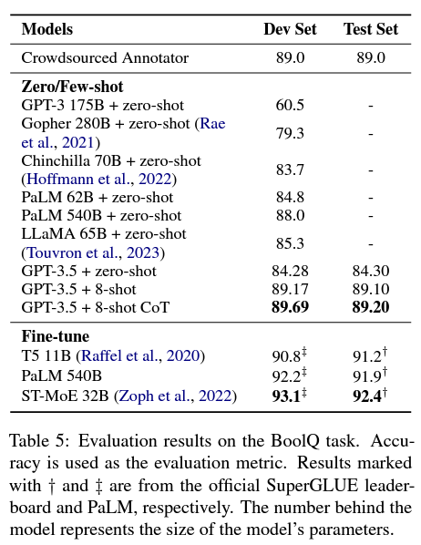
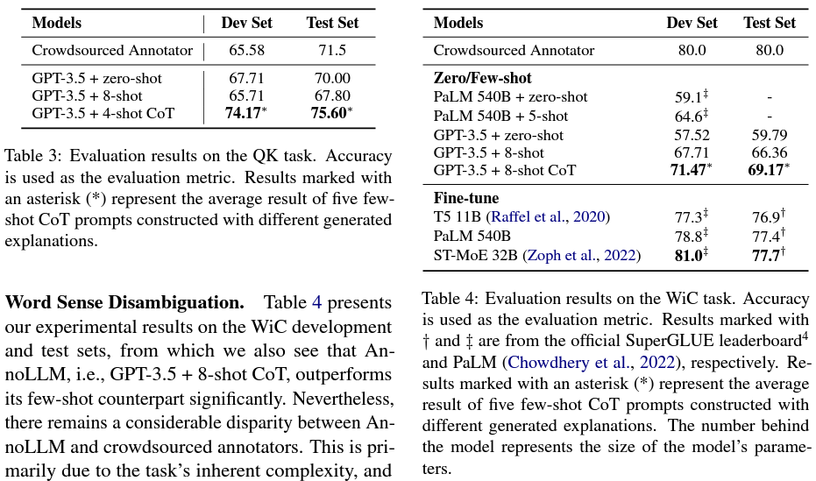
Model vs. Human: Annotation
He, Xingwei, et al. "Annollm: Making large language models to be better crowdsourced annotators." arXiv preprint arXiv:2303.16854 (2023).
Notes:
https://arxiv.org/pdf/2303.16854.pdf

Slide 11
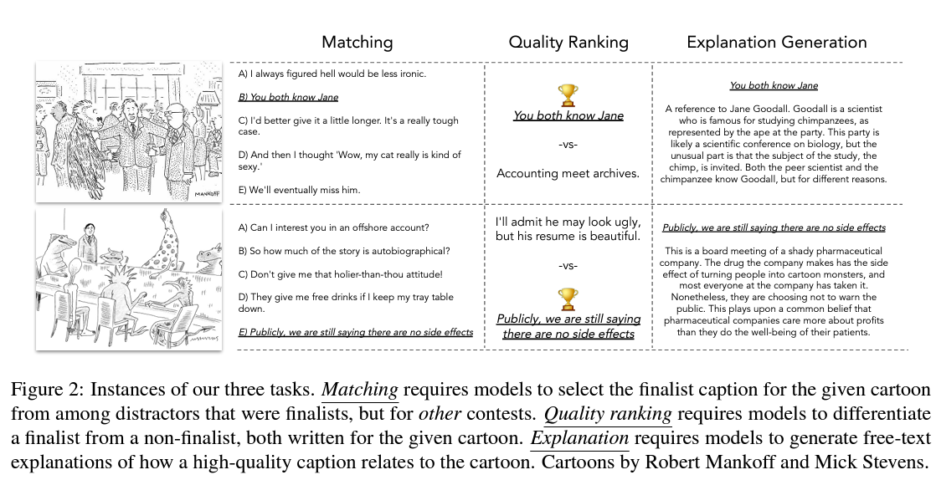
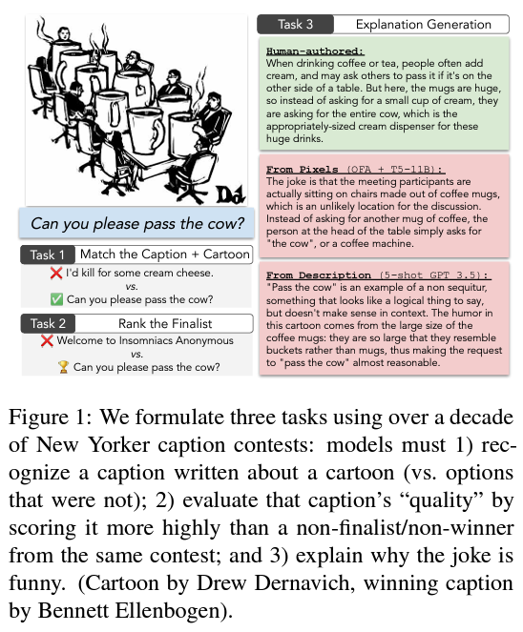
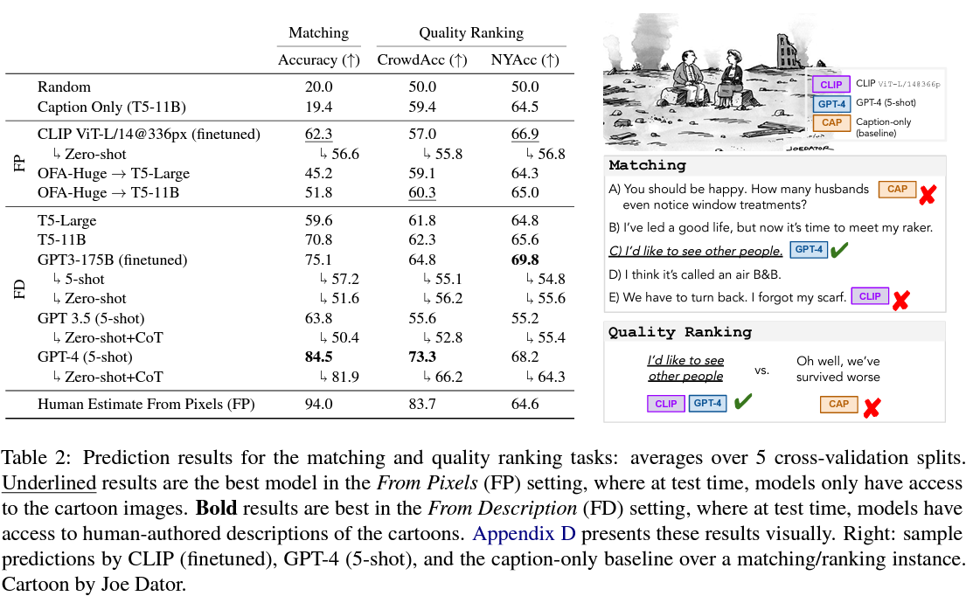
Model vs. Human: Generation
Hessel, Jack, et al. "Do androids laugh at electric sheep? humor" understanding" benchmarks from the new yorker caption contest." (2022).
Notes:
Hessel, Jack, et al. "Do androids laugh at electric sheep? humor" understanding" benchmarks from the new yorker caption contest." arXiv preprint arXiv:2209.06293 (2022).

Slide 12
Q&A

Slide 13
THANK YOU

