Slide 1

TOD: Task-Oriented Dialogue
July 20, 2023
Language & Intelligence Lab
Artificial Intelligence Graduate School
Yumin Kim
2023 U-SURF Research Intern

Slide 2

2
CONTENTS
1. TOD
03
2. <SimpleTOD> Review
08
3. Recent Developments
13

Slide 3
1. TOD
3
Conversational AI
Conversational AI
Open-domain dialogue system
ex) Chit-chat
Training: end-to-end
Data: large-scale data from social media
Task-Oriented dialogue system (TOD)
ex) hotel reservation, medical consultant chatbot
Goal: To accomplish a goal described by a user
Notes:
Open-domain dialogue:
Open-ended conversations with human in more natural and engaging
TOD

Slide 4
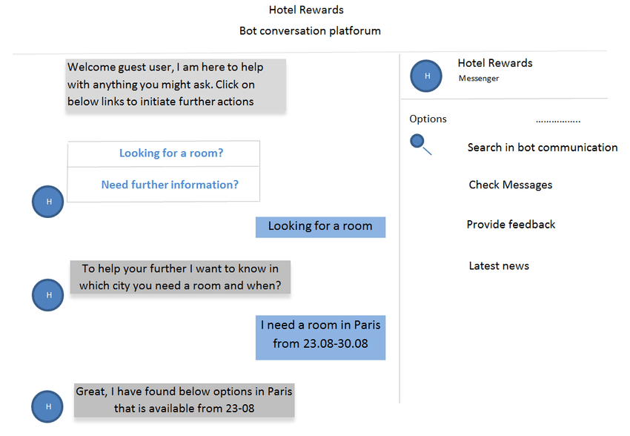
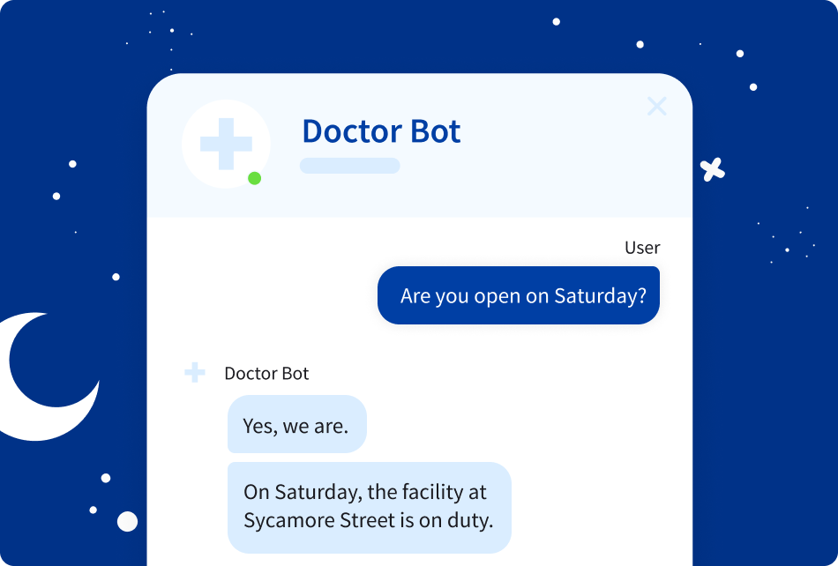
1. TOD
4
Example of TOD

Slide 5
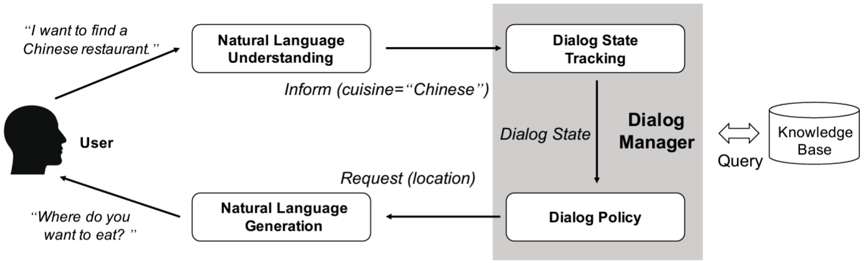
1. TOD
5
Traditional 3 Pipelines
NLU module: extract belief state
DM module (Dialog Manager): decides which actions to take based on those beliefs
- Dialog State Tracking (DST), Dialog Policy
NLG module: generate responses
➔ Traditionally, each component is trained independently with different supervision
Notes:
NLU (Natural Language Understanding)
사용자의 발화를 이해하기 위한 모듈입니다. 입력으로 들어온 발화는 분석되어 정형화된 데이터로 변환됩니다.
사용자 > “내일 서울 날씨 알려줘”
NLU 결과: intent(Search-Weather), location(Seoul), date(2020-05-17)
DM (Dialogue Manager)
사용자와 시스템이 주고 받는 대화의 흐름을 관리합니다. 크게 두 가지 모듈로 구성되어 있는데, Dialog State Tracker 는 현재 대화 상태를 추적 관리합니다. 아래의 예를 보면 NLU 결과로부터 Dialog State 를 업데이트 하면서 대화를 진행하고 있습니다. 실제로는 NLU 결과 뿐 아니라 더 많은 데이터를 유지합니다. Policy Manager는 내부 정책을 통해서 시스템이 사용자에게 전달할 Action 을 결정합니다. Action 은 NLG 에게 바로 전달되기도 하고 Database로부터 응답에 필요한 정보를 가져오는데 사용되기도 합니다. 아래의 예에서 내일 서울의 날씨를 사용자에게 알려주기 위해서는 외부 Database로부터 날씨정보를 가져와야 합니다.
사용자 > “내일 날씨 알려줘”
NLU 결과: intent(Search-Weather), location(Seoul), date(2020-05-17)
Dialog State: intent(Search-Weather), date(2020-05-17)
시스템 > “어느 지역 날씨를 알려드릴까요?”
Action: REQUEST_LOCATION
사용자 > “서울”
NLU 결과: location(Seoul), date(2020-05-17)
Dialog State: intent(Search-Weather), location(Seoul), date(2020-05-17)
NLG (Natural Language Generation)
DM 으로부터 데이터를 입력 받아서 사람이 쉽게 이해할 수 있는 시스템의 응답을 생성합니다. 응답은 각 시스템의 페르소나를 결정할 수 있기 때문에 매우 주의 깊게 다루어져야 합니다. 예를 들어서 성적 농담이나 인종차별과 같은 민감한 질문에 우스꽝스러운 응답을 한다면 대화 시스템의 신뢰에 나쁜 영향을 미칠 수 있습니다.
시스템 > “내일 서울에는 비가 올 예정입니다. 우비와 장화를 꼭 챙기세요!”

Slide 6

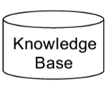

1. TOD
6
Traditional 3 Pipelines: Example
I’m looking for a restaurant in UNIST.
Dialog state (=Belief state):
Domain(restaurant), Area(UNIST), Date(07-20-2023),
Intent(Search_Restaurant)
Database Query
SELECT *from RESTAURANT
WHERE area=UNIST
NLU + DST
Dialog Manager
Decide Action:
INFORM_CHOICE, REQUEST_FOOD,
BYE, CONFIRM, ….
Policy
Query Result
value_count = 5
There are [value_count] restaurants that meet your
criteria. What type of food do you want?
NLG

Slide 7
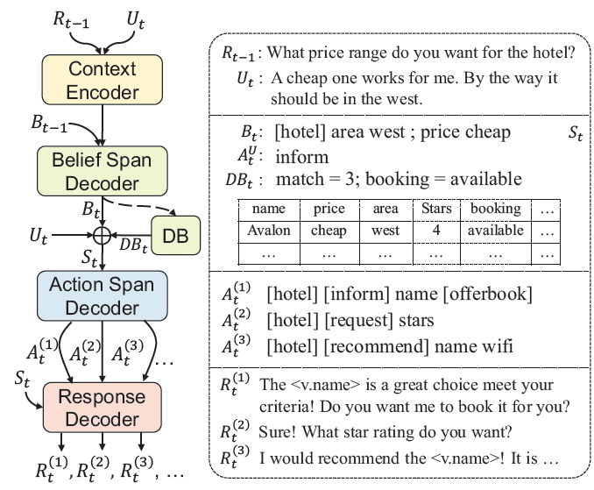
1. TOD
7
Towards End-to-End Training
Prior work (1): domain-aware multi-decoder model (DAMD) + augmentation
→ SOTA combined score for Dialogue Management and Response Generation
@ 2020 AAAI
Notes:
DAMD used augmented dialogue datasets

Slide 8
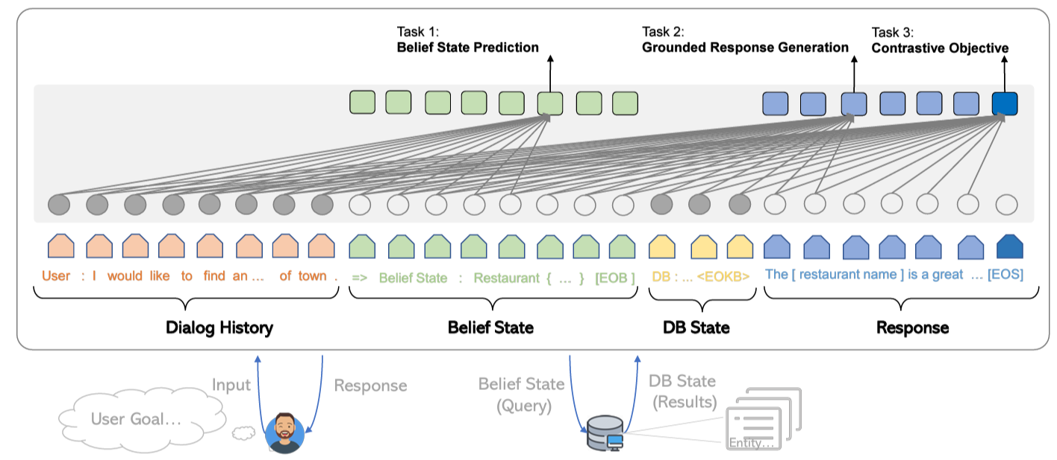
1. TOD
8
Towards End-to-End Training
Prior work (2): SOLOIST: GPT2-based end-to-end training model
→ But didn’t show end-to-end performance w/o pretraining on other dialogue datasets
@ 2020 Microsoft Research
Notes:
Traditionally
NLU module ← domain and intent labels
DM module ← dialogue belief and dialogue act labels
NLG module ← natural responses
Towards End-to-End

Slide 9
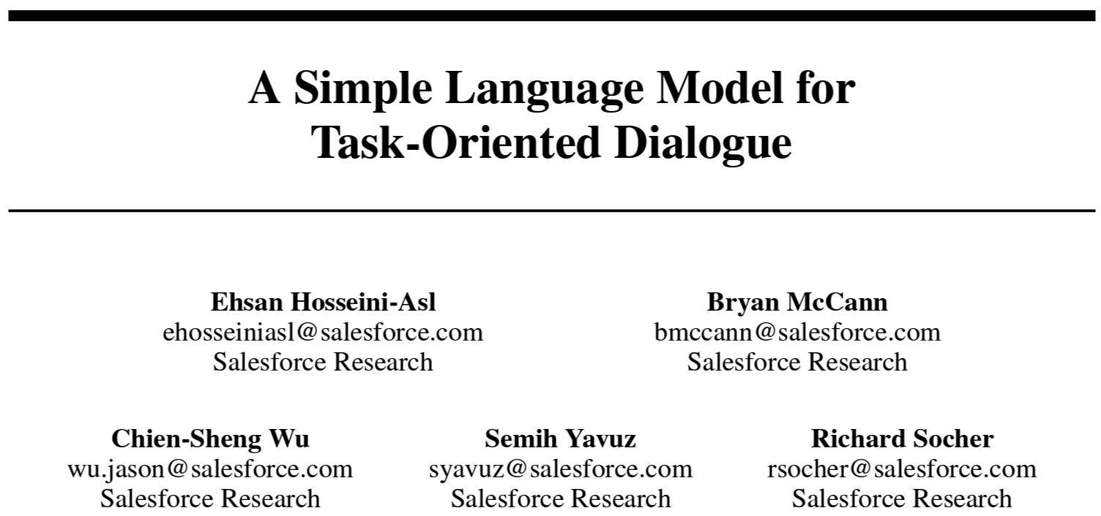
2. <SimpleTOD> Review
9
Overview
SimpleTOD:
End-to-End Baseline Model
uses a single, casual (unidirectional) LM
trained on all sub-tasks
in an end-to-end single sequence prediction
first model to achieve SOTA performance for
DST, action decisions, and response generation
@ 2020 NeurIPS

Slide 10
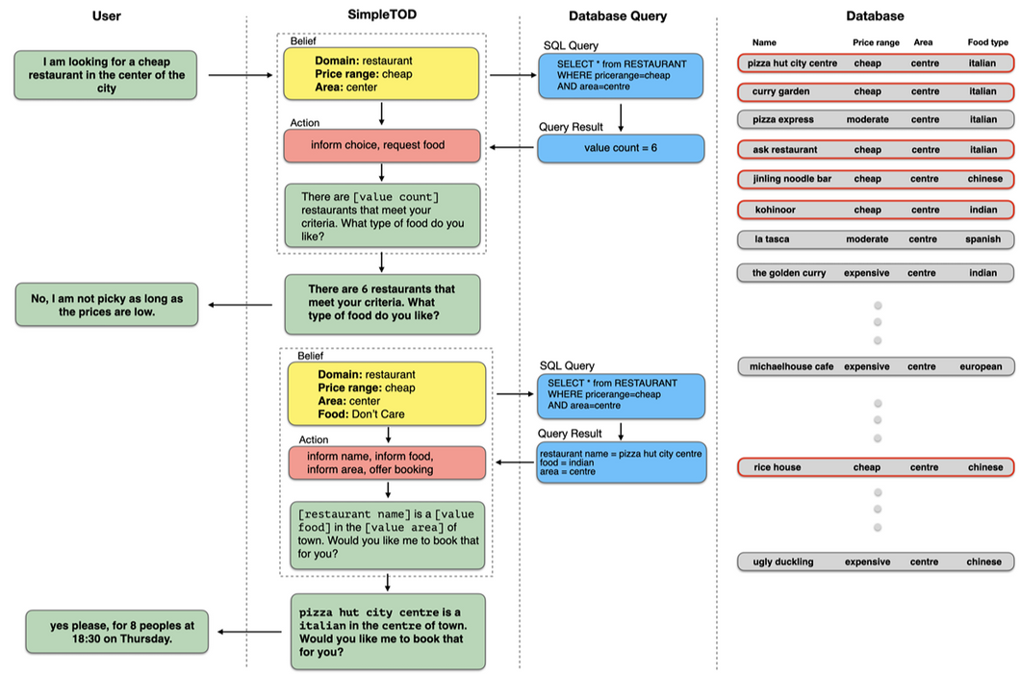

Slide 11
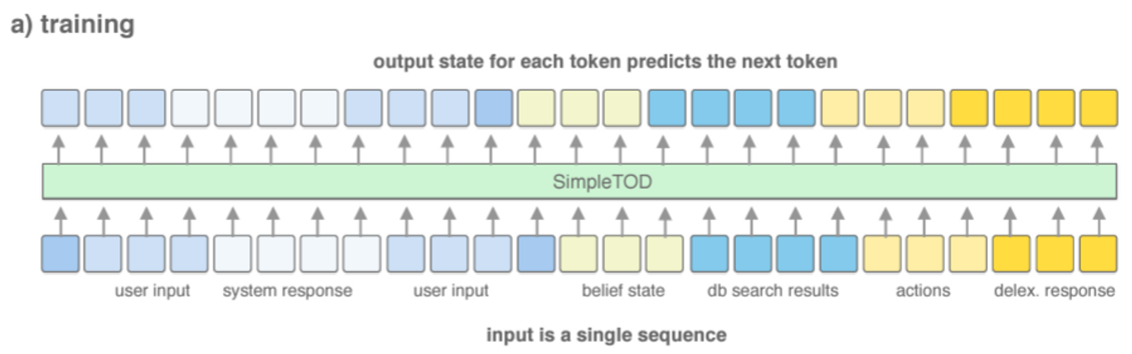
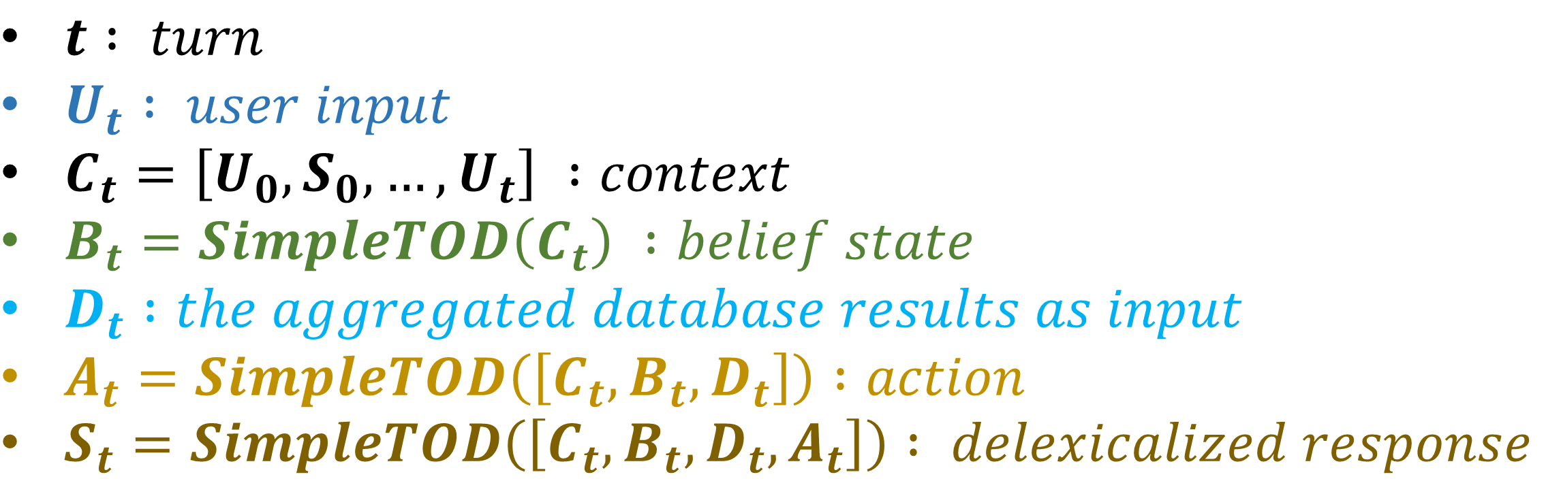
2. <SimpleTOD> Review
11
Training
$t : turn$
$U_{t} : user input$
$C_{t}=\left[U_{0},S_{0},…, U_{t}\right] :context$
$B_{t}=SimpleTOD\left(C_{t}\right) :belief state$
$D_{t} :the aggregated database results as input$
$A_{t}=SimpleTOD\left(\left[C_{t}, B_{t}, D_{t}\right]\right) :action$
$S_{t}=SimpleTOD\left(\left[C_{t}, B_{t}, D_{t}, A_{t}\right]\right) : delexicalized response$

Slide 12
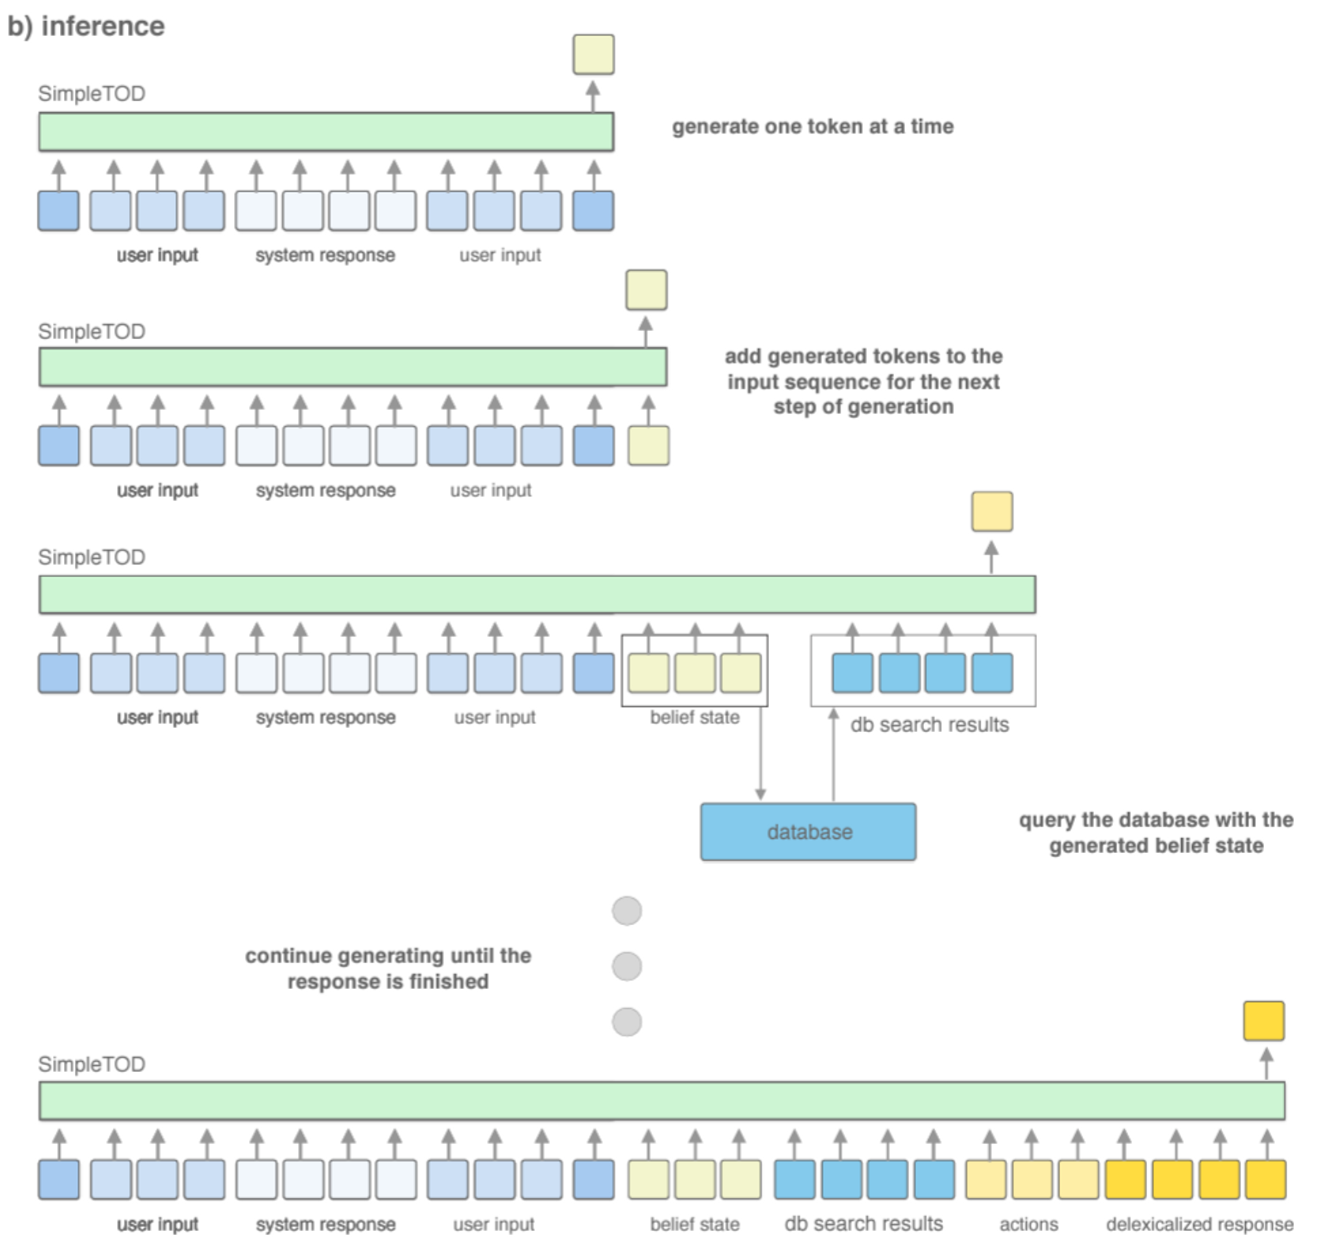

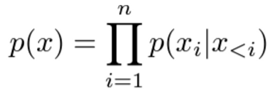
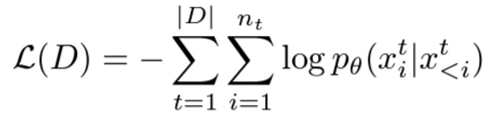
2. <SimpleTOD> Review
Causal Language Modeling
(Min)

Slide 13
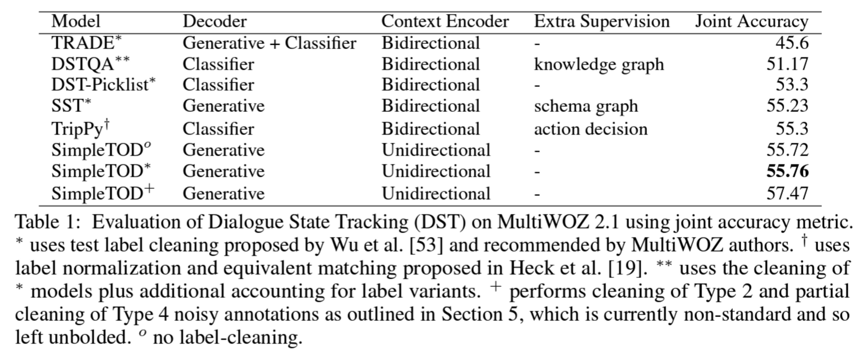
2. <SimpleTOD> Review
13
Evaluation

Slide 14
2. <SimpleTOD> Review
14
Wrap-up
SimpleTOD Previous Models
Causal Language Modeling (unidirectional)
= NOT bidirectional
Simple Greedy Decoding
= NOT costly
w/o any cleaning or normalization
= simply on the raw, original annotations
All previous models propose a bidirectional encoder
→ to learn better representation of context
beam search, diverse beam search, top-k sampling
= costly decoding strategy
test label cleaning

Slide 15
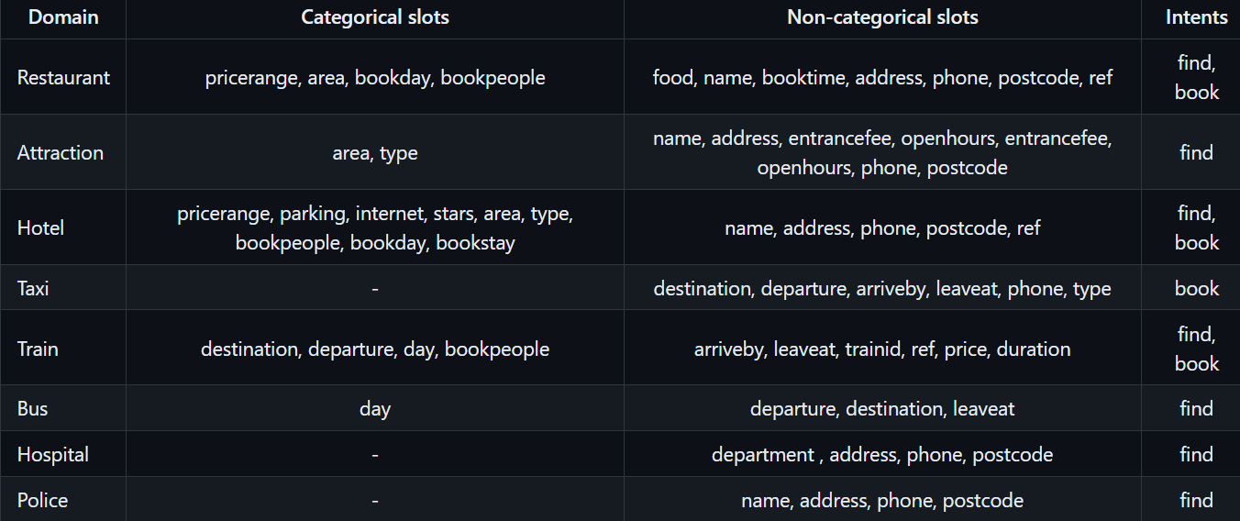
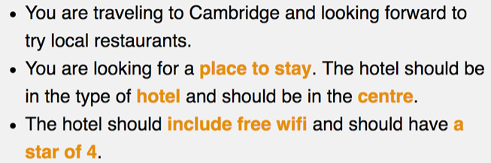
2. <SimpleTOD> Review
15
MultiWOZ Dialogue Dataset (Multi-Domain Wizard-of-Oz)
8 domains
14,000 multi-turn dialogues
sample task template (domain: hotel)

Slide 16
3. Recent Developments
16
Evaluation

Slide 17
3. Recent Developments
16
Evaluation

Slide 18
3. Recent Developments
16
Evaluation

Slide 19
References
5
1. TOD
Zhang, Zheng, et al. "Recent advances and challenges in task-oriented dialog systems." Science China Technological Sciences 63.10 (2020): 2011-2027.
Zhang, Yichi, Zhijian Ou, and Zhou Yu. "Task-oriented dialog systems that consider multiple appropriate responses under the same context." Proceedings of the AAAI Conference on Artificial Intelligence. Vol. 34. No. 05. 2020.
Peng, Baolin, et al. "Soloist: Few-shot task-oriented dialog with a single pretrained auto-regressive model." arXiv preprint arXiv:2005.05298 3 (2020).
2. SimpleTOD Review
Hosseini-Asl, Ehsan, et al. "A simple language model for task-oriented dialogue." Advances in Neural Information Processing Systems 33 (2020): 20179-20191.
Budzianowski, Paweł, et al. "Multiwoz--a large-scale multi-domain wizard-of-oz dataset for task-oriented dialogue modelling." arXiv preprint arXiv:1810.00278 (2018).
3. Recent Developments
Dfd

Slide 20
THANK YOU

Slide 21
1. TOD
5
Slot, DST
01
02
03
04
UNIST will promote excellence in science and technology by improving our quality of research.
UNIST will promote excellence in science and technology by improving our quality of research.
UNIST will promote excellence in science and technology by improving our quality of research.
UNIST will promote excellence in science and technology by improving our quality of research.
“ UNIST is reborn as a national research institute for science and
technology under a special law with government funding. ”

