Slide 1
Neural Network
Lab 10
953411 Semester 01/2567

Slide 2
Objective
**Objective:** Students will practice
* to model simple Neural Network

Slide 3
Lab instruction
The **LAB10** instruction and lab resources are shared in the MSTeam platform (**Labsheet10_neural_network**.pptx)
* Student has to ‘**read and follow instruction through the labsheet**'. After that you can edit the code in your own drive.
* There are **1 tasks** according to the **LAB10** sheet posted on the channel.
* The **LAB10** is worth ** 20 points** in total.
---
**Assignment Submission:**
Once you have done all assignment, on VSC,
* Create folder: File LAB10
* Save the filenames as **LAB10_neural_network_[your_student_ID]_inclass.ipynb** for the work that you finished in the class
* Save the filename as ** LAB10_neural_network_[your_student_ID]_outclass.ipynb** for the work that you finished after the class
* Zip the folder and upload your code files to MS Team assignments. The submission later than the ‘due date’ will get 50% off your score. You cannot submit your work to the system at the close date.
>* **Be careful**: The uploaded time will be checked. If you replace the inclass file on the later upload, you score will be graded by the uploaded time.

Slide 4
This lab practice refers to tutorial contributed on the following sites:
https://towardsdatascience.com/a-brief-introduction-to-neural-networks-a-regression-problem-c58c26e18008
https://github.com/Chim-SO/introductiontomachinelearning.git

Slide 5
Modelling steps
Clean data
Separate blind data (samples)
Split Train/Test data (for model validation)
Normalize data
Model (algorithm fitting)
Performance Evaluation
Prediction

Slide 6
Library
Keras
a deep learning API written in Python
running on top of the machine learning platform TensorFlow.
This lab, we use Keras
to structure the neural network model ,
to fit data to the model using algorithm
from tensorflow.python.keras import Input
from tensorflow.python.keras.models import Sequential
from tensorflow.python.keras.layers import Dense
import pandas as pd
import matplotlib.pyplot as plt
from sklearn.metrics import median_absolute_error, mean_absolute_percentage_error
from numpy import arange
Keras imports ‘Input’, ‘Sequential’, ‘Dense’
We will discuss about this later…

Slide 7
Preprocessing – data spliting

Slide 8
Train/Test data
Dataset
Training set
Test set
split
Data is used for model training to fit the model e.g. regression line
ML Model will use this data set to evaluate error (MSE,RMSE,MAE)
- Y will be hidden
- predicted Y will be compared with the hidden Y

Slide 9
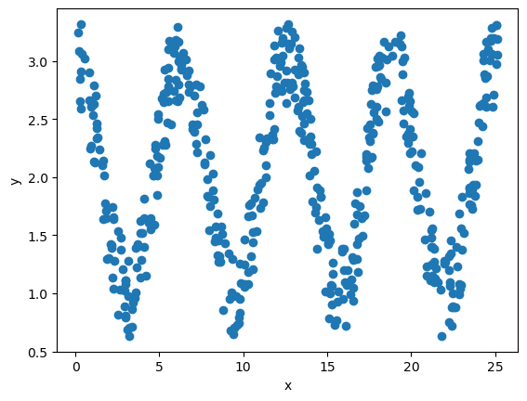
Load dataset from CSV file
Load dataset into pandas array
Data plot shows distribution of dataset
# Read dataset:
dataset = pd.read_csv('dataset/regression/cosine/train.csv')
print(f"There are {len(dataset.index)} instances.")
print(dataset.head())
plt.scatter(dataset['x'], dataset['y'])
plt.xlabel('x')
plt.ylabel('y')
plt.show()

Slide 10
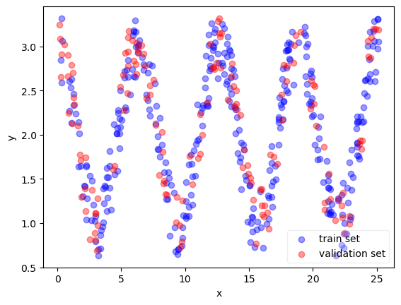
Data split
def split_dataset(dataset, train_frac=0.7):
train = dataset.sample(frac=train_frac)
val = dataset.drop(train.index)
return train, val
# Split dataset into train and validation:
train, validation = split_dataset(dataset, train_frac=0.7)
plt.scatter(train['x'], train['y'], c='blue', alpha=0.4)
plt.scatter(validation['x'], validation['y'], c='red', alpha=0.4)
plt.xlabel('x')
plt.ylabel('y')
plt.legend(['train set', 'validation set'], framealpha=0.3)
plt.show()
Dataset is split
‘train’ variable
70% of dataset → train set
‘val’ variable
30% of dataset → test set for model validation
Data plot shows distribution of ‘train’ and ‘val’ datasets

Slide 11
Modelling

Slide 12
Create model structure
from tensorflow.python.keras.models import Sequential
from tensorflow.python.keras import Input
from tensorflow.python.keras.layers import Dense
Sequential()
It groups a linear stack of network layers into a tf.keras.Model
add()
Add a network layer into the ‘model’ sequential stack
Layers:
1. Input layer
The first layer that receives input features from the dataset
‘shape=(1,)’ specifies array dimension shape
Specify → (number of features, number of samples)
This example specified input as ‘1’ feature and ‘all’ rows
# Create model:
model = Sequential()
model.add(Input(shape=(1,)))
model.add(Dense(200, activation='sigmoid'))
model.add(Dense(200, activation='sigmoid'))
model.add(Dense(200, activation='sigmoid'))
model.add(Dense(1, activation='linear'))
print(model.summary())

Slide 13
Create model structure
Layers:
2. Dense layers
The hidden layers
This example has 3 hidden layers
Each layer has 200 nodes
The activation function is ‘sigmoid’
3. Output layers
The last layer of ‘Dense’ is used to store output value of the model
This example has 1 output
model.summary() displays the model architecture.
# Create model:
model = Sequential()
model.add(Input(shape=(1,)))
model.add(Dense(200, activation='sigmoid'))
model.add(Dense(200, activation='sigmoid'))
model.add(Dense(200, activation='sigmoid'))
model.add(Dense(1, activation='linear'))
print(model.summary())

Slide 14
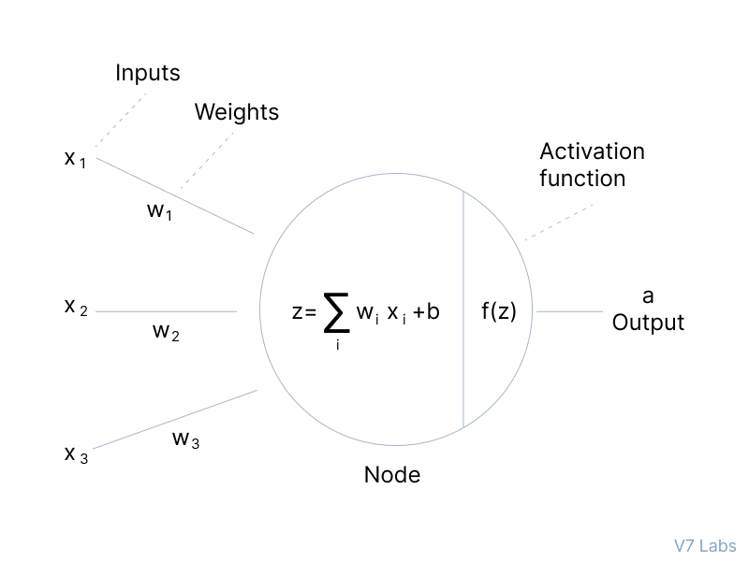
Artificial Neuron
Output
1
0
Input

Slide 15
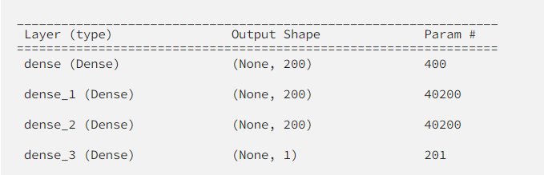
model.summary()
model.summary() displays the model architecture.
number of weights (number of parameters) of dense_1 is computed as follows:
the number of input which are the units of the previous layer is 200
Base on y = ax + b;
a and b are parameters for the relation of x and y
a is weight or coefficient
b is bias or intercept
each unit is connected to all the previous units so we have 200 * 200 = 40000 weights (relation linkage between the previous layer and the considering layer)
In addition, each unit (of the considering layer) has its bias then in total we have 200 biases.
Therefore, the total number of parameters is 40000 + 200 = 40200 .
Can you tell how the number of parameters of dense and dense_3 are computed?

Slide 16
Model Training

Slide 17
Model training steps
1. Initialize the weights and bias.
2. Forward pass: compute the model output.
3. Measure the error between the target and the output using the loss function.
4. Backward pass: propagate the error and update the weights and bias using an optimizer.
5. Repeat the steps 2 to 4 for every batch.
6. Repeat the steps from 2 to 5 epochs times.

Slide 18
Training
Epochs.
One round of all data rows in the train dataset is used for the model fitting is called ‘epoch’
The number of epochs defines how many times the weights are updated along all the training data.
In the code, you have to define ‘a condition’ to stop training
This example,
The stop condition defined as Epochs are 1750 rounds
# Train:
loss = 'mse'
metric = 'mae’
epochs = 1750
x_train, y_train = train['x'], train['y']
x_val, y_val = validation['x'], validation['y']
model.compile(loss=loss, optimizer='adam', metrics=[metric])
history = model.fit(x_train, y_train, epochs=epochs, batch_size=64, verbose=1, validation_data=(x_val, y_val))

Slide 19
Training
Batch.
the number of samples that are used in order to update weights.
During one epoch of training, the data is divided into batches and the weights are updated according to each batch
On one batch,
the forward pass is executed to update weights and bias
then, the backward pass (backpropagation) is executed to update weights and bias according to the error between the Y of the model output and the Y of the expected from dataset
# Train:
loss = 'mse'
metric = 'mae’
epochs = 1750
# dataset is split ‘X’ as input to model
# ‘Y’ as the expected output of model
x_train, y_train = train['x'], train['y']
x_val, y_val = validation['x'], validation['y’]
model.compile(loss=loss, optimizer='adam', metrics=[metric])
history = model.fit(x_train, y_train, epochs=epochs, batch_size=64, verbose=1, validation_data=(x_val, y_val))

Slide 20
Training
Model.compile().
To configure the approach for model training.
For the compiler, model can be configured as follows:
Optimizer.
Specify the algorithm to updates the trainable weights.
Keras provides a set of optimizers: SGD (Stochastic Gradient Descent)and Adam.
Loss function.
Specify the metric to measure error
how well the model is fitted with the training dataset;
Keras provides MSE (Mean Squared Error) and MAE (Mean Absolute Error).
# Train:
loss = 'mse'
metric = 'mae’
epochs = 1750
# dataset is split ‘X’ as input to model
# ‘Y’ as the expected output of model
x_train, y_train = train['x'], train['y']
x_val, y_val = validation['x'], validation['y’]
model.compile(loss=loss, optimizer='adam', metrics=[metric])
history = model.fit(x_train, y_train, epochs=epochs, batch_size=64, verbose=1, validation_data=(x_val, y_val))

Slide 21
Training
Model.fit().
To execute the model training.
the train data (x_train, y_train) are passed in
X_train is for input
Y_train is as expected output for comparing with model output to find error , then the backpropagation is executed
validation_data.
Specify dataset for validation
This example, we prepared test dataset in (x_val, y_val).
# Train:
loss = 'mse'
metric = 'mae’
epochs = 1750
# dataset is split ‘X’ as input to model
# ‘Y’ as the expected output of model
x_train, y_train = train['x'], train['y']
x_val, y_val = validation['x'], validation['y’]
model.compile(loss=loss, optimizer='adam', metrics=[metric])
history = model.fit(x_train, y_train, epochs=epochs, batch_size=64, verbose=1, validation_data=(x_val, y_val))

Slide 22
Model Evaluation

Slide 23
Training result
Result
Result of each epoch will be reported
loss: error of training
mae: error of training using mae metric
val_loss: error of test dataset
val_mae: error of test dataset using mae metric
Plots displays the loss and metric error when model training and testing
Check if it’s underfitting or overfitting
Epoch 1749/1750 6/6 [==============================] - 0s 8ms/step - loss: 0.0554 - mae: 0.1955 - val_loss: 0.0596 - val_mae: 0.2085
Epoch 1750/1750 6/6 [==============================] - 0s 12ms/step - loss: 0.0539 - mae: 0.1966 - val_loss: 0.0586 - val_mae: 0.2062
# Display loss:
plt.plot(history.history['loss'])
plt.plot(history.history['val_loss'])
plt.title('model loss')
plt.ylabel('loss')
plt.xlabel('epoch')
plt.legend(['train', 'test'])
plt.show()
# Display metric:
plt.plot(history.history['mae'])
plt.plot(history.history['val_mae'])
plt.title('model mean absolute error (mae)')
plt.ylabel('mae')
plt.xlabel('epoch')
plt.legend(['train', 'test'])
plt.show()

Slide 24
Task (20 points)
1. Use dataset of the computer price from the lab 09
2. Choose 3 features to create a neural network model to predict computer price
save it as ‘model_neural_2.ipynb’
save the plot of model metric as ‘model_neural_2.png’
The model should not be overfitting or underfitting

Slide 25
Model Configuration – using optimizer
A different model configuration results different model performance.
Variation of model performance can be from:
Feature – the relevance relation among selected features and output Y;
‘width’,’height’ ←→ ‘price’ is different to ‘width’,’height’,’ram’ ←→ ‘price’
Optimizer – algorithm to updates the trainable weights and bias;
Epochs – number of iterations for training dataset
Batch_size – In each epoch data samples are split for several batches training. batch_size specifies number of samples to work on a batch.
Loss function - metric to measure error
Referred to labsheet10_neuralNetwork
# Train:
loss = 'mse'
metric = 'mae’
epochs = 1750
# dataset is split ‘X’ as input to model
# ‘Y’ as the expected output of model
x_train, y_train = train['x'], train['y']
x_val, y_val = validation['x'], validation['y’]
model.compile(loss=loss, optimizer='adam', metrics=[metric])
history = model.fit(x_train, y_train, epochs=epochs, batch_size=64, verbose=1, validation_data=(x_val, y_val))

