Slide 1
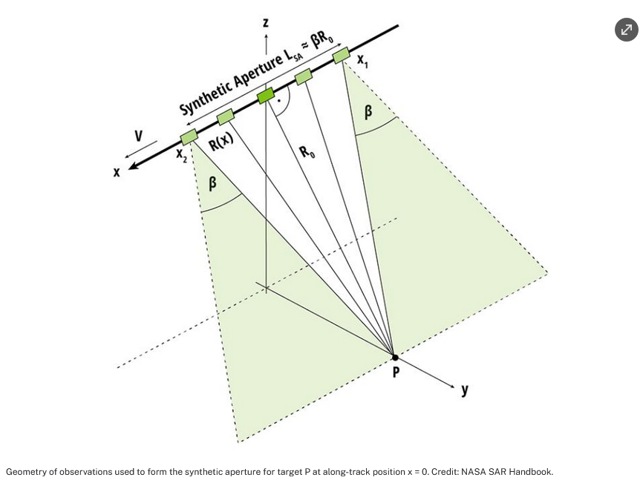
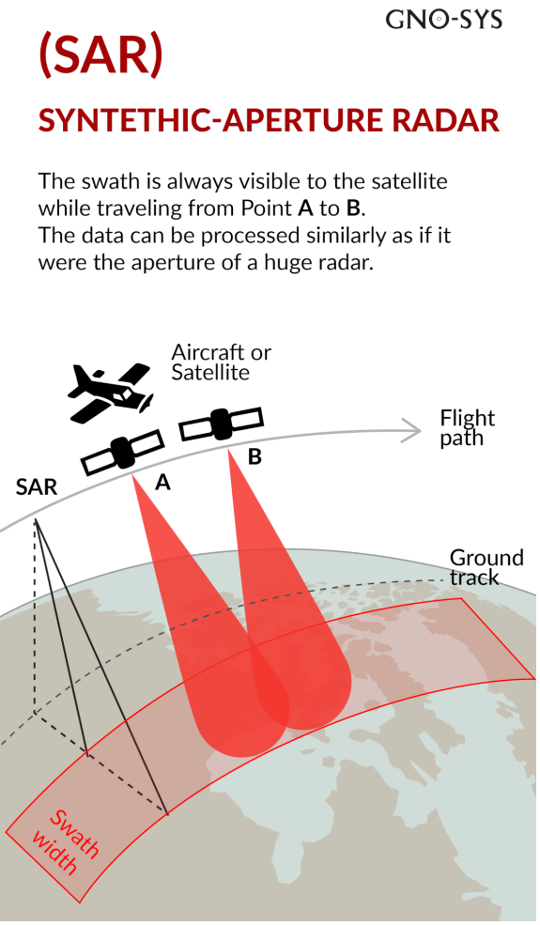
Analysis: Rainfall Regression from C-Band Synthetic Aperture Radar Using Multitask Generative Adversarial Networks
(Synthetic Aperture, n.d.).
By Gary Yu
(Synthetic-Aperture Radar, n.d.).

Slide 2




Introduction
(College of Arts, 2026)
(The Ohio State University, 2026)
Gary Yu – OSU Econ and Poli-Sci BA in the MGIST Program
Paper Title: Rainfall Regression from C-Band Synthetic Aperture Radar Using Multitask Generative Adversarial Networks (Colin & Husson, 2025, p. 1).
Authors: Aurelien Colin, and Romain Husson | Published in Jan 17, 2025 (Colin & Husson, 2025, p. 1).
Affiliation 1: Both: Collecte Localisation Satellite (CLS) , Brest, France – French Satellite company (CLS Collecte Satellite, 2026)
Affiliation 2: Aurelien Colin: CELAD: French engineering & IT services company (CELAD, 2026).
(CLS Collecte Satellite , 2026)
(CELAD, 2026).

Slide 3
Purpose of the Research
The journal article discloses a data-based method to estimate precipitation from SAR or synthetic aperture radar at 200M per pixel for the spatial resolution. (Colin & Husson, 2025, p. 1).
It communicates previous problems close to synthetic aperture radar (SAR) usage, and weather radar data. (Colin & Husson, 2025, p. 1).
The misalignment in usage and lack of rainfall examples under fast/strong wind speeds. (Colin & Husson, 2025, p. 1).
This is important for weather reports, an to reduce harm from weather events. (Colin & Husson, 2025, p. 1).
SAR is used in airplanes, and spacecraft as it requires moving vehicles. (Synthetic Aperture, 2026)
NEXRAD ground radar archive is utilized to compare with Sentinel-1 data. (Colin & Husson, 2025, p. 1).
This training procedure is created to biased towards scarce meteorological events and increase the wind speed range that is ready for precipitation detection. (Colin & Husson, 2025, p. 15).

Slide 4
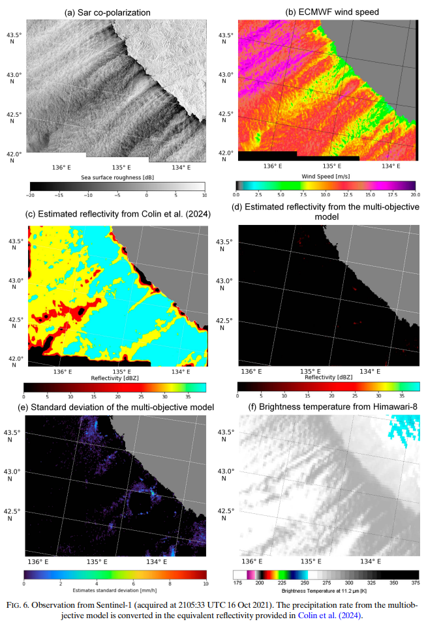
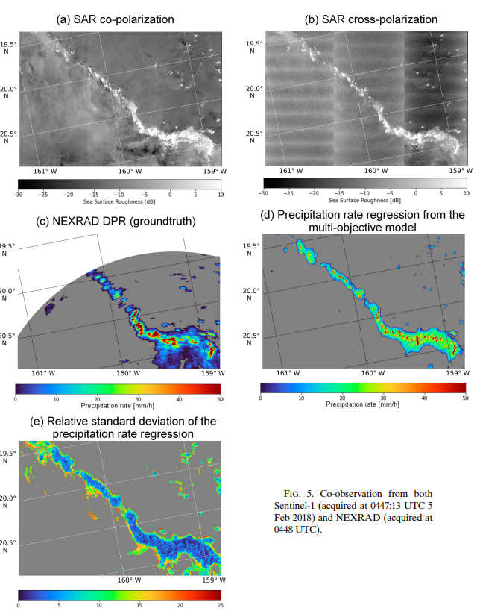
(Colin & Husson, 2025, p. 8).
(Colin & Husson, 2025, p. 9)

Slide 5
Methods Used in Research
Data: 29,369 observations from Sentinel-1 and NEXRAD made on July 27, 2015, all the way to the date of April 29, 2023 (Colin & Husson, 2025, p. 2).
This is adjusted in a Multiobjective framework to decrease the discrepancies between both sensors. (Colin & Husson, 2025, p. 1).
It over represents high wind speeds to train on them to stress test and improve the model for high wind speeds. (Colin & Husson, 2025, p. 2).
Uses convolutional model deep learning model(Neural Network that uses 3-D data for image classifying, and to recognize objects) based around precipitation rate predictions. (Colin & Husson, 2025, p. 2).
Rainfall Regression in 25 km by 25 km Patches. (Colin & Husson, 2025, p. 3)

Slide 6
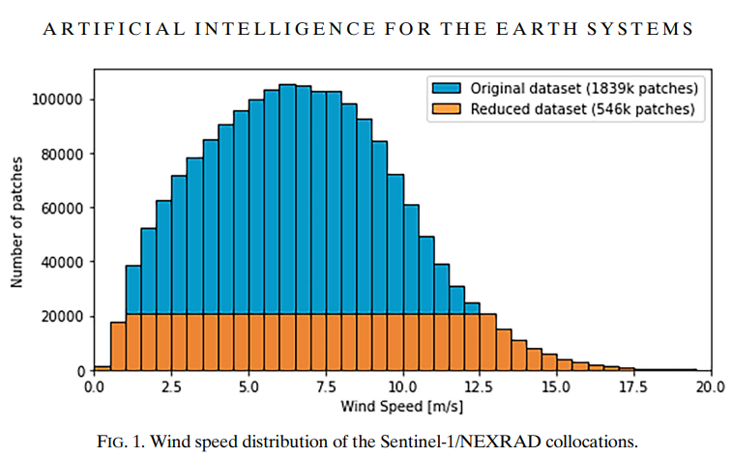
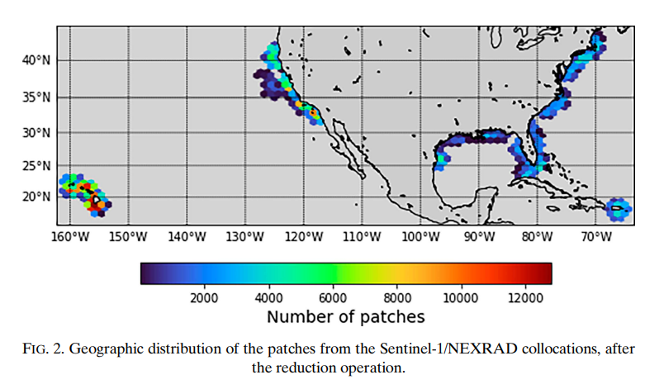
The Dataset
(Colin & Husson, 2025, p. 4).
(Colin & Husson, 2025, p. 4).

Slide 7
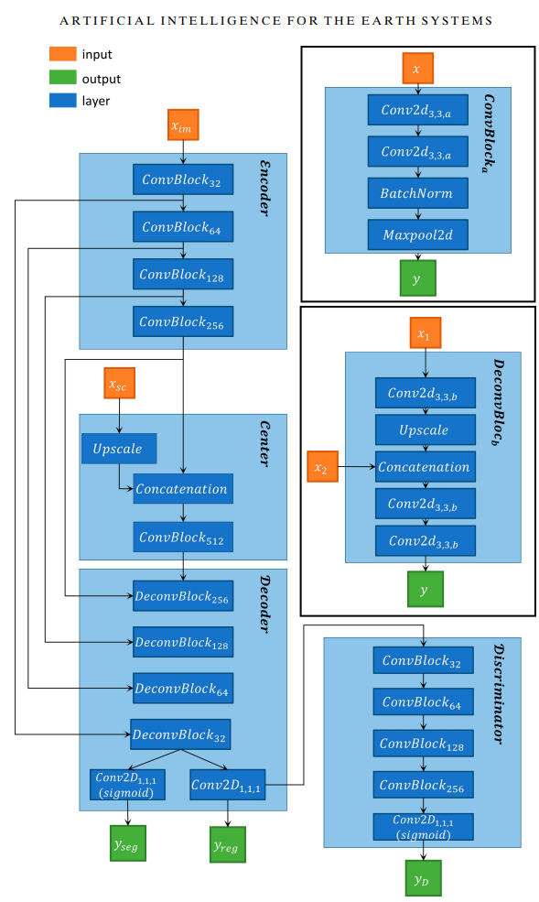
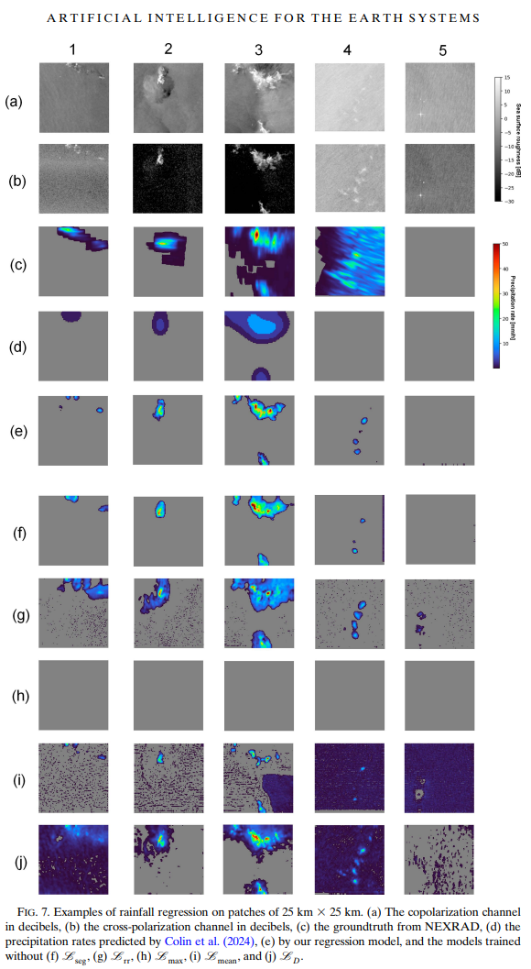
(Colin & Husson, 2025, p. 12).
(Colin & Husson, 2025, p. 6).

Slide 8
Results
By adding on improvements and more inputs to training the rainfall model and imaging, the resulting model shows enhanced accuracy in precipitation estimates and the ability to extend its performance to scenarios to a maximum efficiency of 15 m s ^-1. (Colin & Husson, 2025, p. 16)
The performance remains good before wind speeds gets to 15 m s ^-1. (Colin & Husson, 2025, p. 16)

Slide 9
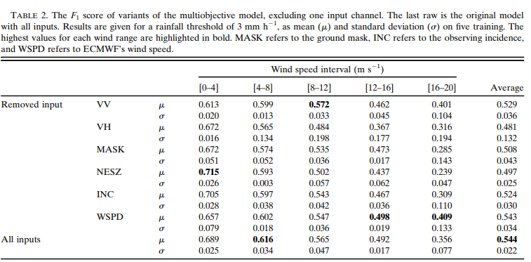
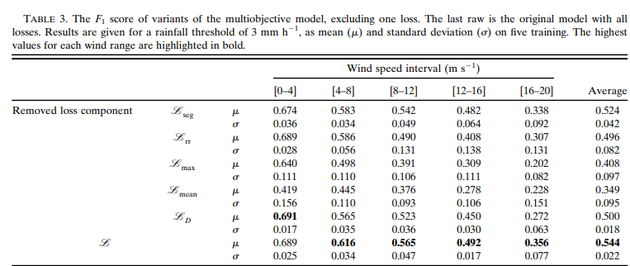
(Colin & Husson, 2025, p. 10).
(Colin & Husson, 2025, p. 11).

Slide 10
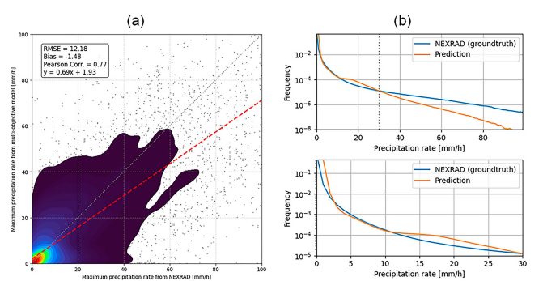
Precipitation Predictions
(Colin & Husson, 2025, p. 7).

Slide 11
Other Possible Applications
Military weather condition prediction system for military operations.
Airport early warning system for rain, and the need for extra maintenance, ground crew preparation, etc.
Flood Detection for coastal cities.
Climate change related analysis with regards to its impact on rainfall in different places around the globe.

Slide 12
APA Citations
Synthetic-Aperture Radar (SAR) [Photograph]. (n.d.). GNO-SYS. https://gno-sys.com/selecting-your-system-synthetic-aperture-radar-sar-technology/
Colin, A., & Husson, R. (2025). Rainfall Regression from C-Band Synthetic Aperture Radar Using Multitask Generative Adversarial Networks. Artificial Intelligence for the Earth Systems, 4(1), 1-18. https://doi.org/10.1175/AIES-D-24-0007.1
College of Arts and Sciences [Image]. (2026, February 2). College of Arts and Sciences. https://artsandsciences.osu.edu/
The Ohio State University [Image]. (2026, February 2). College of Arts and Sciences. https://artsandsciences.osu.edu/
CLS Collecte Localisation Satellite [Image]. (2026, February 2). CLS. https://www.cls.fr/
CELAD [Photograph]. (2026, February 2). CELAD. https://www.celad.com/company/company/?lang=en
Synthetic Aperture Radar (SAR). (2026, February 2). Earth Data. Retrieved February 2, 2026, from https://www.earthdata.nasa.gov/learn/earth-observation-data-basics/sar
Synthetic Aperture [Photograph]. (n.d.). Earth Data. https://www.earthdata.nasa.gov/learn/earth-observation-data-basics/sar

