Slide 1
RESTful Corpus Platform
Jiajun Yu 11711102

Slide 2
Catalog
RESTful Architecture
MVC Architecture
Process of Server & Client
Class Diagram
Levenshtein Distance

Slide 3
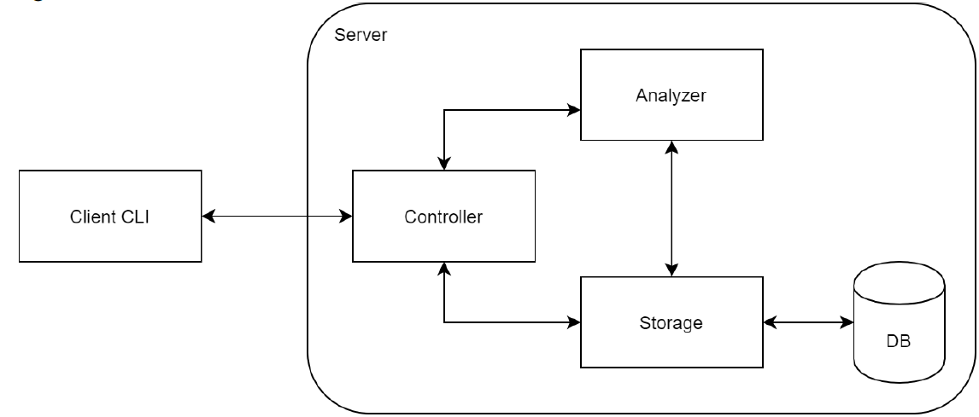
RESTful architecture
TextService.java
Client.java
Server.java
TextDao.java
Doc.db

Slide 4
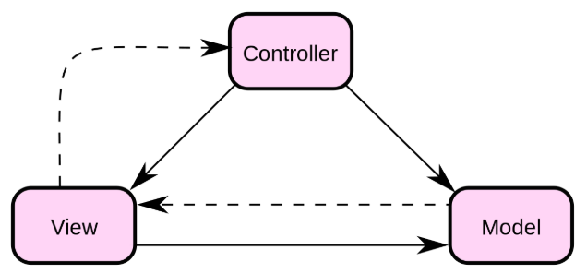
MVC Architecture
Controller.java
ClientUI.java
Client.java
Source: https://www.runoob.com/design-pattern/mvc-pattern.html

Slide 5
Process of Client
Controller.java
params
button click
ClientUI.java
Client.java
command
Source: https://www.runoob.com/design-pattern/mvc-pattern.html

Slide 6
Process of Server
TextService.java
Command
Method call
Client.java
Server.java
response
TextDao.java
Doc.db
query / update
result

Slide 7
Process of Client
Controller.java
Result show in label
(Resolve to Map)
ClientUI.java
Client.java
Label shown on stage
response

Slide 8
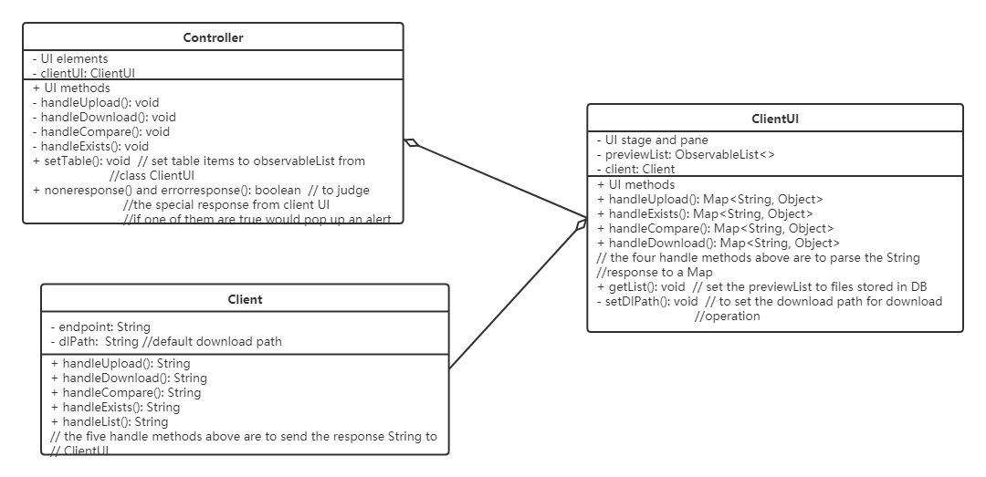
Class Diagram of GUI

Slide 9
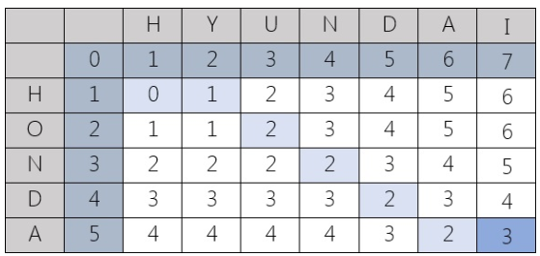
Levenshtein Distance
Calculate by dynamic programming
Source: https://dzone.com/articles/the-levenshtein-algorithm-1

Slide 10
Thanks for listening!

