Slide 1

Repairing DataBase with 500,000 + rows
Prepared by | Yury Kositsyn
2022

Slide 2
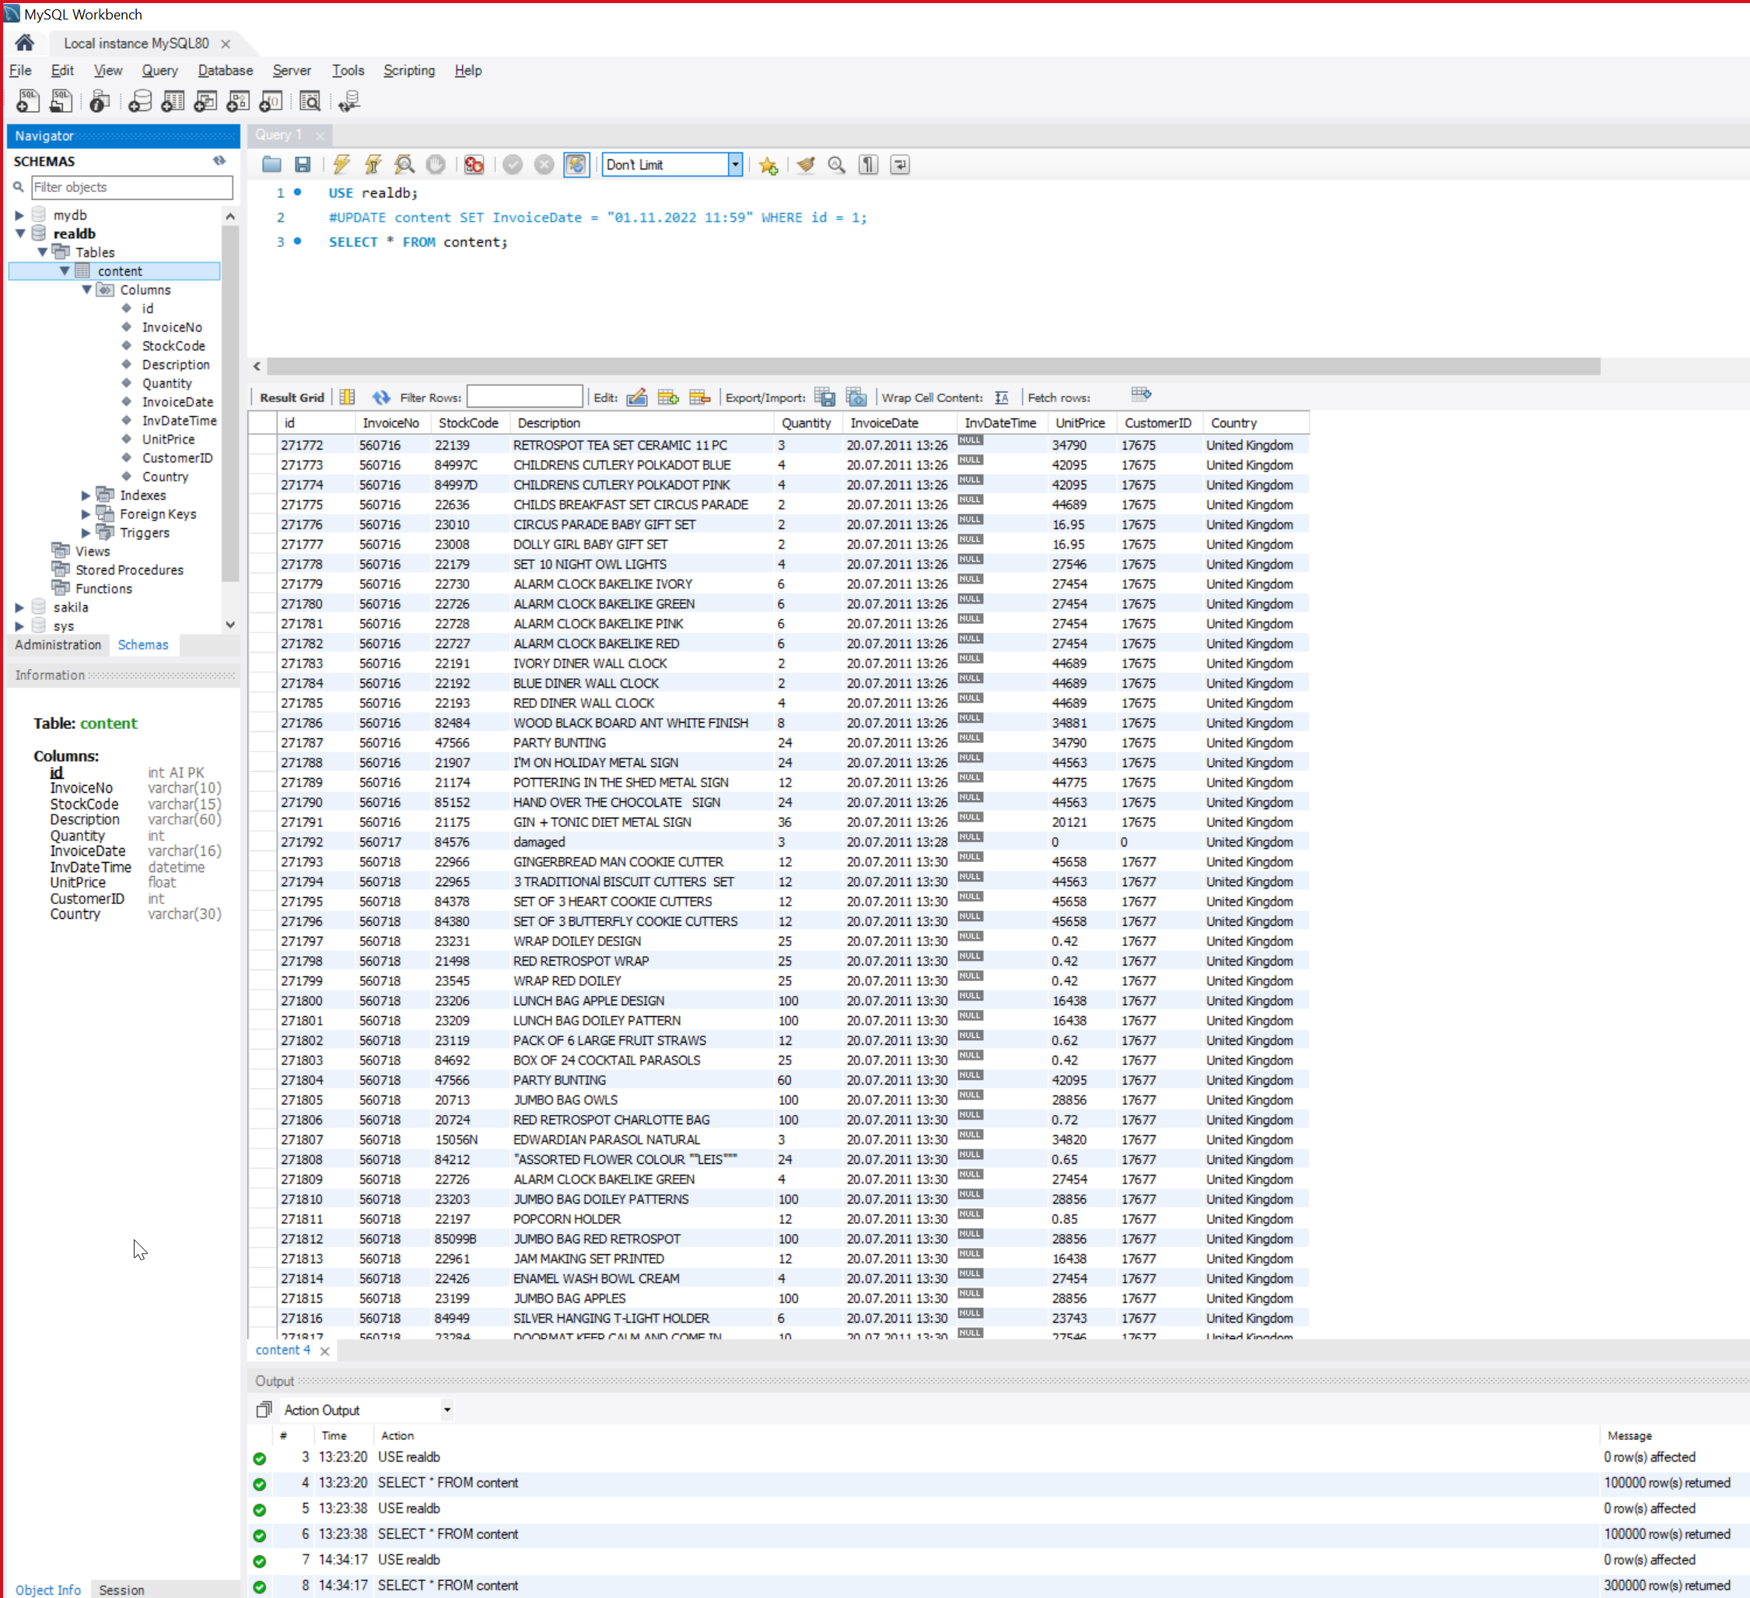
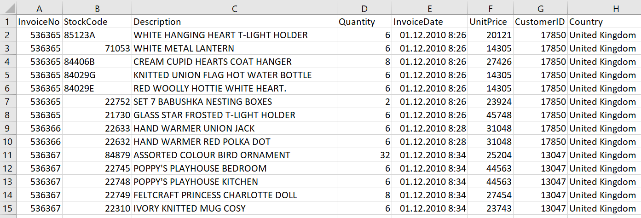
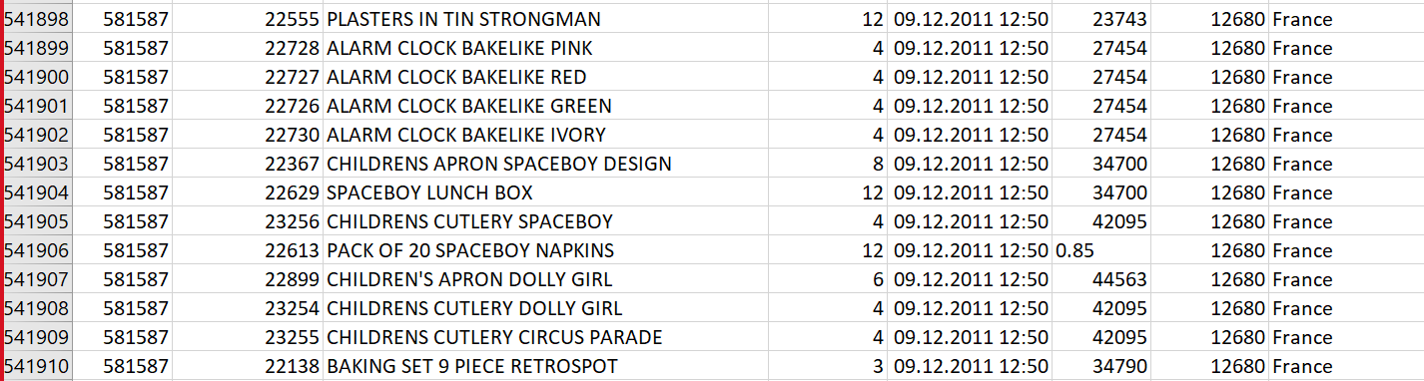
Original data contains a lot of unallowed symbols, empty fields and other moments preventing for regular work with database
Database file was reworked with Python Scripts in MySQL
During the repairment multiple errors were fixed
Fields were adjusted to correct, meaningful formats (INT, FLOAT, DATETIME)
Current condition of database will allow to run queries that will be efficient and not so time consuming as if it was done in Excel

Slide 3
import csv import pymysql realdb = pymysql.connect( host="127.0.0.1", user="root", database='realdb', password="QAZZAQQWE1234" ) cur = realdb.cursor() cur.execute("TRUNCATE content") with open('C:/Users/ykmc1/PycharmProjects/SQLProject/dataset_20201207.csv') as File: fhand = csv.DictReader(File) n = 0 for row in fhand: n += 1 #if n <= 300000: #continue if n > 300000: break for k,v in row.items(): #print(v) v1 = v.split(';') InvoiceNo = v1[0] StockCode = v1[1] Description = v1[2] Quantity = v1[3] InvoiceDate = v1[4] UnitPrice = v1[5] CustomerID = v1[6] Country = v1[7] #print(InvoiceNo, StockCode, Description, Quantity, InvoiceDate, UnitPrice, CustomerID, Country) loadData = 'INSERT content(InvoiceNo, StockCode, Description, Quantity, InvoiceDate, UnitPrice, CustomerID, Country) VALUES(%s,%s,%s,%s,%s,%s,%s,%s);' val = (InvoiceNo, StockCode, Description, Quantity, InvoiceDate, UnitPrice, CustomerID, Country) if n == 623: pass try: cur.execute(loadData, val) realdb.commit() except: try: if InvoiceNo == '': InvoiceNo = 'NA' if StockCode == '': StockCode = 'EMPTYSTOCK' if Description == '': Description = 'EMPTYDESCR' if Quantity == '': Quantity = '0' if int(Quantity) < 0: Quantity = str(int(Quantity) * (-1)) if UnitPrice == '': UnitPrice = 0.00 if CustomerID == '': CustomerID = 0 if Country == '': Country = 'EMPTYCOUNTRY' val = (InvoiceNo, StockCode, Description, Quantity, InvoiceDate, UnitPrice, CustomerID, Country) cur.execute(loadData, val) realdb.commit() except: print('Error writing data in row: ', n)
Repairing and writing DB

Slide 4
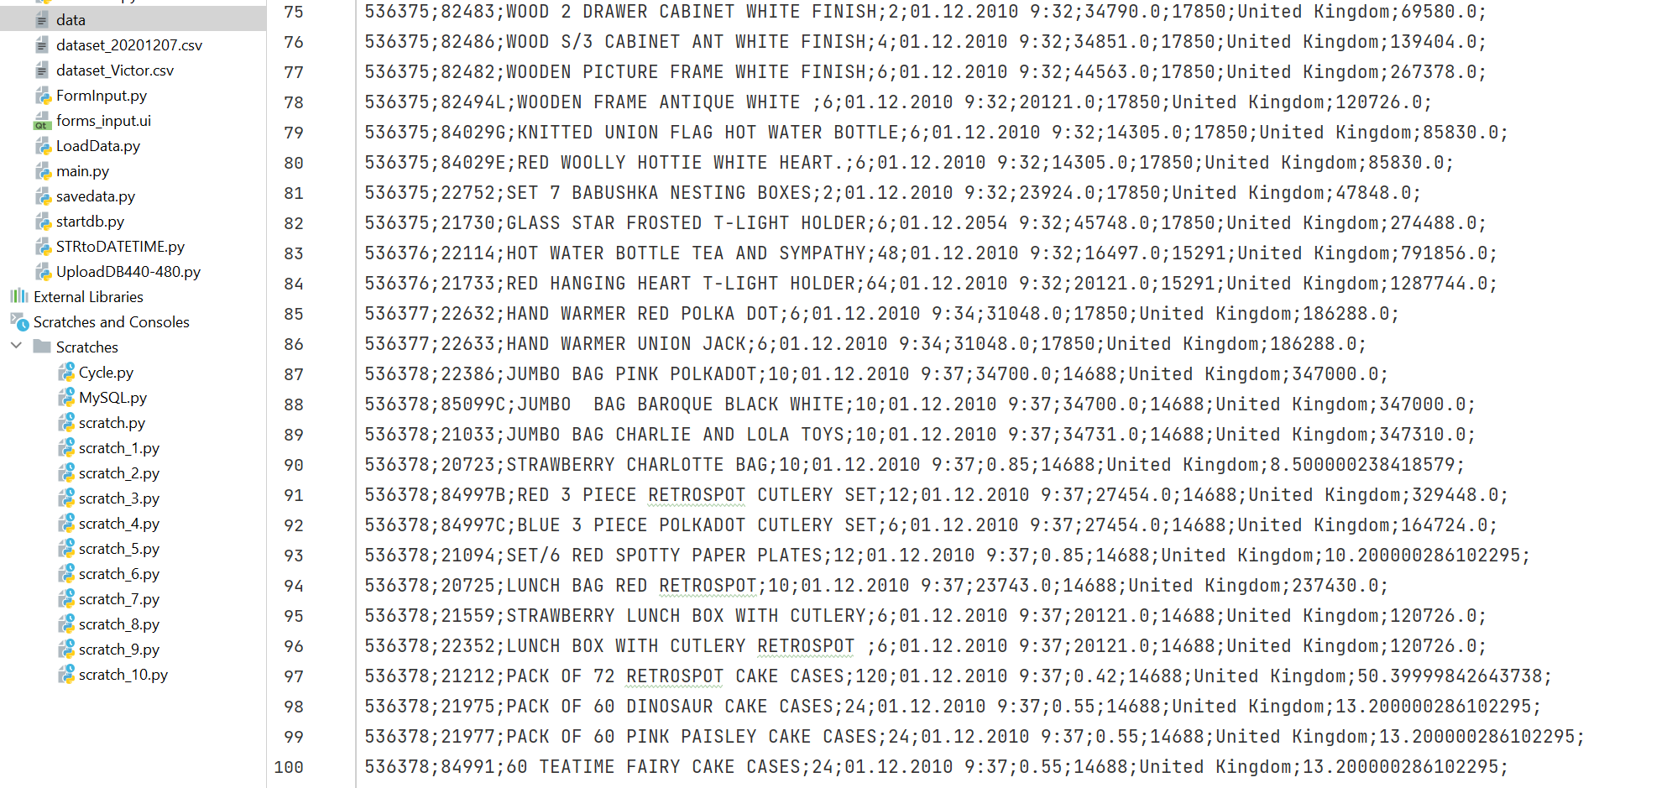
Saving results of queries as file (Profit)
import pymysql realdb = pymysql.connect( host="127.0.0.1", user="root", database='realdb', password="QAZZAQQWE1234" ) def convert_tuple(c_tuple): str1='' for i in c_tuple: i = str(i) str1=str1+i+';' return str1 cursor = realdb.cursor() sql = "SELECT InvoiceNo, StockCode, Description, Quantity, InvoiceDate, UnitPrice, CustomerID, Country, Quantity * UnitPrice AS Profit FROM content;" filename = 'data' f = open(filename, 'w') cursor.execute(sql) result = cursor.fetchall() print(result) for item in range(100): c_string = convert_tuple(result[item]) #print(c_string) f.write(c_string+'\n') cursor.close()

Slide 5
use realdb; select * from content where InvoiceDateTime > '01.12.2010'; use realdb; SELECT SUM(UnitPrice) FROM content WHERE InvoiceDateTime >= '2010-12-01'; use realdb; SELECT id, InvoiceNo, Description, InvoiceDateTime FROM content WHERE InvoiceDateTime>= "2010-12-01 0:00:00" ; use realdb; SELECT id, InvoiceNo, Description, InvoiceDateTime FROM content WHERE InvoiceDateTime>= "2010-12-01 0:00:00" and InvoiceDateTime<= "2011-12-01 0:00:00" ; use realdb; SELECT id, InvoiceNo, Description, InvoiceDateTime FROM content WHERE InvoiceDateTime>= "2010-12-01" and InvoiceDateTime<= "2011-12-01"; use realdb; SELECT id, InvoiceNo, Description, InvoiceDateTime FROM content WHERE InvoiceDateTime BETWEEN "2010-12-01" and "2011-12-01";
Prepared by | Yury Kositsyn
2022

Slide 6
Thank you for your ATTENTION
Prepared by | Yury Kositsyn
2022

