Slide 1
BMEG3105-TUT9: PyTorch & GATK
Qinze YU
Friday, November 4, 2022
qzyu22@cse.cuhk.edu.hk
Department of Computer Science and Engineering (CSE)
The Chinese University of Hong Kong (CUHK)

Slide 2
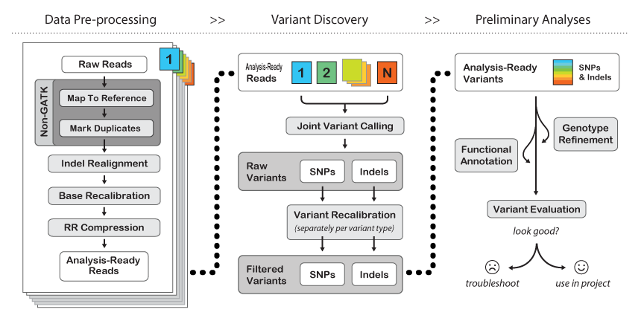
GATK Pipeline

Slide 3
Preprocessing tools
Mapping:
Using BWA or STAR
Output: BAM format file
Sort BAM file: Samtools
Mark duplicates: Picard (wget)

Slide 4
Installation
BWA
Download:
wget http://sourceforge.net/projects/bio-bwa/files/bwa-0.5.9rc1.tar.bz2/download
Decompress:
tar jxvf bwa-0.5.9rc1.tar.bz2
Compile:
cd bwa-0.5.9rc1 make

Slide 5
Installation
SAMTools
Download:
wget http://sourceforge.net/projects/samtools/files/samtools/0.1.13/samtools-0.1.13.tar.bz2/download
Decompress:
tar jxvf samtools-0.1.13.tar.bz2
Compile:
cd samtools-0.1.13 make

Slide 6
Installation
Picard
Download:
wget https://github.com/broadinstitute/picard/releases/download/2.25.5/picard.jar
Compile:
java -jar picard.jar

Slide 7
Installation
GATK
https://gatk.broadinstitute.org/hc/en-us/articles/360036194592-Getting-started-with-GATK4

