Slide 1
Scikit-learn & Matplotlib
Liang Hong
Sep30, 2022

Slide 2
Tasks: Clustering & Classification
Are they labelled?

Slide 3
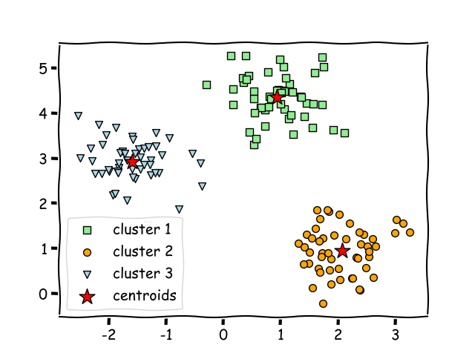
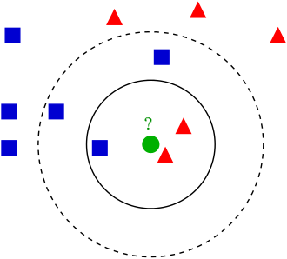
Algorithms: K-means & KNN

Slide 4
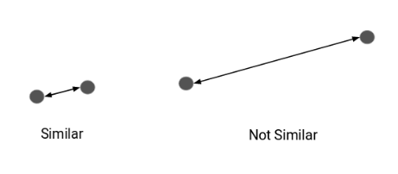
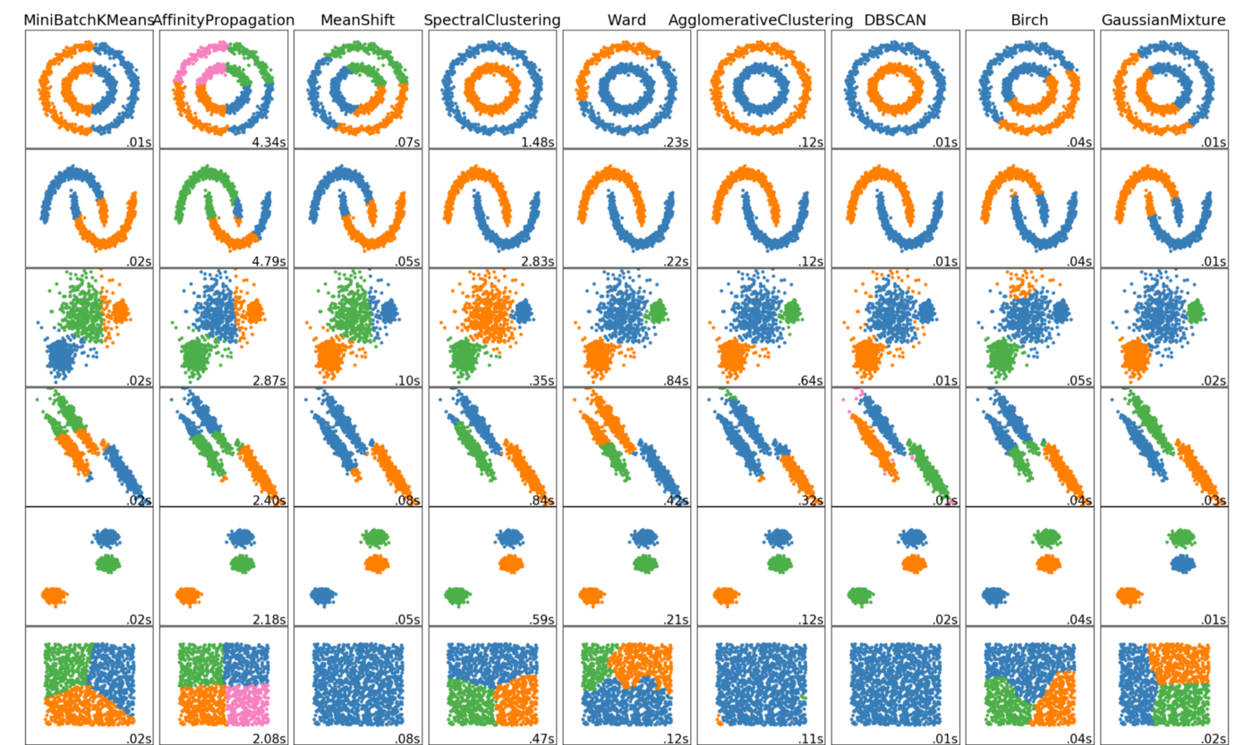
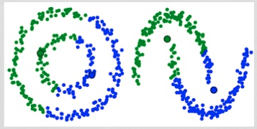
Distance & clustering/classification algorithm
Distance – Similarity
Distance – Clustering

Slide 5
Scikit-learn
Pipeline
Import package with desired algorithm
Pre-process data (define labels/train test splits/convert to multidimentioanl data)
Fit on the data
Do prediction

Slide 6
Matplotlib
Pipeline
Define global plot parameters(font/num of subfigure/color palette/legends)
Prepare data(for xy axis/grouping)
Select plot type(histogram, scatter, line…)
Adjust figure and show/save

Slide 7
Example
https://colab.research.google.com/drive/1eQd3-utlRjuxOK5II1BsnNs_nobogzv-?usp=sharing

