Slide 1
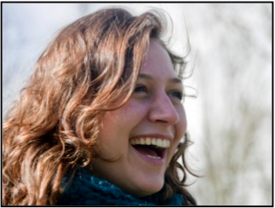
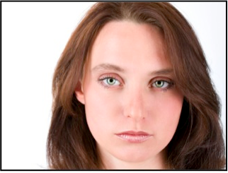
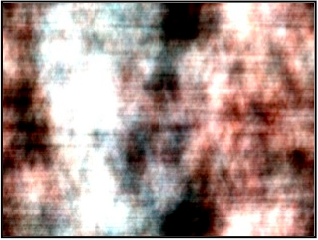
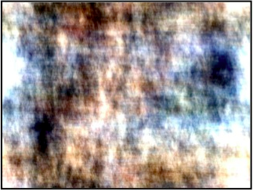
Image Observation Task
You will be presented with a variety of images.
Some will show faces
Some will show abstract patterns
We are interested in how your brain responds to these different types of images. Please pay close attention to all images. To make sure you are paying attention, we will occasionally repeat an image:
When you see an image repeated, press BUTTON 1 immediately.

Slide 2
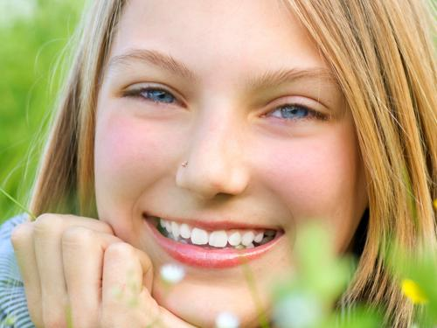
Photo Judgment Test
For this test, you will answer questions about different types of photos. A question will appear, followed by a photo. When the photo appears, answer the question as quickly as you can. The following diagram illustrates the sequence of a single trial:
A crosshair appears before each question.
The question is always presented before the photo.
Use BUTTON 1 to answer “Yes” and BUTTON 2 to answer “No”. Answer as quickly as can.
+
looking at the camera?
If you are not sure about any answer, just make your best guess. You will have a limited amount of time to respond to each photo.
Press BUTTON 1 to start the practice test

Slide 3
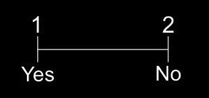
How and Why Test
For this test, you will answer questions about how and why people perform actions. Each question is presented in two parts:
Part 1 asks either a how or why question about an action.
Part 2 presents a potential answer. Use BUTTON 1 to accept the answer and BUTTON 2 to reject it.
How to
ride a bike?
grip handlebars
For how questions, judge whether the offered answer describes a commonly accepted part of performing the action. For why questions, judge whether the offered answer describes a commonly accepted reason for performing the action. If you are not sure about any answer, just make your best guess. You will have a limited amount of time to make each response.
Press BUTTON 1 to start the practice test

Slide 4
How and Why Test
For this test, you will answer questions about how and why people perform actions. Each question is presented in two parts:
Part 1 asks either a how or why question about an action.
Part 2 presents a potential answer. Use BUTTON 1 to accept the answer and BUTTON 2 to reject it.
How to
ride a bike?
grip handlebars
For how questions, judge whether the offered answer describes a commonly accepted part of performing the action. For why questions, judge whether the offered answer describes a commonly accepted reason for performing the action. If you are not sure about any answer, just make your best guess. You will have a limited amount of time to make each response.
Press BUTTON 1 to start the practice test

