Slide 1
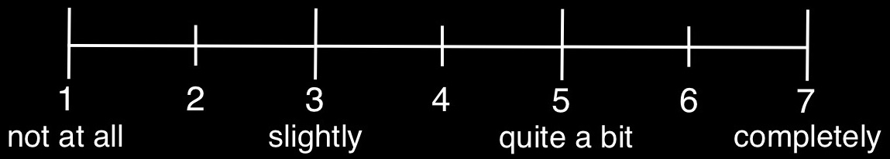
Do you understand what this animal/person is feeling?

Slide 2
Do you empathize with this person/animal?

Slide 3
How good vs. bad does this photograph make you feel?

Slide 4
1
2
3
4
5
6
7
8
9
not at all
slightly
somewhat
very
extremely

Slide 5
1
2
3
4
5
6
7
not at all
slightly
quite a bit
completely

