Slide 1
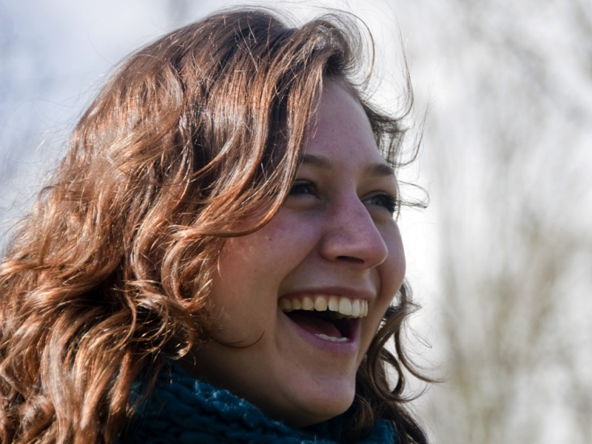
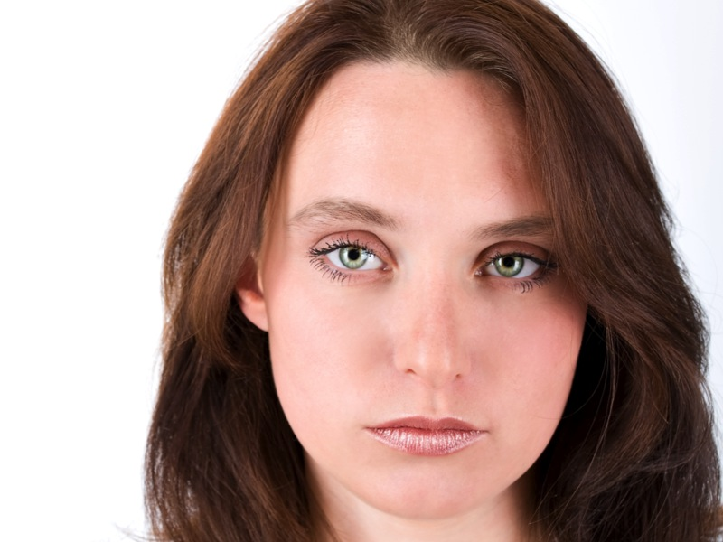
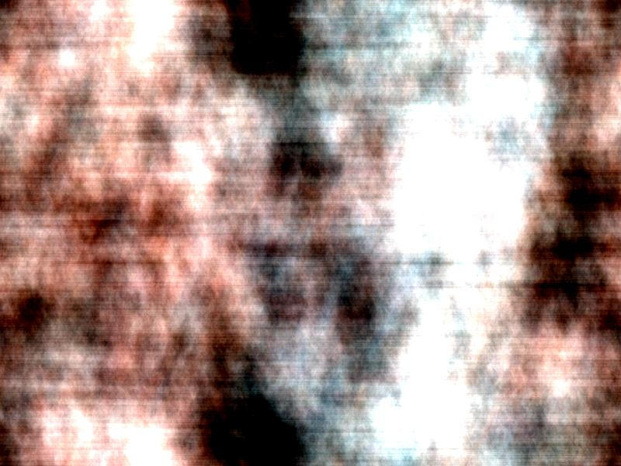
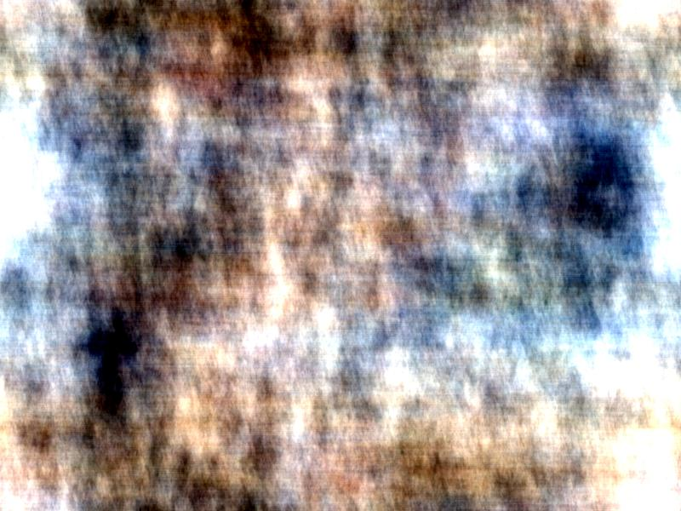
Image Observation Task
You will be presented with a variety of images.
Some will show faces
Some will show abstract patterns
We are interested in how your brain responds to these different types of images. Please pay close attention to all images. To make sure you are paying attention, we will occasionally repeat an image:
When you see an image repeated, press button 1 immediately.

