Slide 1
GLM Results
Russo 20210820

Slide 2
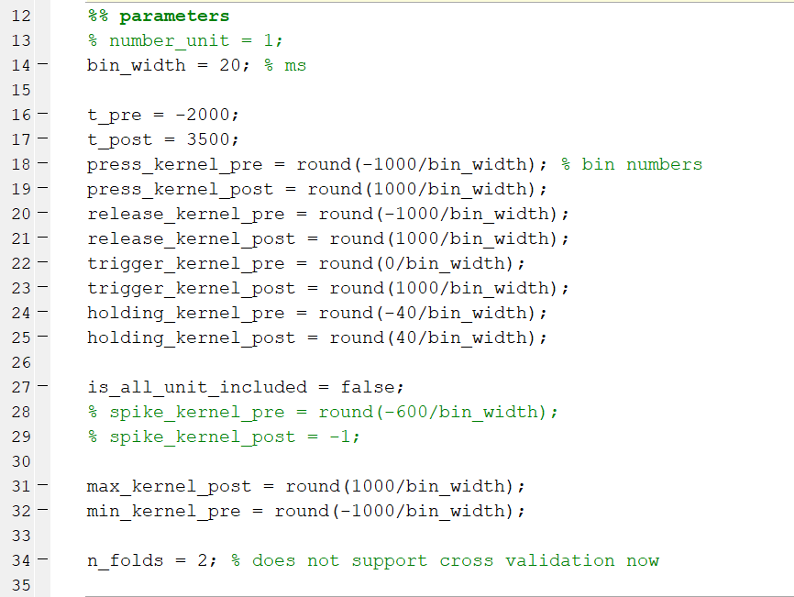

Slide 3
Press
Trigger
Release
Holding

Slide 4
Stimulus

Slide 5
Link function: exponential
Ridge Regression + L2 smoothing(tutorial4_regularization_PoissonGLM.m)

Slide 6
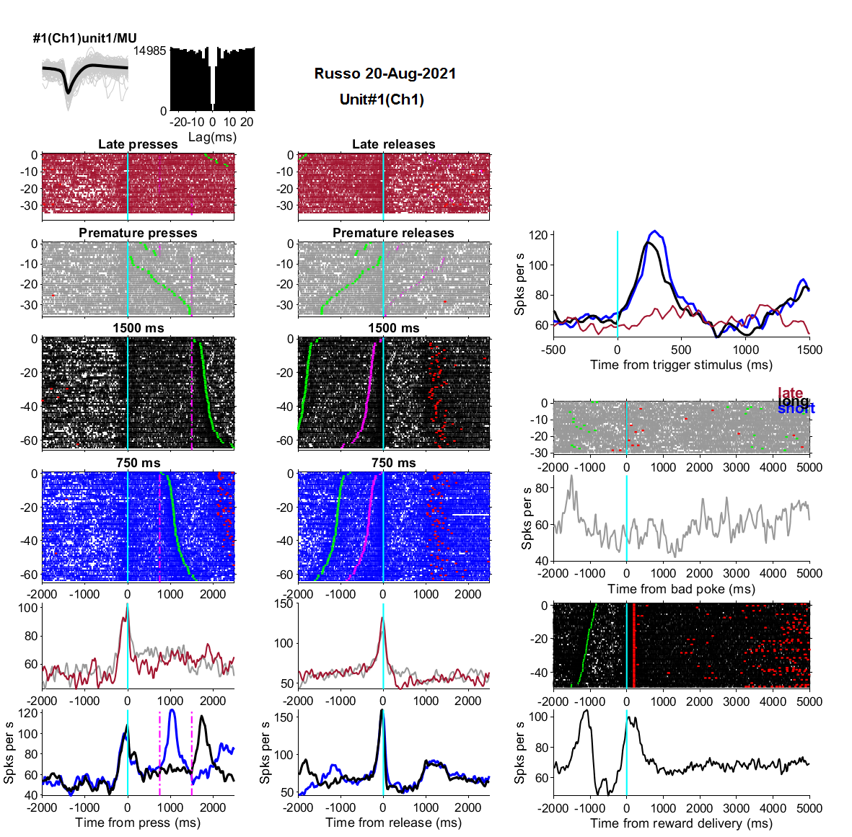
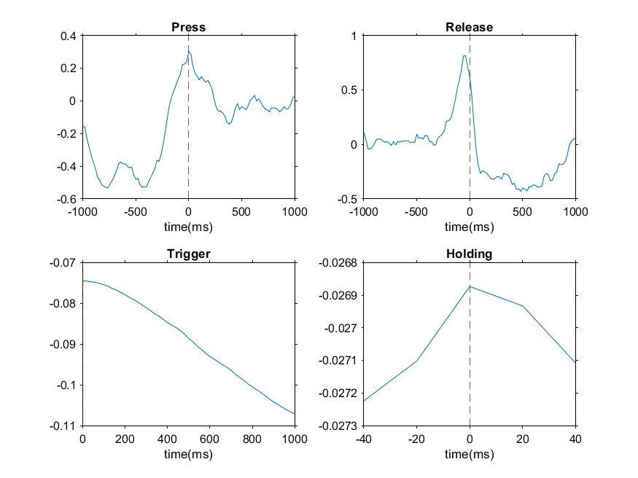

Slide 7
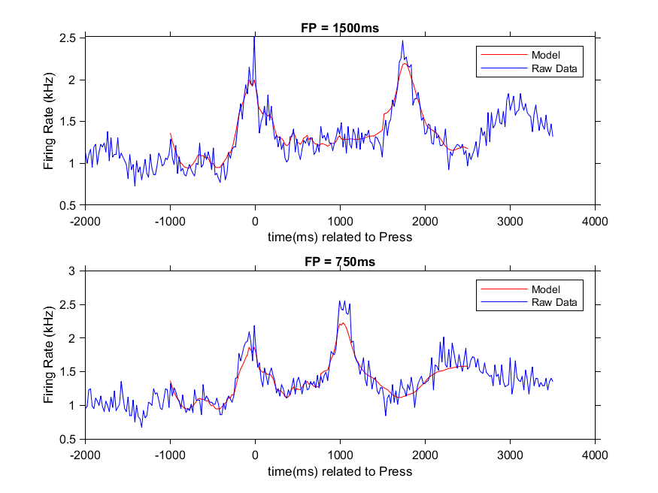

Slide 8
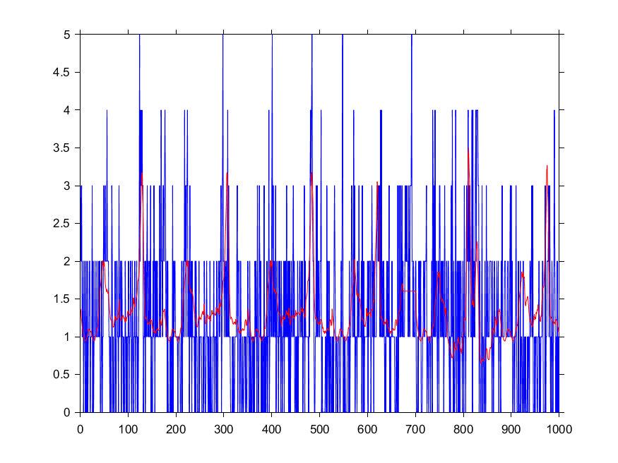

Slide 9
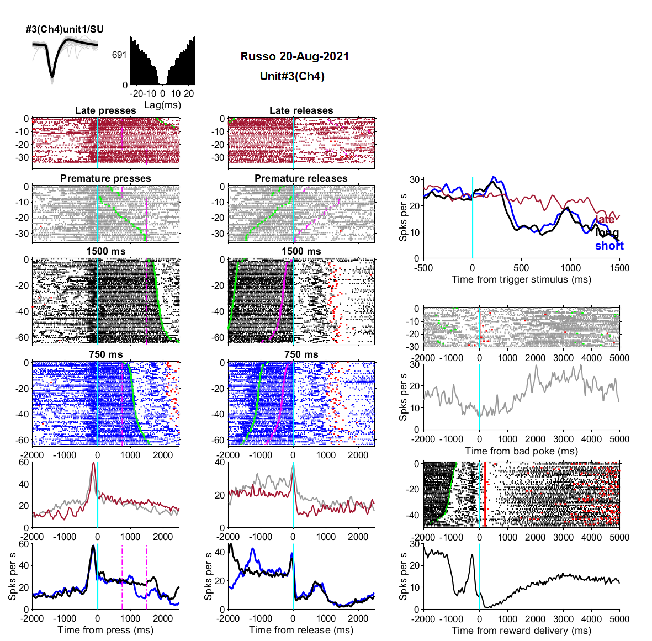
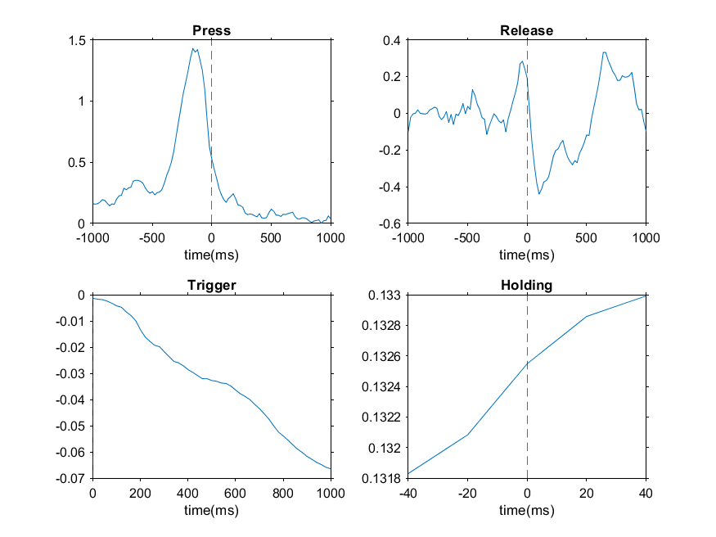
Model PSTH vs Data PSTH

Slide 10
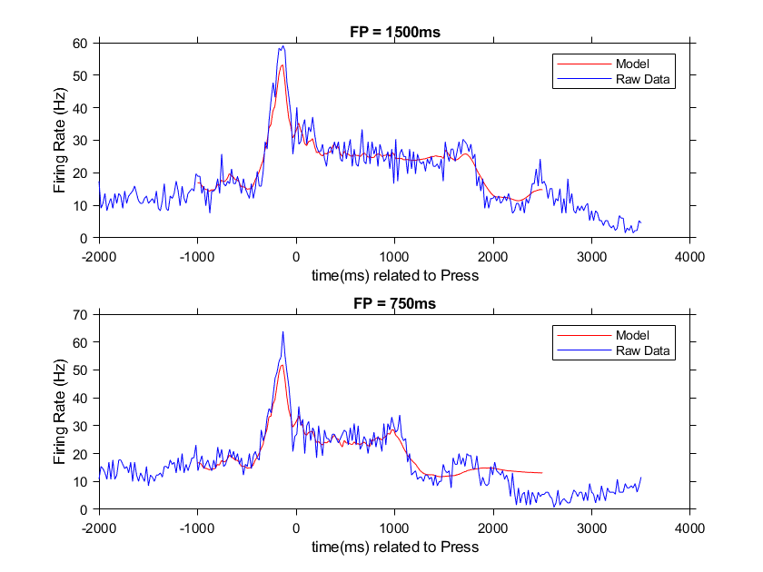
Kernel vs PSTH

Slide 11
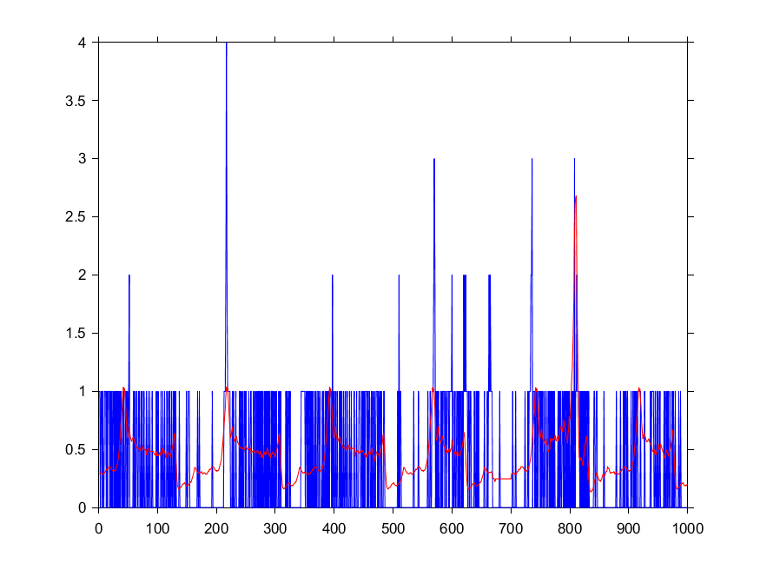

Slide 12
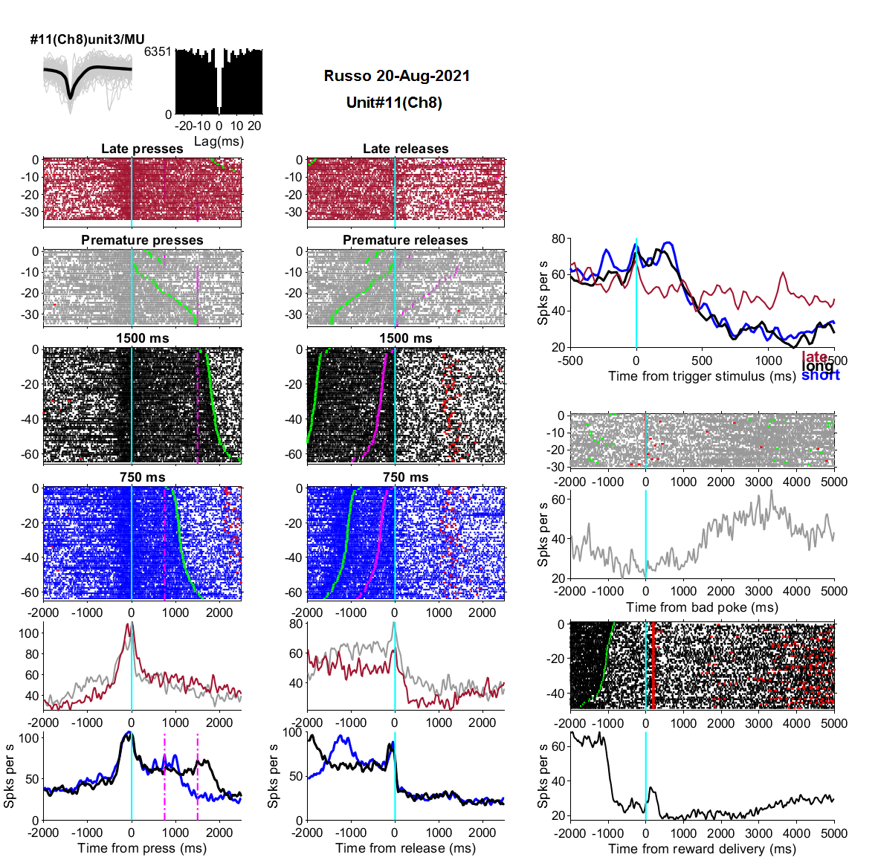
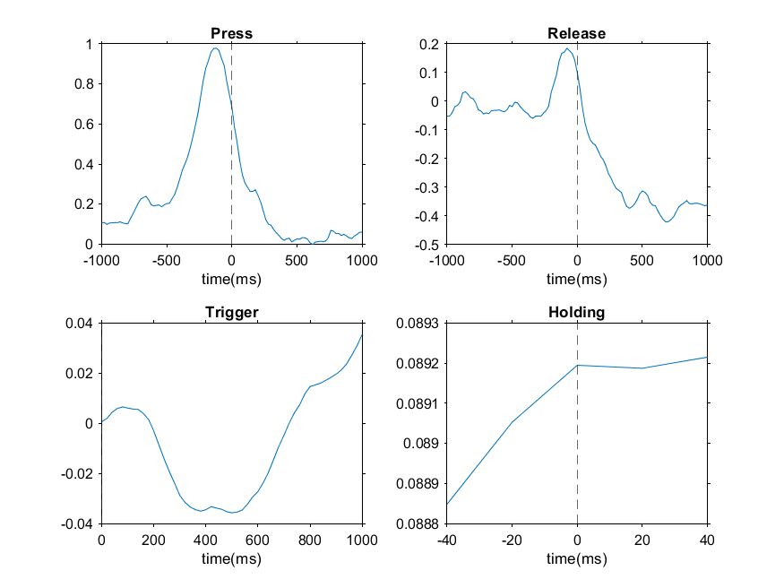

Slide 13
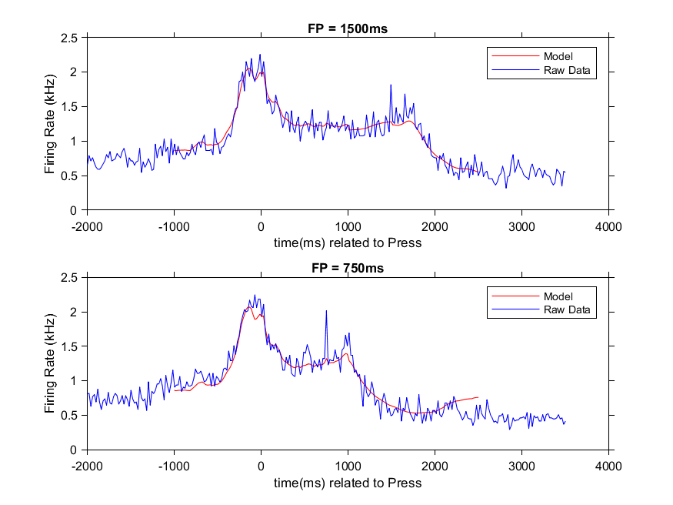

Slide 14
