Slide 1





A Uniﬁed Model for Extractive and Abstractive Summarization using Inconsistency Loss
Project page
Wan-Ting Hsu
National Tsing Hua University
Chieh-Kai Lin
National Tsing Hua University
Notes:
Hello everyone
I’m 許菀庭 and this is 林倢愷
We are going to introduce our work A Unified Model for Extractive and Abstractive Summarization using Inconsistency Loss

Slide 2
Outline
Motivation
Our Method
Training Procedures
Experiments and Results
Conclusion
Notes:
I will first introduce our motivation and method.
Then 倢愷 will describe the training procedure and experiment.
And finally give a conclusion.

Slide 3
Outline
Motivation
Our Method
Training Procedures
Experiments and Results
Conclusion
Notes:
So lets begin with our motivation

Slide 4





Overview
Textual Media
People spend 12 hours everyday consuming media in 2018.
– eMarketer
https://www.emarketer.com/topics/topic/time-spent-with-media
Notes:
Nowadays, people spend 12 hours everyday consuming media.
Among these media, we receive lots of textual information such as news, emails, social media and so on.
Hence, there is a great need for summarization to reduce our time on browsing and organizing the data.

Slide 5

Overview
Text Summarization
To condense a piece of text to a shorter version while maintaining the important points
Notes:
Text summarization is a task to produce a summary which condense a long article into few words or sentences.

Slide 6

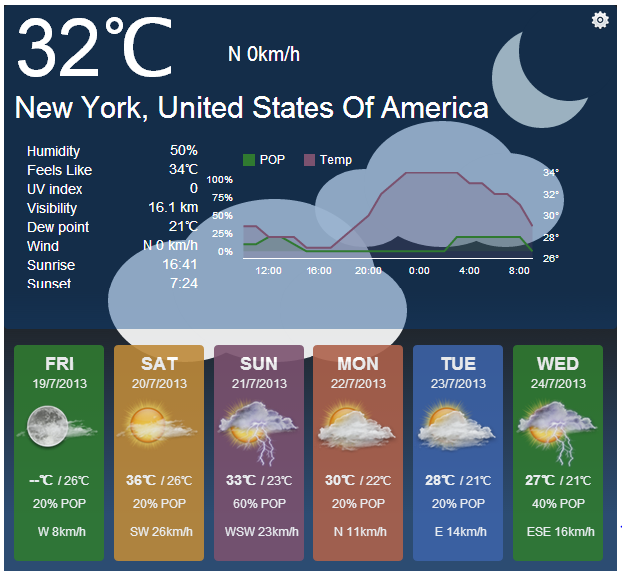


Overview
Examples of Text Summarization
Article headlines
Meeting minutes
Movie/book reviews
Bulletins (weather forecasts/stock market reports)
Notes:
There are already many kinds of summarization around us.
Like article headlines, …
Imagine that if all of these summaries can be generated automatically, we can obtain, process and search the data more efficiently.
So in this work, we explore some new methods to improve the task of automatic text summarization.

Slide 7


Overview
Automatic Text Summarization
To condense a piece of text to a shorter version while maintaining the important points
Extractive Summarization
Abstractive Summarization
select text from the article
generate the summary word-by-word
Notes:
Before going to our method, we first introduce two main methods for summarization: Extractive and abstractive summarization.
On the left, extractive method selects important phrases or sentences from the article.
While the abstractive method generates the summary word-by-word.
The main difference between them is that the abstractive summary can include words that are not in the original article while the extractive summary can only copy text from the article.

Slide 8

Overview
Extractive Summarization
Select phrases or sentences from the source document
Representation
sentence 1
1 | 3 | 9 | 2
sentence 2
5 | 6 | 5 | 7
sentence 3
8 | 1 | 1 | 4
…
Shen, D.; Sun, J.-T.; Li, H.; Yang, Q.; and Chen, Z. 2007. Document summarization using conditional random fields. IJCAI 2007.
Kågebäck, M., Mogren, O., Tahmasebi, N., & Dubhashi, D. Extractive Summarization using Continuous Vector Space Models. EACL 2014.
Cheng, J., and Lapata, M. Neural summarization by extracting sentences and words. ACL 2016.
Ramesh Nallapati, Feifei Zhai, and Bowen Zhou. Summarunner: A recurrent neural network based sequence model for extractive summarization of documents. AAAI 2017
Notes:
Earlier works focus on extractive summarization. Most of them perform sentence-level extraction.
They calculate sentence representations using handcraft features or learned from neural networks and then pick a few sentences as the summary.
While the extractive summarization can select important part of the article, it’s still not perfect since extractive summaries often contain redundant words.

Slide 9
Overview
Abstractive Summarization
Select phrases or sentences from the source document
Encoder
Article
Representations
Decoder
Alexander M Rush, Sumit Chopra, and Jason Weston. A neural attention model for abstractive sentence summarization. EMNLP 2015.
Ramesh Nallapati, Bowen Zhou, Cicero dos Santos, Caglar Gulcehre, and Bing Xiang. Abstractive text summarization using sequence-tosequence rnns and beyond. CoNLL 2016.
Abigail See, Peter J Liu, and Christopher D Manning. Get to the point: Summarization with pointergenerator networks. ACL 2017.
Romain Paulus, Caiming Xiong, and Richard Socher. A deep reinforced model for abstractive summarization. ICLR 2018.
Fan, Angela, David Grangier, and Michael Auli. Controllable abstractive summarization. arXiv preprint arXiv:1711.05217 (2017).
Notes:
With the advance of deep learning techiques, more and more research aims to generate abstractive summaries.
They use large paired data to train an encoder-decoder network.
This is a more challenging problem compared with extractive method.
But abstractive method provides a more flexible solution for summarization.
We can not only control the length but also style and content of the generated summaries.

Slide 10
Overview
Motivation
not concise
Extractive summary (select sentences):
important, correct
incoherent or not concise
Abstractive summary (generate word-by-word):
readable, concise
may lose or mistake some facts
Unified summary:
important, correct
readable, concise
Italian artist Johannes Stoetter has painted two naked women to look like a chameleon.
The 37-year-old has previously transformed his models into frogs and parrots but this may be his most intricate and impressive artwork to date.
concise
Justin Bieber
Johannes Stoetter has previously transformed his models into frogs and parrots but this chameleon may be his most impressive artwork to date.
Notes:
With current techniques, these two methods have their pros and cons.
Extractive method is a classification task. It can easily select important and correct sentence. However, the sentence may be incoherent or not concise
For example, if this sentence is selected as the summary, people will be confused about who is the 37-year-old and what is this means.
Hence, we may need to select one earlier sentence that describe the subjects.
But now we get the second problem that the summary is not concise.
Well these two problems ideally can be solved by abstractive method.
For example the abstractive summary can combine the two sentences into one like this.
But since this is a more challenging approach, it is hard for the model to find all important fact and generate correct sentence.
For example, the model may change the person to a celebrity who appears in the data a lot and thus mistakes the fact.
In this example, we can see that both extractive and abstractive methods have their strength and weakness.
Therefore, in this work, we want to combine both methods and get their advantage from them.
So we call our method unified summarization.

Slide 11
Outline
Motivation
Our Method
Training Procedures
Experiments and Results
Conclusion
Notes:
Next, I will introduce our method in details.

Slide 12
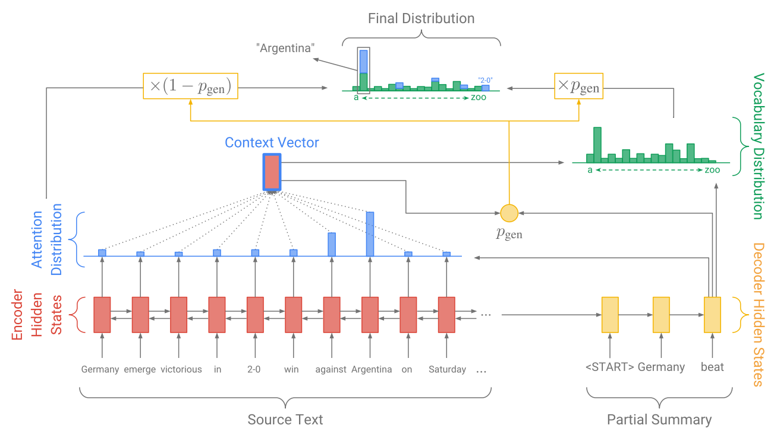
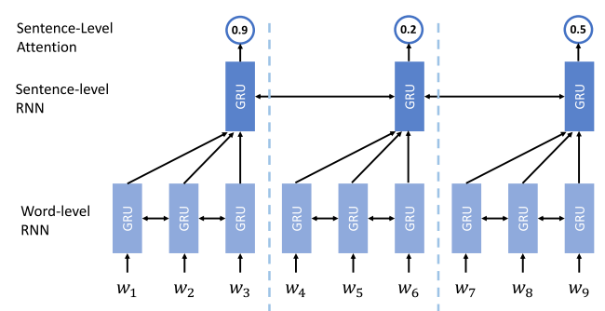
Method
Models
Extractor
Abstracter
static sentence
attention
dynamic word
attention
Ramesh Nallapati, Feifei Zhai, and Bowen Zhou. Summarunner: A recurrent neural network based sequence model for extractive summarization of documents. AAAI 2017
Abigail See, Peter J Liu, and Christopher D Manning. Get to the point: Summarization with pointer-generator networks. ACL 2017
Notes:
Our model is based on two existing models.
The first one is the extractive model from Nallapati et al. which we call extractor.
It consists of a hierarchical recurrent neural network and finally generate the selecting probability for each sentence.
The second one is the abstractive model from See et al. which we call abstracter.
The abstracter is an encoder-decoder model with attention mechanism.
The encoder will read the article and the decoder generates the summary.
Here the word level attention will guide the model to pay attention on the specific part when generating the summary.

Slide 13
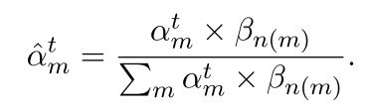
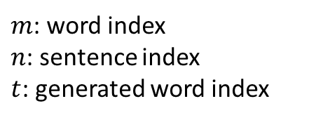


Method
Combined Attention
Extractor
Abstracter
static sentence
attention
dynamic word
attention
$$β$$
$$α$$
$m$: word index
$n$: sentence index
$t$: generated word index
Notes:
Our idea is to use the sentence level attention from extractor to guide the abstracter.
We view the selecting probability for each sentence as the sentence-level attention beta.
And the word level attention alpha is produced by the abstracter.
We then combine the word-level and sentence-level attention by simply multiplying them.
Each word attention alpha m is multiplied with the sentence attention beta n of m
n of m means the index of the sentence where the m^th word belongs to.

Slide 14












Method
Combined Attention
Extractor
Abstracter
static sentence
attention
dynamic word
attention
$$β_{1}$$
$$β_{2}$$
$$β_{3}$$
$$α_{1}$$
$$α_{2}$$
$$α_{3}$$
$$α_{4}$$
$$α_{5}$$
$$α_{6}$$
$$α_{7}$$
$$α_{8}$$
$α_{9}$ …
Cindy is lucky. She won $1000. She is going to …
$m$: word index
$n$: sentence index
$t$: generated word index
Notes:
For example, the first 3 word attention will multiply with the first sentence attention beta 1.
Word attention of second sentence will multiply with beta 2. and so on.
After normalizing, we can obtain the updated word-level attention alpha head.

Slide 15
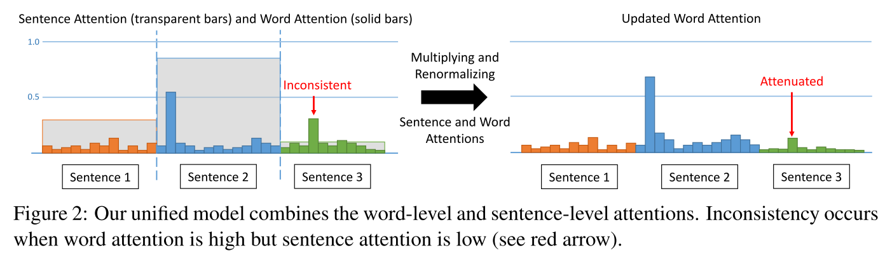
Method
Combined Attention
Our uniﬁed model combines sentence-level and word-level attentions to take advantage of both extractive and abstractive summarization approaches.
Notes:
This picture visualizes how the combined attention works.
Here the solid bars are word attention and transparent bars represent sentence attention.
In this case, there is a word with high word attention, however, it belongs to a sentence with low sentence attention.
So we say the extractor and abstracter are inconsistent at this word.
After multiplying the two levels of attentions, we can attenuate the inconsistency.

Slide 16
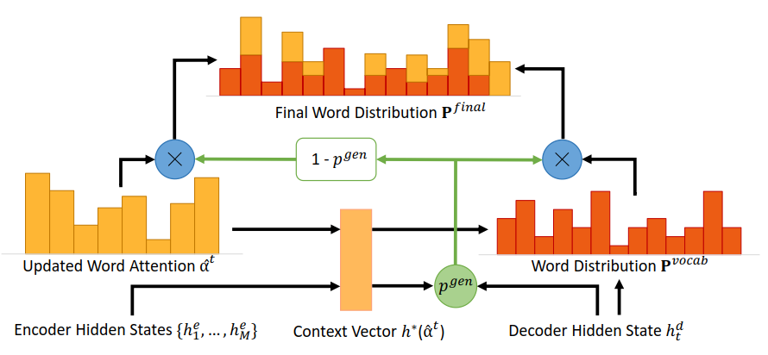
Method
Combined Attention
Updated word attention is used for calculating the context vector and final word distribution
Notes:
The updated word attention alpha head will then be used for calculating the context vector and final word distribution just like the original word attention alpha.
Hence, with a better word attention alpha head, we can generate a better summary.
However, this is a passive way to combine the extractor and abstracter.

Slide 17
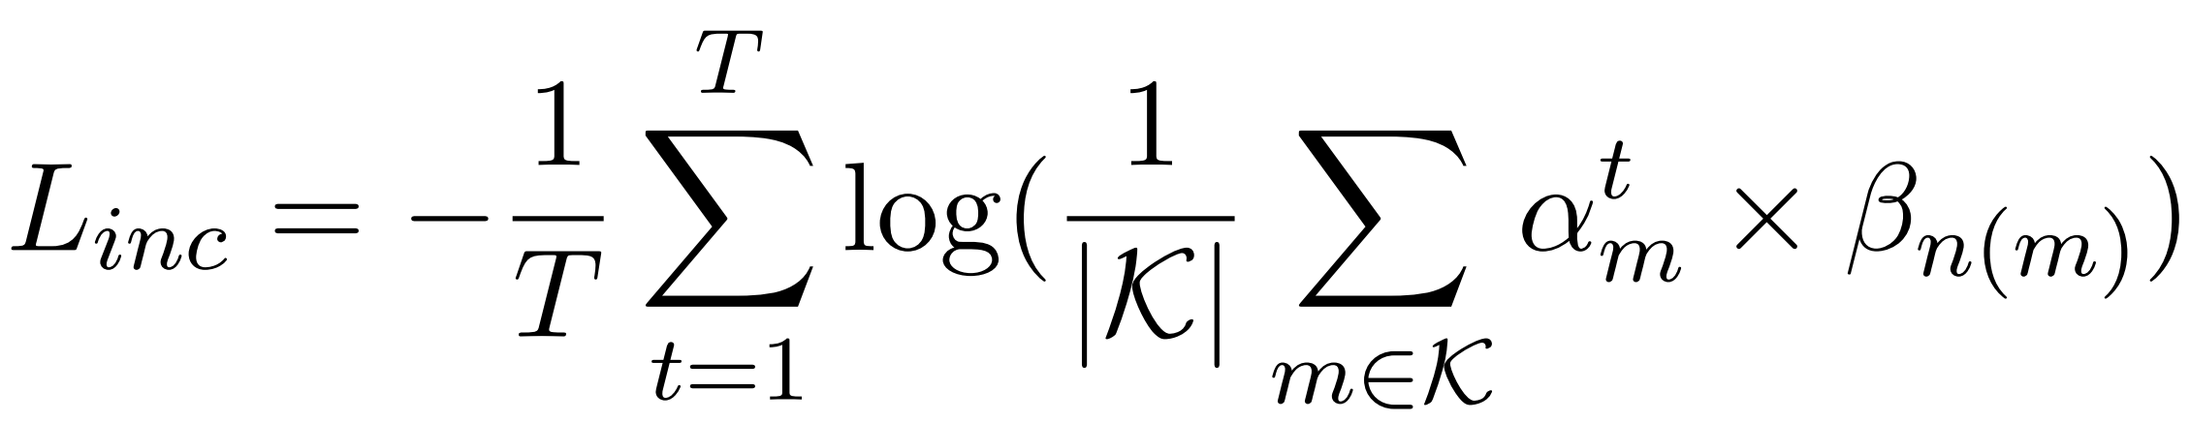
Method
Encourage Consistency
We propose a novel inconsistency loss function to ensure our uniﬁed model to be mutually beneﬁcial to both extractive and abstractive summarization.
multiplied attention of
top K attended words
maximize
Notes:
Instead of only leveraging the complementary nature between sentence-level and word-level attentions, we would like to encourage them to be mostly consistent to each other.
Therefore, we design an inconsistency loss function to directly penalize the inconsistency.
At each decoder time step, we calculate the multiplication of word and sentence attention at top K attended words.
Then we will maximize the sum of these multiplied attention so that the top attended words should also belongs to highly attended sentences.

Slide 18
Method
Encourage Consistency
encourage consistency of the top K attended words at each decoder time step.
inconsistency loss: consistent < inconsistent
1.0
consistent
K = 2
inconsistent
0.5
Sentence 1
Sentence 2
Sentence 3
Notes:
So lets see how it works.
We focus on encouraging consistency of the top K attended words since those words are most likely to be generated.
For example, if we set K=2, we will then focus on these two most attended words.
The left one is consistent while the right one is inconsistent since the sentence attention of the third sentence is low.
According to our inconsistency loss, the inconsistent word will get higher inconsistency loss.

Slide 19
Method
Encourage Consistency
encourage consistency of the top K attended words at each decoder time step.
1.0
consistent
inconsistent
K = 2
consistent
0.5
Sentence 1
Sentence 2
Sentence 3
Notes:
Hence, training the model with inconsistency loss will encourage consistency of the top K attended words.
By adding this inconsistency loss, we can obtain further improvement.

Slide 20
Outline
Motivation
Our Method
Training Procedures
Experiments and Results
Conclusion
Notes:
Next, 倢愷 will introduce our training procedures.
Wan-Ting has introduced our model in details. Now I am going to explain our training procedures.

Slide 21
Training Procedures
Extractive Summarization
Abstractive Summarization
select sentences from the article
generate the summary word-by-word
Notes:
Our model has two submodel, an extractor and an abstracter. Our core idea is to let extractor highlight the important sentences and the abstracter rewrite a summary base on these important sentences. By combining both extractive summarization and abstractive summarization’s strength we can get better summaries.

Slide 22
Training Procedures
3 types of loss functions:
extractor loss
abstracter loss + coverage loss
inconsistency loss
Notes:
As a result, to train both extractor & abstracter we need meticulously designed loss function.We have 3 different types of loss functions.

Slide 23
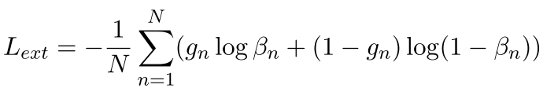

Training Procedures
3 types of loss functions:
extractor loss
abstracter loss + coverage loss
inconsistency loss
Notes:
Now I am going to introduce them one by one. The first one is extractor loss. The extractor is trained as a binary classifier to determine if a sentence is important or not. Therefore, the extractor loss is simply a binary classification cross entropy.

Slide 24
Training Procedures
Ground Truth 1 0 1
3 types of loss functions:
extractor loss
abstracter loss + coverage loss
inconsistency loss
Notes:
The “g_n” in the formula is the ground truth which is either 0 or 1.

Slide 25
Training Procedures
Ground Truth 1 0 1
3 types of loss functions:
extractor loss
abstracter loss + coverage loss
inconsistency loss
Notes:
The “Beta_n” is the output from our model and is between 0 and 1.

Slide 26
Training Procedures
Extractor Target
To extract sentences with high informativity: the extracted sentences should contain information that is needed to generate an abstractive summary as much as possible.
Ground-truth labels:
Measure the informativity of each sentence in the article by computing the ROUGE-L recall score between the sentence and the reference abstractive summary.
Select the sentence in the order of high to low informativity and add one sentence at a time if the new sentence can increase the informativity of all the selected sentences.
Ramesh Nallapati, Feifei Zhai, and Bowen Zhou. Summarunner: A recurrent neural network based sequence model for extractive summarization of documents. AAAI 2017
Notes:
However, we only have human hand written summaries and we do not have any binary label telling us which sentence is important and which is not. Therefore, we need binary labels to supervise our extractor loss. We adapted from nallapati et al’s work to automatically generate the extractor ground truth from abstractive summaries. We want our extractor to extract sentences from article and maintain the main idea. Therefore, we calculate ROUGE-L recall instead ROUGE-L f-score between each sentences and reference abstractive summary. Select the sentences in the order of high to low ROUGE-L recall score. The detail explanation can be found in our paper.

Slide 27
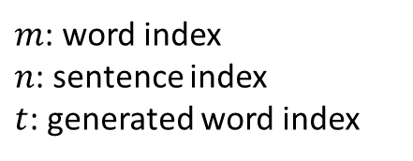
Training Procedures
Combined Attention
Extractor
Abstracter
static sentence
attention
dynamic word
attention
0.5 0.5 0.5
$m$: word index
$n$: sentence index
$t$: generated word index
Notes:
Now I’m going to explain why we need extractor loss. Going back to the idea of combining the sentence attention and word attention while generating words. We multiply both attention to gain the final attention. If we don’t add some constraint to our extractor we may get some degenerate solution that the extractor just output the same number for each sentences and do nothing to help the abstracter generate summary. If you highlight everything then you just highlight nothing. We don’t want that. That’s why we need extractor loss. Actually this is one of our contribution in my opinion. Our extractor is work as a sentence attention so the extractor loss is a simple method to supervise attention!

Slide 28
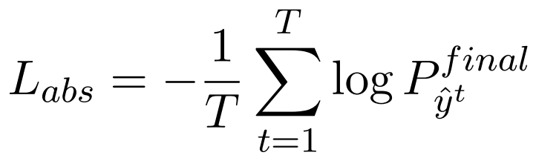
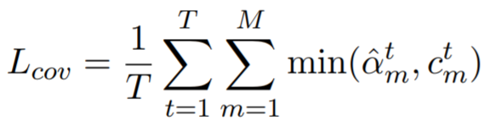
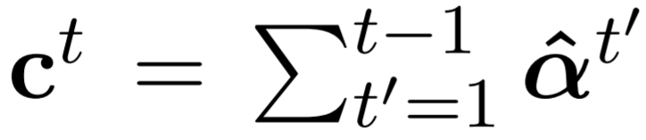
Training Procedures
3 types of loss functions:
extractor loss
abstracter loss + coverage loss
inconsistency loss
Abigail See, Peter J Liu, and Christopher D Manning.
Get to the point: Summarization with pointer-generator networks. ACL 2017
Notes:
The abstracter we use is the same model from Abigail See’s brilliant work so do the loss functions. In brief, they use cross entropy to supervise seq2seq model and combine with a coverage loss to penalize the model for attending the same place too many times. Details please refer to their paper.

Slide 29
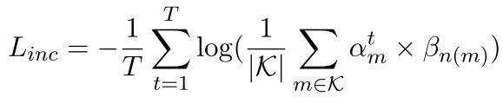
Training Procedures
3 types of loss functions:
extractor loss
abstracter loss + coverage loss
inconsistency loss
Notes:
The third one is the inconsistency loss introduced before by Wen-Ting. It penalize the model when the abstracter is attending some words in those unimportant sentences. This is our main contribution.

Slide 30
Training Procedures
Two-stages training
End-to-end training without inconsistency loss
End-to-end training with inconsistency loss
Notes:
Now we have introduced all of our loss function. This leads me to our next section. Let’s talk about our training procedures. We designed 3 kinds of training procedures to train our whole model.

Slide 31
Training Procedures
Two-stages training
The extractor is used as a classiﬁer to select sentences with high informativity and output only those sentences. = Hard attention on the original article.
simply combine the extractor and abstracter by feeding the extracted sentences to the abstracter.
Extractor
Abstracter
extracted sentences
article
summary
Notes:
The first one is two-stages training. We just combine extractor and abstracter by feeding the extracted sentences into abstracter as input. So it’s like our extractor output a hard attention of input article masking out all the unimportant sentences and send the rest sentences into abstracter. The abstracter just rewrite a short summary base on those important sentences only. At 2-stages training we didn’t add our inconsistency loss into our model.

Slide 32

Training Procedures
2. End-to-end training without inconsistency loss
the sentence-level attention is soft attention and will be combined with the word-level attention
minimize extractor loss and abstracter loss
Extractor
Abstracter
article
+
summary
Notes:
The second one is end2end training without inconsistency loss. We feed both extractor and abstracter with the whole article. However when the abstracter is calculating the attention, it will first calculate the original word attention distribution then multiply with the extractor’s output which is sentence-level attention and form the final attention.

Slide 33

Training Procedures
3. End-to-end training with inconsistency loss
the sentence-level attention is soft attention and will be combined with the word-level attention
minimize extractor loss, abstracter loss and inconsistency loss:
Extractor
Abstracter
article
+
summary
Notes:
The third one is end2end training with inconsistency loss. The flow is just like previous slide, However, we add inconsistency loss to our model this time. Both sentence-level attention from extractor and word-level attention from abstracter are constrained by the inconsistency loss.

Slide 34
Outline
Motivation
Our Method
Training Procedures
Experiments and Results
Conclusion
Notes:
Ok, Let’s move on to see some empirical results.

Slide 35
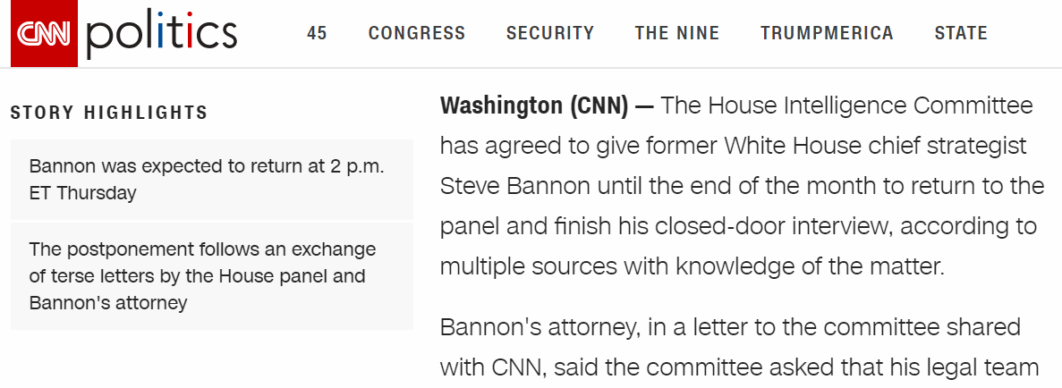
Experiment
Dataset – CNN/DailyMail Dataset
Article $≈$ 766 words
Summary $≈$ 53 words
 | Train | Validation | Test
Article-summary pairs | 287,113 | 13,368 | 11,490
(…)
Notes:
We use a summarization dataset called CNN/DailyMail.

Slide 36
Experiment
Dataset – CNN/DailyMail Dataset
Article $≈$ 766 words
Summary $≈$ 53 words
 | Train | Validation | Test
Article-summary pairs | 287,113 | 13,368 | 11,490
Article
700 words
Highlight
50 words
(…)
Notes:
This dataset contains almost 300 thousand training datas, 10 thousand validation datas and 10 thousand test datas. All of the data in CNN/DM contain a news article and a human written summary. The articles have seven hundreds word in average. And the human written summaries have fifty words in average.

Slide 37
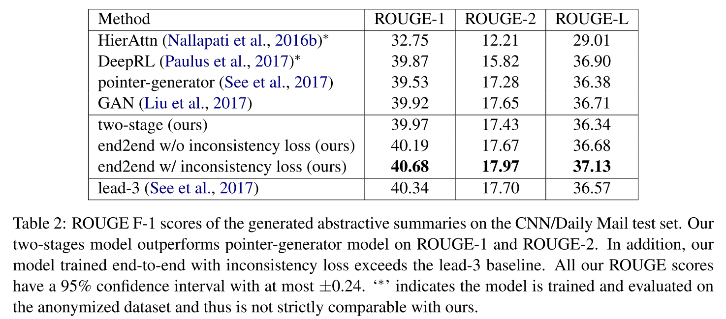
Experiment
Results – Abstractive Summarization
Notes:
We calculated ROUGE score on CNN/Dailymail to compare with other models. Those three row in the red block are our model and those four row above are some baselines we compare with. The first row in the red block is our 2stage training model. The 2 stage model already outperform our baseline pointer-generator. The second row in the red block is our end2end model without inconsistency loss, and the third row in the red block is our end2end model with inconsistency loss. To our knowledge, the work done by Liu et al is the state of the art before we submitted our paper. You can see that we gain some improvement comparing with before.

Slide 38
Experiment
Results – Abstractive Summarization
Notes:
The star up here means that this use anonymized data. Anonymized data replace names with entity numbers and numbers with 0s.

Slide 39
Experiment
Results – Abstractive Summarization
Notes:
Besides, Lead 3 is very strong. Most abstractive summarization model can’t compete with lead three. We are the only abstractive summarization model which defeat the lead-3 on non-anonymized data while we submitted our paper.

Slide 40
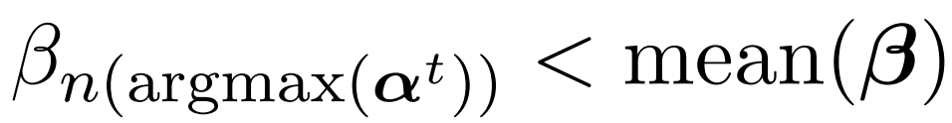
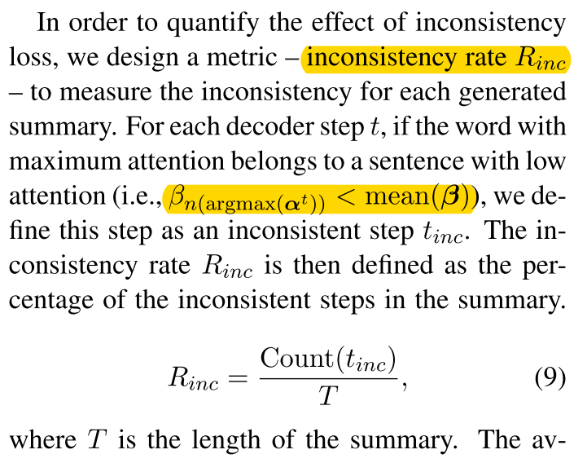
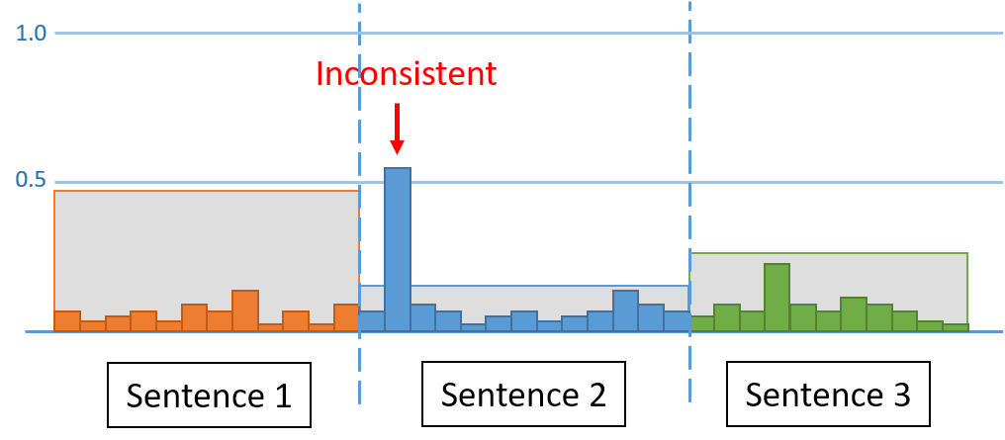
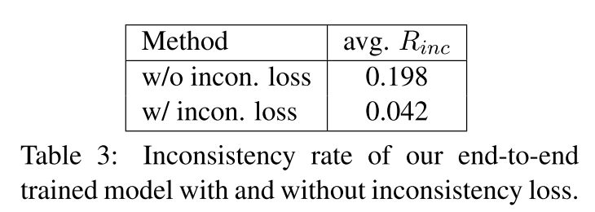
Experiment
Results – Inconsistency Rate $R_{inc}$
inconsistency step $t_{inc}$:
inconsistency rate:
sentence attention and word attention in time step $t$
Notes:
Besides, we calculated “inconsistency rate” to see whether the inconsistency loss work as we want.

Slide 41
Experiment
Results – Inconsistency Rate $R_{inc}$
inconsistency step $t_{inc}$:
inconsistency rate:
sentence attention and word attention in time step $t$
Notes:
The idea is to count the inconsistency timesteps while generating summary and this is “Count of t_inc”. And then we divide this number by total timesteps “T” and we get inconsistency rate.

Slide 42
Experiment
Results – Inconsistency Rate $R_{inc}$
inconsistency step $t_{inc}$:
inconsistency rate:
sentence attention and word attention in time step $t$
Notes:
How to decide whether a timestep is inconsistent? We use a simple definition. At each decoder timestep, if the word with highest attention belongs to a sentence which has lower importance score than mean of all the sentences, this timestep is inconsistent.

Slide 43
Experiment
Results – Inconsistency Rate $R_{inc}$
inconsistency step $t_{inc}$:
inconsistency rate:
sentence attention and word attention in time step $t$
Notes:
The inconsistency rate decrease a lot after we add inconsistency loss which may be considered as a proof of concept of our idea. And this is calculated in test time.

Slide 44
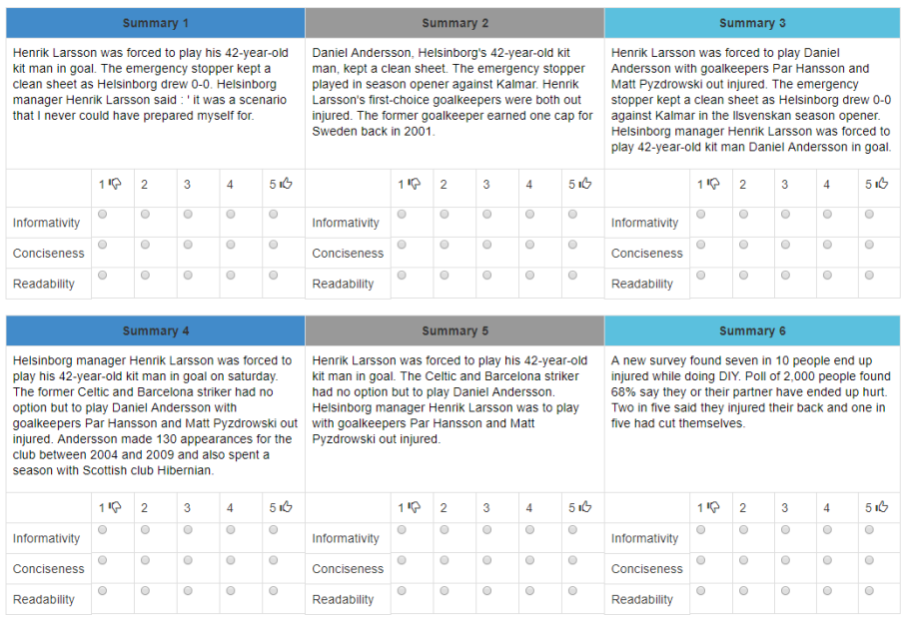
Experiment
Results – Human Evaluation on MTurk
Informativity:
how well does the summary capture the important parts of the article?
Conciseness:
is the summary clear enough to explain everything without being redundant?
Readability:
how well-written (ﬂuent and grammatical) the summary is?
trap
Notes:
Additionally, we conduct some human evaluation on Mturk. Each evaluator is given an article and 6 summaries. There is a trap summary among them to avoid cheating. The trap summary is totally irrelevant to the article but well written. Therefore if a turker give the trap summary high informativity score, maybe five? We can know that he is cheating and we will reject all of his evaluation.

Slide 45
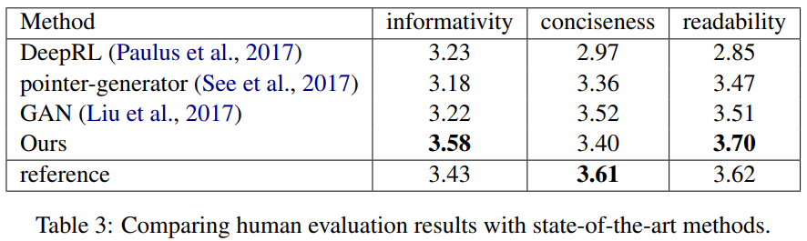
Experiment
Results – Human Evaluation
Informativity: how well does the summary capture the important parts of the article?
Conciseness: is the summary clear enough to explain everything without being redundant?
Readability: how well-written (ﬂuent and grammatical) the summary is?
Notes:
We achieve the best score on both informativity and readability. This proof that our model can generate more human preferred summary compare to other systems. Surprisingly, we gain better scores than reference on informativity and readability. Let me explain this. Our output summary have 80 words in average which is more than the reference, 50 words. Therefore we get better informativity can be reasonable cause the longer a sentence is the more information it can contain. However we are not sure about the result of readability. We think this might reflect that reference may not be the only best summary for the article.

Slide 46
Outline
Motivation
Our Method
Training Procedures
Experiments and Results
Conclusion
Notes:
Great. I’ve come to the end of our talk. I am going to make some conclusions of our contribution.

Slide 47
Conclusion and Future work
Conclusion
We propose a uniﬁed model combining the strength of extractive and abstractive summarization.
A novel inconsistency loss function is introduced to penalize the inconsistency between two levels of attentions. The inconsistency loss enables extractive and abstractive summarization to be mutually beneﬁcial.
By end-to-end training of our model, we achieve the best ROUGE scores while being the most informative and readable summarization on the CNN/Daily Mail dataset in a solid human evaluation.
Notes:
The main contribution of our work is proposing a unified model conbining the strength of extractive and abstractive summarization. In addition, we propose an inconsistency loss function to encourage consistency between word-level attention and sentence-level attention. And we achieve the best ROUGE scores and human-evaluation on the non-anonymized CNN/Dailymail dataset when we submitted our paper.

Slide 48

Acknowledgements
Min Sun
Wen-Ting Tsu
Chieh-Kai Lin
Ming-Ying Lee
Kerui Min
Jing Tang
Notes:
In the end. I want to thank my coworkers, teacher from National Tsing-Hua University and researchers from cheetahmobile. Thank you for listening.

Slide 49
Q & A
Project page
Code
Test output
Supplementary material
https://hsuwanting.github.io/unified_summ/
Notes:
And the Qrcode is our project page. You can find the same link in our arxiv page. It contains our code, our test output and our supplementary materials.
Is there any question you’d like to ask?

