Slide 1
Prototype Model Design
Jamie Yen

Slide 2
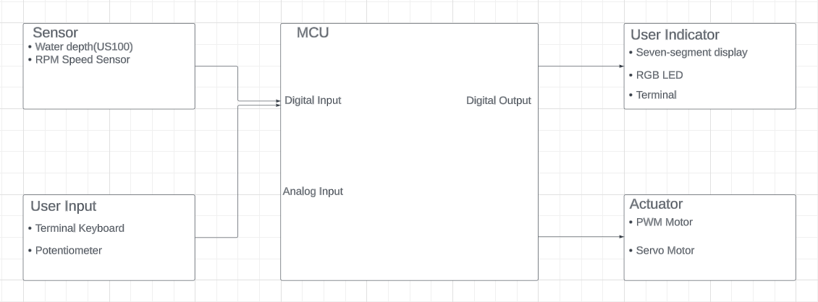
System-Level Design

Slide 3
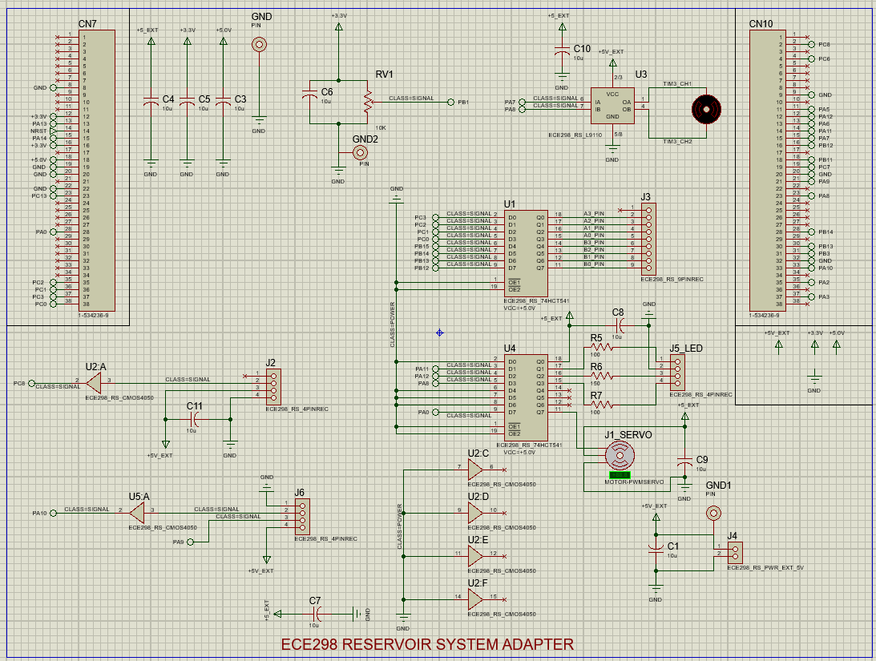
Schematics

Slide 4
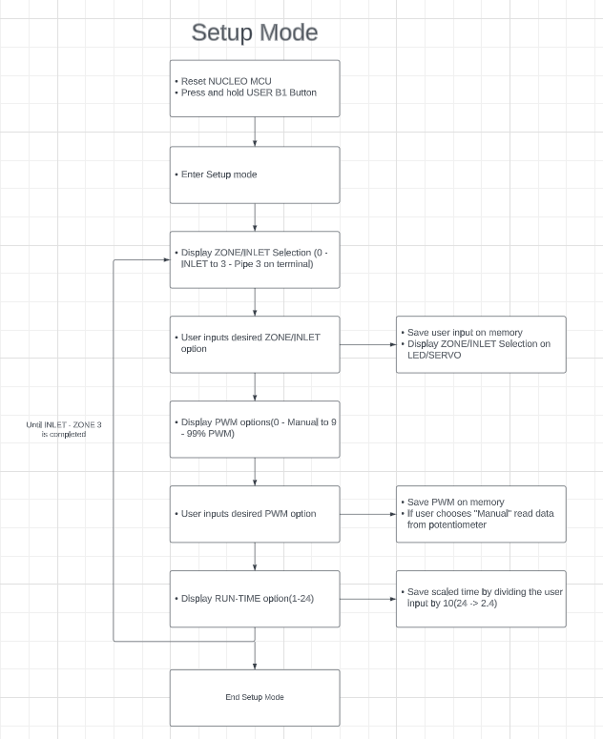
Setup Mode Flow Chart

Slide 5
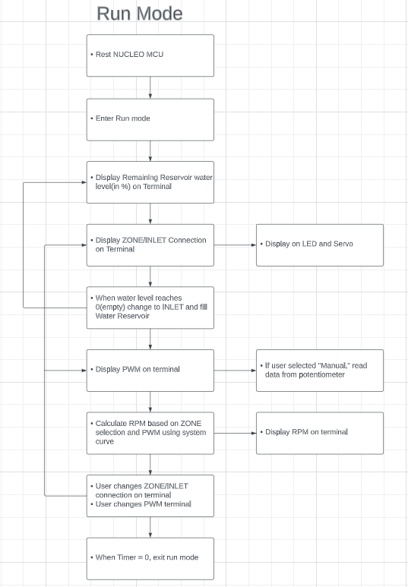
Run Mode Flow Chart

Slide 6
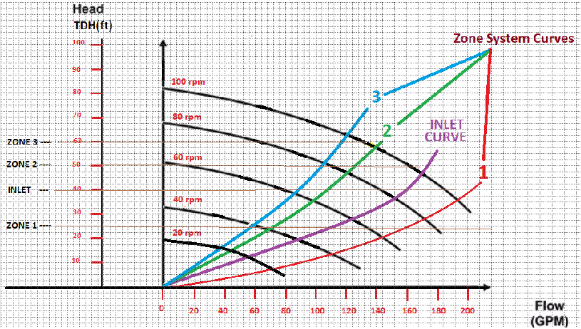
Minimal Energy Operation Plan
ZONE/GPM | 20 | 40 | 60 | 80 | 100
Zone 1 | 70 | 110 | 144 | 172 | 193
INLET | 65 | 88 | 124 | 152 | 170
Zone 2 | 44 | 71 | 98 | 121 | 140
Zone 3 | 38 | 58 | 85 | 105 | 121
GPM according to the customer site system curves

Slide 7
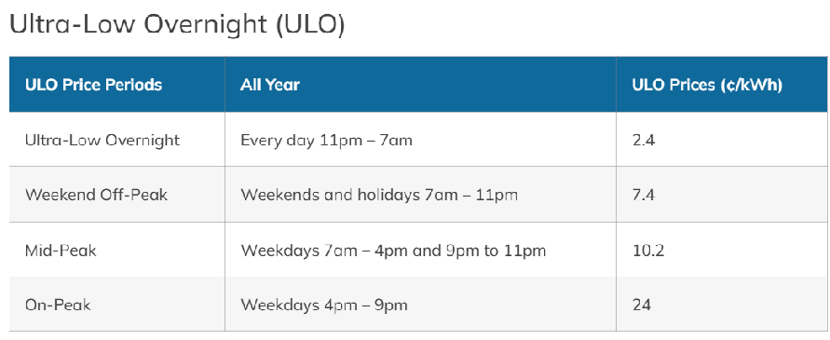
Minimal Energy Operation Plan cont.
Order of Operation :
INLET -> HOLD -> Zone 1 -> Zone 2 -> Zone 3
Planned Time of Operation :
INLET : 11:00 pm - 9:00 am
HOLD : 9:00 am - 11:30 am
ZONE 1 : 11:30 am - 5:00 pm
ZONE 2 : 5:00 pm - 9:00 pm
ZONE 3 : 9:00 pm - 11:00 pm
Using Ultra-Low Overnight & Weekend Off-Peak pricing
INLET : (260kW x 8hr x 2.4¢/kWh) + (260kW x 2hr x 7.4¢/kWh) = 8840¢
ZONE 1 : 125kW x 5.5hr x 7.4¢/kWh = 5087.5¢
ZONE 2 : 210kW x 4hr x 7.4¢/kWh = 6216¢
ZONE 3 : 120kW x 2hr x 7.4¢/kWh = 1776¢
Total Pricing = 8840¢ + 5087.5¢ + 6216¢ + 1776¢ = 21919.5¢ = $219.20/day

