Slide 1
Evaluating and Improving Mathematical Reasoning in Large Language Models
CS6493 Natural Language Processing | City University of Hong Kong, Q2 2025-2026
Peihan Yu | Xuelin Hu | Ziyan Weng | Haichao Zhao | Leying Deng
Key Result: PVP achieves 64.0% accuracy, outperforming CoT baseline (57.5%)

Slide 2
Motivation & Background
Why Mathematical Reasoning?
LLMs excel at language but struggle with mathematical reasoning
Math requires: multi-step deduction, precise arithmetic, formal reasoning
Real-world impact: education, science, finance
Our Approach
Systematic evaluation of 5 prompting strategies
Across 2 model scales and 2 benchmarks
Novel contribution: Progressive Verification Prompting (PVP)
Key Question
Can we improve LLM mathematical reasoning purely through better prompting - without retraining?

Slide 3
Research Questions
RQ | Research Question
RQ1 | How do different prompt methods compare across model architectures?
RQ2 | Can a verification-based prompt method (PVP) outperform standard CoT?
RQ3 | How does problem difficulty interact with method effectiveness?

Slide 4
Background - Existing Prompt Methods
Method | Key Idea | Reference
Chain-of-Thought (CoT) | "Think step by step" - elicits reasoning | Wei et al., NeurIPS 2022
Self-Consistency | Sample multiple paths, majority vote | Wang et al., NeurIPS 2022
Self-Refine | Generate > Critique > Refine (iterative) | Madaan et al., NeurIPS 2024
Least-to-Most | Decompose into sub-problems, solve sequentially | Zhou et al., NeurIPS 2023
Limitation of Existing Methods
CoT: No error detection - errors cascade through steps
Self-Consistency: Requires 5x inference passes
Self-Refine: Post-hoc review may miss intermediate errors
Gap: No method combines single-pass efficiency with step-wise verification

Slide 5
Our Contribution - PVP
Progressive Verification Prompting
Core Innovation
Why PVP Works
Insert self-verification checkpoints BETWEEN every reasoning step
For EACH reasoning step:
1. Complete the step
2. PAUSE - Verify:
- Is this step logically correct?
- Does it follow from the previous step?
- Are there arithmetic errors?
3. If error found > correct immediately
4. Proceed to next step
Final: Overall consistency review
Prevents cascading errors: Error at step 2 caught before propagating to steps 3, 4, ...
Decomposed verification: Checking one step is easier than reviewing entire solution
Single-pass: No extra inference calls - same latency as CoT

Slide 6
Experimental Setup
Models, Datasets, and Configuration
Models
Datasets
Model | Params | Type | Specialization
Qwen2.5-Math-1.5B | 1.5B | Local GGUF CPU | Math-specialized
DeepSeek-R1-Qwen-1.5B | 1.5B | Local GGUF CPU | General reasoning
Dataset | Size | Difficulty | Examples
MATH-500 | 500 | Competition | Algebra, Geometry, NT
GSM8K | 1,319 | Grade school | Word problems
Configuration
Temperature: 0.0 (deterministic) | Max tokens: 2,048 | Seed: 42
Self-Consistency: 5 samples | Self-Refine: max 2 rounds
All inference on CPU (no GPU) via GGUF Q4_K_M quantization
30 Python modules | 63 unit tests | Checkpoint/resume support

Slide 7
System Architecture
End-to-End Pipeline
Math Problem
|
[Prompt Engine] - 5 methods (CoT / Self-Consistency / Self-Refine / Least-to-Most / PVP)
|
[Model Router] - Local (GGUF) or API
|
[Answer Extractor] - \boxed{}, ####, regex fallback
|
[Evaluator] - SymPy equivalence checking
|
Results (JSON) + Visualizations (PNG) + Streamlit Web Demo

Slide 8
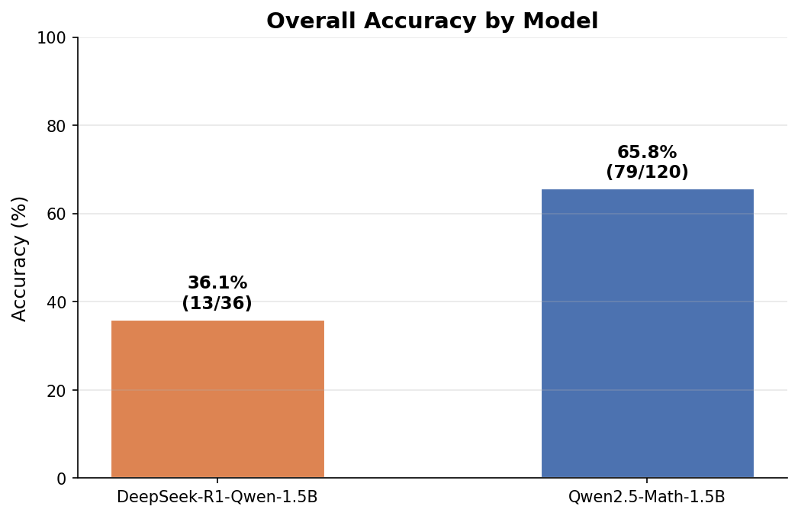
Results - Model Comparison
Model | Accuracy | Correct/Total
Qwen2.5-Math-1.5B | 65.83% | 79/120
DeepSeek-R1-Qwen-1.5B | 36.36% | 16/44
Gap: +29.5 percentage points
Task-specific fine-tuning (Qwen2.5-Math) provides a far stronger foundation than general reasoning (DeepSeek-R1), regardless of prompting strategy.

Slide 9
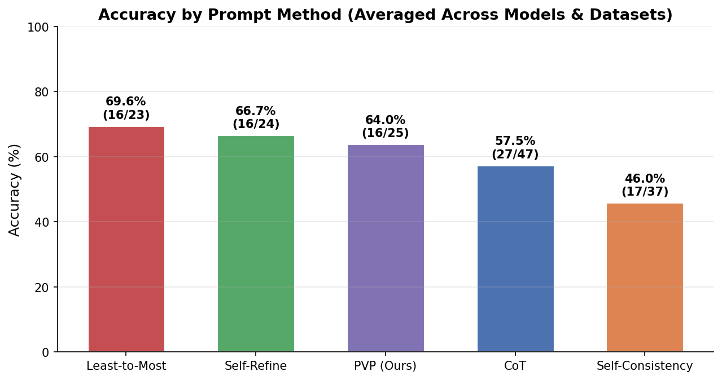
Results - Method Comparison
Accuracy Ranking
Rank | Method | Accuracy | vs CoT
1 | Least-to-Most | 69.57% | +12.1%
2 | Self-Refine | 66.67% | +9.2%
3 | PVP (Ours) | 64.00% | +6.5%
4 | CoT (Baseline) | 57.45% | -
5 | Self-Consistency | 44.44% | -13.0%
Top 3 methods all outperform CoT with different strategies
Self-Consistency fails with small 1.5B models - insufficient reasoning diversity
PVP achieves 3rd place while being the most efficient (single-pass)

Slide 10
Results - PVP Deep Dive
PVP vs CoT Comparison
Metric | CoT | PVP | Delta
Overall Accuracy | 57.45% | 64.00% | +6.55%
MATH-500 Accuracy | 52.5% | 60.0% | +7.5%
GSM8K Accuracy | 80.0% | 66.7% | -13.3%
Avg Latency | 22-73s | 24-31s | Same
Inference Calls | 1 | 1 | Same
PVP vs Other Verification Methods
Method | Accuracy | Avg Latency | Cost
Self-Refine | 66.67% | 81-98s | 3x
PVP (Ours) | 64.00% | 24-31s | 1x
Self-Consistency | 44.44% | 82-335s | 5x
PVP achieves 97% of Self-Refine's accuracy at 30% of the cost Verification most beneficial on harder problems (MATH-500: +7.5%)

Slide 11
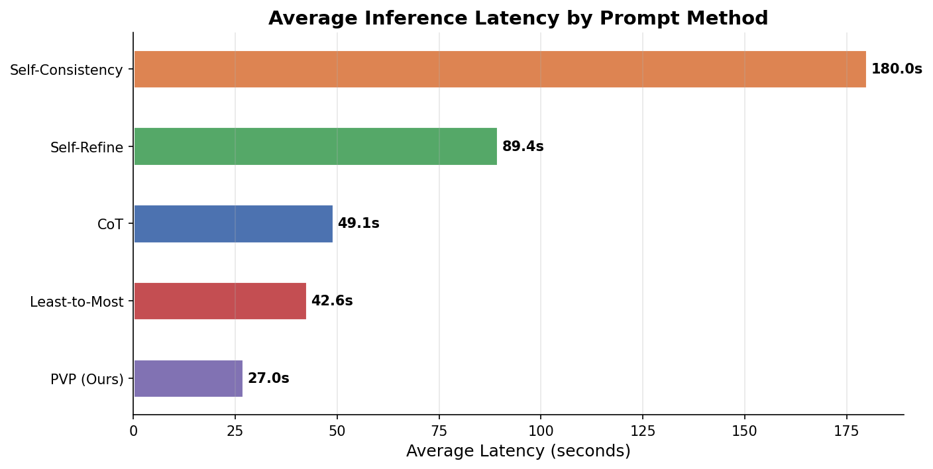
Results - Efficiency Analysis
Accuracy vs Inference Cost
Method | Accuracy | Avg Latency | Efficiency
PVP | 64.0% | ~28s | Best
Least-to-Most | 69.6% | ~43s | Good
CoT | 57.5% | ~47s | Moderate
Self-Refine | 66.7% | ~89s | Low
Self-Consistency | 44.4% | ~208s | Worst
Key Finding: Longer responses do not equal higher accuracy. DeepSeek-R1 + Self-Consistency generates 24K+ chars but achieves only 25.0%.

Slide 12
Discussion & Key Findings
# | Finding
F1 | Model choice > prompt engineering - fine-tuning matters most
F2 | Problem decomposition (Least-to-Most) is most effective for small models
F3 | Self-Consistency fails with small models (insufficient diversity)
F4 | Verification-based methods (PVP, Self-Refine) consistently outperform CoT
F5 | PVP offers the best accuracy/efficiency trade-off
Practical Implications
For limited compute: Use PVP (best accuracy per inference dollar)
For maximum accuracy: Use Least-to-Most (highest overall accuracy)
Avoid Self-Consistency with models < 7B parameters

Slide 13
Live Demo
Streamlit Interactive Solver
1. Select a model (Qwen2.5-Math / DeepSeek-R1)
2. Select a prompt method (CoT / PVP / Least-to-Most)
3. Enter or pick a math problem
4. See: full reasoning response > extracted answer > correctness
Side-by-side comparison: Same problem solved with CoT vs PVP
streamlit run src/app/main.py

Slide 14
Conclusion
Systematic evaluation: 5 methods x 2 models x 2 datasets = 164 problems
PVP is effective: +6.5% over CoT baseline with single-pass efficiency
Key insight: Task-specific models + structured prompting = best results
Open-source framework: Reproducible with pip install + documented commands
Future Work
Scale to larger models (7B, 70B) where PVP benefits may be amplified
Adaptive verification depth based on problem complexity
Combine PVP with Least-to-Most for decomposed + verified reasoning

Slide 15
Questions & Answers
Resources: Full results: results/RESULTS.md Source code: src/ (30 Python modules) Interactive demo: streamlit run src/app/main.py Reproduce: See README.md

Slide 16
Backup: Detailed Per-Dataset Results
Model | Method | GSM8K | MATH-500
Qwen2.5-Math | CoT | 80.0% | 70.0%
Qwen2.5-Math | Self-Consistency | 40.0% | 65.0%
Qwen2.5-Math | Self-Refine | 75.0% | 65.0%
Qwen2.5-Math | Least-to-Most | 100.0% | 65.0%
Qwen2.5-Math | PVP | 66.7% | 60.0%
DeepSeek-R1 | CoT | 100.0% | 35.0%
DeepSeek-R1 | Self-Consistency | - | 25.0%
DeepSeek-R1 | PVP | 100.0% | -

Slide 17
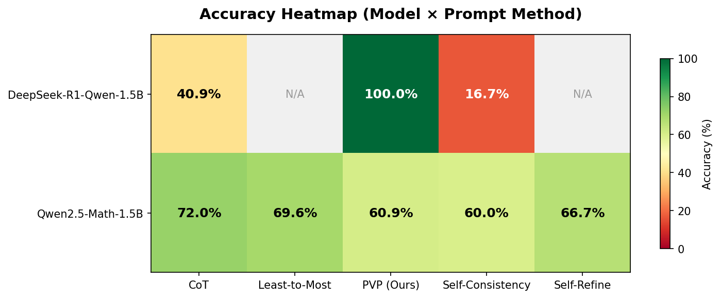
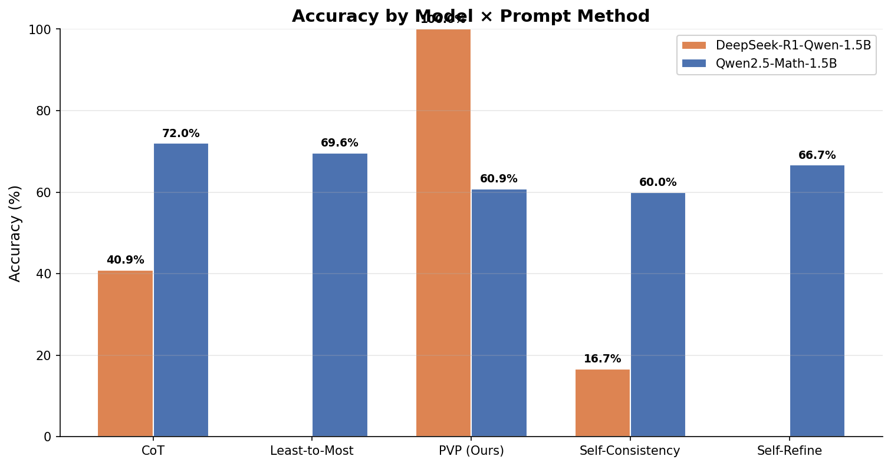
Backup: Model x Method Heatmap

Slide 18
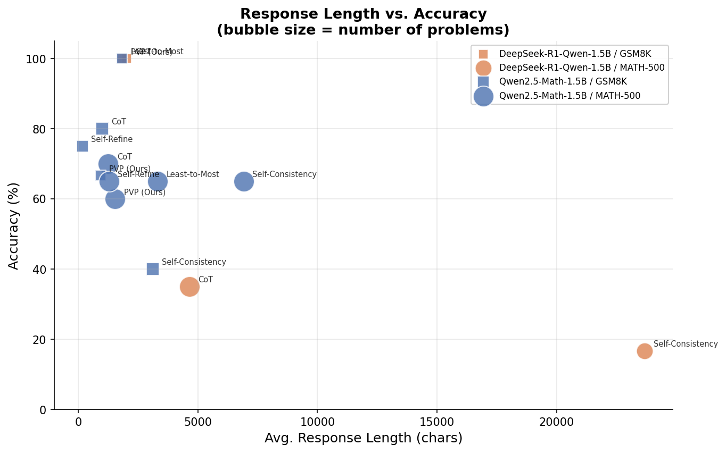
Backup: Response Length vs Accuracy

Slide 19
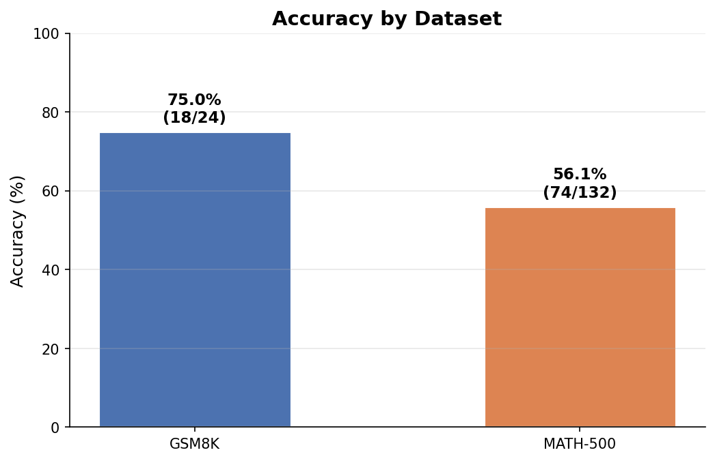
Backup: Accuracy by Dataset
Dataset | Correct | Total | Accuracy
GSM8K | 18 | 24 | 75.00%
MATH-500 | 77 | 140 | 55.00%

Slide 20
Backup: Technology Stack
Component | Technology
Language | Python 3.10+
Local inference | llama-cpp-python (GGUF)
API inference | OpenAI SDK
Datasets | HuggingFace datasets
Math parsing | SymPy
Visualization | Matplotlib, Plotly
Web demo | Streamlit
Testing | pytest (63 tests)

