Slide 1
Ticketing & Train Journey Management
Case Study C1 · ArchiTrain · Focus Area 1
Abstract & Detailed ArchiMate Model
Group C1F1G_
Team: Member 1 · Member 2 · Member 3 · …
TUM School CIT · 2026
Notes:
Good afternoon. We are group C1F1G_. Our case is ArchiTrain and our focus area is F1 - Ticketing & Train Journey Management. We start with the use case and the abstract enterprise model, then go deep into F1 across all three layers, and close with reflection.

Slide 2
ArchiTrain: one architecture, three focus areas
A modern transit enterprise. Passengers tap on / tap off with a Go Card, mobile wallet or contactless bank card; the gate opens in under 400 ms — a single touch spanning hardware, networks, backend and payment.
F1
F2
F3
Ticketing & Train Journey Management
Train Localization & Scheduling
Malfunction & Disruption Management
Fare settlement & journey closure
GPS + odometry + track reference points
Threshold detection → human handover
◀ OUR FOCUS
Material: Sequence Diagram · Interviews (Dr. Marcus Chen · Elena Vasquez · Sarah Mitchell) · Incident Report
Notes:
ArchiTrain is a modern transit enterprise that integrated 14 formerly siloed systems into one architecture. Passengers tap on and off with a Go Card, mobile wallet or contactless bank card, and the gate opens in under 400 milliseconds. The case has three focus areas - F1 ticketing, F2 train localization, F3 disruption - and our team owns F1. Sources: a sequence diagram, three interviews and an incident report.

Slide 3
Our EAM Team

Slide 4
1 Abstract Model
Notes:
First, the abstract model.

Slide 5
Abstract model: three domains × three layers
Layer
F1 Ticketing & Journey
F2 Train Localization
F3 Disruption Mgmt
Passenger · Customer Support Handle Journeys & Fares → Ticketing & Fare Service
Operations Controller · Train Operator Localize & Monitor Trains → Train Operation & Tracking
Malfunction Mgmt (collaboration) Handle Delays & Disruptions → Passenger Information Service
Business
Access Control Mgmt · JAMS Fare Management System · Website
LCCU Control Software Operational Control Center
Disruption Handling System (OCC + PIS + TMS)
Application
Station Infrastructure · App Server Journey & Account Mgmt Backend
LCCU · Central Railway Backend Railway Radio
(shared backend) Private Network
Technology
Abstract level: one generalized process per domain · components without internal structure · devices summarized as nodes · communication as networks only.
Notes:
The abstract model covers the whole enterprise - three domains across three layers. At the abstract level we keep one generalized process per domain, components without internal structure, devices summarized as nodes, and communication shown only as networks. Everything is centered on the Passenger and the three business services.

Slide 6
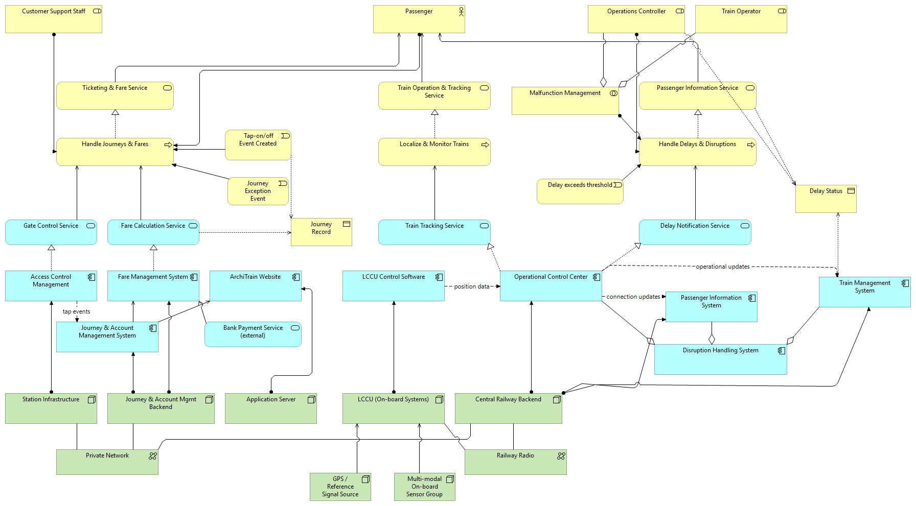
Abstract Model

Slide 7
2 Detailed Model — Focus Area F1 - Business Layer
Notes:
Now the detailed model for our focus area, F1.

Slide 8
Technology layer — Element
1.Element
2.Relationship
3.Overview
Role ：Passenger
Part I ： Journey Handling -- describes how a passenger journey is handled
Full technology view grouped into four perspectives — examined one by one next.
Notes:
Here is the full technology layer, grouped into four perspectives. We examine them one by one: tap and gate, communication, backend storage, and self-service with settlement.

Slide 9
Technology layer — Element
1.Element
2.Relationship
3.Overview
Actor : External Bank
Part II： Fare Handling -- describes how the fare is calculated and settled
Full technology view grouped into four perspectives — examined one by one next.
Notes:
Here is the full technology layer, grouped into four perspectives. We examine them one by one: tap and gate, communication, backend storage, and self-service with settlement.

Slide 10
Technology layer — Element
1.Element
2.Relationship
3.Overview
Role ：Passenger
Part III ：Go Card Management and Passenger Support-- describes how passengers can manage their Go Card
Full technology view grouped into four perspectives — examined one by one next.
Notes:
Here is the full technology layer, grouped into four perspectives. We examine them one by one: tap and gate, communication, backend storage, and self-service with settlement.

Slide 11
Technology layer — Ralationship
1.Element
2.Relationship
3.Overview
Full technology view grouped into four perspectives — examined one by one next.
Notes:
Here is the full technology layer, grouped into four perspectives. We examine them one by one: tap and gate, communication, backend storage, and self-service with settlement.

Slide 12
Technology layer — Overview
1.Element
2.Relationship
3.Overview
Full technology view grouped into four perspectives — examined one by one next.
Notes:
Here is the full technology layer, grouped into four perspectives. We examine them one by one: tap and gate, communication, backend storage, and self-service with settlement.

Slide 13
Business layer
Business layer — to be added
(pending teammate input: actors, processes, services, events)
Notes:
[Business layer - presented by teammate.] The business layer covers Conduct Journey, Calculate Fare and Manage Go Card.

Slide 16
Application layer
Application layer — to be added
(components, application services, data objects)
Notes:
[Application layer - presented by teammate.] Access Control Management, JAMS, the Fare Management System and the Website.

Slide 17
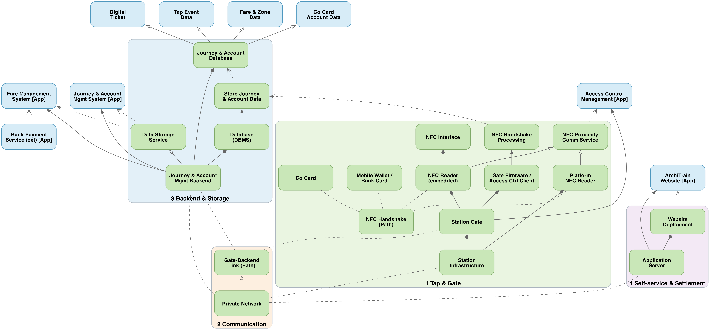
Technology layer — overview & four perspectives
Overview
1 Tap & Gate
2 Communication
3 Storage
4 Self-service
Full technology view grouped into four perspectives — examined one by one next.
Notes:
Here is the full technology layer, grouped into four perspectives. We examine them one by one: tap and gate, communication, backend storage, and self-service with settlement.

Slide 18
Perspective 1 — Tap & gate access
Overview
1 Tap & Gate
2 Communication
3 Storage
4 Self-service
Access Control Management
serving
NFC Proximity Comm Service
NFC Interface
NFC Handshake Processing
real
real
comp
assign
assign
Platform NFC Reader
Go Card
Mobile Wallet / Bank Card
NFC Reader (embedded)
Gate Firmware / Access Ctrl Client
assoc
assoc
assoc
assoc
comp
comp
comp
NFC Handshake (Path)
Station Gate
comp
Station Infrastructure
Passenger taps a Go Card / mobile wallet → NFC Handshake (Path) → reader; NFC Readers realize NFC Proximity Communication Service; Station Gate ⊃ Gate Firmware → NFC Handshake Processing; gate assigned to Access Control Management (< 400 ms).
Notes:
A passenger taps a Go Card or mobile wallet. The NFC Handshake, modelled as a Path, links the card with the reader. Embedded and platform NFC readers realize the NFC Proximity Communication Service. The Station Gate contains the Gate Firmware that performs NFC Handshake Processing, and the gate is assigned to Access Control Management, which opens the barrier in under 400 milliseconds.

Slide 19
Perspective 2 — Communication (pattern P01)
Overview
1 Tap & Gate
2 Communication
3 Storage
4 Self-service
NFC Reader (embedded)
comp
Go Card
Mobile Wallet / Bank Card
Platform NFC Reader
Station Gate
Journey & Account Mgmt Backend
assoc
assoc
assoc
assoc
comp
comp
assoc
assoc
NFC Handshake (Path)
Station Infrastructure
Gate-Backend Link (Path)
Application Server
assoc
assoc
real
assoc
Private Network
Card ↔ reader uses NFC Handshake (Path); Gate-Backend Link (Path) is realized by the Private Network (Communication Network) — course pattern P01; the network connects Station Infrastructure, the backend and the Application Server.
Notes:
Communication follows the course pattern P01. The card-to-reader link is a Path; the Gate-Backend Link is also a Path, realized by the Private Network, which is a Communication Network. That private network connects the station infrastructure, the backend and the application server.

Slide 20
Perspective 3 — Backend storage & data
Overview
1 Tap & Gate
2 Communication
3 Storage
4 Self-service
Tap Event Data
Go Card Account Data
Fare & Zone Data
Digital Ticket
real
real
real
real
Journey & Account Database
access
Store Journey & Account Data
Journey & Account Mgmt System
Fare Management System
assign
comp
serving
serving
Database (DBMS)
assign
Data Storage Service
assign
comp
real
Journey & Account Mgmt Backend
Journey & Account Mgmt Backend ⊃ Database (DBMS) + Journey & Account Database (Artifact); the backend realizes the Data Storage Service serving JAMS & FMS; the artifact realizes Tap Event, Go Card Account, Fare & Zone and Digital Ticket data objects.
Notes:
The Journey & Account Management Backend contains the DBMS and the Journey & Account Database artifact. The backend realizes the Data Storage Service, which serves JAMS and the Fare Management System. The database artifact realizes the four application data objects: Tap Event, Go Card Account, Fare & Zone, and Digital Ticket.

Slide 21
Perspective 4 — Self-service & bank settlement
Overview
1 Tap & Gate
2 Communication
3 Storage
4 Self-service
ArchiTrain Website
real
Website Deployment
Fare Management System
assign
comp
assign
serving
Application Server
Journey & Account Mgmt Backend
Bank Payment Service (ext)
assoc
assoc
Private Network
Application Server ⊃ Website Deployment → realizes the ArchiTrain Website; the app server reads Go Card balances over the Private Network; Bank Payment Service (external) serves the Fare Management System for settlement.
Notes:
The Application Server hosts the Website Deployment, which realizes the ArchiTrain Website. The app server reads Go Card balances over the private network. For payments, the external Bank Payment Service serves the Fare Management System for settlement.

Slide 22
3 Reflection
Notes:
Finally, reflection.

Slide 23
Reflection
Business value
Limitations
[ to be completed with the team ]
[ to be completed with the team ]
Missing information
Modeling challenges
[ to be completed with the team ]
[ to be completed with the team ]
Notes:
Business value: a single card makes the fare chain transparent end to end; we identified a single point of risk - the backend carries journey, fare and account data together; the 24-hour timeout protects revenue. Limitations and missing information: inconsistent naming, and no deployment, network topology, security or reconciliation of a late tap-off. Our main modeling challenge was the level of abstraction and representing tap-on and tap-off as handled equally.

Slide 24
Conclusion
• The abstract model covers the whole enterprise (F1 + F2 + F3) with structure and behaviour
• The F1 detailed model is developed across business, application and technology — communication explicitly modelled
• The vertical chain Node → Component → App Service → Business Process → Business Service → Passenger is derivable
Thank you — questions & discussion welcome.
Notes:
To conclude: the abstract model covers the whole enterprise; the F1 detailed model is developed across all three layers with communication explicitly modelled; and the vertical chain from node to component to service to business process to the passenger is fully derivable. Thank you - we are happy to take questions.

