Slide 1
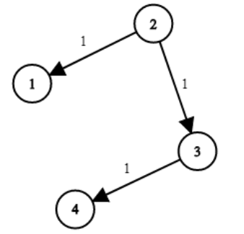
{
2: [(1, 1), (3, 1)],
3: [(4, 1)]
}

