Slide 1
XLM-RoBERTa
Deep Learning

Slide 2
MEMBERS OF GROUP
Nguyễn Công Minh Thành
Trần Trung Dũng
520K0215
520K0339

Slide 3
Table of contents
01
02
03
04
Introduction
Overview
We’’ll introduce about the model.
The overview of the model.
Conclusions
Compare
Comparation with another models
The conclusion about the model

Slide 4
01
Introduction

Slide 5
Do you need longer text?
What is XLM-RoBERTa?
XLM-RoBERTa is pre-trained on a large corpus of text data from multiple languages, allowing it to learn language-agnostic representations. This means that it can understand and generate text in different languages, even if it was not explicitly trained on that language. It can be fine-tuned on specific tasks such as text classification, named entity recognition, machine translation, and other natural language processing tasks to achieve high performance on various multilingual tasks. XLM-RoBERTa is commonly used in tasks that require cross-lingual understanding, such as machine translation, cross-lingual text classification, and cross-lingual named entity recognition.
XLM-RoBERTa stands for Cross-lingual Masked Language Model - RoBERTa. It is a type of language model, which is a deep learning model trained on large amounts of text data to understand and generate human-like text. XLM-RoBERTa is specifically designed for cross-lingual language understanding, meaning it can process and generate text in multiple languages. It is based on the RoBERTa architecture, which is a variant of the popular BERT (Bidirectional Encoder Representations from Transformers) model.

Slide 6
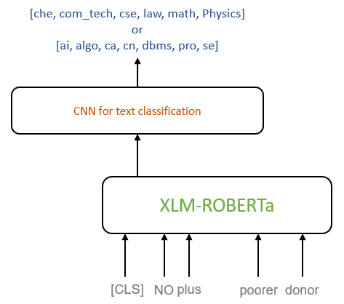

Slide 7

Overview
02
An overview of XLM-RoBERTa

Slide 8
Overview
1
2
3
Cross-lingual
Masked Language Modeling
RoBERTa Architecture
4
5
6
Fine-tuning
Applications
Summary

Slide 9
Overview
1. Cross-lingual: XLM-RoBERTa
XLM-RoBERTa is designed to understand and generate text in multiple languages. It is trained on a large corpus of text data from diverse languages, allowing it to learn language-agnostic representations. This enables it to transfer its knowledge across different languages and perform well in cross-lingual tasks.

Slide 10
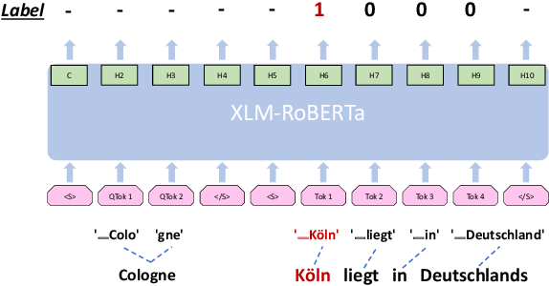
Overview
1. Cross-lingual: XLM-RoBERTa

Slide 11
Overview
2. Pre-training objectives:
XLM-RoBERTa is pre-trained using a combination of Masked Language Modeling and Translation Language Modeling objectives, with the goal of learning a general representations of language that can be applied across multiple languages.

Slide 12
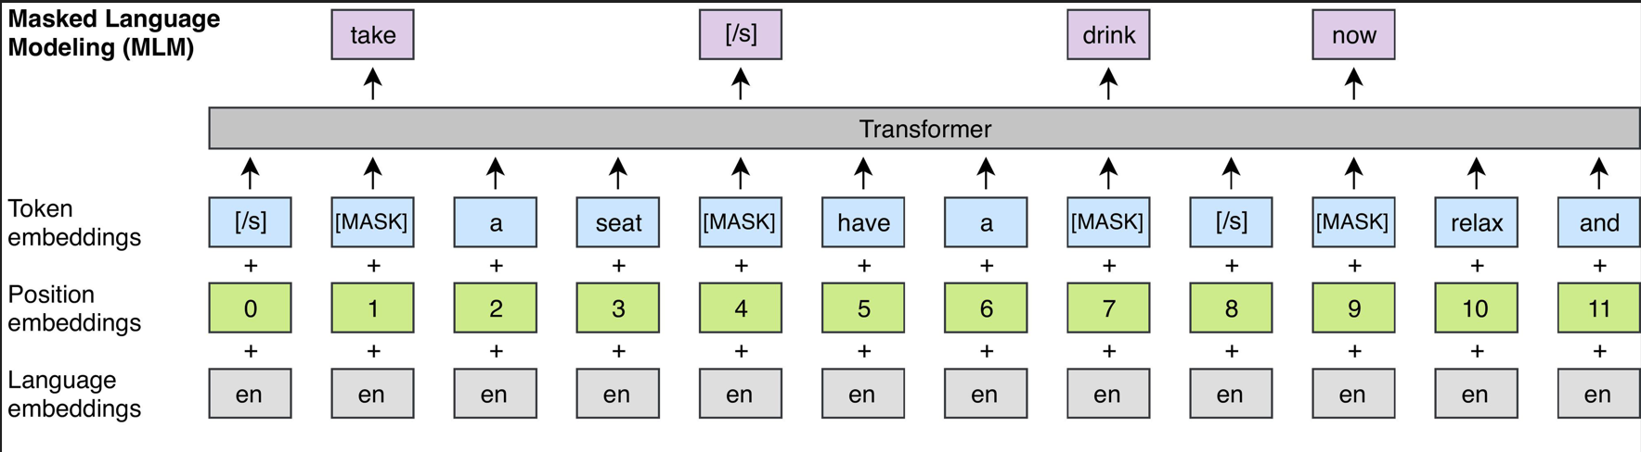
Overview
2.1 Masked Language Modeling

Slide 13
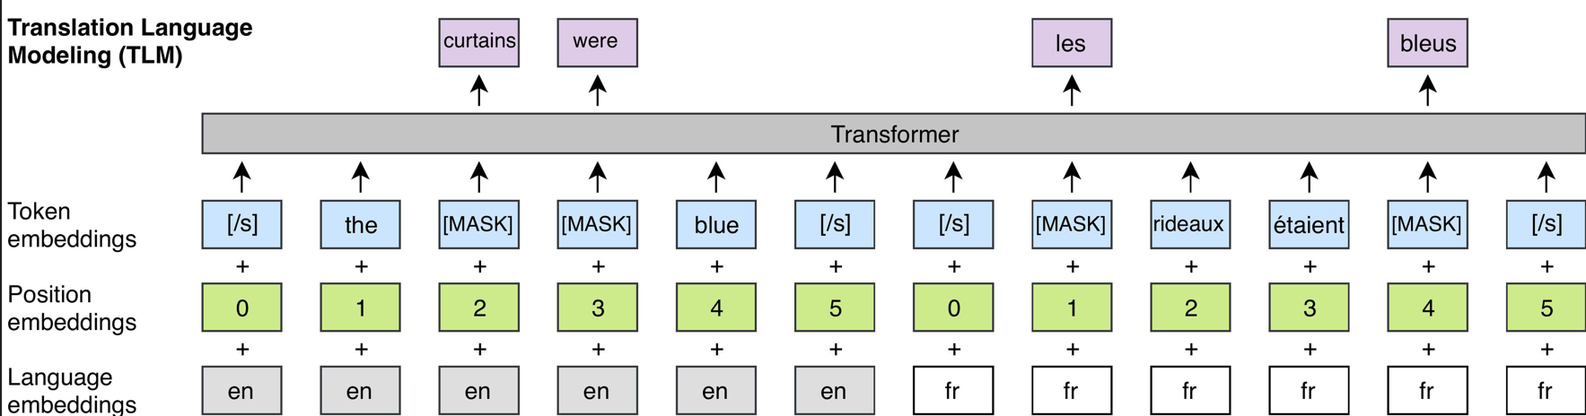
Overview
2.2 Translation Language Modeling:

Slide 14
Overview
3. RoBERTa Architecture: XLM-RoBERTa
XLM-RoBERTa is based on the RoBERTa architecture, which is a variant of the BERT model. RoBERTa stands for "Robustly Optimized BERT" and includes several modifications and optimizations to improve the performance of the original BERT model. It uses a large-scale transformer-based architecture with multiple layers of self-attention and feed-forward neural networks to model the contextual relationships between words in a sentence.

Slide 15
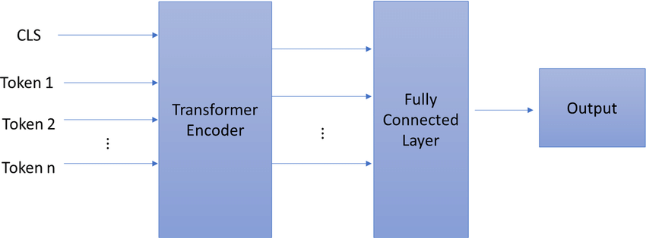
Overview
3. RoBERTa Architecture: XLM-RoBERTa

Slide 16
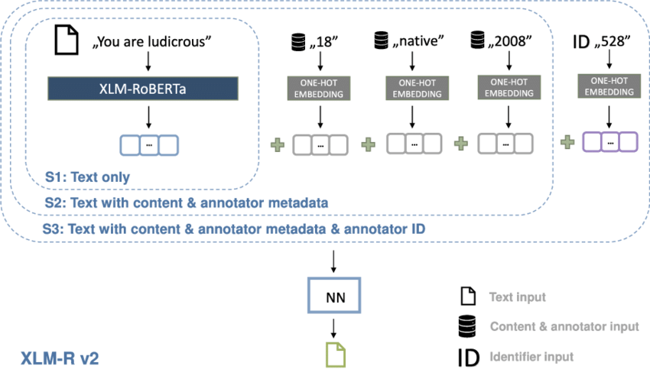
Overview
3. RoBERTa Architecture: XLM-RoBERTa

Slide 17
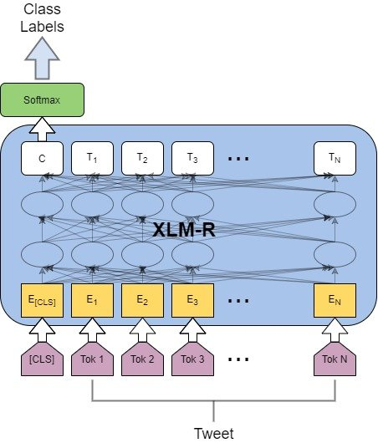
Overview
Text classification architecture with XLM-R

Slide 18
Overview
4. Fine-tuning
After pre-training, XLM-RoBERTa can be fine-tuned on specific downstream tasks, such as text classification, named entity recognition, sentiment analysis, etc., using task-specific data. Fine-tuning helps to adapt the model to the specific task and domain, and achieve high performance in task-specific benchmarks.

Slide 19
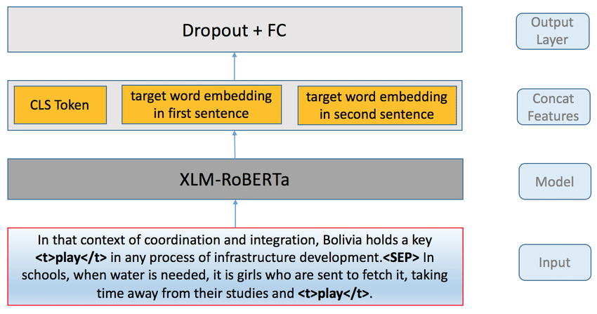
Overview
4. Fine-tuning

Slide 20
Overview
5. Applications
XLM-RoBERTa is commonly used in various natural language processing (NLP) tasks that require cross-lingual understanding. It has been shown to achieve state-of-the-art performance in tasks such as cross-lingual text classification, machine translation, named entity recognition, and more. It is particularly useful in scenarios where multilingual text data is available and cross-lingual transfer learning is required.

Slide 21
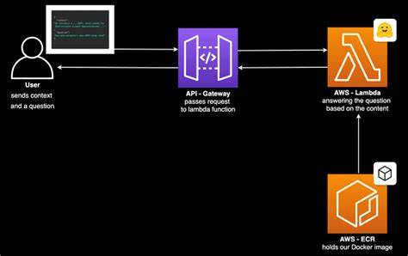
Overview
5. Applications

Slide 22

6. Summary
In summary, XLM-RoBERTa is a powerful language model that combines cross-lingual learning and masked language modeling to understand and generate text in multiple languages. It is based on the RoBERTa architecture and can be fine-tuned for various NLP tasks, making it a versatile tool for cross-lingual text processing.

Slide 23
03
Comparisons

Slide 24
XLM-RoBERTa vs BERT
Pre-training data: Bert was pre-trained on English Wikipedia and Books Corpus dataset, XLM-Roberta was pre-trained on 100 languages text dataset (better cross-lingual transfer learning).
Tokenization: Bert uses WordPiece tokenization algorithm, XLM-Roberta uses Byte Pair Encoding algorithm (better in handle complex morphology languages)
Vocab size: Bert uses 30k token vocab, XLM-Roberta uses 250k token vocab (represent a larger range of words and sub-words).
Model size: Bert has 110 mil parameters in largest version, XLM-Roberta has 355 mil parameters.
Pre-training objective: XLM-Roberta uses a variant of the masked language modeling task used by Bert, plus cross-lingual language modeling task, which involves predicting the masked tokens in parallel text from different languages.

Slide 25
XLM-RoBERTa vs RoBERTa
Pre-training data: same dataset with BERT but with larger size and addition web data.
Vocab size: RoBERTa uses 50k tokens vocab, smaller than XLM-RoBERTa with 250K tokens vocab.
Pre-training objective: RoBERTA uses a modified version of Masked Language Modeling called Dynamic Masking, while XLM-RoBERTA uses MLM objective with a language ID task. This allows the model to learn to generate representations of text in multiple language with a higher quality.
Training data sampling: XLM uses a language-aware data sampling strategy during pre-training, which helps to balance the amount of data from each language in the pre-training corpus (improve ability to handle cross-lingual transfer learning).

Slide 26
XLM-RoBERTa vs GPT-3
Architecture: XLM-RoBERTa is based on the RoBERTa architecture, which is a variant of the BERT model and is specifically designed for cross-lingual language understanding. It uses a transformer-based architecture with multiple layers of self-attention and feed-forward neural networks. On the other hand, GPT-3 (Generative Pre-trained Transformer 3) is a more advanced version of the GPT model, using an autoregressive transformer-based architecture that generates text word-by-word, making it suitable for tasks that require text generation.
Training Objective: XLM-RoBERTa is trained using a masked language modeling objective, where it learns to predict missing words in sentences based on the context of the surrounding words. This helps it learn deep contextual representations of text. On the other hand, GPT-3 is trained using a language modeling objective, where it learns to predict the next word in a sequence of text. This makes GPT-3 more focused on generating coherent and fluent text.
Multilingual vs. Monolingual: XLM-RoBERTa is specifically designed for cross-lingual language understanding, as it is trained on a large corpus of text data from multiple languages, allowing it to understand and generate text in different languages. It is ideal for tasks that require processing multilingual text data. On the other hand, GPT-3 is primarily trained on English text data and is designed for monolingual language understanding and generation tasks, making it more suitable for tasks that focus on English text.

Slide 27
XLM-RoBERTa vs GPT-3
Use Cases: XLM-RoBERTa is commonly used in tasks that require cross-lingual understanding, such as cross-lingual text classification, machine translation, and named entity recognition. It is particularly useful in scenarios where multilingual text data is available and cross-lingual transfer learning is required. On the other hand, GPT-3 is often used in tasks that require text generation, such as chatbots, text completion, and text summarization, where the model generates coherent and fluent text based on the input prompts.
Scale and Capacity: GPT-3 is currently the largest publicly available language model, with a massive number of parameters (175 billion), making it one of the most powerful language models to date. In comparison, XLM-RoBERTa comes in various sizes with different parameter counts, ranging from small to large, depending on the specific version used. GPT-3's large size and capacity enable it to generate more diverse and contextually rich text, but it also requires significant computational resources for training and inference.

Slide 28
XLM-RoBERTa vs T5/mT5
Pre-training objective: XLM-Roberta uses masked language modeling task from Bert along with cross-lingual language modeling task, while T5 and MT5 uses a variant of denoising autoencoder objective (corrupting text and then training the model to reconstruct the original text)
I/O format: T5 and MT5: generative models (trained to take in seq as input and generate output seq), XLM-Roberta: discriminative model (mostly used for tasks like text classification or seq labeling,etc.)
Model size: XLM-Roberta is smaller than T5 and MT5 (355 mil parameters compare to 11 bil parameters in T5 and 570 mil parameters in MT5).
Pre-processing and post-processing: T5 and MT5 require specialized pre-processing and post-processing steps, XLM-Roberta can be used generally for a wide range of NLP tasks.

Slide 29
XLM-RoBERTa and T5 (Text-to-Text Transfer Transformer) and MT5
Pre-training data: XLM-Roberta and MT5 are both trained on multilingual dataset, XLM: 100 languages, MT5: 101 languages (better for cross-lingual transfer learning than T5).
Pre-training objective: XLM-Roberta uses masked language modeling task from Bert along with cross-lingual language modeling task, while T5 and MT5 uses a variant of denoising autoencoder objective (corrupting text and then training the model to reconstruct the original text)
I/O format: T5 and MT5: generative models (trained to take in sequence as input and generate output sequence), XLM-Roberta: discriminative model (mostly used for tasks like text classification or sequence labelling, etc.)
Pre-processing and post-processing: T5 and MT5 require specialized pre-processing and post-processing steps, XLM-Roberta can be used generally for a wide range of NLP tasks.

Slide 30
XLM-RoBERTa and T5 (Text-to-Text Transfer Transformer) and MT5
Training Objective: XLM-RoBERTa is trained using a masked language modeling objective, T5 and MT5 are trained using a text-to-text transfer learning framework.
Task Flexibility: T5 and MT5 are designed to be more flexible and versatile, allowing for fine-tuning on a wide range of NLP tasks by framing them as text-to-text tasks.
Multilingual Capability: XLM-RoBERTa and MT5 are specifically designed for cross-lingual tasks and are trained on multilingual text data, while T5 is trained on monolingual text data from a single language.
Model Size and Capacity: All three models come in different sizes with varying parameter counts, offering different trade-offs between performance and computational resources required.
Use Cases: XLM-RoBERTa and MT5 are commonly used for cross-lingual tasks, while T5 and MT5 are more versatile and can be used for a wide range of text-to-text transfer tasks.

Slide 31

04
Conclusions

Slide 32
XLM-RoBERTa is a powerful language model that is specifically designed for cross-lingual language understanding tasks. It is based on the RoBERTa architecture and is trained on a large corpus of text data from multiple languages, allowing it to capture cross-lingual representations of text. XLM-RoBERTa has been shown to achieve state-of-the-art performance on a wide range of cross-lingual NLP tasks, such as cross-lingual text classification, machine translation, and named entity recognition.
The key strengths of XLM-RoBERTa include its ability to understand and generate text in multiple languages, its strong performance on cross-lingual tasks, and its adaptability for fine-tuning on specific NLP tasks. However, it may be less suitable for monolingual tasks or tasks that require more task-specific fine-tuning with large amounts of task-specific data.
XLM-RoBERTa is widely used in various natural language processing applications, particularly those that involve processing text data from multiple languages. It has been proven to be a valuable tool for overcoming language barriers and enabling cross-lingual communication and understanding. As with any language model, it is important to carefully consider the specific requirements and limitations of XLM-RoBERTa when using it in practical applications, and to thoroughly evaluate its performance and suitability for the task at hand.

Slide 33

END OF PRESENTATIONS! THANKS FOR LISTENING!!!

