Slide 1
Deep Learning Final Project
Human Emotion Classification
© 2025 YuKitAs
https://github.com/YuKitAs/unsupervised-learning-final-project
Apache License 2.0

Slide 2
Intro
Project Goal
Use deep learning to classify human emotions.
Dataset
Image data from Kaggle with 1200 human photos across 6 emotion classes.
Steps
Exploratory Data Analysis (EDA) ‭→ Model Building → Results and Analysis

Slide 3
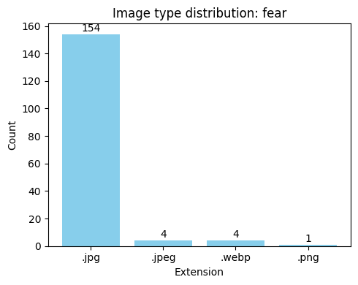
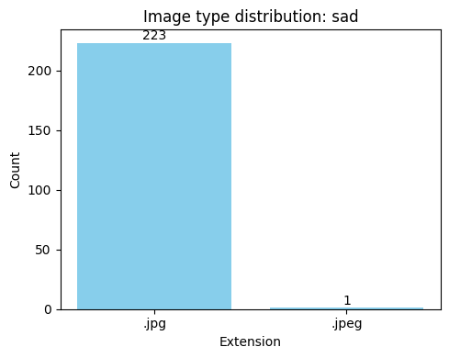
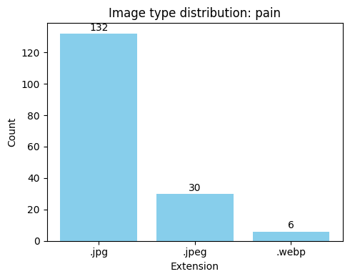
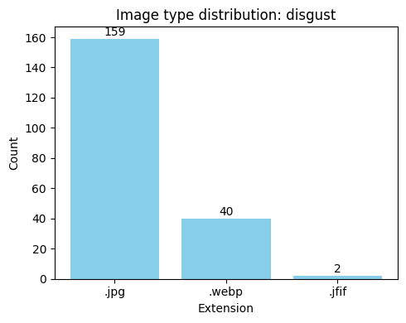

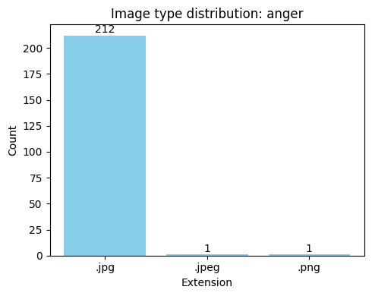
EDA – Data Inspection
Fear: 163 | Sad: 224 | Pain: 168
Disgust: 201 | Happy: 230 | Anger: 214

Slide 4
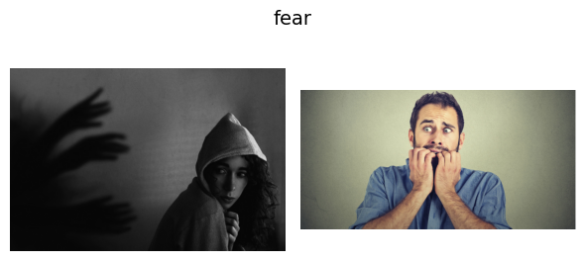
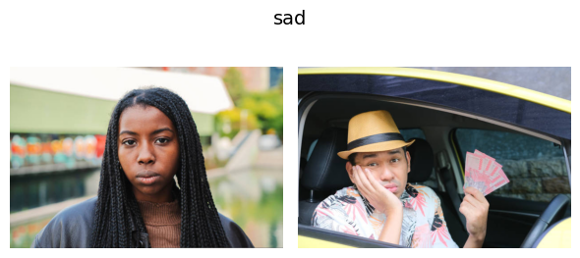
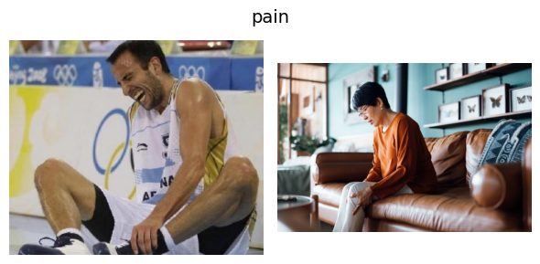


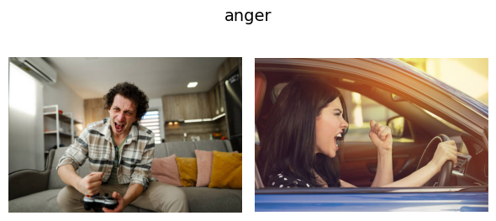
EDA – Data Inspection

Slide 5
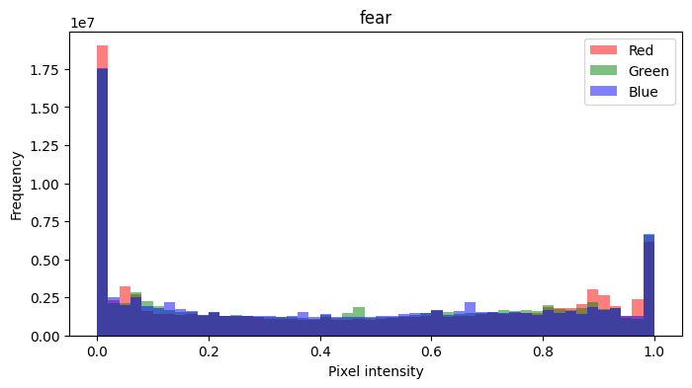
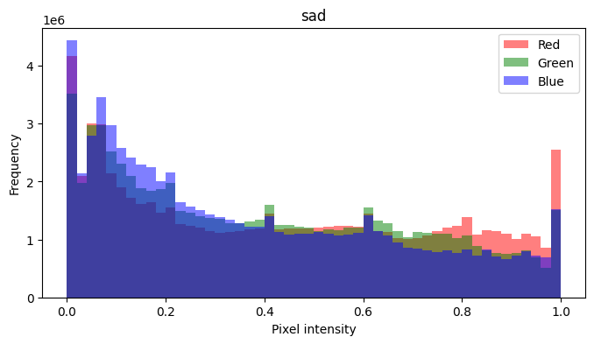
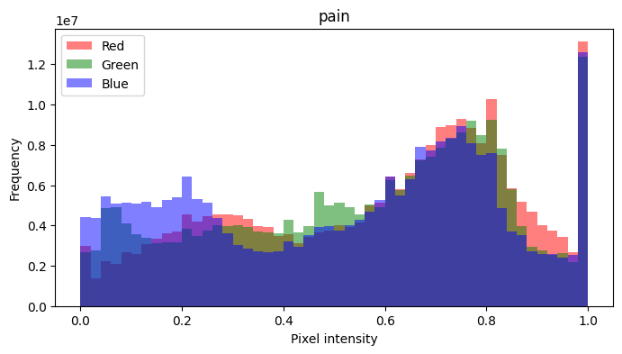
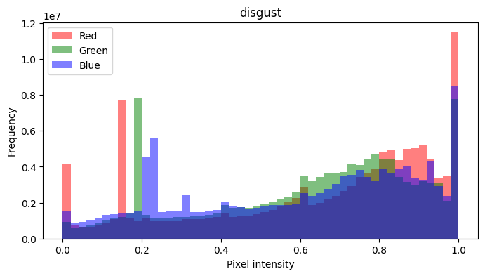
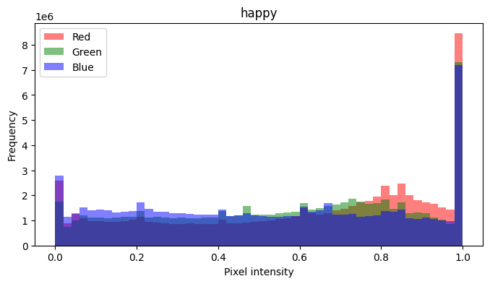
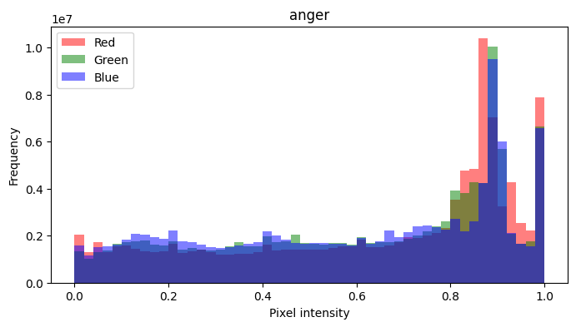
EDA – Data Inspection

Slide 6
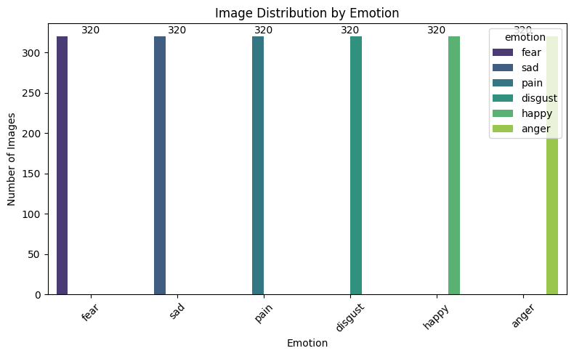
EDA – Data Preprocessing
Convert all images to JPG
Center-crop resize (no padding): 64x64 and 128x128
Data augment: random horizontal flipping + brightness
Rebalance classes

Slide 7
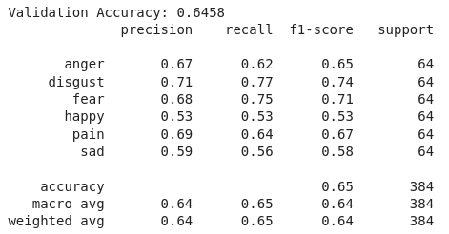
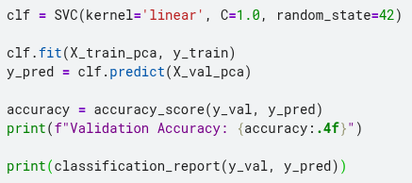
Model – SVM
Works well in high-dimensional spaces and can handle smaller datasets effectively.
Data split: 80% train + 20% valdiation
Feature extraction: HOG + pixel colors
Rescale features
PCA: reduce dimensionality and remove redundancy

Slide 8
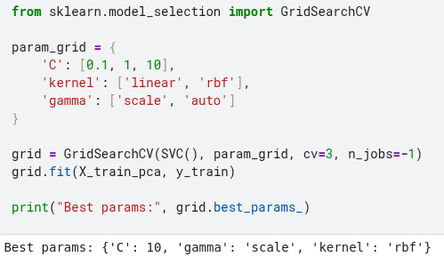

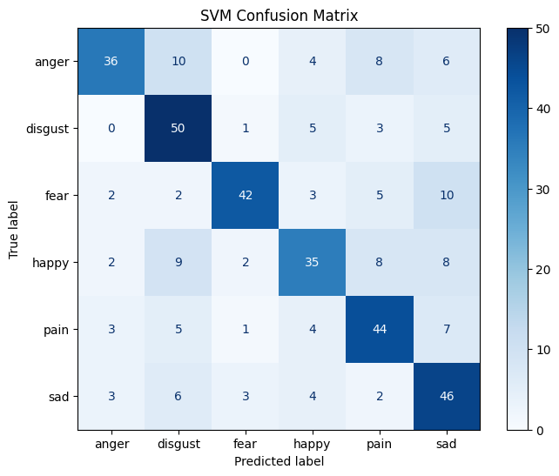
Result – SVM Tuning

Slide 9
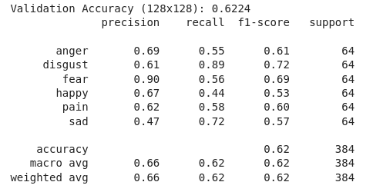
Result – SVM (128x128)

Slide 10
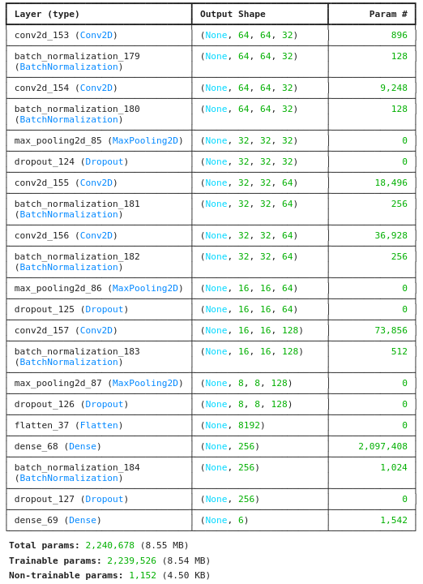
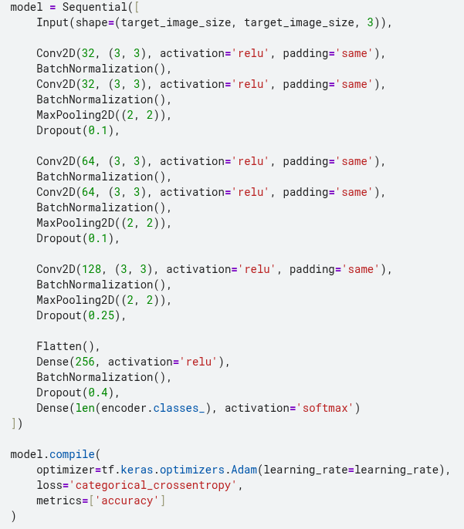
Model – Simple CNN
Baseline to observe how a simple architecture performs without transfer learning.

Slide 11
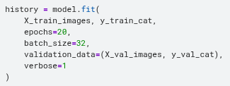
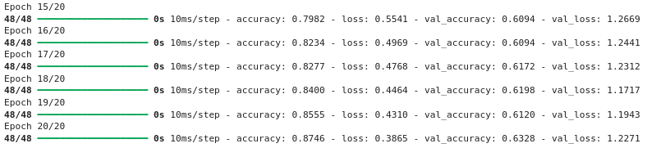
Model – Simple CNN

Slide 12
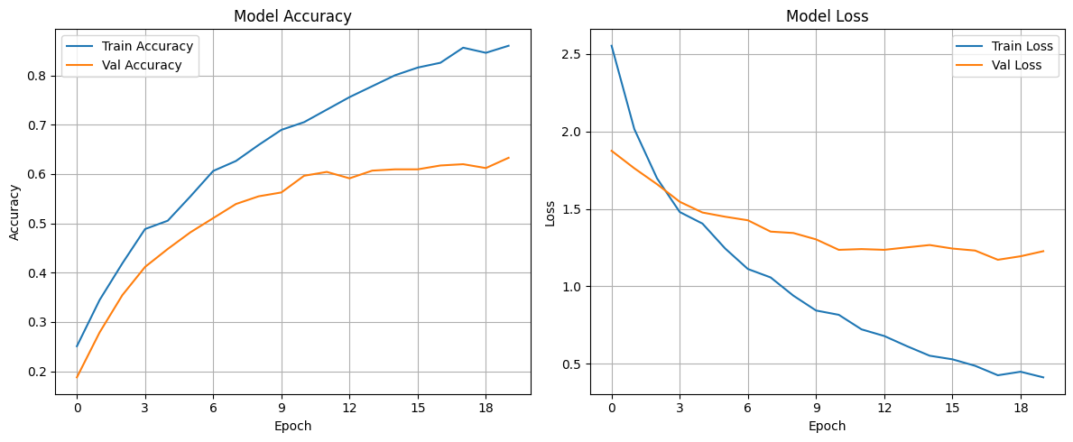
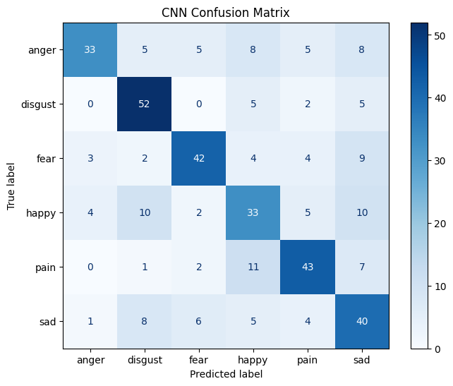
Result – Simple CNN

Slide 13
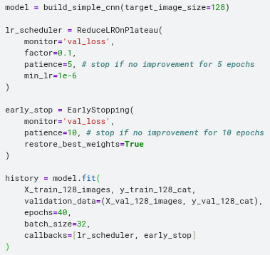
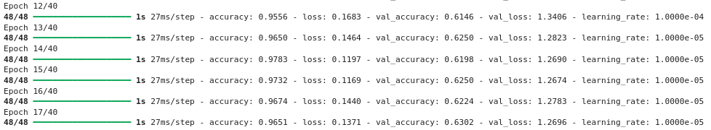
Result – Simple CNN Tuning (128x128)

Slide 14
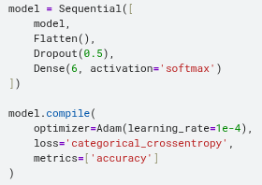
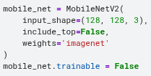
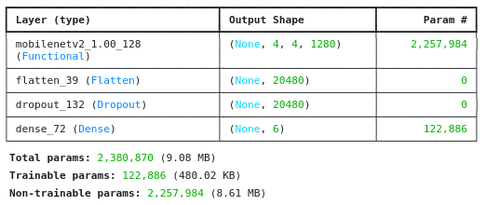
Model – MobileNetV2
Lightweight and efficient, suitable for faster training.

Slide 15
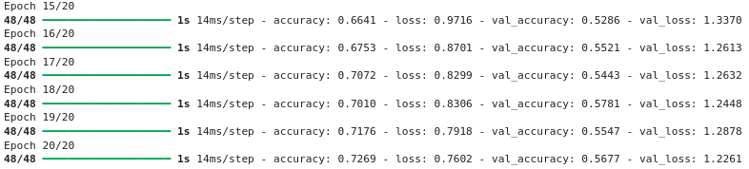
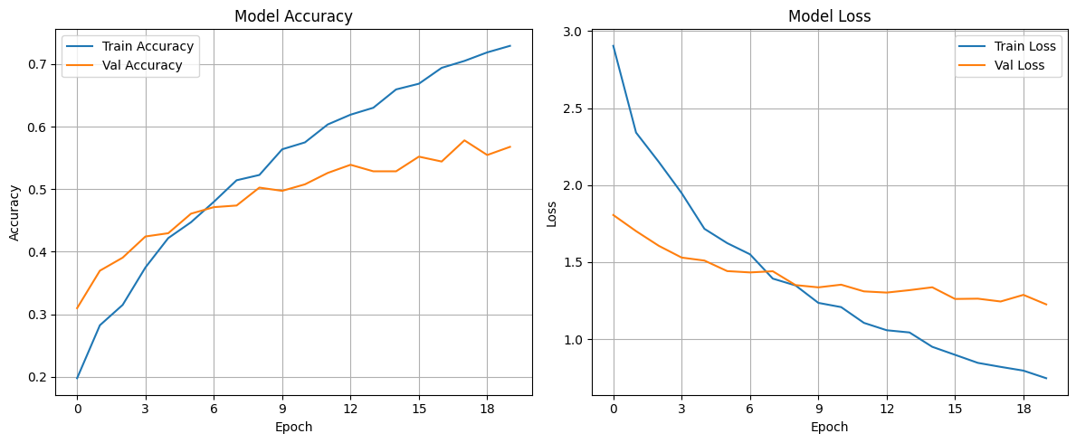
Result – MobileNetV2 (128x128)

Slide 16
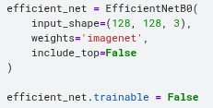
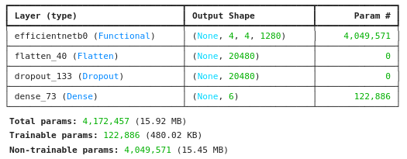
Model – EfficientNetB0
Offers a good balance between accuracy and model size.

Slide 17
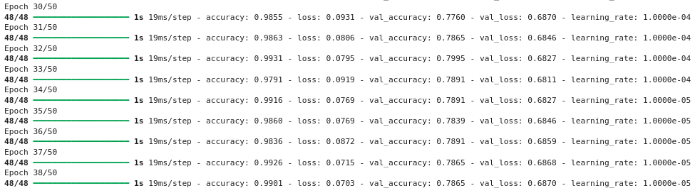
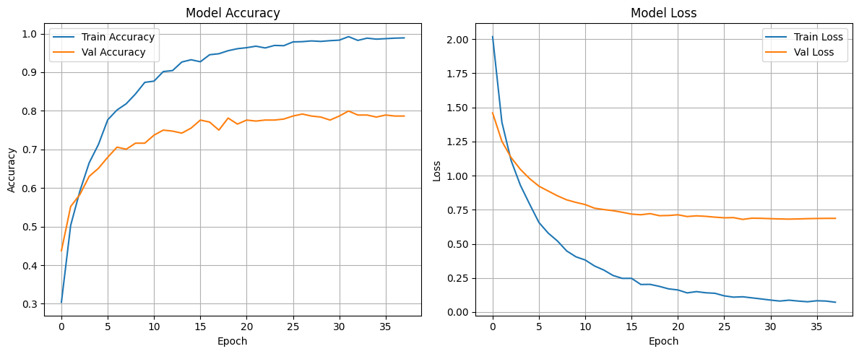
Result – EfficientNetB0 (128x128)

Slide 18
Conclusion
Challenges
  Small, imbalanced dataset
  Varied sizes/types, background noise, faces not well-centered
  Limited training time/resources: only trained on 64×64 & 128×128
SVM vs. Simple CNN: comparable
Best: EfficientNetB0
Future Improvements
  Larger dataset, higher-res images, more augmentation
  Apply face detection/cropping to reduce background noise
  Improve CNN architecture
  Fine-tune pretrained models

Slide 19
Thanks for Your Attention!

