Slide 1
Video Compression
Mentor :
Mr. Niteesh Sahni
Presented By:
Mayank Roy
Sarvagya Mukhi
Riya Aggarwal
Shreya Gupta
Associate Mentors
Mr. Sarvesh Kumar
Ms. Dhanya

Slide 2
VIDEO
A video is the technology of processing a sequence of still images representing scenes in motion.
Hence, any video can be divided into a number of images where each image represents a frame.

Slide 3
THE NEED FOR COMPRESSION
Raw video contains an immense amount of data
Communication and storage capabilities are limited and expensive.
Example HDTV video signal → 720x1280 pixels/frame progressive scanning at 60 frames/sec. (720 x 1280 pixel/frame) X (60 frames/sec) X (3 colors/pixel ) X ( 8bits/color ) = 1.3 Gb/sec !!!
20 Mb/s HDTV channel bandwidth !!
Requires compression by a factor of 70 .

Slide 4

IMAGE
A digital image consists of pixels with color intensity values for red, green and blue(rgb format). These values together make up a 3-D matrix consisting of three planes.

Slide 5
IMAGE
An LUVMAP image is an M-by-3 matrix that contains the NTSC luminance (L) and chrominance (U and V) colour components as columns that are equivalent to the colours in the RGB colour map.
Notes:
National Television System Committee

Slide 6
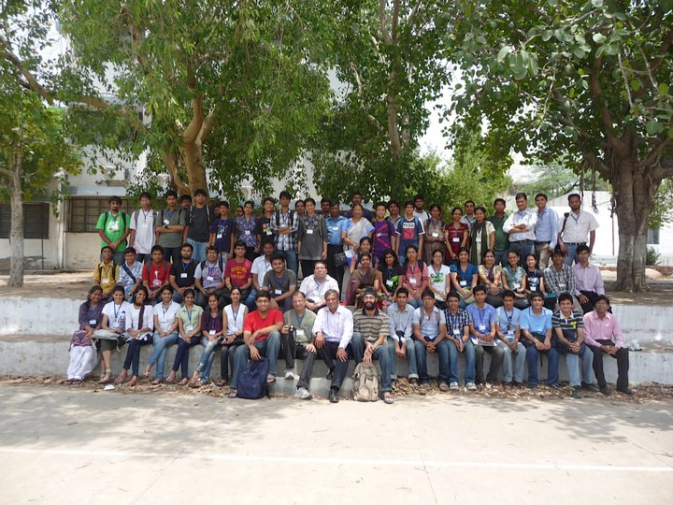
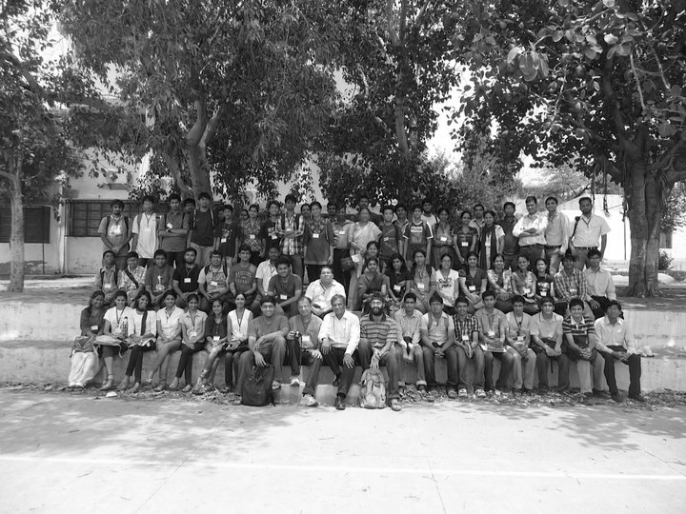
IMAGE
The image on the right shows the L plane of the original image (left).
The L plane consisting of the luminance values returns a grayscale version of the image.
A grayscale image is really just a 2-D matrix whose entries correspond to pixel intensity value.

Slide 7
Image as a vector space
If an image has M rows and N columns of pixels, then we identify it as a matrix V of dimensions M x N.
This matrix V is a vector space.
A vector space is a non-empty set which follows the properties of addition “+” and multiplication “.”.
Notes:
A vector space V is a non empty set with two operations addition “+” and multiplication “.” by scalars such that the following conditions are satisfied for any x,y,z ϵ V and α , β in F :
x + y = y + x
(x + y) + z = x + (y + z)
x+z = y has unique solution z for each pair (x,y).
α(βx) = (αβ)x
(α+β)x = αx+βx
α(x + y) = αx + αy
1.x = x

Slide 8
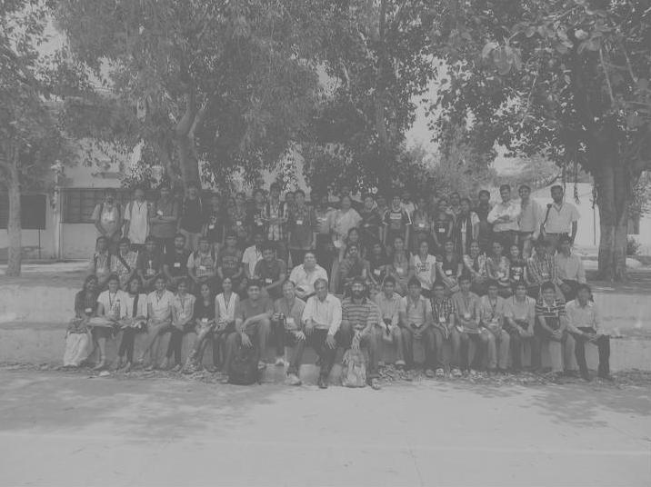
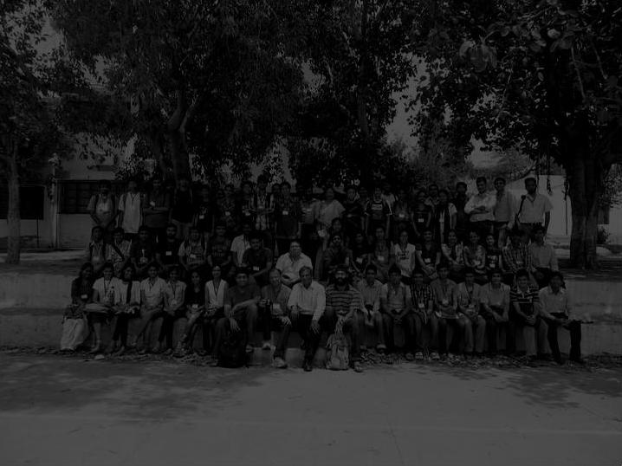
IMAGE AS A VECTOR SPACE
Figure 1
Figures 1 & 2 represent addition operation acted upon the above image.
Figure 1 → image + 80
Figure 2 → image – 20
Thus the image can be treated as a vector space where the specified magnitude gets added/subtracted from the original intensity values.
Figure 2

Slide 9
INNER PRODUCT SPACE
A vector space along with an inner product (dot/scalar product) is called an inner product space.
Inner product of u & v ϵ V (vector space) denoted by <u,v> which returns a scalar value.

Slide 10
BASIS OF A VECTOR
Basis : Suppose S={v₁,v₂,….,v_{n}} is a linearly independent set of vectors from the vector space V. Then S is called a basis (plural is bases) for V if any w ϵ V can be expressed as
w= a₁v₁ + a₂v₂ + ….. + a_{n}v_{n}
where a₁,a₂,…,a_{n} are scalars.
Orthonormal basis:
An orthonormal basis for an inner product space is a basis whose elements are pairwise orthogonal
i.e. <x_{i},x_{j}> = 0 when i≠ j.
and <x_{i},x_{j}>= 1 when i=j.

Slide 11
FOURIER BASIS & TRANSFORM
Two special ortho normal bases :
Standard orthonormal basis
Fourier basis
Standard orthonormal basis {e₀,e₁,…e_{N-1}} where e_{n} [k]=0 when n ≠ k and e_{n}[n]=1 .
Fourier basis {f₀,f₁,…f_{N-1}} for l²(Z_{N}) is defined as follows :
f_{n} [k]=exp ( 2Πikn/N ) / √N
If we express a vector v as a span of its Fourier basis viz.
v= a₀f₀+ a₁f₁+…….+a_{n}f_{n}
Then the set of scalars [a₀ a₁ …… a_{n}]
forms the Fourier transform F(v) of v.

Slide 12
SINGULAR VALUE DECOMPOSITION
Every matrix can be decomposed into 3 different matrices, say U D V where D is a diagonal matrix containing singular values and U & V are unitary matrices whose columns are singular vectors, as shown :
A=U*D*V^{T}
Notes:
Let A ϵ R^{mxn} . Then there exist orthogonal matrices U ϵ R^{mxm} and V ϵ R^{nxn} such that matrix A can be decomposed as follows :
A = U ∑ V^{T}
where ∑ is and m x n diagonal matrix of form :
and a₁ ≥ a₂ ≥….. ≥ a_{p} ≥ 0
The { a_{i} } are termed as the singular values of matrix A.
The column of U are termed as left singular vectors while the column of V are termed as right singular vectors.

Slide 13
SINGULAR VALUE DECOMPOSITION
Using SVD, The Fourier transform can be easily computed as follows . Let A be decomposed as :
A⁺ = V D U^{T}
where the matrix D takes the form :
Where the diagonal values of D are the Fourier coefficients and the matrices U and V are the Fourier basis.
Hence, SVD provides a means to compute the Fourier transform of a singular matrix.

Slide 14
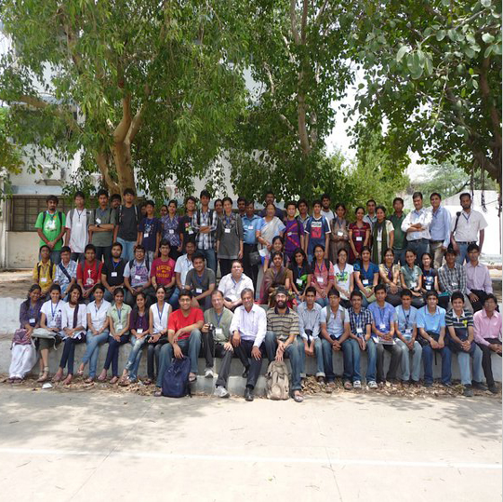
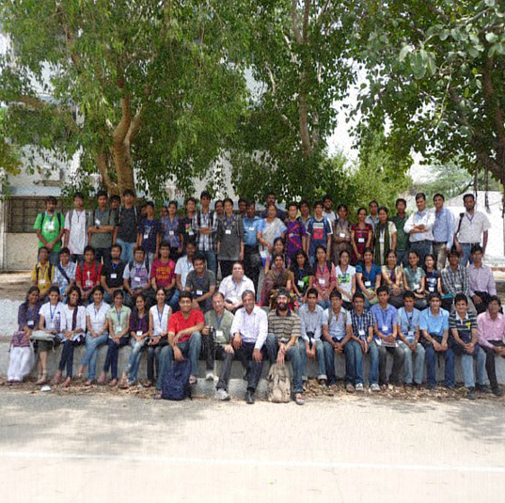
SPOT THE DIFFERENCE
IMAGE RECONSTRUCTION USING ONLY 100 FOURIER COEFFICIENTS
ORIGINAL IMAGE (540 coefficients)

Slide 15
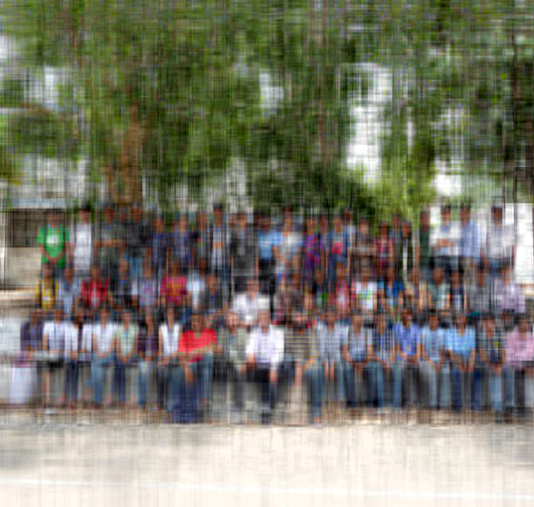
IMAGE RECONSTRUCTION
By addition of one Fourier coefficient at a time we can create a fairly good approximation of the original image where similarity increases with the number of Fourier coefficients.
IMAGE RECONSTRUCTION USING ONLY 15 FOURIER COEFFICIENTS
ORIGINAL IMAGE (540 coefficients)

Slide 16
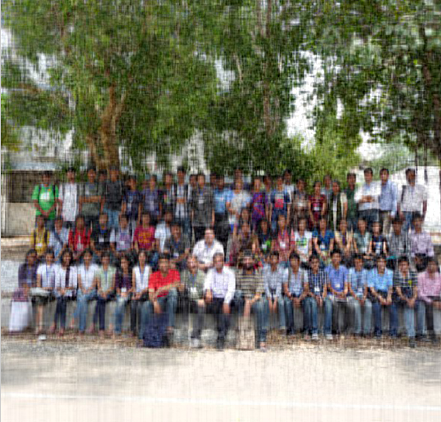

IMAGE RECONSTRUCTION
40 Fourier coefficients
100 Fourier coefficients

Slide 17
IMAGE RECONSTRUCTION
150 Fourier coefficients
Therefore by using only 100 Fourier coefficients we can get a fairly good approximation of the original image having 540 Fourier coefficients.
On rebundling these compressed images we obtain a video requiring much less data.

Slide 18
Video compression
READING THE VIDEO
Breaking the video into Frames
Storing Every Frame in an array of Structures
Processing Each Frame and then applying the compression algorithm
Rebundling the compressed images into a new array of structures
Converting back to a movie
VIDEO RECONSTRUCTED WITH MUCH LESS DATA THAN ORIGINAL VIDEO

Slide 19
THANK YOU

