Slide 1
AlphaPEM Model
Nonlinear time-varying continuous system
Linearization
LTI model (near operation point)
Stability
Observer model
Observability

Slide 3








State observer
$$\hat{x}$$
$$y_{mea}$$
$$u$$
Plant
$$y$$
bias
+
$$−$$
$$e$$
$$x$$
$$L$$
Gain update
Plant: $\dot{x}=Ax+Bu$, $y=Cx$
The objective of state observer is dedicated to stabilize $A−LC$ by optimizing update strategy for error gain $L$

Slide 4
State observer
When?
Where?
How?

Slide 5





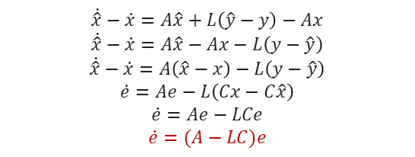
State observer – problem formulation
Define a dynamic system:
$$\dot{x}=Ax$$
State transition matrix
$$y=Cx$$
Assign the notation $\hat{x}$ to denote the state variable of the observer, which needs to be calibrated by observation error:
$$\dot{\hat{x}}=A\hat{x}+L\left(\hat{y}−y\right)$$
$$\hat{y}=C\hat{x}$$
The objective of the state variables is minimizing the error between :
$$\lim_{t→∞}{e}=0, e={\left\|\hat{x}−x\right\|}_{L_{2}}$$
Then implies:
$$\lim_{t→∞}\left\|\hat{x}−x\right\|=0$$
This equation yields:
$$\dot{\hat{x}}−\dot{x}=A\hat{x}+L\left(\hat{y}−y\right)−Ax$$
$$\dot{\hat{x}}−\dot{x}=A\hat{x}−Ax−L\left(y−\hat{y}\right)$$
$$\dot{\hat{x}}−\dot{x}=A\left(\hat{x}−x\right)−L\left(y−\hat{y}\right)$$
$$\dot{e}=Ae−L\left(Cx−C\hat{x}\right)$$
$$\dot{e}=Ae−LCe$$
$$\dot{e}=(A−LC)e$$

Slide 6



State observer – problem formulation
This problem is transformed into finding an optimization scheme for the matrix $(A−LC)$such that the estimation error $e$converges within a finite number of time steps:
$O\left(A,C\right)$ is nonsingular
Observability
Observability: Whether the system can be observed
$$\dot{e}=(A−LC)e$$
Exponential stability: Fast convergency
Stability
Hurwitz: all eigenvalues far into LHP
Lyapunov equation: $A^{T}PA−P+Q=0$

Slide 7
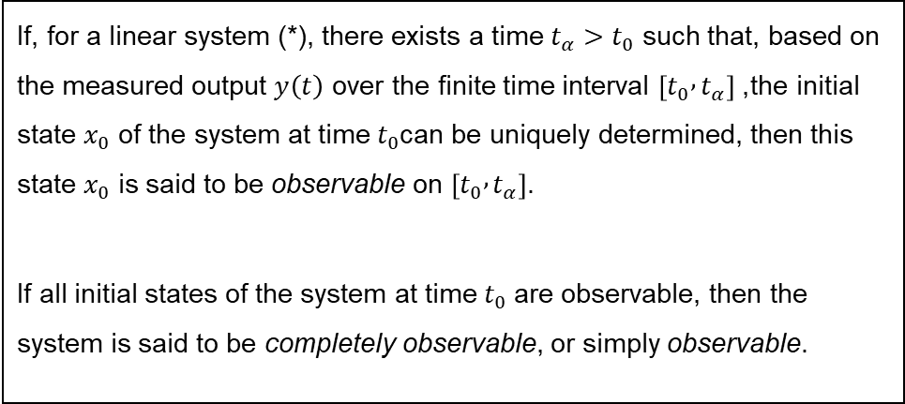
Observability – definition
If, for a linear system (*), there exists a time $t_{α}>t_{0}$ such that, based on the measured output $y\left(t\right)$ over the finite time interval $\left[t_{0} , t_{α}\right]$, the initial state $x_{0}$ of the system at time $t_{0}$can be uniquely determined, then this state $x_{0}$ is said to be observable on $\left[t_{0} , t_{α}\right]$.
If all initial states of the system at time $t_{0}$ are observable, then the system is said to be completely observable, or simply observable.

Slide 8


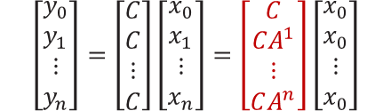
Observability – Linear system
Go back to the system which represented by the state transition matrix $A$:
$$\dot{x}=Ax$$
$$y=Cx$$
If the state variable needs to be observed by $y$, this formula implies:
$$\left[\begin{aligned}y_{0} \\ y_{1} \\ ⋮ \\ y_{n}\end{aligned}\right]=\left[\begin{aligned}C \\ C \\ ⋮ \\ C\end{aligned}\right]\left[\begin{aligned}x_{0} \\ x_{1} \\ ⋮ \\ x_{n}\end{aligned}\right]=\left[\begin{aligned}C \\ CA^{1} \\ ⋮ \\ CA^{n}\end{aligned}\right]\left[\begin{aligned}x_{0} \\ x_{0} \\ ⋮ \\ x_{0}\end{aligned}\right]$$
Hence the observability problem is transformed and stated: proofing that the red color matrix is full rank, such that the $x_{0}$ has unique solution. However, if the system is linear and time-varying, the problem becomes proofing that the matrix below is full rank:
$$\left[\begin{aligned}y_{0} \\ y_{1} \\ ⋮ \\ y_{n}\end{aligned}\right]=\left[\begin{aligned}C(t) \\ C(t) \\ ⋮ \\ C(t)\end{aligned}\right]\left[\begin{aligned}x_{0} \\ x_{1} \\ ⋮ \\ x_{n}\end{aligned}\right]=\left[\begin{aligned}C(t) \\ C(t){A(t)}^{1} \\ ⋮ \\ C(t){A(t)}^{n}\end{aligned}\right]\left[\begin{aligned}x_{0} \\ x_{0} \\ ⋮ \\ x_{0}\end{aligned}\right]$$

Slide 9

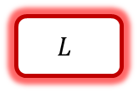





Case study 1 – OXYGEN ESTIMATION
$$y$$
Define the state variable, observation and operation input
Define the state transition matrix
- ODE linearization
Initialize the state variables
Plant
$$\hat{y}$$
$$L$$
$$e$$
$$\hat{x}$$
$$+$$
Plant
$$\dot{\hat{x}}=A\hat{x}+L\left(\hat{y}−y\right)$$
$$y=C\hat{x}$$

Slide 10


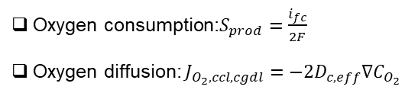
Case study 1 - OXYGEN ESTIMATION
Utilizing the Luenberger observer:
$$\dot{\hat{x}}=A\hat{x}+L\left(\hat{y}−y\right)$$
Take advantage the observer model, we apply it to a simple PEMFC case:
$$\frac{d\hat{x}}{dt}=\left[\frac{{dC}_{O_{2},ccl}}{dt}\right]=\left[\frac{1}{ε_{cl}\left[1−s_{ccl}\right]}\left(−\frac{J_{O_{2},ccl,cgdl}}{H_{cl}}+S_{prod}\right)\right]$$
In this equation, the source and diffusion term is given by:
Oxygen consumption:$S_{prod}=\frac{i_{fc}}{2F}$
Oxygen diffusion: $J_{O_{2},ccl,cgdl}=−2D_{c,eff}∇C_{O_{2}}$

Slide 11





Case study 1 - OXYGEN ESTIMATION
Assumption:
The concentration of nitrogen are well controlled by the pressure regulator at the pressure setpoint
The concentration of vapor are well controlled by the humidity regulator at the humidity setpoint
The amount of the condensed water doesn’t change within the estimation horizon as the natural process is much faster than oxygen concentration varying. (Raphael’s thesis)
The lambda is constant which determines directly by the the humidity.
$$\frac{d\hat{x}}{dt}=\left[\frac{{dC}_{O_{2},ccl}}{dt}\right]=\left[\frac{1}{ε_{cl}\left[1−s_{ccl}\right]}\left(−\frac{J_{O_{2},ccl,cgdl}}{H_{cl}}+S_{prod}\right)\right]$$
$$\frac{d\hat{x}}{dt}=\left[\frac{{dC}_{O_{2},ccl}}{dt}\right]=\left[\frac{1}{ 0.3∗\left[1−0.02\right]}\left(−\frac{J_{O_{2},ccl,cgdl}}{1e−5}+\frac{0.2e4 (A/m^{2})}{2∗96485}\right)\right]$$
Example
Initial value: $C_{O_{2},ccl}=6 mol/m^{3}$
$$J_{O_{2},ccl,cgdl}=D\left(P,T\right)\left(C_{O_{2},ch }−C_{O_{2},ccl}\right)$$
$$\frac{d\hat{x}}{dt}=\left[\frac{{dC}_{O_{2},ccl}}{dt}\right]≈\text{−5251.33}$$
First order Taylor expansion: $F_{1}\left(t\right)=f\left(t_{0}\right)+f^{′}(t_{0})(t−t_{0})$
$$dt=1e−6$$
The transition matrix: $A\left(t=0\right)=\left[\frac{\dot{\hat{x}}(t=0)}{\hat{x}(t=0)}\right]=\left[\frac{6−5251.33 ∗1e−6}{6}\right]≈[0.996]$

Slide 12
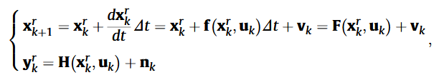
Case study 1 - OXYGEN ESTIMATION
The strategy of converting the state equation to the state transition matrix can also refer to the literature:
L. Xu et al., “Anode state observation of polymer electrolyte membrane fuel cell based on unscented Kalman filter and relative humidity sensor before flooding,” Renewable Energy, vol. 168, pp. 1294–1307, May 2021.

Slide 13
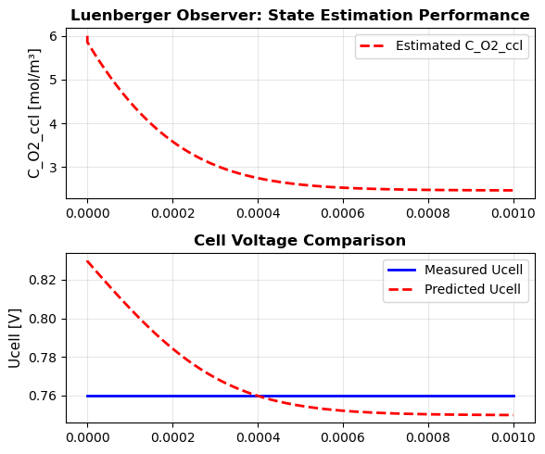
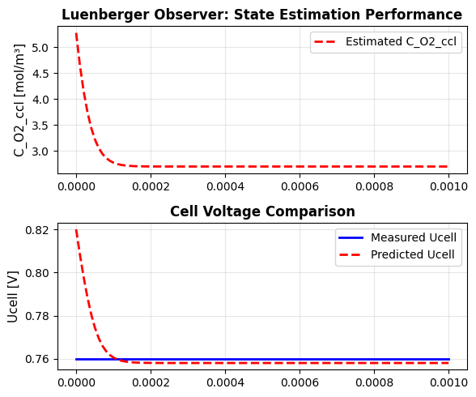
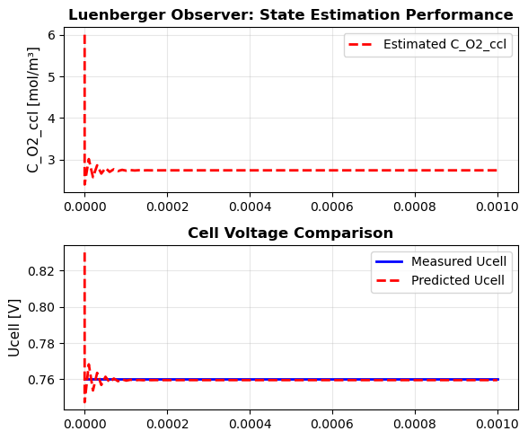







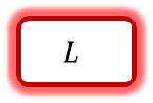

Case study 1 - OXYGEN ESTIMATION
$$y$$
Apply the Luenberger observer to estimate the oxygen concentration:
Plant
$$\hat{y}$$
$$L$$
$$\dot{\hat{x}}=A(t)\hat{x}+L\left(\hat{y}−y\right)$$
$$e$$
$$y=C(t)\hat{x}$$
$$\hat{x}$$
$$+$$
benchmark
$$L=1$$
$$L=10$$
$$L=50$$

Slide 14
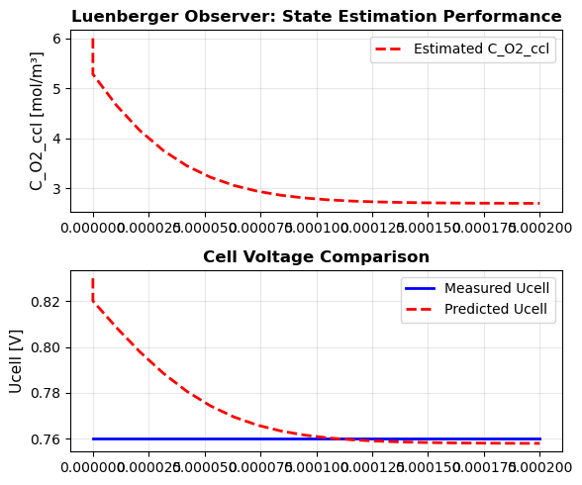
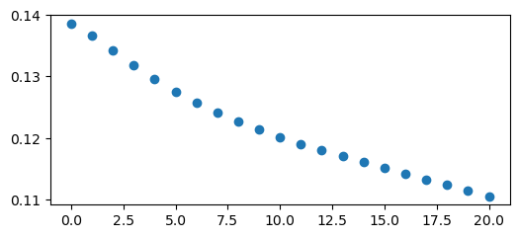
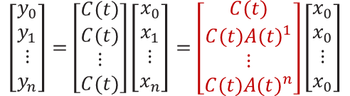


Case study 1 - OXYGEN ESTIMATION
Check the observability $Ο(C,A)$:
$$\left[\begin{aligned}y_{0} \\ y_{1} \\ ⋮ \\ y_{n}\end{aligned}\right]=\left[\begin{aligned}C(t) \\ C(t) \\ ⋮ \\ C(t)\end{aligned}\right]\left[\begin{aligned}x_{0} \\ x_{1} \\ ⋮ \\ x_{n}\end{aligned}\right]=\left[\begin{aligned}C(t) \\ C(t){A(t)}^{1} \\ ⋮ \\ C(t){A(t)}^{n}\end{aligned}\right]\left[\begin{aligned}x_{0} \\ x_{0} \\ ⋮ \\ x_{0}\end{aligned}\right]$$
$$n=20$$
The n element of the observability matrix
Value
$$n$$
It’s very easy to tell that the observability matrix is full rank until the convergency of the estimation

Slide 15




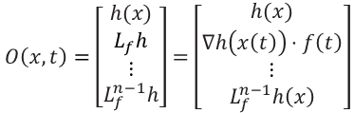
Observability – nonlinear time-varying system
For a fixed time $t$, the stacked output vector $H$ is a function that maps the state $x_{0}$ to the vector of output derivatives $Y_{n}$. If $H$ is full rank, $x_{0}$ can be uniquely solved because the mapping function is invertible:
$$H:R^{n}→R^{n}$$
$$Y_{n}=H(x_{0})$$
Consider a nonlinear time-varying system (NTVS) which represented by the state equation$f$:
$$\dot{x}=f(x)$$
$$y=h(x)$$
The time derivative of the output is calculated using the chain rule:
$$\dot{y}\left(t\right)=\frac{∂h\left(x(t)\right)}{∂t}=∇h\left(x\left(t\right)\right)⋅\dot{x}\left(t\right)=∇h\left(x\left(t\right)\right)⋅f\left(t\right)$$
Lie derivative
$$∇h\left(x\left(t\right)\right)=\left[\frac{∂h}{∂x_{1}},\frac{∂h}{∂x_{2}},…,\frac{∂h}{∂x_{n}}\right]$$
Where:
Calculate the Jacobian of this stacked vector yields a vector field at time $t$:
$$O\left(x,t\right)=\left[\begin{aligned}h(x) \\ L_{f}h \\ ⋮ \\ L_{f}^{n−1}h\end{aligned}\right]=\left[\begin{aligned}h(x) \\ ∇h\left(x\left(t\right)\right)⋅f\left(t\right) \\ ⋮ \\ L_{f}^{n−1}h\left(x\right)\end{aligned}\right]$$

Slide 16
Observability – numerical calculation

Slide 17
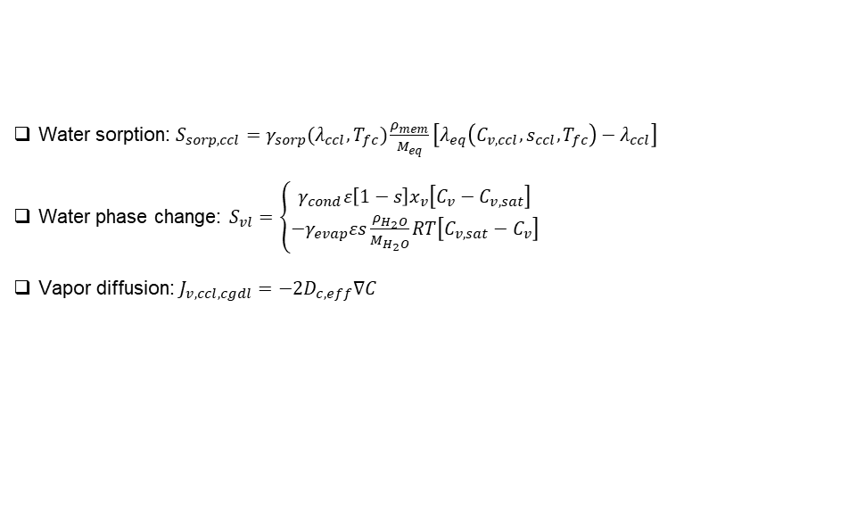
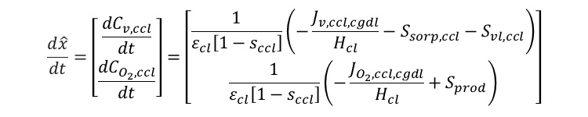
Case study 2 – gas concentration estimation
Utilizing the Luenberger observer:
$$\dot{\hat{x}}=A\hat{x}+L\left(\hat{y}−y\right)$$
Take advantage the observer model, we apply it to a simple PEMFC case:
$$\frac{d\hat{x}}{dt}=\left[\begin{aligned}\frac{{dC}_{v,ccl}}{dt} \\ \frac{{dC}_{O_{2},ccl}}{dt}\end{aligned}\right]=\left[\begin{aligned}\frac{1}{ε_{cl}\left[1−s_{ccl}\right]}\left(−\frac{J_{v,ccl,cgdl}}{H_{cl}}−S_{sorp,ccl}−S_{vl,ccl}\right) \\ \frac{1}{ε_{cl}\left[1−s_{ccl}\right]}\left(−\frac{J_{O_{2},ccl,cgdl}}{H_{cl}}+S_{prod}\right)\end{aligned}\right]$$
In this equation, the source and diffusion components are given by:
Water sorption: $S_{sorp,ccl}=γ_{sorp}(λ_{ccl},T_{fc})\frac{ρ_{mem}}{M_{eq}}\left[λ_{eq}\left(C_{v,ccl},s_{ccl},T_{fc}\right)−λ_{ccl}\right]$
Water phase change: $S_{vl}=\left\{\begin{aligned}γ_{cond}ε\left[1−s\right]x_{v}\left[C_{v}−C_{v,sat}\right] \\ {−γ}_{evap}εs\frac{ρ_{H_{2}O}}{M_{H_{2}O}}RT\left[C_{v,sat}−C_{v}\right]\end{aligned}\right.$
Vapor diffusion: $J_{v,ccl,cgdl}=−2D_{c,eff}∇C$

Slide 18
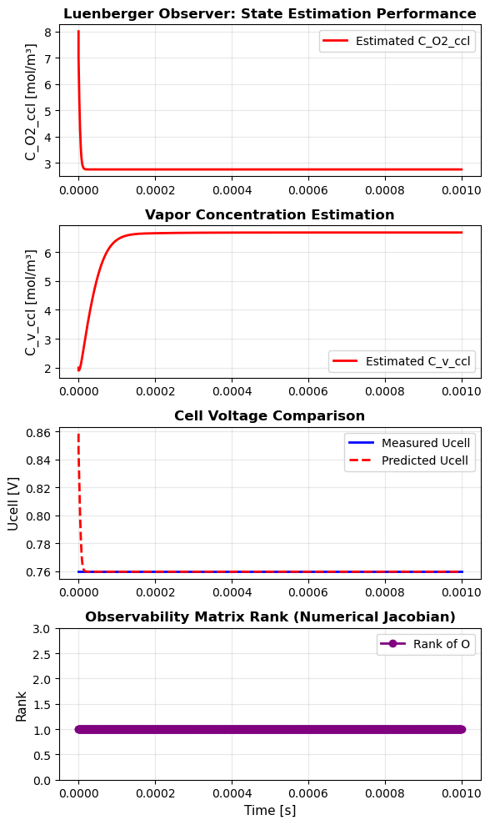
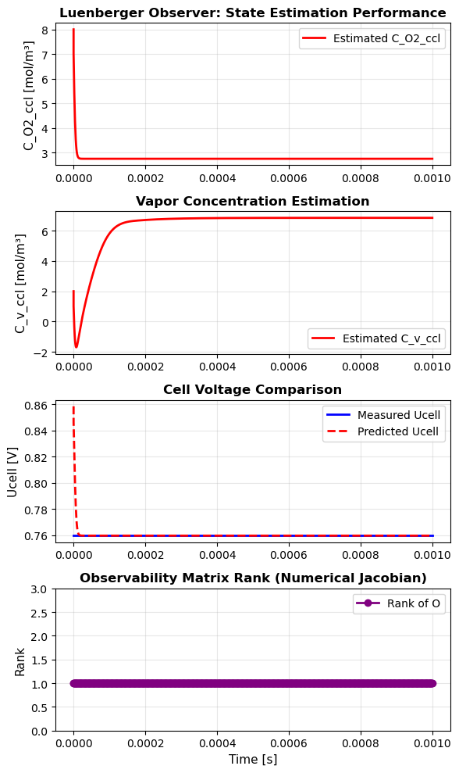
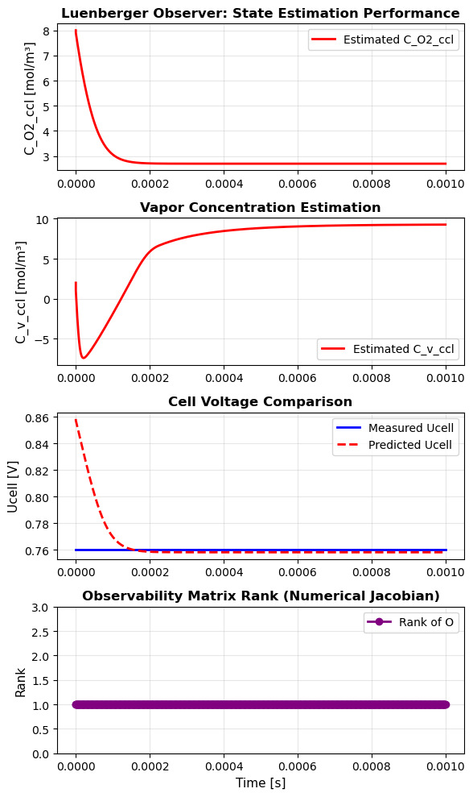



Case study 2 – gas concentration estimation
$$L=[10, 1]$$
$$L=[10,10]$$
$$L=[1,10]$$

Slide 19

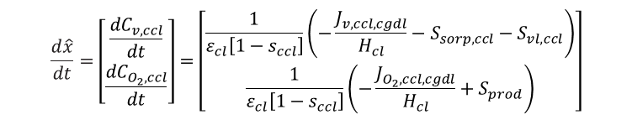

Case study 2 – gas concentration estimation
Q: Why unobservable?
$$\frac{d\hat{x}}{dt}=\left[\begin{aligned}\frac{{dC}_{v,ccl}}{dt} \\ \frac{{dC}_{O_{2},ccl}}{dt}\end{aligned}\right]=\left[\begin{aligned}\frac{1}{ε_{cl}\left[1−s_{ccl}\right]}\left(−\frac{J_{v,ccl,cgdl}}{H_{cl}}−S_{sorp,ccl}−S_{vl,ccl}\right) \\ \frac{1}{ε_{cl}\left[1−s_{ccl}\right]}\left(−\frac{J_{O_{2},ccl,cgdl}}{H_{cl}}+S_{prod}\right)\end{aligned}\right]$$
$$y=[U_{cell}]$$
Cell voltage: $U_{cell}=U_{eq}−η_{c}−i_{fc}\left(R_{p}+R_{e}\right)$
Cathode overpotential: $η_{c}=\frac{1}{f_{drop}}\frac{RT}{α_{C}F}ln\left(\frac{i_{fc}+i_{n}}{i_{0,c}^{ref}}{\left(\frac{C_{O_{2}}^{ref}}{C_{O_{2}}}\right)}^{κ_{c}}\right)$
A: The partial gradient of $y$ to $x_{1}$ always equals 0

Slide 20
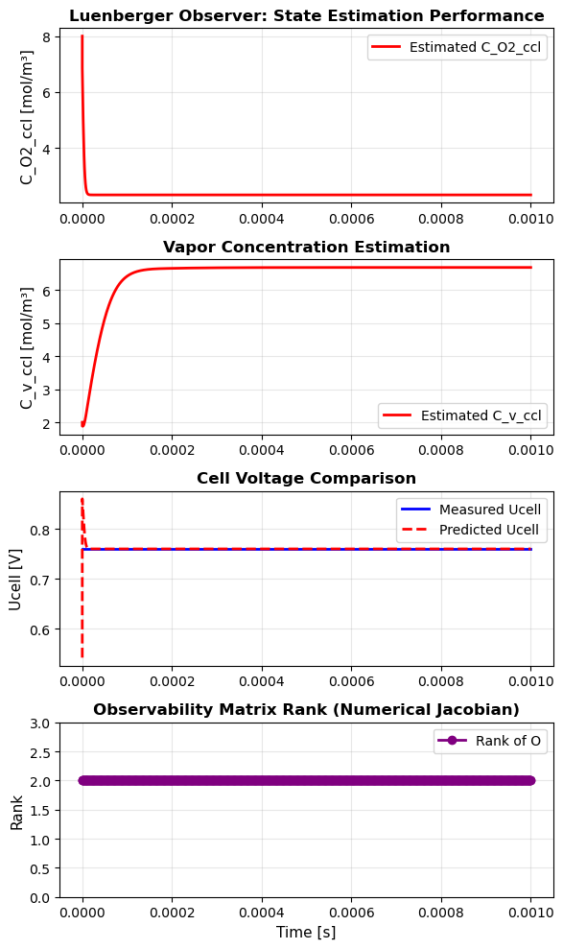

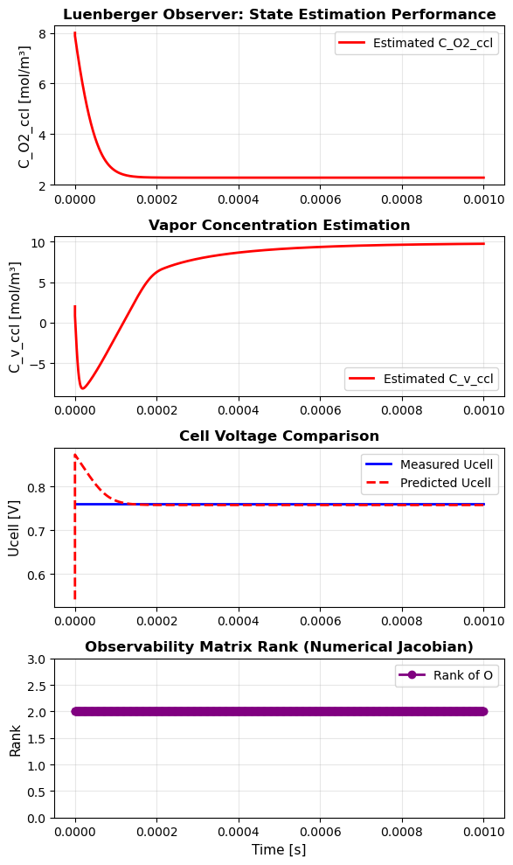

Case study 2 - gas concentration estimation
Any method to make this state variables fully observable?
Remove the assumption 4: The lambda is constant in terms of the humidity ratio setpoint (0D implementation)
$$λ=0.043+17.81a−39.85a^{2}+36.0a^{3}$$
where
$$a=P_{v,ccl}/P_{sat}$$
$$L=[10, 1]$$
$$L=[10,10]$$
$$L=[1,10]$$

Slide 21
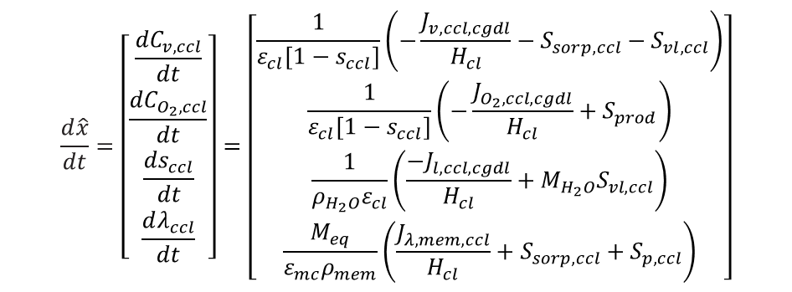
Case study 3 – gas & water estimation
Utilizing the Luenberger observer:
$$\dot{\hat{x}}=A\hat{x}+L\left(\hat{y}−y\right)$$
Take advantage the observer model, we develop a 4-order observer:
$$\frac{d\hat{x}}{dt}=\left[\begin{aligned}\frac{{dC}_{v,ccl}}{dt} \\ \frac{{dC}_{O_{2},ccl}}{dt} \\ \frac{{ds}_{ccl}}{dt} \\ \frac{dλ_{ccl}}{dt}\end{aligned}\right]=\left[\begin{aligned}\frac{1}{ε_{cl}\left[1−s_{ccl}\right]}\left(−\frac{J_{v,ccl,cgdl}}{H_{cl}}−S_{sorp,ccl}−S_{vl,ccl}\right) \\ \frac{1}{ε_{cl}\left[1−s_{ccl}\right]}\left(−\frac{J_{O_{2},ccl,cgdl}}{H_{cl}}+S_{prod}\right) \\ \frac{1}{ρ_{H_{2}O}ε_{cl}}\left(\frac{−J_{l,ccl,cgdl}}{H_{cl}}+M_{H_{2}O}S_{vl,ccl}\right) \\ \frac{M_{eq}}{{ε_{mc}ρ}_{mem}}\left(\frac{J_{λ,mem,ccl}}{H_{cl}}+S_{sorp,ccl}+S_{p,ccl}\right)\end{aligned}\right]$$

Slide 22
Case study 3 – gas & water estimation

