Slide 1
Evaluation of Influence of Simulated Physical Layers to Brain Segmentation
Yu Miao, Xuan Liu

Slide 2
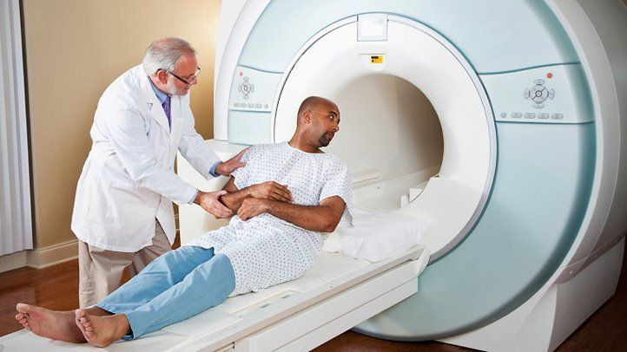
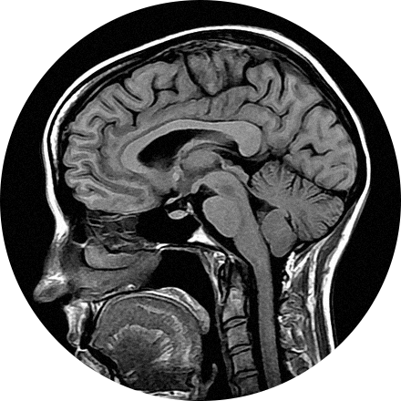
Background
About 700,000 Americans are living with a primary brain tumor.
Magnetic Resonance Imaging (MRI) has becoming one of the most powerful tool in brain tumor diagnosis.
It uses magnetic fields to produce detailed images of the brain.
Patients may receive Intravenous (IV) gadolinium-enhanced for better contrasts, so patients may feel headache, nausea, dizziness and other side effects.
Thus, accurate images and diagnosis is highly demanded.
https://braintumor.org/brain-tumor-information/brain-tumor-facts/
https://www.webmd.com/a-to-z-guides/what-is-an-mri

Slide 3
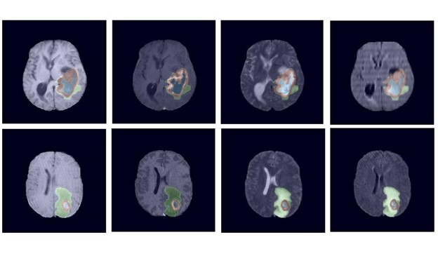
Current Problem
Image segmentation has been created to help doctors to locate anatomical features of brain.
However, MRI images may contain artifacts such as motion artifacts, metal artifacts, chemical shifts artifacts and low contrast.
So, is there any method that could eliminate artifacts and improve accuracy by using deep learning models?
https://developer.nvidia.com/blog/nvidia-data-scientists-take-top-spots-in-miccai-2021-brain-tumor-segmentation-challenge/

Slide 4
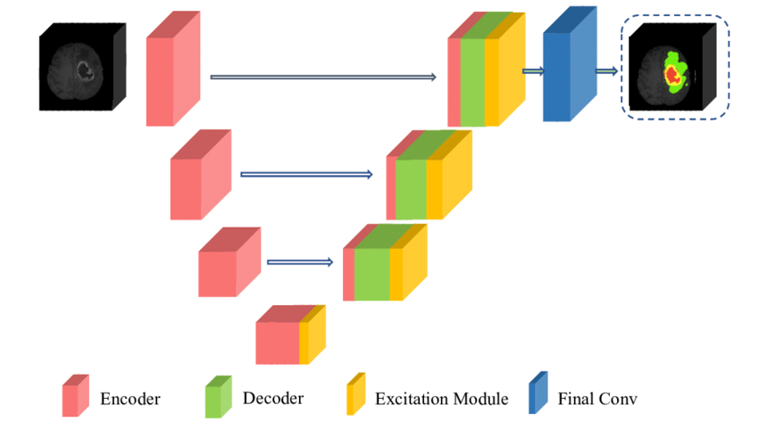
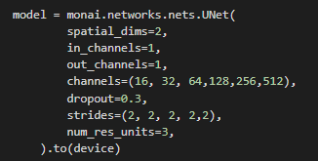
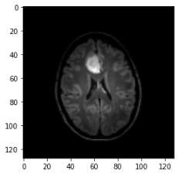
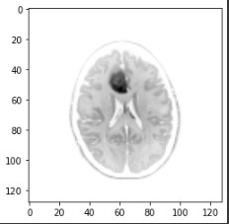
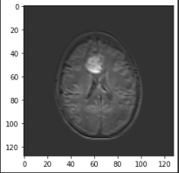
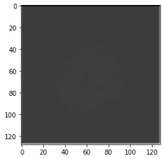
Methods
U-Net (MONAI)
Downsampling to 512 Channels
Adding two physical layers
Two kernel 3*3 layers
One kernel 1*1 layer
Other parameters:
https://paperswithcode.com/method/u-net
https://www.researchgate.net/figure/Our-proposed-segmentation-architecture-3D-attention-UNet-by-composing-of-sequential_fig1_341487874

Slide 5
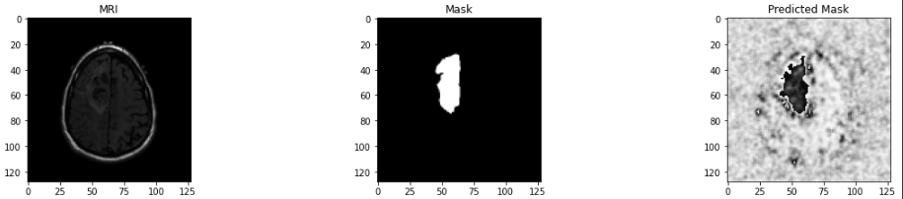
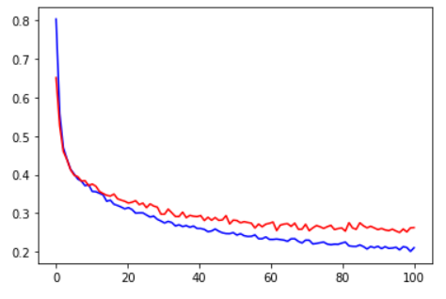
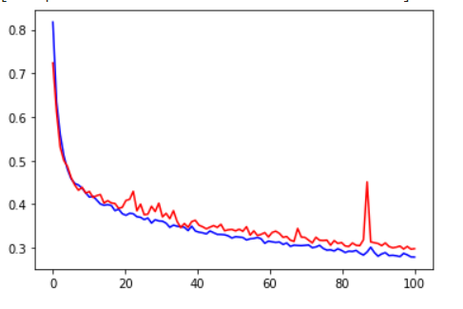
Results
Unet without Physical Layer Unet with 2 Conv 3x3 Physical Layers
Final Loss: 0.2628 (100 epochs) Final Loss: 0.2982 (100 epochs)
Nearly Overfit Still Under Capacity

Slide 6
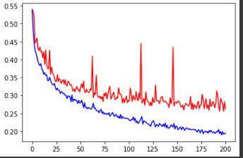
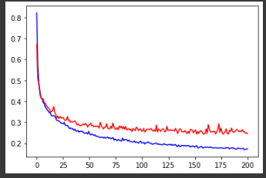
Results
Unet with 1 conv 1x1 Physical Layer Unet with 2 Conv 1x1 Physical Layers
Validation Loss: 0.2859 (100 epochs) Validation Loss: 0.2841(epochs)

Slide 7
Conclusion
Unet without physical layer will overfit much early than Unet with physical layer.
Physical layer has significant impact on Unet results
Unet with physical layer will blur original brain images to some extent which reduce the performance after same epochs

Slide 8
Future Work
Train more epochs on Unet with conv 3x3 physical layer
Try more different physical layer structures before Unet
Try more training tricks including reducing learning rate after several epochs
Train Unet model in larger datasets

Slide 9
Thanks!
Question?

