Slide 1
Chapter 7
More SQL : Complex Queries, Triggers,
Views, and Schema Modification

Slide 2
Table of Contents
7.1 More Complex SQL Retrieval Queries
7.2 Specifying Constraints as Assertions and Triggers
7.3 Views (Virtual Tables) in SQL
7.4 Schema Change Statements in SQL
7.5 Summary

Slide 3
7.1.1 Comparisons Involving NULL and
Three-Valued Logic
It is possible for tuples to have a null value, denoted by NULL, for some of their attributes
Meanings of NULL
Value is unknown (age), Value is withheld (phone), Value is not applicable (Phd)
SQL does not distinguish between the different meanings of NULL
The result of any arithmetic expression involving NULL is NULL
Any comparison with NULL returns UNKNOWN
All aggregate operations except count(*) ignore tuples with null values on the aggregated attributes
avg, min, max, sum, count
SELECT COUNT(*) AS StuNum
FROM STUDENT
The predicate 'IS NULL' or 'IS NOT NULL' can be used to check for NULL value of an attribute
Query 18: Retrieve the names of all employees who do not have supervisors
SELECT Fname, Lname
FROM EMP
WHERE Super_ssn IS NULL;

Slide 4
7.1.1 Comparisons Involving NULL and
Three-Valued Logic
SQL uses a three-valued logic: TRUE, FALSE, UNKNOWN
Result of WHERE clause predicate is treated as false if it evaluates to unknown
Table represents the values of the results of comparison conditions, which would typically appear in the WHERE clause of an SQL query
If the truth-values of TRUE=1, FALSE=0, UNKNOWN=1/2
Then AND of two truth-values is the minimum of those values
OR of two truth-values is the maximum of those values
Negation of truth-value V is 1-V
x | y | x AND y | x OR y | NOT x
TRUE TRUE TRUE UNKNOWN UNKNOWN UNKNOWN FALSE FALSE FALSE | TRUE UNKNOWN FALSE TRUE UNKNOWN FALSE TRUE UNKNOWN FALSE | TRUE UNKNOWN FALSE UNKNOWN UNKNOWN FALSE FALSE FALSE FALSE | TRUE TRUE TRUE TRUE UNKNOWN UNKNOWN TRUE UNKNOWN FALSE | FALSE FALSE FALSE UNKNOWN UNKNOWN UNKNOWN TRUE TRUE TRUE

Slide 5
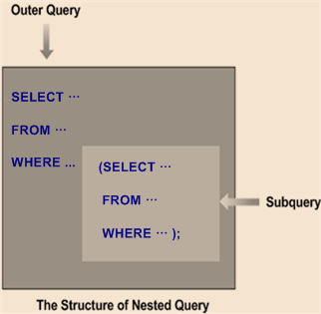
7.1.2 Nested Queries, Tuples,
and Set/Multiset Comparisons
Nested queries (중첩 질의)
SQL provides a mechanism for the nesting of subqueries
A nested query (or subquery) is a SELECT-FROM-WHERE expression that is nested within another query (outer query)
A nested query is usually used to return data that will be used in the outer query as a condition to further restrict the data to be retrieved
A common use of subqueries is to perform tests for set membership and set comparisons
Complex query can be expressed easily with several logical steps of a nested query
Nested queries can be used in various ways
Subquery can return a single value and it can be compared with another value in WHERE clause of the outer query
Subquery can return a relation and it can be used in various ways in WHERE clause of the outer query
Subquery can have their relations appear in FROM clause of the outer query, just like any stored relation can

Slide 6
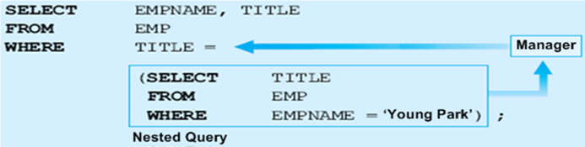
7.1.2 Nested Queries, Tuples,
and Set/Multiset Comparisons
When a subquery returns a single value
Subquery is evaluated before the outer query and its result is evaluated with a comparison operator (=,<,<=,>,>=,<>) in WHERE clause of the outer query
Ex: Retrieve the names and titles of all employees whose titles are the same as “Young Park”
EMPNAME | TITLE
Young Park | Manager
Min Cho | Manager
⇒
EMP
EMPNO | EMPNAME | TITLE | MANAGER | SALARY | DNO
2106 | Chang Kim | Staff | 1003 | 2500000 | 2
3426 | Young Park | Manager | 4377 | 3000000 | 1
3011 | Soo Lee | Director | 4377 | 4000000 | 3
1003 | Min Cho | Manager | 4377 | 3000000 | 2
3427 | Jong Choi | Staff | 3011 | 1500000 | 3
1365 | Sang Kim | Staff | 3426 | 1500000 | 1
4377 | Sung Lee | President | - | 5000000 | 2

Slide 7
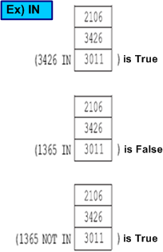
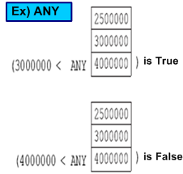
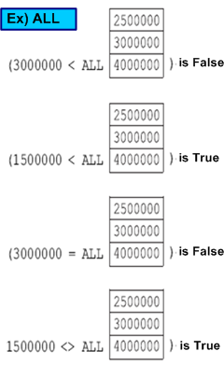
7.1.2 Nested Queries, Tuples,
and Set/Multiset Comparisons
In general, the subquery will return a relation which is a set or multiset of tuples
The comparison operator IN, ANY(SOME), ALL, and EXISTS can be used in WHERE clause of the outer query
The IN compares a value v with a set (or multiset) of values V and evaluates to TRUE if v is one of the elements in V
WHERE Dno IN (1,3)
The = ANY (or = SOME) operator returns TRUE if the value v is equal to some value in the set V and is hence equivalent to IN
Other operators that can be combined with ANY (or SOME) include {>, >=, <, <=, <>}
WHERE Dno = ANY (1,3), WHERE Dno > ANY (1,3)
The ALL operator can also be combined with each of those operators
WHERE Dno > ALL (1,3), WHERE Dno <> ALL (1,3)
The EXISTS operator returns the value TRUE if the subquery result contains at least one tuple (not empty)
IN, ANY, ALL, EXISTS can be negated by putting NOT in front

Slide 8
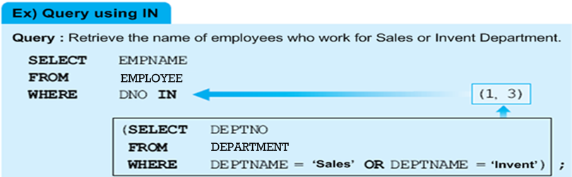
7.1.2 Nested Queries, Tuples,
and Set/Multiset Comparisons
Comparison operator IN
Compares value v with a set (or multiset) of values V
Evaluates to TRUE if v is one of the elements in V
EMPLOYEE
DEPARTMENT
EMPNO | EMPNAME | TITLE | MANAGER | SALARY | DNO
2106 | Chang Kim | Staff | 1003 | 2500000 | 2
3426 | Young Park | Manager | 4377 | 3000000 | 1
3011 | Soo Lee | Director | 4377 | 4000000 | 3
1003 | Min Cho | Manager | 4377 | 3000000 | 2
3427 | Jong Choi | Staff | 3011 | 1500000 | 3
1365 | Sang Kim | Staff | 3426 | 1500000 | 1
4377 | Sung Lee | President | - | 5000000 | 2
DEPTNO | DEPTNAME | FLOOR
1 | Sales | 8
2 | Planning | 10
3 | Invent | 9
4 | General | 7

Slide 9
7.1.2 Nested Queries, Tuples,
and Set/Multiset Comparisons
Query 4: Make a list of all project numbers for projects that involve an employee whose last name is ‘Smith’, either as a manager or as a worker of the department that controls the project.
Q4: (SELECT DISTINT Pnumber FROM PROJECT, DEPART, EMP
WHERE Dnum=Dnumber AND Mgr_ssn=Ssn AND Lname=‘Smith’)
UNION
(SELECT DISTINT Pno AS Pnumber FROM WORKS_ON, EMP
WHERE Essn=Ssn AND Lname=‘Smith’);
Query 4 can be rephrased to use nested queries as shown in Q4A
Q4A: SELECT DISTINT Pnumber
FROM PROJECT
WHERE Pnumber IN
(SELECT Pnumber FROM PROJECT, DEPARTMENT, EMP
WHERE Dnum=Dnumber AND Mgr_ssn=Ssn AND Lname=‘Smith’)
OR
Pnumber IN
(SELECT Pno FROM WORKS_ON, EMP
WHERE Essn=Ssn AND Lname=‘Smith’ );

Slide 10
7.1.2 Nested Queries, Tuples,
and Set/Multiset Comparisons
SQL allows the subtuple of values in comparisons by place them within parentheses
Ex: Select Essns of all employees who work for the same (project, hours) combination on some project that employee 'John Smith' whose Ssn='12345' works on
SELECT DISTINCT Essn
FROM WORKS_ON
WHERE (Pno, HOURS) IN (SELECT Pno, Hours
FROM WORKS_ON
WHERE Essn=‘12345’);
We can use explicit set of values in WHERE clause
Query 17: Retrieve the SSNs of all employees who work on project numbers 1, 2 or 3
SELECT DISTINCT Essn
FROM WORKS_ON
WHERE Pno IN (1, 2, 3) ;

Slide 11
7.1.2 Nested Queries, Tuples,
and Set/Multiset Comparisons
Find the name of employees whose salary is grater than the salary of all the employees in department 5
SELECT Lname, Fname
FROM EMP
WHERE Salary > ALL (SELECT Salary FROM EMP WHERE Dno=5) ;
In general, we can have several levels of nested queries
The scoping rule is that a reference to an unqualified attribute refers to the relation declared in the innermost nested query
It is generally advisable to create tuple variables (aliases) for all the tables referenced in an SQL query to avoid potential errors and ambiguities
Query 16: Retrieve the names of each employee who has a dependent with the same first name and the same sex as the employee
Q16A: SELECT E.Fname, E.Lname
FROM EMP AS E, DEPENDENT AS D
WHERE E.Ssn=D.Essn AND E.Fname=D. Dependent_name AND E.Sex= D.Sex
Q16: SELECT E.Fname, E.Lname
FROM EMP AS E
WHERE E.Ssn IN (SELECT D.Essn
FROM DEPENDENT AS D
WHERE E.Fname=D.Dependent_name AND E.Sex=D.Sex);

Slide 12
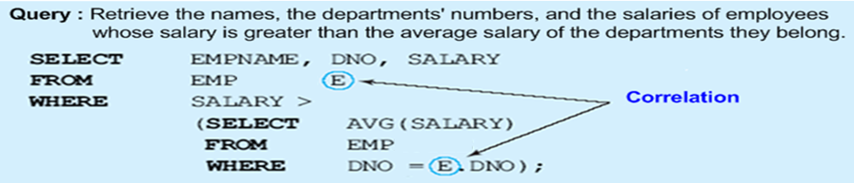

7.1.3 Correlated Nested Queries
Correlated nested query (상관 중첩 질의)
Correlated subquery (synchronized subquery) is a subquery that contains a reference to an attribute in the outer query
The subquery is evaluated once for each tuple processed by the outer query
Above English sentence can be rephrased to fit into a correlated nested query such that: For each salary of EMP tuple of the outer query, evaluate the nested query which retrieves the average salary values for all EMP tuples with the same DNO as that of EMP tuple of the outer query; if the salary value of EMP tuple of the outer query is greater than the average salary of the nested query, then select that EMP tuple of the outer query.
EMPNO | EMPNAME | TITLE | MANAGER | SALARY | DNO
2106 | Chang Kim | Staff | 1003 | 100000 | 2
3426 | Young Park | Manager | 4377 | 300000 | 5
1003 | Min Cho | Manager | 4377 | 300000 | 2
1365 | Sang Kim | Staff | 3426 | 100000 | 5
4377 | Sung Lee | President | - | 500000 | 2
EMPNAME | DNO | SALARY
Sung Lee | 2 | 50000
Young Park | 5 | 30000

Slide 13
7.1.3 Correlated Nested Queries
Query 16: Retrieve the names of each employee who has a dependent with the same first name and the same sex as the employee
For each Ssn of EMP tuple, evaluate the correlated nested query which retrieves the Essn values for all DEPENDENT tuples with the same first name and the same sex as those of EMP tuple; if the Ssn value of EMP tuple is in the result of the nested query, then select that EMP tuple
Q16: SELECT E.Fname, E.Lname
FROM EMP AS E
WHERE E.Ssn IN (SELECT D.Essn
FROM DEPENDENT AS D
WHERE D.Dependent_name=E.Fname AND D.Sex=E.Sex);
A query written with nested SELECT-FROM-WHERE blocks and using the "= or IN" comparison operators can always be expressed as a single block query
Retrieve the names of each employee who has a dependent with the same first name and the same sex as the employee
Q16A: SELECT E.Fname, E.Lname
FROM EMP AS E, DEPENDENT AS D
WHERE E.Ssn=D.Essn AND D. Dependent_name=E.Fname AND D.Sex=E.Sex ;

Slide 14
7.1.4 The EXISTS and UNIQUE Functions in SQL
EXISTS operator
The EXISTS checks whether the result of a subquery is empty or not
EXIST and NOT EXISTS are typically used in conjunction with a correlated subquery
Query 16: Retrieve the names of each employee who has a dependent with the same first name and the same sex as the employee
Q16: SELECT E.Fname, E.Lname
FROM EMP AS E
WHERE E.Ssn IN (SELECT D.Essn
FROM DEPENDENT AS D
WHERE D.Dependent_name=E.Fname AND D.Sex=E.Sex);
For each EMP tuple, evaluate the correlated subquery which retrieves all DEPENDENT tuples with the same Essn, the same first name, and the same sex as those of EMP tuple; if at least one tuple EXISTS in the result of the nested query, then select that EMP tuple
Q16B: SELECT E.Fname, E.Lname
FROM EMP AS E
WHERE EXISTS (SELECT *
FROM DEPENDENT AS D
WHERE D.Essn=E.Ssn AND
D.Dependent_name=E.Fname AND D.Sex=E.Sex);

Slide 15
7.1.4 The EXISTS and UNIQUE Functions in SQL
Query 6: Retrieve the names of employees who have no dependents
For each EMP tuple, the correlated subquery selects all DEPENDENT tuples whose Essn value matches the EMP Ssn; if the result is empty, no dependents are related to the employee, so we select that EMP tuple and retrieve its Fname and Lname
SELECT Fname, Lname
FROM EMP AS E
WHERE NOT EXISTS (SELECT *
FROM DEPENDENT AS D
WHERE D.Essn=E.Ssn) ;
Query 7: List the names of managers who have at least one dependent
SELECT Fname, Lname
FROM EMP AS E
WHERE EXISTS (SELECT *
FROM DEPART AS R
WHERE R.Mgr_ssn=E.Ssn) ;
AND
EXISTS (SELECT *
FROM DEPENDENT AS D
WHERE D.Essn=E.Ssn)

Slide 16
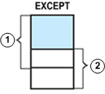
7.1.4 The EXISTS and UNIQUE Functions in SQL
Query 3A: Retrieve the name of each employee who works on all the projects controlled by department number 5
Q3A: SELECT Fname, Lname
FROM EMP AS E
WHERE NOT EXISTS (( SELECT Pnumber
FROM PROJ ①
WHERE Dnum=5)
EXCEPT (SELECT Pno
FROM WORKS_ON AS W ②
WHERE W.Essn=E.Ssn));
The first subquery (which is not correlated with the outer query) selects all projects controlled by department 5 => Let’s say P1, P3
The second subquery (which is correlated) selects all projects that the particular employee works on => Let’s say P1, P2, P3
If ① - ② = (P1,P3)-(P1,P2,P3) = Ø, then it means that the employee works on all the projects controlled by department 5 and is therefore selected
UNIQUE(Q) function
Returns TRUE if there are no duplicate tuples in the result of query Q
This can be used to test whether the result of a nested query is a set or a multiset

Slide 17
7.1.5 Subqueries in the From Clause
SQL allows a subquery expression to be used in a FROM clause (Inline view)
Ex: Find all the producers’ names of the movies in which Tom Cruise stars
Movie(title, year, length, stuioName, producerID)
StarsIn(movieTitle, movieYear, starName)
Producer(Pname, address, PID, netWorth)
SELECT Pname FROM Producer, Movie, StarsIn
WHERE PID=producerID AND title=movieTitle AND year=movieYear AND
starname=‘Tom Cruse';
Above join query can be rephrased to use a subquery in the FROM clause
If we have a relation that gives the producers’ IDs of the movies in which Tom Cruse stars, then it would be a simple matter to look up the names of those producers in the Producer relation as shown in the following query
SELECT Pname
FROM Producer (SELECT producerID
FROM Movie, StarsIn
WHERE title=movieTitle AND year=movieYear AND
starname=‘Tom Cruise') PIDforTomCruse
WHERE PID = PIDforTom.producerID;

Slide 18
7.1.6 Joined Tables in SQL
The concept of a joined table (or joined relation) was incorporated into SQL to permit users to specify a table resulting from a join operation in the FROM clause of a query
Query 1: Retrieve the name and address of all employees who work for the ‘Research’ department
Q1: SELECT Fname, Lname, Address
FROM EMP, DEPART
WHERE Dno=Dnumber AND Dname=‘Research’;
Q1A: SELECT Fname, Lname, Address
FROM (EMP JOIN DEPART ON Dno=Dnumber)
WHERE Dname=‘Research’;
Multiway join
Can nest join specifications; that is, one of the tables in a join may itself be a joined table
Allows the specification of the join of three or more tables as a single joined table
Query 2: For every project located in ‘Stafford’, list the project number, the controlling department number, and the department manager’s last name
Q2: SELECT Pnumber, Dnum, Lname FROM PROJ, DEPART, EMP
WHERE Dnum=Dnumber AND Mgr_ssn=Ssn AND Plocation=‘Stafford’;
Q2A: SELECT Pnumber, Dname, Lname
FROM ((PROJ JOIN DEPART ON Dnum=Dnumber) JOIN EMP ON Mgr_ssn=Ssn)
WHERE 'Plocation='Stafford';

Slide 19
7.1.6 Joined Tables in SQL and Outer Joins
Joined table (or joined relation)
Permits users to specify a table resulting from a join operation in the FROM clause of a query
This construct may be easier to comprehend than mixing together all the join and select conditions in the WHERE clause
THETA JOIN
R JOIN S ON (allows for arbitrary comparison relationships such as ≥ )
Query 1: Retrieves the name and address of all employees who work for the 'Research' department
Q1: SELECT Fname, Lname, Address
FROM EMP, DEPART
WHERE Dno=Dnumber AND Dname=‘Research’;
Q1A: SELECT Fname, Lname, Address
FROM (EMP JOIN DEPART ON Dno=Dnumber) // joined table
WHERE Dname=‘Research’;
An equijoin is a theta join using the equality operator
NATURAL JOIN
R NATURAL JOIN S is an implicit equijoin on attributes that have the same name from R and S, and retains only one copy of each common column
Q1B: SELECT Fname, Lname, Address
FROM (EMP NATURAL JOIN DEPART AS DEPT(Dname, Dno, Mssn, Msdate)
WHERE Dname=‘Research’ ;
The implied join condition of Q1B is EMP.Dno=DEPT.Dno

Slide 20
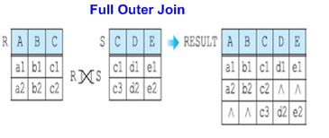
7.1.6 Joined Tables in SQL and Outer Joins
The key word CROSS JOIN is used to specify the CARTESIAN PRODUCT
OUTER JOIN
An extension of the join operation that avoids loss of information
It computes the join and then adds tuples from
one relation that does not match tuples in the
other relation to the result of the join
If the join attributes have the same name,
one can also specify the natural join variation of
outer joins, called a natural outer join
MovieStar(name, address, birthdate), MovieExec(name, cert#, netWorth)
FULL OUTER JOIN
MovieStar NATURAL FULL OUTER JOIN MovieExec
Those representing individuals who are both stars and executives
An individual who is a star but not an executive
An executive who is not also a star
LEFT (RIGHT) OUTER JOIN
MovieStar NATURAL LEFT (RIGHT) OUTER JOIN MovieExec
Every tuple in left (right) table must appear in result
If it does not have a matching tuple, it is padded with NULL values for the attributes of the right (left) table

Slide 21
7.1.7 Aggregate Functions in SQL
Built-in aggregate functions are used to summarize information from multiple tuples into a single-tuple summary
avg, min, max, sum, count(=number of values)
Aggregate functions can be used in the SELECT or HAVING clause
Query 20: Find the sum of the salaries of all employees of the ‘Research’ department, as well as the average salary in this department
SELECT SUM (Salary), AVG (Salary)
FROM EMP, DEPART
WHERE Dno=Dnumber AND Dname=‘Research’;
In general, NULL values are discarded when aggregate functions are applied to a particular attribute
However, COUNT(*) returns the number of all the tuples in the result of the query
Query 22: Retrieve the number of employees in the ‘Research’ department
SELECT COUNT (*) FROM EMP, DEPART
WHERE Dno=Dnumber AND DNAME=‘Research’;
Aggregate functions can be used in selection conditions involving nested queries
Query 5: Retrieve the names of all employees who have two or more dependents
SELECT Lname, Fname FROM EMP AS E
WHERE (SELECT COUNT(∗) FROM DEPENDENT AS D WHERE D.Essn=E.Ssn) >=2;

Slide 22
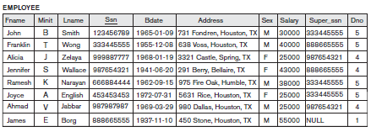
7.1.8 Grouping: The GROUP BY
and HAVING Clauses
There are circumstances where we would like to apply the aggregate function to a group of sets of tuples
The attribute(s) given in the GROUP BY clause are used to form group
Aggregate function is applied to each such group independently
The grouping attributes specified by the GROUP BY clause should also appear in the SELECT clause
Query 24: For each department, retrieve the department number, the number of employees in the department, and their average salary
SELECT Dno, COUNT(∗), AVG(Salary)
FROM EMP
GROUP BY Dno ;
If NULLs exist in grouping attribute
Separate group created for all tuples with a NULL value in grouping attribute
Query 25: For each project, retrieve the project number, the project name, and the number of employees who work on that project
SELECT Pnumber, Pname, COUNT (*)
FROM PROJ, WORKS_ON
WHERE Pnumber = Pno
GROUP BY Pnumber;

Slide 23
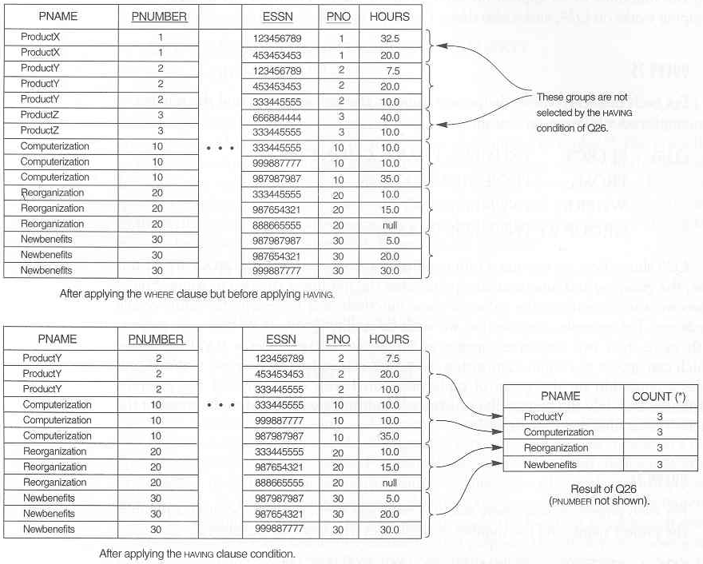
7.1.8 Grouping: The GROUP BY
and HAVING Clauses
HAVING clause
Provides a condition on the GROUP BY clause
Query 26: For each project on which more than two employees work, retrieve the project number, the project name, and the number of employees who work on the project
SELECT Pnumber, Pname, COUNT(∗)
FROM PROJ, WORKS_ON
WHERE Pnumber=Pno
GROUP BY Pnumber
HAVING COUNT(∗) > 2 ;
Query 27: For each project, retrieve the project number, the project name, and the number of employees from department 5 who work on the project
SELECT Pnumber, Pname, COUNT(∗)
FROM PROJ, WORKS_ON, EMP
WHERE Pnumber = Pno AND
Essn = Ssn AND Dno=5
GROUP BY Pnumber;

Slide 24
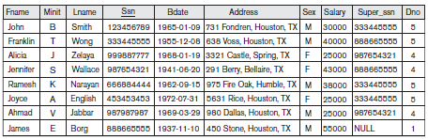
7.1.8 Grouping: The GROUP BY
and HAVING Clauses
Q28: For each department that has more than three employees, retrieve the department number and the number of its employees who are making more than $30,000 ⇒ (Dno : 5, Number of emp : 2)
Following query is incorrect because it will select only department that have more than 3 employees who each earn more than $30,000
SELECT Dno. COUNT(*)
FROM EMP
WHERE Salary>30000
GROUP BY Dno
HAVING COUNT(*) > 3;
One way to write Q28 correctly is to use the following nested query
SELECT Dno. COUNT(*)
FROM EMP
WHERE Salary>30000 AND Dno IN (SELECT Dno
FROM EMP
GROUP BY Dno
HAVING COUNT(*) > 3)
GROUP BY Dno

Slide 25
7.1.9 Other SQL Constructs:
With and CASE
The WITH clause allows a user to define a table that will be used only in one query and then dropped
Q28' WITH BIGDEPTS (Dno) AS
(SELECT Dno
FROM EMP
GROUP BY Dno
HAVING COUNT(*) > 3
SELECT Dno. COUNT(*)
FROM EMP
WHERE Salary>30000 AND Dno IN BIGDEPTS
GROUP BY Dno
SQL also has a CASE construct which can be used when a value can be different based on certain conditions
Supposes we want to give employees different raise amounts depending on which department they work for
U6': UPDATE EMP
SET Salary = CASE
WHEN Dno = 5 THEN Salary + 2000
WHEN Dno = 4 THEN Salary + 1500
ELSE Salary + 1000;
END

Slide 26
7.1.10 Discussion and Summary of SQL Queries
Additional features allow users to specify more complex retrievals from database
Nested queries, joined tables, aggregate functions, grouping
SELECT <attribute and function list>
FROM <table list> [nested query]
[ WHERE <condition> [nested query] ]
[ GROUP BY <grouping attribute(s)> ]
[ HAVING <group condition> ]
[ ORDER BY <attribute list> ];
Conceptual sequence of a retrieval query
Cartesian product of relations in FROM statement
Retrieve tuples which satisfy the condition of WHERE statement
Grouping the tuples of (2)'s result by GROUP BY statement
Retrieve some groups by applying a condition with HAVING statement
Applying aggregation function to the remaining groups and ordering those attributed listed in SELECT statement

Slide 27
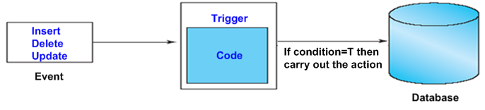
7.2 Specifying Constraints as Assertions
and Actions as Triggers
Trigger and assertion are used to specify additional types of constraints that are outside the scope of the built-in relational model constraints such as primary keys, referential integrity, check constraints, etc
TRIGGER
The SQL statements that are executed automatically when a specified condition occurs during insert/delete/update operations
ASSERTION
A Boolean-valued SQL expression that must be true at all times
DB modification is allowed unless it causes the assertion to become false
Trigger specifies the action to be executed when a DB operation violates a constraint; On the other hand, assertion is specified not to execute a DB operation which will violate a constraints
It is usually used to specify constraints which involve more than two relations
However, it should be used carefully because a complex assertion can cause considerable overhead

Slide 28
7.2.2 Introduction to Triggers in SQL
Triggers are usually used to enforce the business rules which may not be expressed by a built-in relational model constraints
A trigger is a statement that is executed automatically by the system as a side effect of a modification to DB
This type of functionality is generally referred to as active databases
Triggers follow an event-condition-action (ECA) model
1) Specify the events under which the trigger is examined
Database modification such as insert, delete, and update
2) Specify the conditions under which the trigger is to be executed.
Any true/false expression
3) Specify the actions to be taken when the trigger executes.
Sequence of SQL statements that will be automatically executed, but it could be a DB transaction or an external program
There are three types of trigger-insert, delete, and update-and the number of each of type trigger to be declared to a table is zero or more

Slide 29
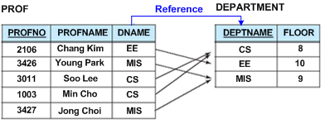
7.2.2 Introduction to Triggers in SQL
TRIGGER statement
CREATE TRIGGER <trigger_name>
{ BEFORE | AFTER | INSTEAD OF } { event [ OR ... ] } ON <table_name>
[ FOR EACH { ROW | STATEMENT } ]
[ WHEN <condition>]
BEGIN <SQL statement(s)> END
If no condition is specified then condition is always true; Otherwise, a following condition is evaluated
AFTER: Executes the condition after the event: event->condition->action
BEFORE: Executes the condition before the event: condition->action->event
The optional keyword FOR EACH ROW specify that the rule action will be executed for each tuple that is affected by the triggering event
OLD ROW can be used to refer to a deleted tuple or to a tuple before it was updated
NEW ROW can be used to refer to a newly inserted or newly updated tuple
The optional keyword FOR EACH STATEMENT (default) specify that the rule action will be executed once for the triggering event, no matter how many tuples are affected
OLD TABLE or NEW TABLE can be used to refer to temporary tables containing all the affected tuples

Slide 30
7.2.2 Introduction to Triggers in SQL
Let's write a SQL trigger that applies to the MovieExec(name, address, certNo, netWorth) table so that it foils any attempt to lower the net worth of a movie executive
It is necessary to write one trigger for the update event
The optional keyword FOR EACH ROW specify that the rule action will be executed for each tuple that is affected by the triggering event
OLD ROW is used to refer to a deleted tuple or to a tuple before it was updated
NEW ROW is used to refer to a newly inserted or newly updated tuple
1) CREATE TRIGGER NetWorthTrigger
2) AFTER UPDATE OF netWorth ON MovieExec // Event
3) REFERENCING
4) OLD ROW AS OldTuple,
5) NEW ROW AS NewTuple
6) FOR EACH ROW
7) WHEN (OldTupe.netWorth > NewTuple.netWorth) // Condition
8) UPDATE MovieExec // Action
9) SET netWorth = OldTuple.netWorth
10) WHERE certNo = NewTuple.certNo;

Slide 31
7.2.2 Introduction to Triggers in SQL
Let's write a SQL trigger that applies to the MovieExec(name, address, cert#, netWorth) table so that it prevents the average net worth of movie executives from dropping below $500,000.
It is necessary to write one trigger for each of three events: insert, delete, and update of relation MovieExec. (But the following code shows the trigger for the update event)
The optional keyword FOR EACH STATEMENT specify that the rule action will be executed once for the triggering event, no matter how many tuples are affected
OLD TABLE or NEW TABLE can be used to refer to temporary tables containing all the affected tuples before the update or after the update, respectively
1) CREATE TRIGGER AveNetWorthTrigger
2) AFTER UPDATE OF netWorth ON MovieExec // Event
3) REFERENCING
OLD TABLE AS OldStuff,
NEW TABLE AS NewStuff
6) FOR EACH STATEMENT
7) WHEN (500000 > (SELECT AVG(netWorth) FROM MovieExec)) //Condition
8) BEGIN // Action
9) DELETE FROM MovieExec
10) WHERE (name, address, certNo, netWorth) IN NewStuff;
11) INSERT INTO MovieExec
12) SELECT * FROM OldStuff;
13) END

Slide 32
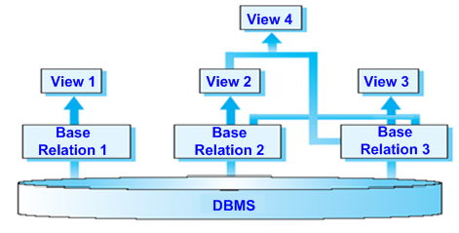
7.3 Views (Virtual Tables) in SQL
Concept of a view in SQL
A view is a virtual table derived from
other tables which are base tables or
previously defined views
A view does not necessarily exist in
physical forms; This limits the possible update operations, but it does
not provide any limitations on querying a view
We can think of a view as a way of specifying a table that we need to reference frequently, even though it may not exist physically
We may frequently issue queries that retrieve the employee name and the the project names that the employee works on
Rather than having to specify the join of the three tables EMP, WORKS_ON, and PROJECT every time we issue this query, we can define a view that is specified as the result of these joins
Then we can issue queries on the view, which are specified as single table retrievals rather than as retrievals involving three tables

Slide 33
7.3 Views (Virtual Tables) in SQL
CREATE VIEW command
The view is given a table name, a list of attribute names, and a query to specify the contents of the view
CREATE VIEW <view_name> [(attribute(s))]
AS <query expression>
[ WITH CHECK OPTION];
If none of the view attributes results from applying arithmetic or aggregation operations, we do not have to specify new attribute names for the view
CREATE VIEW EMP_Dno3
AS SELECT Ename, Super_ssn
FROM EMP
WHERE Dno=3;
The clause WITH CHECK OPTION must be added for the system to keep for data consistency if a view is to be updated
If a tuple inserted or updated into the view does not satisfy the view’s where clause condition, the insertion or update is rejected
DROP VIEW command
DROP VIEW view_name [RESTRICT | CASCADE]
CREATE VIEW DEPTINFO(Dname, Totalsal)
AS SELECT Dname, SUM(Salary)
FROM DEPART, EMP
WHERE Dnumber=Dno
GROUP BY Dname;
UPDATE EMP_Dno3
SET Dno = 2
WHERE Name = 'Kim';

Slide 34
7.3.2 Specification of Views in SQL
Main advantages of a view
Views are used as a security and authorization mechanism because they can restrict users to see only specified columns and rows in a table
Several different views can be provided from the same data
Views are used to simplify the specification of complex queries
v2: CREATE VIEW DEPT_INFO(Dname, No_of_emps, Total_sal)
AS SELECT Dname, COUNT(*), SUM(Salary)
FROM EMP, DEPT
WHERE Dno=Dnumber
GROUP BY Dname;
Views can also be used for data independence: Suppose that an EMP table is divided by two EMP1 and EMP2 tables for some reason. Then we cannot use an application program which use the EMP table. However, if we create an EMP view, then we can still use an application program
Ex: CREATE VIEW EMP
AS SELECT EMP1.Name, EMP1.Bdate, EMP2.Dno
FROM EMP1, EMP2
WHERE EMP1.Ssn = EMP2.Ssn

Slide 35
7.3.3 View Implementation, View Update,
and Inline Views
If a user modifies the base tables on which the view is defined, the view must automatically reflect these changes
Query modification approach
If a user creates a view, only its definition is stored in a system catalog
For example, the left query would be automatically modified to the right query by the DBMS since it has a definition of the view EMP_Dno3
SELECT * SELECT Name, Sex, Super_ssn
FROM EMP_Dno3 ⇒ FROM EMP
WHERE Sex='male'; WHERE Dno=3 AND Sex='male';
The disadvantage of this approach is that it is inefficient for views defined via complex queries that are time-consuming to execute
View materialization approach
Physically create a view table (materialized view) when the view is first queried
Thereafter, queries based on materialized view can be faster than re-computing view each time
Difficulty is maintaining the currency of view while base table(s) are being updated
The task of keeping a materialized view up-to-date with the underlying data is known as materialized view maintenance

Slide 36
7.3.3 View Implementation, View Update,
and Inline Views
Updating of views is complicated and can be ambiguous
In general, an update on a view defined on a single table without any aggregate functions can be mapped to an update on the underlying base table under certain conditions
1) An update on a view defined on a single table
INSERT INTO EMP_PUBLIC_Dno3 ⇒ INSERT INTO EMP
VALUES (Kim, male, 1324) VALUES(Kim, male, NULL ... NULL, 1324)
2) An update on a view which includes aggregate functions does not make
much sense
UPDATE DEPT_INFO
SET Total_sal=100000
WHERE Dname = 'Sales';
3) For a view involving joins, an update operation may be mapped to update
operations on the underlying base relations in multiple ways
CREATE VIEW DEPT_INFO(Dname, No_of_emps, Total_sal)
AS SELECT Dname, COUNT(*), SUM(Salary)
FROM EMP, DEPT
WHERE Dno=Dnumber
GROUP BY Dname;

Slide 37
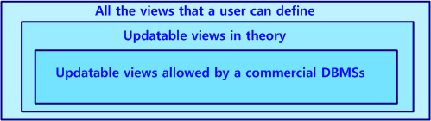
7.3.3 View Implementation, View Update,
and Inline Views
In summary, we can make the following observations
A view with a single defining table is updatable
If the view attributes contain the primary key of the base relation
All attributes with the NOT NULL constraint but have default values specified
Views defined using grouping and aggregate functions are not updatable
Views defined on multiple tables using joins are generally not updatable
Inline view
It is possible to define a view in the FROM clause of an SQL query
SELECT Pname
FROM Producer, (SELECT producerID FROM StarsIn, Movie
WHERE movieTitle=title AND movieYear=year AND
starname=‘Tom Cruise') PIDforTom
WHERE PIDforTom.producerID=PID;

Slide 38
7.4 Schema Change Statements in SQL
Schema evolution commands
Can be done while the database is operational
Does not require recompilation of the database schema
DROP command
Used to drop named schema elements, such as tables, domains, or constraint
Drop behavior options: CASCADE or RESTRICT
Ex: DROP SCHEMA COMPANY CASCADE;
Ex: DROP TABLE DEPENDENT RESTRICT;
Alter table actions include:
Adding or dropping a attribute. (CASCADE or RESTRICT for drop)
Ex: ALTER TABLE EMP
ADD COLUMN Job VARCHAR(12);
Changing a column definition
Ex: ALTER TABLE DEPARTMENT ALTER COLUMN Mgr_ssn
SET DEFAULT ‘3344555’;
Change constraints specified on a table
Add or drop a named constraint
Ex: ALTER TABLE EMPLOYEE
DROP CONSTRAINT EMPSUPERFK CASCDE;

Slide 39
Summary
Complex SQL:
Nested queries, joined tables, aggregate functions, grouping
ASSERTION and TRIGGER
CREATE ASSERTION <name>
CHECK (<condition>) // usually EXISTS and NOT EXIST style of SQL condition
DB modification is allowed if the results of the condition is TRUE
Views
Virtual or derived tables
Materialized view
Schema Change Statements in SQL

