Slide 1




Elm Elementary School
Open House
September 8, 20xx

Slide 2
Welcome Parents!
Welcome parents to your classroom.
List the goals for the open house:
To help parents understand the work their child will be doing throughout the school year.
To explain your expectations of their child.
To share information about how parents can support their child’s learning.

Slide 3
Curriculum Goals
Describe what the students will study during the school year, including the overall curriculum plans and goals.
Include a detailed, colorful syllabus for parents to take home.
Suggest ways that parents can help their child learn, such as reading together for 20 minutes a day.
Use more than one slide to cover this information.

Slide 4
In-class Activity
Invite parents to take part in an activity, and then discuss it. Some ideas include:
Solving a math problem, such as estimating the number of beans in a jar.
Writing an encouraging letter to their child.
Going on a classroom scavenger hunt for their child's work, the books their child likes best, and messages from their child.

Slide 5
Class Information
Explain how students will be evaluated and graded.
Tell parents when report cards and progress reports will be sent home.
Describe the amount of homework students can expect.
Provide a calendar of upcoming events, such as class field trips and parent-teacher conferences

Slide 6

Class Rules
Explain the behavior you expect in your classroom.
Your class rules might include:
Be respectful.
Be responsible.
Follow directions.
Be punctual.
Be organized.
Be a self-starter.
Be prepared.

Slide 7
School Policies
Explain how the school addresses academic and behavioral problems.
Outline the school's policies regarding tardiness, absence, and discipline.
Provide policy information about:
School cancellations for bad weather and other reasons.
Emergency procedures.
Transportation.
After-school activities.
Volunteering.

Slide 8
Get Involved
List opportunities for parents to become involved in volunteer programs, advisory councils, and the PTA.
Provide sign-up sheets for parents who are interested in helping to plan parties or special projects for your class.

Slide 9

Questions?
Take questions from parents.
Ask parents to fill out a questionnaire about their child.
Have them describe areas in which they would like to see their child improve.
Have them describe their child's personality, interests, and talents

Slide 10
Handouts
Translate handouts for parents for whom English is a second language.
Handouts might include:
A list of school phone numbers, e-mail addresses, and Web site addresses.
Copies of classroom and school policies.
A list of materials that children will need for class.

Slide 11
Unit 1 - Leisure Time
Getting Started

Slide 12
Warm-up
What do you like to do in your free time?

Slide 13
Listen and Read
Listen to and read the conversation between Tom and Trang.

Slide 14
Complete the Sentences
Complete sentences based on the dialogue.

Slide 15
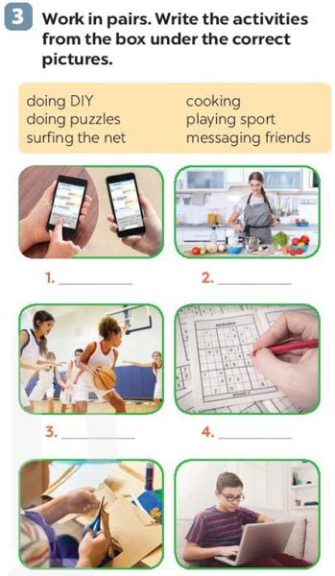
Categorize Activities
Write the activities from the box under the correct pictures.

Slide 16
Match Descriptions to Activities
Read the phrases and guess which activities are described.

Slide 17
Group Discussion
If you have some free time this weekend, what will you do?

Slide 18
Wrap-up
Review key vocabulary and activities from the lesson.

Slide 19
Unit 3: Hobbies
A Closer Look 1

Slide 20
Warm-up
Introduction to hobbies and interests
What are your hobbies?

Slide 21
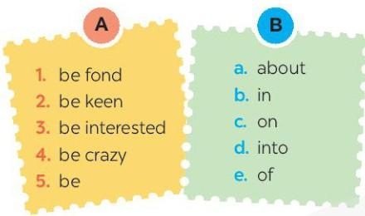
Stage 1: Vocabulary Matching
Match a word/phrase in column A with a word in column B to make expressions about likes.

Slide 22

Stage 2: Vocabulary Fill-in-the-blanks
Fill in each blank with a correct word from the box.

Slide 23
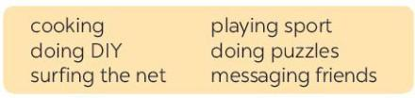
Stage 3: Sentence Completion
Complete the sentences about what you like or dislike doing.

Slide 24
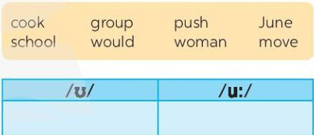
Stage 4: Pronunciation Practice
Listen and repeat the words. Pay attention to the sounds /ʊ/ and /u:/.

Slide 25
Stage 5: Sentence Practice
Listen and practise the sentences. Underline the bold words with /ʊ/, and circle the bold words with /u:/.

Slide 26
Wrap-up
Review of vocabulary and pronunciation covered in the lesson.
What did you find interesting or challenging about the lesson?

Slide 27
Unit 1 - Leisure Time
A Closer Look 2

Slide 28
Warm-up
What are some activities you like or dislike doing in your free time?

Slide 29
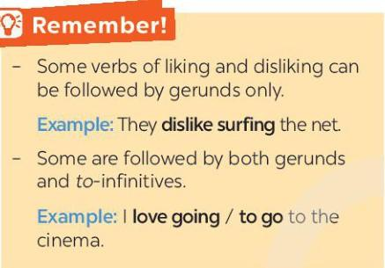
Grammar Introduction
Some verbs of liking and disliking can be followed by gerunds only. Example: They dislike surfing the net.
Some are followed by both gerunds and to-infinitives. Example: I love going / to go to the cinema.

Slide 30
Unit 5: Leisure Activities
COMMUNICATION

Slide 31
Warm-up
What are your favorite leisure activities?
Have you ever invited someone to join you?

Slide 32
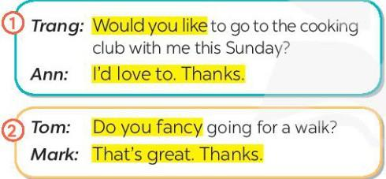
Stage 1: Listen and Read
Listen to the dialogues and follow along in your textbooks.
Highlight the phrases used for inviting and accepting invitations: 'Would you like to go...?', 'I’d love to.', 'Do you fancy going...?', 'That’s great.'

Slide 33
Stage 2: Practice in Pairs
Practice the dialogues with your partners, using the highlighted language from the dialogues.
Scenarios: playing badminton, making paper flowers, trying home-made pizza.

Slide 34
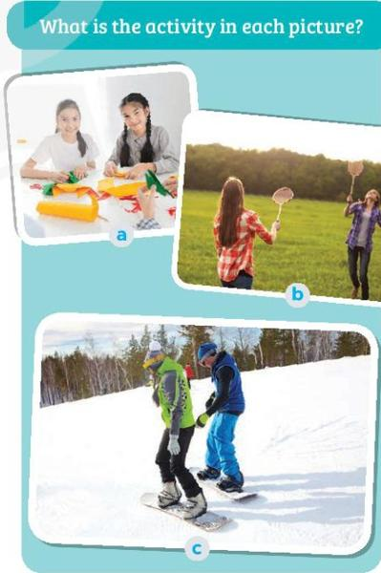
Stage 3: Identify Activities
Discuss in pairs what each activity is and share your answers with the class.

Slide 35
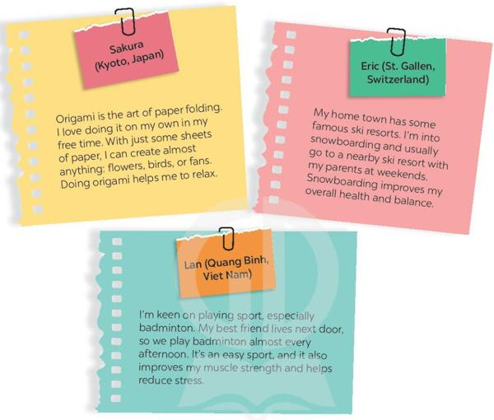
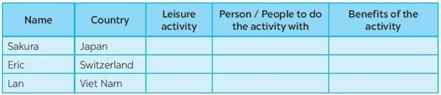
Stage 4: Read and Complete Table
Read the text about Sakura, Eric, and Lan's leisure activities.
Read the text and complete the table with information about each teenager's leisure activity, who they do it with, and the benefits.

Slide 36
Stage 5: Group Discussion
Which activity would you like to try? Why do you want to try it?
Discuss in groups and prepare to report your answers.

Slide 37
Wrap-up
What did you find most interesting about the lesson?

Slide 38
Leisure Activities
Skills 1

Slide 39
Warm-up
What are some leisure activities you know?

Slide 40
Task 1: Picture Discussion
Look at the pictures and discuss the activities you see.

Slide 41
Task 2: Reading Comprehension - Multiple Choice
Read a text about Trang's leisure activities and answer multiple choice questions.

Slide 42
Task 3: Vocabulary Focus
The word 'connect' is closest in meaning to ______.

Slide 43
Task 4: Detailed Reading and Question Answering
Read the text again and answer detailed questions about Trang's activities.

Slide 44
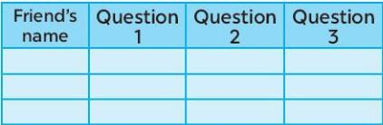
Task 5: Group Discussion
Discuss personal leisure activities in groups and record answers.

Slide 45
Task 6: Reporting
Report on group members' leisure activities and identify common ones.

Slide 46
Wrap-up
Summarize the lesson and ask any final questions.

Slide 47
Unit 1 - Leisure Time
Skills 2

Slide 48
Warm-up
What are your favorite leisure activities with friends?

Slide 49
Stage 1: Answer the Questions
In your opinion, what activities can we do with our friends in our leisure time?
Why should we spend time with our friends?

Slide 50
Stage 2: Listen and Choose the Correct Answer
Listen to an interview with Mark and choose the correct answers to the questions.
When does Mark usually have free time?
Who does he spend his free time with?

Slide 51
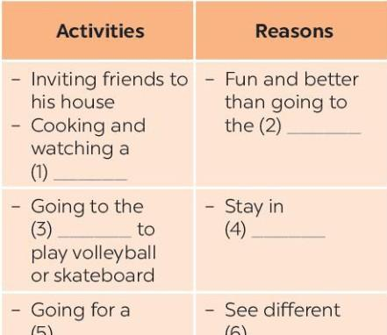
Stage 3: Listen Again and Fill in the Blanks
Listen to the interview again and fill in the blanks in the table.

Slide 52
Stage 4: Pair Work - Ask and Answer Questions
Work in pairs to ask and answer questions about free time activities.
When do you usually have free time?
What do you usually do with your friends in your free time?
Why do you do these activities?

Slide 53
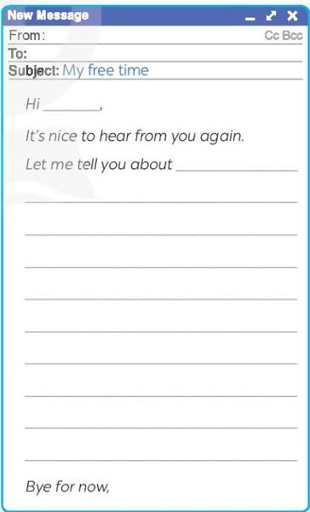
Stage 5: Write an Email to a Penfriend
Write an email to a penfriend about what you usually do with friends in your free time.

Slide 54
Wrap-up
What did you learn about leisure activities?
How can you spend your free time with friends?

Slide 55
Leisure Activities
Looking Back

Slide 56
Warm-up
Introduction to the topic of leisure activities.

Slide 57
Vocabulary Task 1
Complete the sentences with appropriate leisure activities.

Slide 58
Writing Task 2
Write complete sentences from the given cues.

Slide 59
Grammar Task 3
Fill in each blank with the correct form(s) of the verb in brackets.

Slide 60
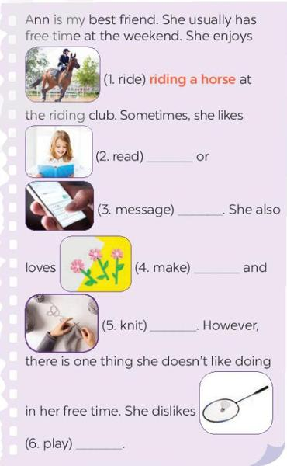
Grammar Task 4
Complete the passage using the correct form(s) of the verbs in brackets and the pictures.

Slide 61
Wrap-up
Review of key vocabulary and grammar points covered in the lesson.

Slide 62
Unit 1 - Leisure Time
Project: Leisure Time Survey

Slide 63
Warm-up
What do you usually do in your free time?

Slide 64
Stage 1: Conduct Interviews
Form groups and interview classmates using the following questions:
1. When do you have free time?
2. What do you like doing with your family in your free time?
3. What do you like doing with your friends in your free time?
4. What leisure activities do you like doing on your own?
5. What leisure activities would you like to try in the future?

Slide 65
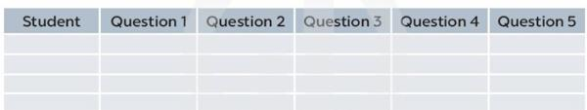
Stage 2: Collect and Organize Data
Fill in the table with the collected data, ensuring each student's responses are recorded under the appropriate questions.

Slide 66
Stage 3: Report Findings
Prepare and deliver a presentation based on the survey findings, using the guiding questions to structure your report.
Guiding questions:
1. How many students did you interview?
2. When do the students have free time?
3. What are the most popular activities they do with their family?
4. What are the most popular activities they do with their friends?
5. What are the most popular activities they do on their own?
6. What leisure activities would they like to try in the future?

Slide 67
Wrap-up
Participate in the pronunciation practice and ask any remaining questions about the lesson.

