Slide 1




Elm Elementary School
Open House
September 8, 20xx

Slide 2
Welcome Parents!
Welcome parents to your classroom.
List the goals for the open house:
To help parents understand the work their child will be doing throughout the school year.
To explain your expectations of their child.
To share information about how parents can support their child’s learning.

Slide 3
Curriculum Goals
Describe what the students will study during the school year, including the overall curriculum plans and goals.
Include a detailed, colorful syllabus for parents to take home.
Suggest ways that parents can help their child learn, such as reading together for 20 minutes a day.
Use more than one slide to cover this information.

Slide 4
In-class Activity
Invite parents to take part in an activity, and then discuss it. Some ideas include:
Solving a math problem, such as estimating the number of beans in a jar.
Writing an encouraging letter to their child.
Going on a classroom scavenger hunt for their child's work, the books their child likes best, and messages from their child.

Slide 5
Class Information
Explain how students will be evaluated and graded.
Tell parents when report cards and progress reports will be sent home.
Describe the amount of homework students can expect.
Provide a calendar of upcoming events, such as class field trips and parent-teacher conferences

Slide 6

Class Rules
Explain the behavior you expect in your classroom.
Your class rules might include:
Be respectful.
Be responsible.
Follow directions.
Be punctual.
Be organized.
Be a self-starter.
Be prepared.

Slide 7
School Policies
Explain how the school addresses academic and behavioral problems.
Outline the school's policies regarding tardiness, absence, and discipline.
Provide policy information about:
School cancellations for bad weather and other reasons.
Emergency procedures.
Transportation.
After-school activities.
Volunteering.

Slide 8
Get Involved
List opportunities for parents to become involved in volunteer programs, advisory councils, and the PTA.
Provide sign-up sheets for parents who are interested in helping to plan parties or special projects for your class.

Slide 9

Questions?
Take questions from parents.
Ask parents to fill out a questionnaire about their child.
Have them describe areas in which they would like to see their child improve.
Have them describe their child's personality, interests, and talents

Slide 10
Handouts
Translate handouts for parents for whom English is a second language.
Handouts might include:
A list of school phone numbers, e-mail addresses, and Web site addresses.
Copies of classroom and school policies.
A list of materials that children will need for class.

Slide 11
Unit 1 - Leisure Time
Getting Started

Slide 12
Warm-up
What do you like to do in your free time?
Share your hobbies.

Slide 13
Stage 1: Listen and Read
Listen to the audio and read the conversation between Tom and Trang.

Slide 14
Stage 2: Complete the Sentences
Complete the sentences based on the conversation.

Slide 15
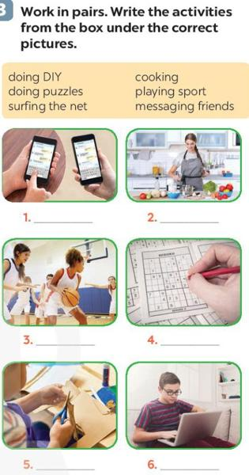
Stage 3: Work in Pairs
Match the activities to the pictures.

Slide 16
Stage 4: Guess the Activities
Guess activities from the given phrases.

Slide 17
Stage 5: Group Discussion
If you have some free time this weekend, what will you do?
Discuss your weekend plans.

Slide 18
Wrap-up
Recall the new vocabulary and expressions learned today.

Slide 19
Unit 1 - Leisure Time
A Closer Look 1

Slide 20
Warm-up
What do the expressions 'be fond of', 'be keen on', 'be interested in', 'be crazy about', 'be into' mean?

Slide 21
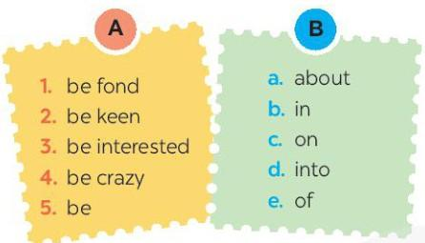
Stage 1: Vocabulary Matching
Match words from column A with words from column B to form expressions.

Slide 22

Stage 2: Fill in the Blanks
Fill in the blanks in sentences using words from the box.

Slide 23
Stage 3: Sentence Completion
Complete sentences about your own likes and dislikes.

Slide 24


Stage 4: Pronunciation Practice
Listen and repeat words, sorting them into /ʊ/ and /u:/ sounds.

Slide 25
Stage 5: Sentence Practice
Listen to sentences and mark the /ʊ/ and /u:/ sounds.

Slide 26
Wrap-up
Recall the expressions and sounds practiced in the lesson.

Slide 27
Unit 1 - Leisure Time
A Closer Look 2

Slide 28
Warm-up
How are the verbs 'love', 'like', 'enjoy', 'fancy', 'prefer', 'dislike', 'detest', 'hate' used in sentences?

Slide 29
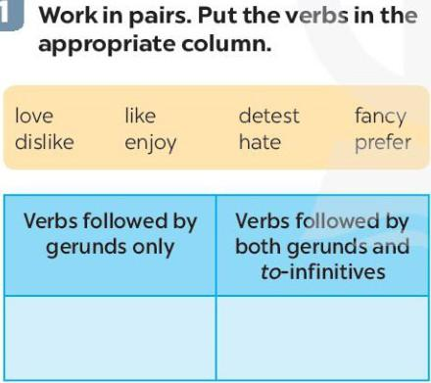
Stage 1: Verb Categorization
Categorize verbs into two columns based on their usage with gerunds and to-infinitives.

Slide 30
Stage 2: Multiple-Choice Exercise
Choose the correct answer for each sentence from options A, B, or C.

Slide 31
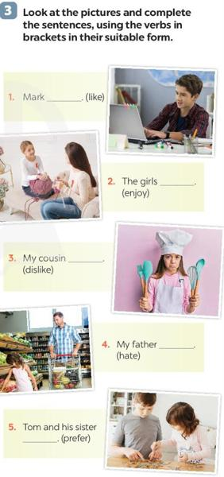
Stage 3: Sentence Completion with Pictures
Complete sentences using verbs in brackets, with reference to pictures.

Slide 32
Stage 4: Personal Sentence Completion
Complete sentences about yourself using verbs of liking and disliking.

Slide 33
Stage 5: Likes and Dislikes Mimes Game
Mime a leisure activity you like or dislike, and others guess by asking Yes/No questions.

Slide 34
Wrap-up
Recall the verbs and their usage.

Slide 35
Unit 1 - Leisure Time
Communication

Slide 36
Warm-up
When might you use the expressions 'Would you like to...?','Do you fancy...?','I’d love to.','That’s great.'?

Slide 37
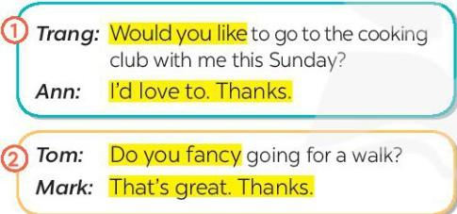
Stage 1: Listen and Read Dialogues
Listen to and read dialogues focusing on inviting and accepting invitations.

Slide 38
Stage 2: Practice Inviting and Accepting Invitations
Practice dialogues in pairs using the highlighted language.
Would you like to play badminton?
Do you fancy making paper flowers?
I’d love to try your home-made pizza.

Slide 39
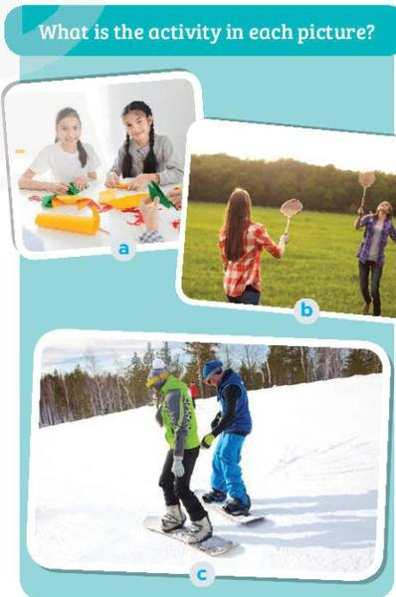
Stage 3: Identify Activities from Pictures
Identify activities in pictures.

Slide 40
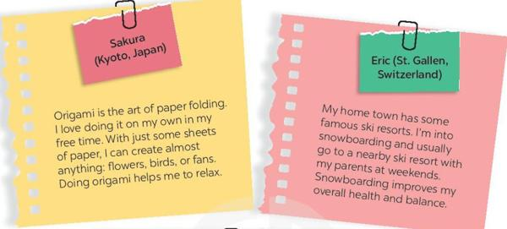
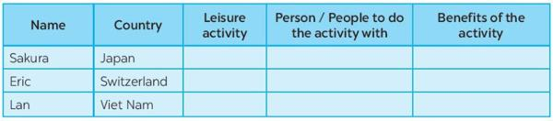
Stage 4: Read and Complete the Table
Read about teenagers' leisure activities and complete a table with the information.

Slide 41
Stage 5: Group Discussion
Discuss which activities you would like to try and why.
Which activity do you want to try?
Why do you want to try it?

Slide 42
Wrap-up
Recall the expressions for inviting and accepting invitations.
Summarize the activities identified and discussed.

Slide 43
Unit 1 - Leisure Time
Skills 1

Slide 44
Warm-up
What are some activities you do in your free time?

Slide 45
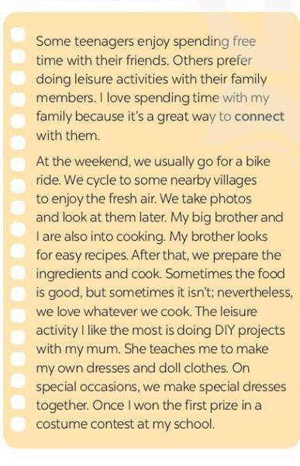
Stage 1: Picture Identification
Identify the activities you see in the pictures.

Slide 46
Stage 2: Reading Comprehension - Multiple Choice
Read about Trang's leisure activities and answer multiple-choice questions.

Slide 47
Stage 3: Vocabulary Meaning
What does the word 'connect' mean in the text?

Slide 48
Stage 4: Detailed Reading and Question Answering
Read the text again and answer detailed questions.

Slide 49
Stage 5: Group Discussion - Leisure Activities
Discuss your own leisure activities with family in groups and record answers.

Slide 50
Stage 6: Reporting Group Findings
Report your group's findings to the class and discuss common activities.

Slide 51
Wrap-up
What are the main activities discussed in the lesson?
What did you learn?

Slide 52
Unit 1 - Leisure Time
Skills 2

Slide 53
Warm-up
What are some activities you enjoy doing with your friends during your free time?

Slide 54
Stage 1: Pre-listening Discussion
What activities can we do with our friends in our leisure time?
Why should we spend time with our friends?

Slide 55
Stage 2: Listening for Specific Information
Listen to the interview with Mark and choose the correct answers.

Slide 56
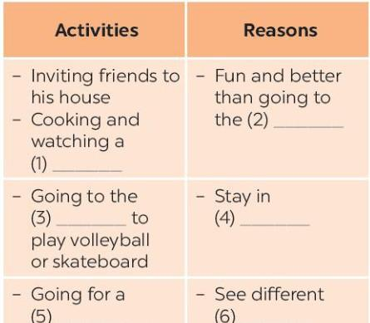
Stage 3: Listening and Filling in Information
Listen again and fill in the blanks in the table with no more than two words.

Slide 57
Stage 4: Pair Work - Speaking Practice
Ask and answer questions about your free time activities.

Slide 58
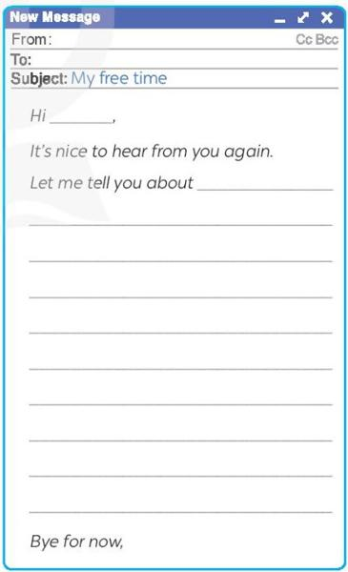
Stage 5: Writing an Email
Write an email to a penfriend about your leisure activities using your answers from the speaking task.

Slide 59
Wrap-up
What are the main activities discussed in the lesson?
What did you learn?

Slide 60
Unit 1 - Leisure Time
Looking Back

Slide 61
Warm-up
What are some leisure activities you enjoy doing in your free time?

Slide 62
Stage 1: Vocabulary Review - Sentence Completion
Complete sentences with appropriate leisure activities.

Slide 63
Stage 2: Sentence Formation from Cues
Write complete sentences using provided cues.

Slide 64
Stage 3: Grammar Practice - Gerunds
Fill in the blanks with correct forms of verbs in brackets.

Slide 65
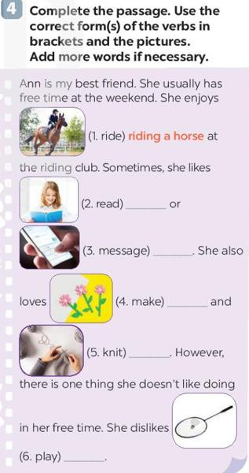
Stage 4: Passage Completion
Complete a passage using correct verb forms and additional words.

Slide 66
Wrap-up
What are the main activities and grammar points discussed?
What did you learn?

Slide 67
Unit 1 - Leisure Time
Project

Slide 68
Warm-up
What are some of your favorite activities to do in your free time?

Slide 69
Stage 1: Preparing for the Interview
Review the interview questions:
- When do you have free time?
- What do you like doing with your family?
- What do you like doing on your own?

Slide 70
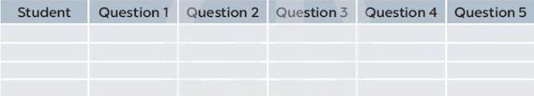
Stage 2: Conducting the Interviews
Conduct interviews with classmates using the prepared questions.

Slide 71
Stage 3: Analyzing and Summarizing Data
Analyze the data collected and prepare to report findings.

Slide 72
Stage 4: Reporting Findings
Report your findings to the class using guiding questions.
How many students?
What are the popular activities?
What would you like to try?

Slide 73
Wrap-up
What did you learn about leisure activities?
What were the interesting findings from the project?

