Slide 1




Elm Elementary School
Open House
September 8, 20xx

Slide 2
Welcome Parents!
Welcome parents to your classroom.
List the goals for the open house:
To help parents understand the work their child will be doing throughout the school year.
To explain your expectations of their child.
To share information about how parents can support their child’s learning.

Slide 3
Curriculum Goals
Describe what the students will study during the school year, including the overall curriculum plans and goals.
Include a detailed, colorful syllabus for parents to take home.
Suggest ways that parents can help their child learn, such as reading together for 20 minutes a day.
Use more than one slide to cover this information.

Slide 4
In-class Activity
Invite parents to take part in an activity, and then discuss it. Some ideas include:
Solving a math problem, such as estimating the number of beans in a jar.
Writing an encouraging letter to their child.
Going on a classroom scavenger hunt for their child's work, the books their child likes best, and messages from their child.

Slide 5
Class Information
Explain how students will be evaluated and graded.
Tell parents when report cards and progress reports will be sent home.
Describe the amount of homework students can expect.
Provide a calendar of upcoming events, such as class field trips and parent-teacher conferences

Slide 6

Class Rules
Explain the behavior you expect in your classroom.
Your class rules might include:
Be respectful.
Be responsible.
Follow directions.
Be punctual.
Be organized.
Be a self-starter.
Be prepared.

Slide 7
School Policies
Explain how the school addresses academic and behavioral problems.
Outline the school's policies regarding tardiness, absence, and discipline.
Provide policy information about:
School cancellations for bad weather and other reasons.
Emergency procedures.
Transportation.
After-school activities.
Volunteering.

Slide 8
Get Involved
List opportunities for parents to become involved in volunteer programs, advisory councils, and the PTA.
Provide sign-up sheets for parents who are interested in helping to plan parties or special projects for your class.

Slide 9

Questions?
Take questions from parents.
Ask parents to fill out a questionnaire about their child.
Have them describe areas in which they would like to see their child improve.
Have them describe their child's personality, interests, and talents

Slide 10
Handouts
Translate handouts for parents for whom English is a second language.
Handouts might include:
A list of school phone numbers, e-mail addresses, and Web site addresses.
Copies of classroom and school policies.
A list of materials that children will need for class.

Slide 11
Unit 1 - Leisure Time
Getting Started

Slide 12
Warm-up
What are your favorite leisure activities?

Slide 13
Stage 1: Listen and Read
Students listen to and read along with the dialogue between Tom and Trang.

Slide 14
Stage 2: Read and Complete Sentences
Complete sentences based on the dialogue.
1. Trang is looking for a _____.
2. She likes doing DIY in her _____.
3. Tom loves spending his free time with _____.
4. Tom and his friends usually _____.
5. Tom, Mark, Trang, and Mai are going to see a comedy this ____.

Slide 15
Unit 1 - Leisure Time
A Closer Look 1

Slide 16
Warm-up
What activities do you like or dislike doing in your free time?

Slide 17
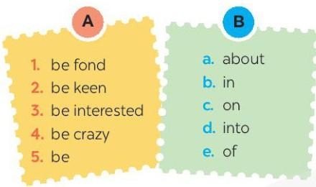
Stage 1: Vocabulary Matching
Match a word/phrase in column A with a word in column B to make expressions.

Slide 18

Stage 2: Vocabulary Practice
Fill in each blank with a correct word from the box.
1. I'm ________ of taking photos.
2. Mai is ________ in history.
3. My sister is ________ on cooking.
4. My brother spends lots of time surfing the net, but I'm not ________ it.
5. I'm not crazy ________ doing DIY.

Slide 19
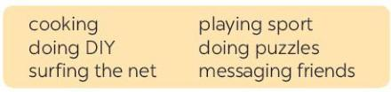
Stage 3: Sentence Completion
Complete the sentences about what you like or dislike doing.
1. I'm crazy about ________.
2. I'm keen on ________.
3. I'm fond of ________.
4. I'm not interested in ________.
5. I'm not into ________.

Slide 20
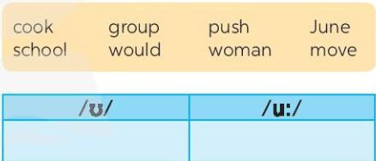
Stage 4: Pronunciation Practice
Listen and repeat words, then categorize them by sound.

Slide 21
Stage 5: Sentence Practice
Listen and practice sentences, marking sounds as instructed.
1. She likes reading books and swimming in the pool.
2. When it is cool, we like to play football.
3. She drew and made puddings in her free time.
4. My mum loves pumpkin soup and coffee with a little sugar.
5. My brother is fond of watching the cartoon about a clever wolf.

Slide 22
Wrap-up
Summarize key points from the lesson.
What did you learn today?

Slide 23
Unit 1 - Leisure Time
A Closer Look 2

Slide 24
Warm-up
What activities do you love or hate doing during your free time?

Slide 25
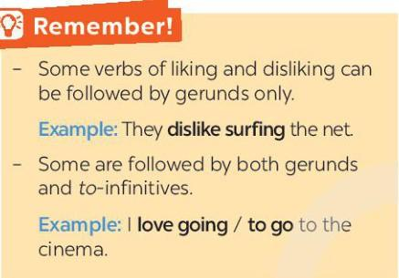
Stage 1: Grammar Introduction
Introduce the grammar rules for using verbs of liking and disliking.

Slide 26
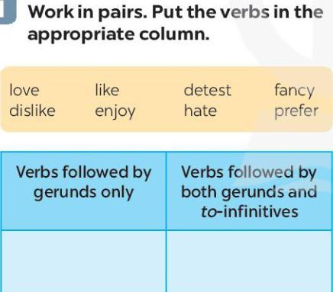
Stage 2: Verb Classification
Classify verbs into appropriate columns.

Slide 27
Stage 3: Multiple Choice Practice
Choose the correct answer A, B, or C for each sentence.
1. I love ________.
2. Tom enjoys ________ puzzles.
3. When do you like ________ TV?
4. Do you fancy ________ to the cinema?
5. I detest ________.

Slide 28
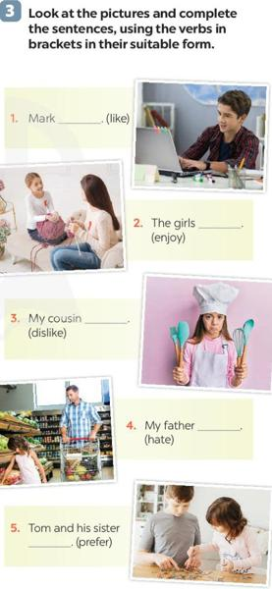
Stage 4: Sentence Completion with Pictures
Use pictures to complete sentences with the correct verb form.
1. Mark __________ (like)
2. The girls __________ (enjoy)
3. My cousin __________ (dislike)
4. My father __________ (hate)
5. Tom and his sister __________ (prefer).

Slide 29
Stage 5: Personal Sentence Completion
Complete sentences about personal preferences.
I like ______.
I prefer ______.
I love ______.
I dislike ______.
I hate ______.
I detest ______.

Slide 30
Stage 6: Likes and Dislikes Mimes Game
Play a miming game to guess activities.

Slide 31
Wrap-up
Summarize key points from the lesson.
What did you learn today?

Slide 32
Unit 1 - Leisure Time
Communication

Slide 33
Warm-up
How do you invite someone to do something with you?
How do you accept an invitation?

Slide 34
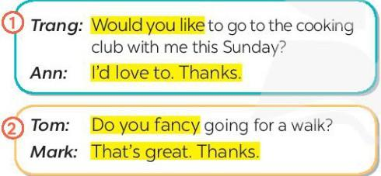
Stage 1: Listen and Read Dialogues
Listen and read the dialogues, paying attention to the highlighted parts.
Would you like to..., Do you fancy..., I’d love to. Thanks., That’s great. Thanks.

Slide 35
Stage 2: Pair Practice - Inviting and Accepting
Practice inviting and accepting invitations using the highlighted language.
1. Play badminton.
2. Make paper flowers.
3. Try home-made pizza.

Slide 36
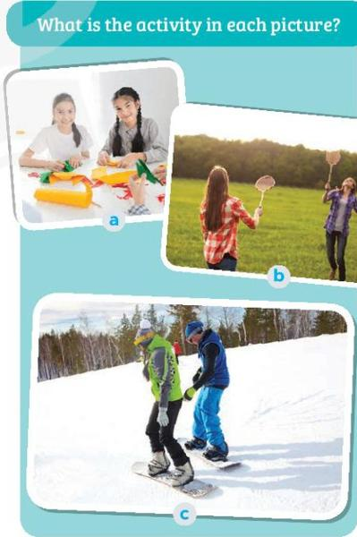
Stage 3: Picture Activity Identification
Identify the activity in each picture.

Slide 37
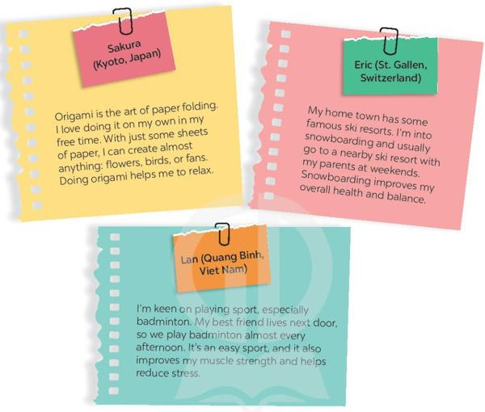
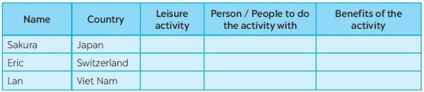
Stage 4: Reading and Completing the Table
Read about teenagers' leisure activities and complete the table.
Name, Country, Leisure activity, Person/People to do the activity with, Benefits of the activity.

Slide 38
Stage 5: Group Discussion
Discuss which activities they want to try and why.
Which activity do you want to try?
Why do you want to try it?

Slide 39
Stage 6: Reporting to the Class
Share which activities they want to try and the reasons.

Slide 40
Wrap-up
Summarize key points from the lesson.
What did you learn today?

Slide 41
Unit 1 - Leisure Time
Skills 1

Slide 42
Warm-up
What activities do you usually do with your family?

Slide 43
Stage 1: Picture Discussion
Look at the pictures and identify the activities shown.

Slide 44
Stage 2: Reading Comprehension - Multiple Choice
Read about Trang's leisure activities and choose the correct answers.
1. The text is about Trang's leisure activities ______.
2. The word 'connect' is closest in meaning to ______.

Slide 45
Stage 3: Reading Comprehension - Answering Questions
Read the text again and answer the questions.
1. What does Trang do with her family members at the weekend?
2. Who looks for recipes when Trang and her brother cook?
3. Which leisure activity does she love the most?
4. What does Trang's mum teach her to do?
5. What did she win?

Slide 46
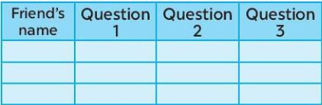
Stage 4: Group Discussion
Discuss leisure activities with family and personal preferences.
1. What leisure activities do you usually do with your family?
2. Which one do you like the most? Why?
3. How do you feel when you spend time with your family members? Record answers in the table.

Slide 47
Stage 5: Reporting to the Class
Report the group's answers and identify common activities.

Slide 48
Wrap-up
Summarize key points from the lesson.
What did you learn today?

Slide 49
Unit 1 - Leisure Time
Skills 2

Slide 50
Warm-up
What activities do you like to do with your friends in your free time?

Slide 51
Stage 1: Pre-listening Discussion
In your opinion, what activities can we do with our friends in our leisure time?
Why should we spend time with our friends?

Slide 52
Stage 2: Listening for Specific Information
Listen to an interview with Mark and choose the correct answers.
1. When does Mark usually have free time?
2. Who does he spend his free time with?

Slide 53
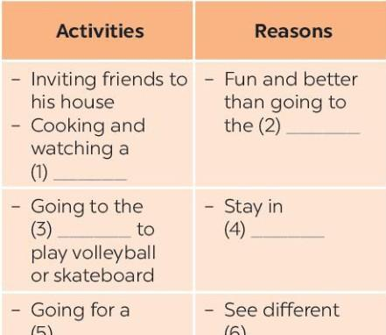
Stage 3: Listening for Details
Listen to the interview again and fill in the blanks in the table.
1. Cooking and watching a (1) ________.
2. Fun and better than going to the (2) ________.
3. Going to the (3) ________ to play volleyball or skateboard.
4. Stay in (4) ________.
5. Going for a (5) ________.
6. See different (6) ________.

Slide 54
Stage 4: Pair Discussion
When do you usually have free time?
What do you usually do with your friends in your free time?
Why do you do these activities?

Slide 55
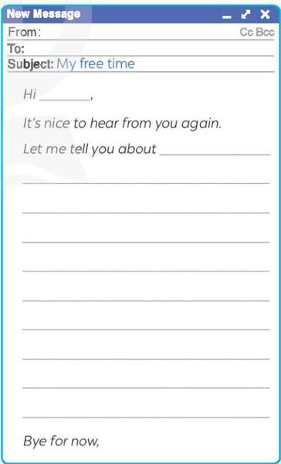
Stage 5: Writing an Email
Write an email to a penfriend about personal leisure activities.
From:
To:
Subject: My free time
Hi ________,
It's nice to hear from you again. Let me tell you about ______________. Bye for now,

Slide 56
Wrap-up
Summarize key points from the lesson.
What did you learn today?

Slide 57
Unit 1 - Leisure Time
Looking Back

Slide 58
Warm-up
What leisure activities do you enjoy doing in your free time?

Slide 59
Stage 1: Vocabulary Practice - Sentence Completion
Complete the sentences with appropriate leisure activities.
1. Mai loves __________ online.
2. My favourite leisure activity is __________.
3. __________ is a popular way for teens.
4. My brother is fond of __________ with his friends.
5. Tom spends one hour on the Internet. He is keen on __________.

Slide 60
Stage 2: Sentence Formation from Cues
Write complete sentences from the given cues.
1. My cousin is crazy about playing computer games.
2. Are they interested in playing badminton after school?
3. I am not fond of making models because I am not patient.
4. Why are you not into cooking? Because I often burn myself.
5. My friends are keen on doing judo and they go to the judo club every Sunday.

Slide 61
Stage 3: Grammar Practice - Gerunds
Fill in each blank with the correct form(s) of the verb in brackets.
1. Does Tom enjoy cycling in the park?
2. Some teenagers don’t like reading comic books.
3. Mai detests playing sport.
4. Trang and Ann love chatting.
5. What do Nam and Mark prefer doing at the weekend?

Slide 62
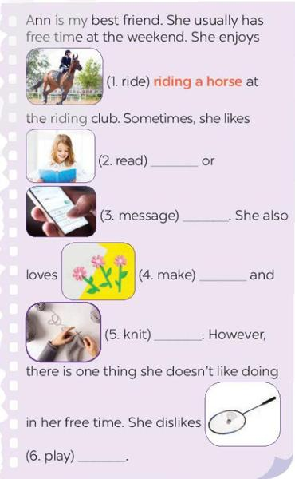
Stage 4: Passage Completion
Complete the passage using the correct form(s) of the verbs in brackets.
Ann is my best friend. She enjoys riding a horse. Sometimes, she likes reading or messaging. She also loves making and knitting. However, she dislikes playing.

Slide 63
Wrap-up
Summarize key points from the lesson.
What did you learn today?

Slide 64
Unit 1 - Leisure Time
Project

Slide 65
Warm-up
Why is it important to know about leisure activities people enjoy?

Slide 66
Stage 1: Group Formation and Preparation
Form groups and prepare interview questions for the survey.

Slide 67
Stage 2: Conducting the Survey
Interview classmates or students from other classes using the prepared questions:
1. When do you have free time?
2. What do you like doing with your family in your free time?
3. What do you like doing with your friends in your free time?
4. What leisure activities do you like doing on your own?
5. What leisure activities would you like to try in the future?

Slide 68
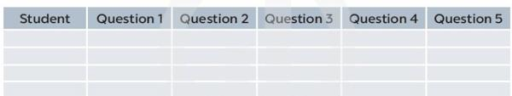
Stage 3: Data Collection and Organization
Collect and organize the answers using the provided table format:
Student | Question 1 | Question 2 | Question 3 | Question 4 | Question 5.

Slide 69
Stage 4: Group Analysis and Discussion
Discuss and analyze the survey results within the group.
1. How many students did you interview?
2. When do the students have free time?
3. What are the most popular activities they do with their family?
4. What are the most popular activities they do with their friends?
5. What are the most popular activities they do on their own?
6. What leisure activities would they like to try in the future?

Slide 70
Stage 5: Reporting to the Class
Present the survey findings to the class based on the analysis.

Slide 71
Wrap-up
Summarize the key points from the survey project.
What did you learn from conducting the survey?

