Slide 1
ALGORITHMIC TRADING. MTH9894
SYSTEMATIC
Lecture 4
Quantitative Investment Framework: Part 3
Dmitry Rakhlin, PhD
Goldman Sachs Asset Management, Quantitative Investment Strategies
917-343-5355
Dmitry.Rakhlin@gs.com

Slide 2
COURSE STRUCTURE
Scope: Overview Of Popular Themes in Quant Trading
Lecture 1 (March 23th) Statistical Arbitrage
Review of Avellaneda’s and Meucci frameworks
Course projects assignment
Lecture 2-3-4 (March 30th, April 6th, April 27^{th)} Fundamental Quant Models
Part 1: Common market anomalies,
Part 2: More anomalies. Portfolio construction.
Part 3: The role of factor decay. Cost of strategy implementation. Performance evaluation.
Lecture 5 (May 4th) High Frequency Trading Pt.1 (by Jarrod Yuster – CEO, Pico Trading)
Raison d'être, infrastructure design and requirements
Current state of research & market regulations.
Lecture 6 (May 11th) High Frequency Trading Pt.2 – Impact on Markets. Final project review
Current market ecosystem. Who are liquidity takers and liquidity providers?
Interaction of market participants. Another look at how trading impact investment performance.
Lecture 7 (May 18th) Modern Agency Algo Strategies
A bit of history. Modern algos. SORs
Performance evaluation and all kinds of TCA
Lecture 8 (May 25th) Course project presentation

Slide 3
Final Projects
Build a Better Strategy. Defend It.
Research, replicate and (hopefully) improve existing investment strategy
Working in groups of 2 or 3
You may use any framework (R, Matlab, Python, Java …). The code will be reviewed
  May 4th: Working groups have to be finalized. Strategies are clearly stated.
May 11th: Progress review. Groups are given 3-4 min to update/ask questions.
May 25th: Final presentations. Each group will have 15 min to present the results.

Slide 4
Course Projects: Literature
Course Projects: Study one of these. Implement. Suggest Improvements
The Little Book That Still Beats the Market by Joel Greenblatt
The Handbook of Equity Market Anomalies, by Leonard Zacks (editor)
Quantitative Equity Portfolio Management, by E. Qian, R. Hua, E. Sorensen
Momentum: http://papers.ssrn.com/sol3/papers.cfm?abstract_id=299107
By Narasimhan Jegadeesh, Sheridan Titman
Value and momentum everywhere by AQR (Asness, Moskowitz, and Pedersen) (posted on Forum)
What is Dividend Premium: Laura Liu (posted on Forum)
Generating Excess Returns through Global Industry Rotation: John Okunev http://papers.ssrn.com/sol3/papers.cfm?abstract_id=904106
Multifactor Evaluation of Style Rotation: Kevin Q. Wang http://papers.ssrn.com/sol3/papers.cfm?abstract_id=1339671

Slide 5
Course Projects: Suggestions
Data sources
  Quandl: https://www.quandl.com/
  Quantopian: https://www.quantopian.com/
  CRSP (Center for Research in Security Prices): http://www.crsp.com/
  Kenneth French site: http://mba.tuck.dartmouth.edu/pages/faculty/ken.french/data_library.html
  Yahoo and Google finance sites
Improve StatArb model … Just a suggestion: calculate implied correlation:
  For each stock in the universe for each day (or week) compute matrix A(t) of sign correlations of residual returns (e.g. after removing industry or sector returns) with residual returns of all other stocks over some trailing period (6-12 months). Retain top & bottom10% of highly correlated names (or set some minimum threshold). For a few stocks check most correlated names. Do they make sense?
  Optional: replace A(t) with PCA(A(t)) only keeping top few eigenvectors (check spectrum & apply random matrix theory). You can also try A(t) squared instead to overweight highly-correlated names.
  Your raw score for stock I (raw forward return) will be A(t) times stock returns over previous day minus the return of I (equivalent of replacing A(t) diagonal with -1). Smooth raw score by computing exponential moving average of this signal with 5-10 day half-life. Industry-neutralize and normalize raw score.
  Form portfolio (top/bottom deciles or just a factor-mimicking portfolio). Compute all stats (see next page)
Fully replicate a momentum strategy (refer to chapter 8 or Zack’s book)
Fully replicate "Dimensions of Popularity", by Ibbotson, Idzorek. Think what else you can use besides turnover to quantify stock’s popularity.

Slide 6
Course Projects: Requirements
Factor Diagnostics
Define a signal (for example 6 month return from 7 to 2 months ago)
Define a universe (for example S&P500, Russell 1000, Nikkei 225 etc.)
  If you measure index return from T₁ to T₂ (typically you will work with closing prices), take index weights as of one day before T₁
  To evaluate forward performance of a signal from T₁ to T₂,include all stocks in your universe as of one day before T₁
Calculate raw signal exposures for your universe. Neutralize signal within industries (U.S.) or sectors (all other counties) by grouping exposures, subtracting group means, and dividing by stdev (typically of the whole universe, sometime by stdev of a group, if they are drastically different from each other). Winsorize exposures from -3 to 3.
Define your rebalance strategy (daily/weekly/monthly). Backtest should be at least 5 years, 10 or more is better.
Calculate IC: rank correlation of your exposures to forward total industry-adjusted returns (“total” means adjusted for corporate actions: dividends, splits, etc. “Industry-adjusted” means your subtract equal weighed industry return)
Report average IC, moving-average IC, variance(IC), IC/stdev(IC), IC decay (e.g.) rank correlations of the exposures to the returns and to forward exposures over multiple forward periods. If satisfied with the result, move forward.
Further factor diagnostics: decile (A-C) and factor-mimicking portfolios (D-F)
  For each period form 10 decile sub-portfolios. For each decile calculate total industry-adjusted forward equal weighted returns for multiple periods – days/weeks/months – a.k.a. excess return (ER). Compute hit ratio (HR) – % of stocks outperforming industry.
  Average across time for each forward period (e.g. 1,2,3,…N months). Report average ER, HR and t-stat: ER/stdev(ER).
  Split your entire testing period into 2 or more sub-periods and report ER/HR/t-stats for each. Are they different?
  Factor mimicking portfolios are most useful for multivariate case to evaluate the contribution of a new factor & also remove risk factors
  Compute factor-mimicking portfolios. When computing WLS, either use total industry-adjusted returns or (better) include industry dummies as factors. For true multivariate regression, include other risk factors (Fama-French, you can get exposures from their website)
  Assume your paper portfolio is a linear combination of your lagged factor-mimicking portfolios (how many – depends on the desired turnover of your strategy and/or optimal holding period from item 6 and 7B. Try a few. Lagged portfolios can be equal weighted or exponentially decayed.
  Compute cumulative excess return (over the benchmark index) of your paper portfolio, as well as information ratio, turnover, maximum drawdowns, skewness, kurtosis, and correlation of paper returns to benchmark returns.

Slide 7
Course Projects: Requirements
Portfolio Construction & Trading
Based on 1-7 decide on portfolio construction rules
  Simple: invest 1/n of AUM in buying top & selling bottom decile. Continue buying/selling for n periods (n can be 1, it regulates turnover)
  At n+1 period sell/buy the portfolio you bought in the 1st period and buy/sell current top/bottom decides. Continue doing this
  Keep track of all trades. Fill your paper trades at close prices less some T-cost penalty. Try varying costs: 5bps, 10bps, etc.
Do linear optimization. Maximize alpha while keeping maximum industry or sector exposures constrained. As a bonus, add T-Cost (as a linear function of size. Coefficient can be higher as stock capitalization goes down and/or stock volatility goes up). Will be happy to assist with providing more details on the T-Cost. For each optimization allocate some turnover (cumulative difference between current and optimized weights)
Actually do quadratic mean-variance optimization. Let me know if you have access to any Barra or Axioma models. I’ll be happy to assist you and you get extra points for doing it.
If you did simple portfolio construction (as in item 1), report cumulative portfolio performance (ER/IR/hit ratios, max drawdown, skewness, kurtosis of returns as a function of n and T-costs. If you did steps 2 or3, report the same stats as a function of turnover, level of T-Cost and sector constraints. Try to evaluate portfolio capacity.
Calculate correlation of portfolio returns to market. It shouldn’t be high… Does outperformance come from the long or short side of portfolio? If short side, you may need to add borrow costs (2-25 bps range per month of holding the position, make it higher as stock capitalization goes lower)
Bonus: you can regress portfolio returns on industry (sector) returns and check how much of the performance can be attributed to industry (sector) returns and how much to stock selection.

Slide 8
Lecture Outline:
Return Factors (cont’d)
Factor Diagnostics
Multi-Factor return models
The curse of T-Cost (turnover, capacity)
Crowding

Slide 9
BUILDING AN ALPHA MODEL
FACTOR CONSTUCTION
Compute raw factor (price to book)
Normalize factor exposure (winsorize, demean within county/sector/industry and then normalize)
Compute factor returns (mean(F) = Factor Premia, cov(F) = Factor Risk)
Typically (BARRA): GARCH(1,1) to estimate factor variances and EWMA to estimates factor correlations
  https://www.msci.com/documents/10199/67b801e5-43ef-4200-8531-540851378835
  https://www.msci.com/resources/research/barra_risk_model_handbook.pdf
  http://www.northinfo.com/documents/8.pdf
Compute residual (specific) risk
Compute view portfolios
Combine factor view portfolios into portfolio of factors
Compute implied alpha
Mean-variance optimization using alpha, risk and cost models

Slide 10
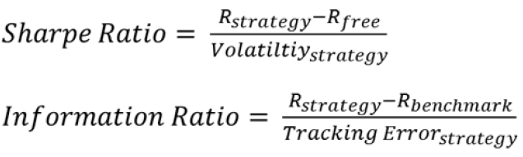

How To Assess Factors
Quantitative Equity Portfolio Management, by E. Qian, R. Hua, E. Sorensen
Rank Correlations
Sharpe Ratio and Information Ratio
Turnover (short-horizon strategies have higher turnover)
Maximum Drawdowns
Skewness / Kurtosis: 3rd and 4th moments of return distribution
Correlations with the market, other factors, co-linearity

Slide 11
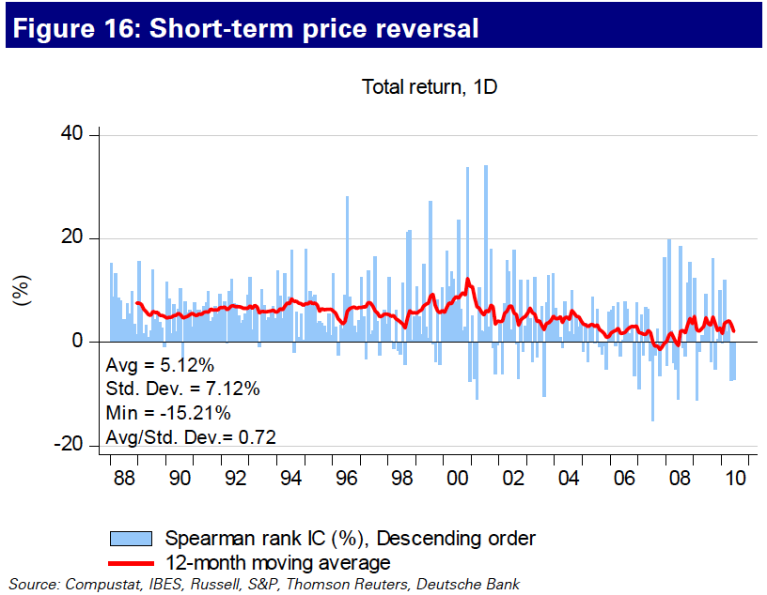
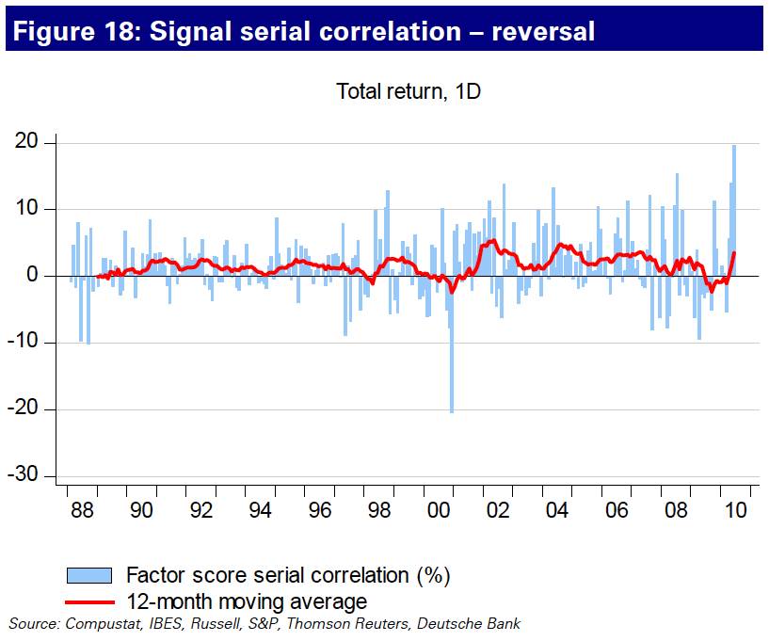
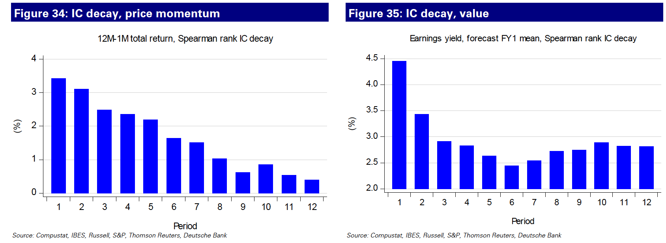
How To Assess Factors

Slide 12
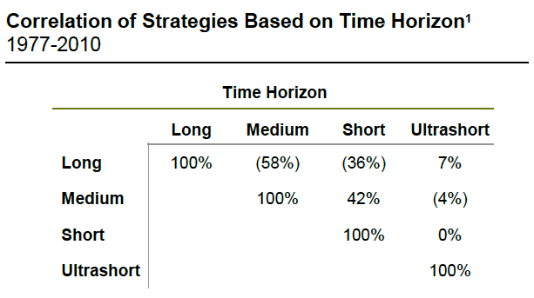
Time Horizon – Another Form of Diversification
Investment style is mostly defined by time horizon
  Toolsets and performance systems
  Analysts “style” and focus
  Turnover – good proxy for horizon
Blending and varying different time horizons can improve performance
  Works when traditional approaches fail
Time horizon diversification has worked well in every crisis
  Lengthen Time Horizon in your strategies when risk subsides
  Shorten your time horizon when risk aversion rises and investors aren’t concerned with fundamentals

Slide 13
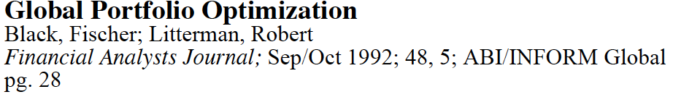
Combining Strategies
How to maximize a bag full of tricks?
  Equal weight: no opinion on individual strategy efficacy
  No opinion is actually an opinion on the risk/reward trade-offs
  Results aren’t so bad!
  A standard to beat
Cyclically adjusted:
  Strategies have varying degrees of risk/reward profile depending on their relationships with risk
  For example, in recession, we favor profitability and momentum, but caution is to the upside risk
Opinion Pooling:
  Black-Litterman Framework: fundamentally mean-variance trade-off between factors;
  Copula-based: similar to BL framework with more esoteric statistics, performs better in some rare cases
Black-Litterman Framework
  (http://papers.ssrn.com/sol3/papers.cfm?abstract_id=334304)
  https://www3.nd.edu/~zda/BL_JOI.pdf
  Fundamentally no different from a fundamental manager hedging his/her bet between growth and value;
  Risk, Reward, as well as Correlation among strategies are considered simultaneously

Slide 14
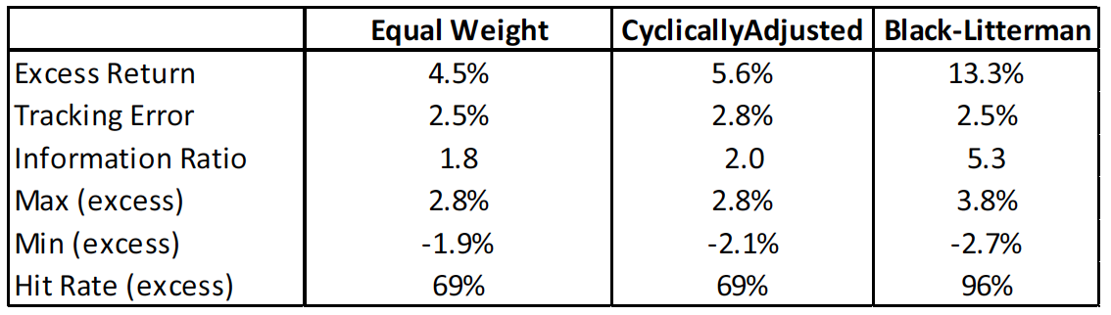
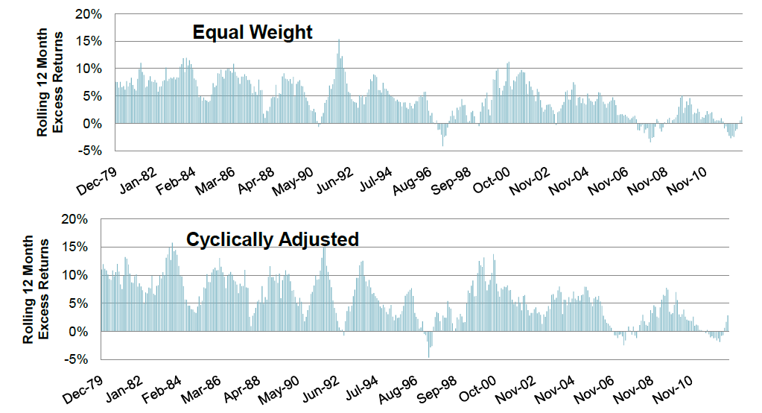
Combining Strategies
Centrality of risk allocation across strategies, not the expected returns
Expected returns, or alphas, can be derived as α=λ×Inv(COV)×W, where λ is the risk aversion parameter, COV is the covariance matrix of the strategies, W is allocation across strategies
Expected returns being a single number disguise the underlying economics behind the investment decision

Slide 15
Portfolio Construction
Accounting for the ingredients for constructing a portfolio
  Client objective: tracking error, geographical preferences etc.
  Benchmark selection: cap-weighted indices or custom benchmark or short-term instruments?
  Rebalance frequencies / Turnover
  T-Cost estimation (commissions, clearing charges, impact, cost of borrow)
Optimizer to glue them together
  Objective
  Generic optimizers like Matlab, financial apps from Barra, Axioma, Northfield
Where does “alpha modeling” stop and “portfolio construction” begin?
  The more flexible the mandate, the more blurred the line between alpha model and portfolio construction
  Flexibility means significant room to time strategies

Slide 16
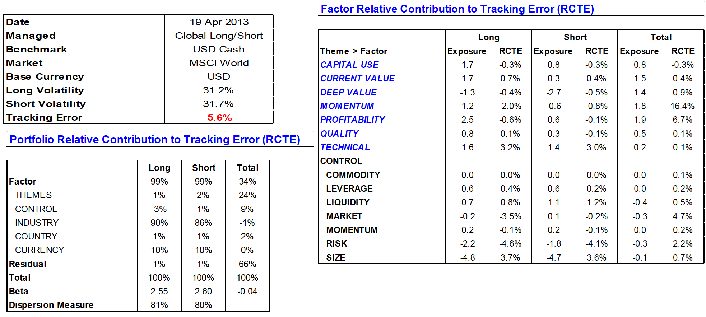
Performance Attributions – Risk Analysis

Slide 17
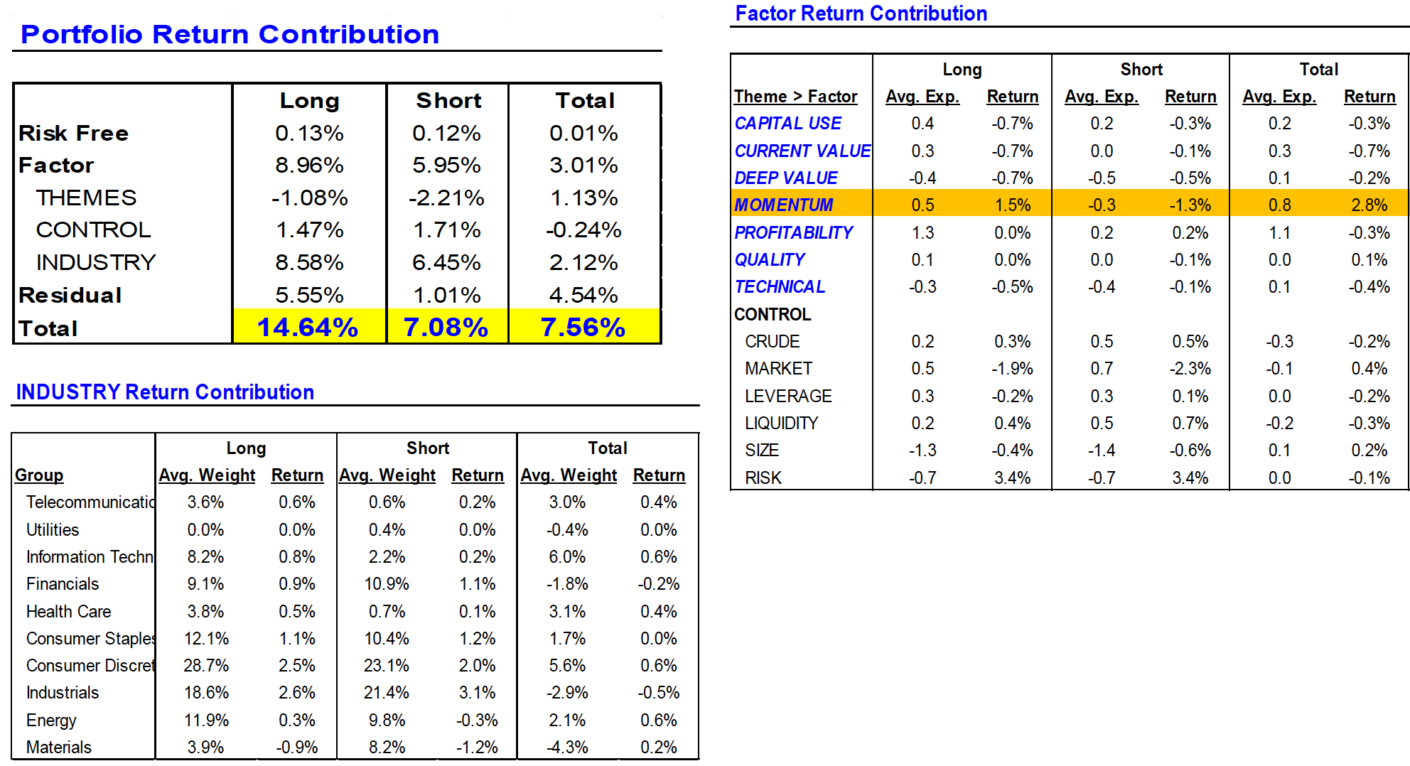
Performance Attributions – Factor Attributions

Slide 18
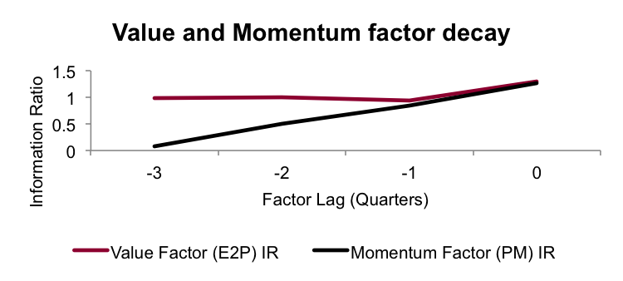
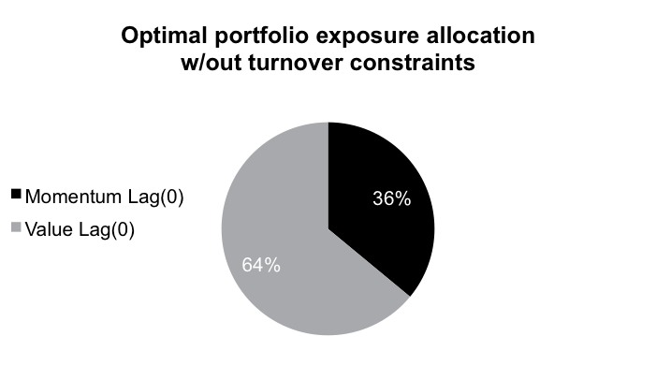
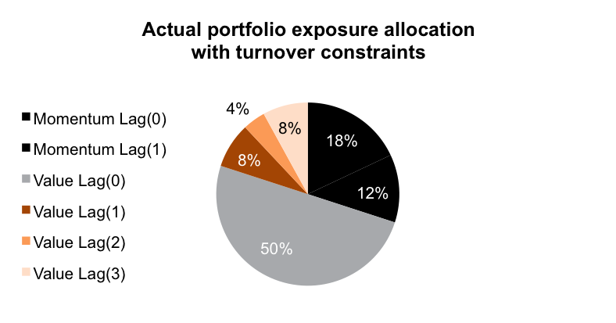
Fast Factors & the Curse of Portfolio Turnover
Equating T-Cost and Turnover leads to underutilization of faster factors and loss of alpha
“Slow” & “Fast” factors – similar IR if we use most recent values (no lag)
Factors have negative correlation
T-cost assumptions impose an artificial limit on exposure to the momentum factor and force the use of lagged factors
In the end, despite equally compelling levels given current information...we are forced to allocate more to Value because of execution inefficiency
“Information Horizon, Turnover & Optimal Alpha Models” by E. Qian, E. Sorensen, R. Hua, Jour. Portfolio Management, Fall 2007, pp.27-40

Slide 19
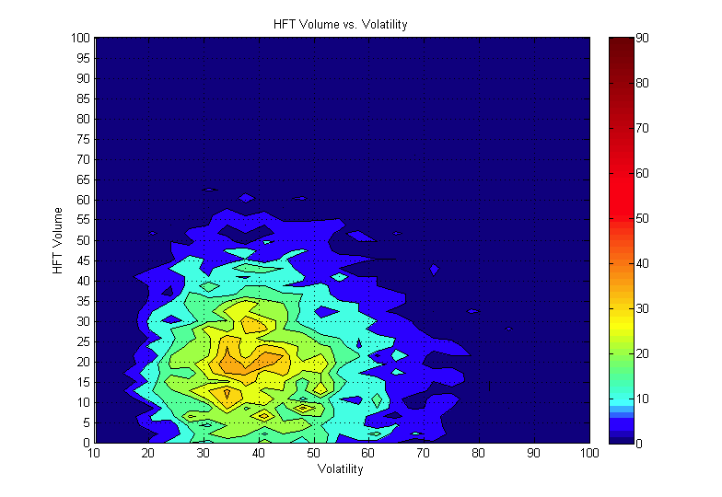
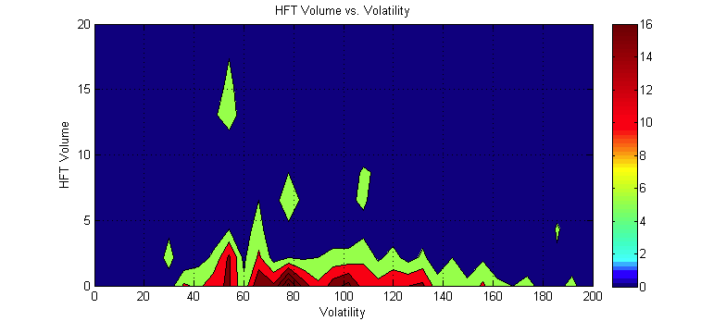


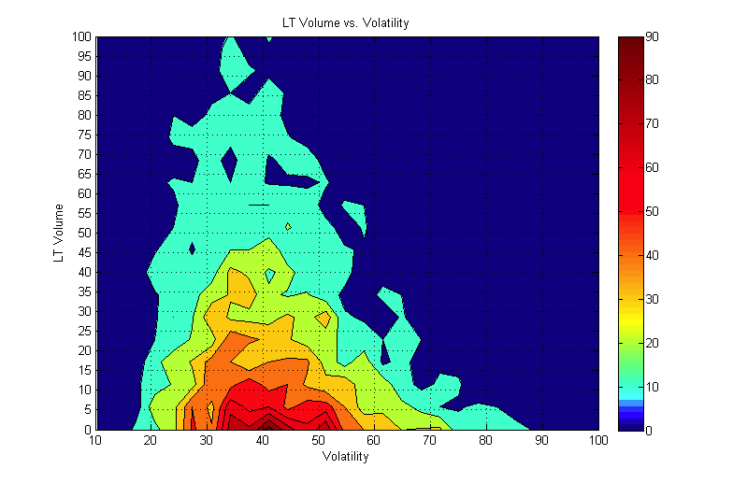
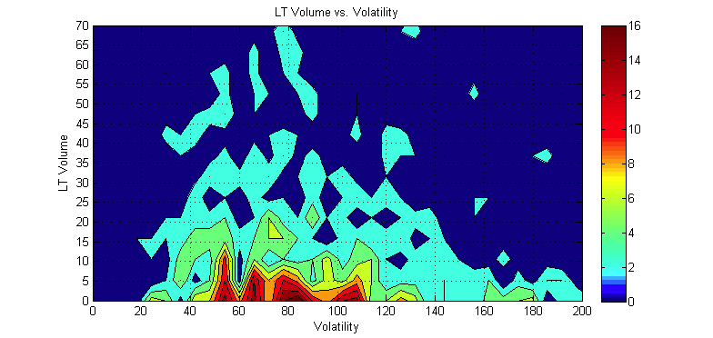
Trading Large Caps vs. Small Caps
Market makers supply average liquidity in LC names, but nearly non-exists in SC
Top 75 Nikkei stocks
Bottom 75 Nikkei stocks
Market Makers:
In top 75 names provide liquidity within “normal” volatility regime and non beyond that mark
Institutional Investors:
Trade top and bottom names identically without realizing that liquidity supply is much different.
Frequently originate small trades across wide range of stocks: cash flows, rebalances
%Volatility over 30-min trading period, annualized
Color: Event probability: Frequent Event Rare Event
Outside of the most liquid names and “normal” volatility, investors need to (a) monitor fragmented market & patiently wait for rare natural liquidity or (b) dislocate the stock price to attract liquidity
N. Bershova, D. Rakhlin “The Non-Linear Market Impact of Large Trades: Evidence from Buy-Side Order Flow” J. of Investment Strategies, v2, n.2, pp 3-47, 2013

Slide 20
Factor Crowding
Typical measures
Active bets – number of institutional managers holding the stock as one their top 10/20/50 relative overweights (from FactSet’s ownership database)
Trade persistence – several consecutive quarters of net purchases by aggregated institutional investors (13F)
Long-term price momentum – strong outperformance over the trailing two years
Sell-Side analyst “Buy” rating – analyst sentiment. (contrarian indicator). When consensus recommendations are unanimous, there is essentially no further room to upgrade/downgrade, so one can expect reversion to the mean.
High expectations – increase in short- and long-term earnings estimates vs. 2 years ago, combined with high forward P/E multiples
Based on securities lending (Data Explorers) – only looks at the positions of long-short managers.
Strong pairwise intraday correlations of residual returns– (Cahan, Luo – DB)
  http://www.bfjlaward.com/pdf/25907/14-23_cahan_jpm_0716.pdf
  http://finpko.faculty.ku.edu/myssi/FIN938/Crowding_DBQS_Portfolios_Under_Construction_Feb-1-2012.pdf
Cross-stock factor based on co-movement of unrelated securities held by institutional investors.
  https://papers.ssrn.com/sol3/papers.cfm?abstract_id=2817059

Slide 21
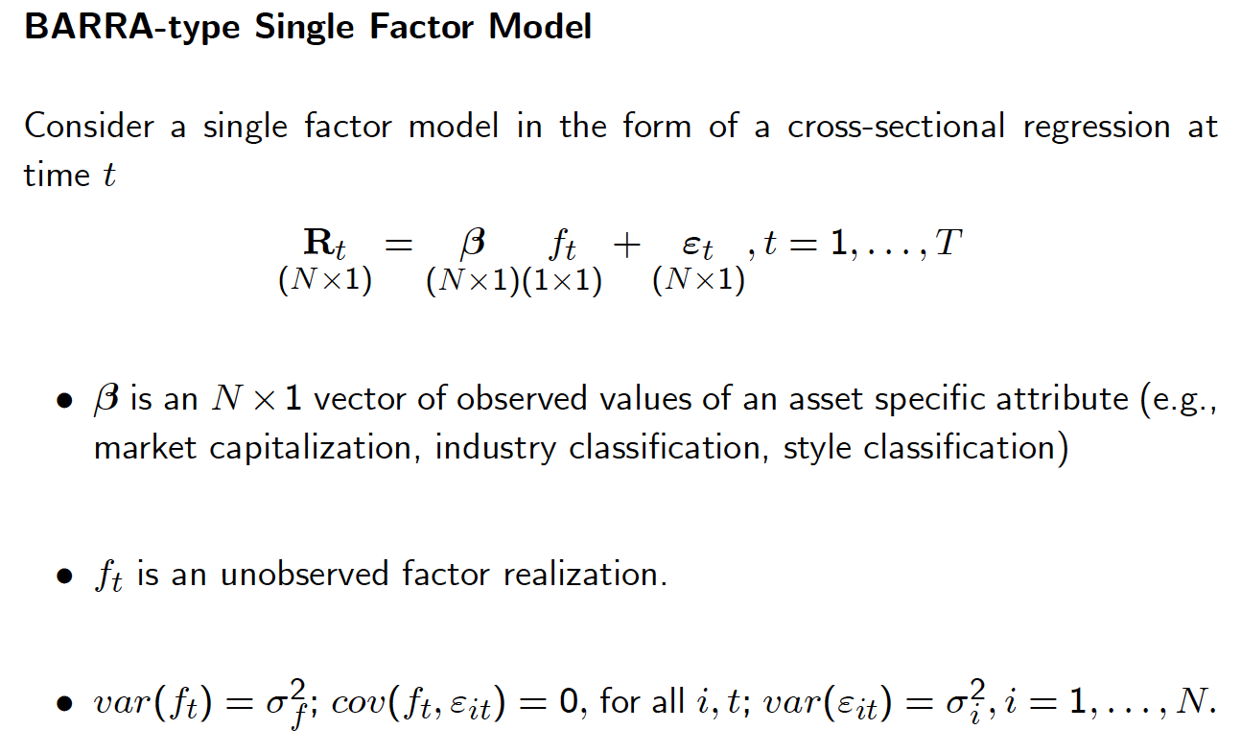
Multi-Factor Portfolios
http://faculty.washington.edu/ezivot/research/factormodellecture_handout.pdf

Slide 22
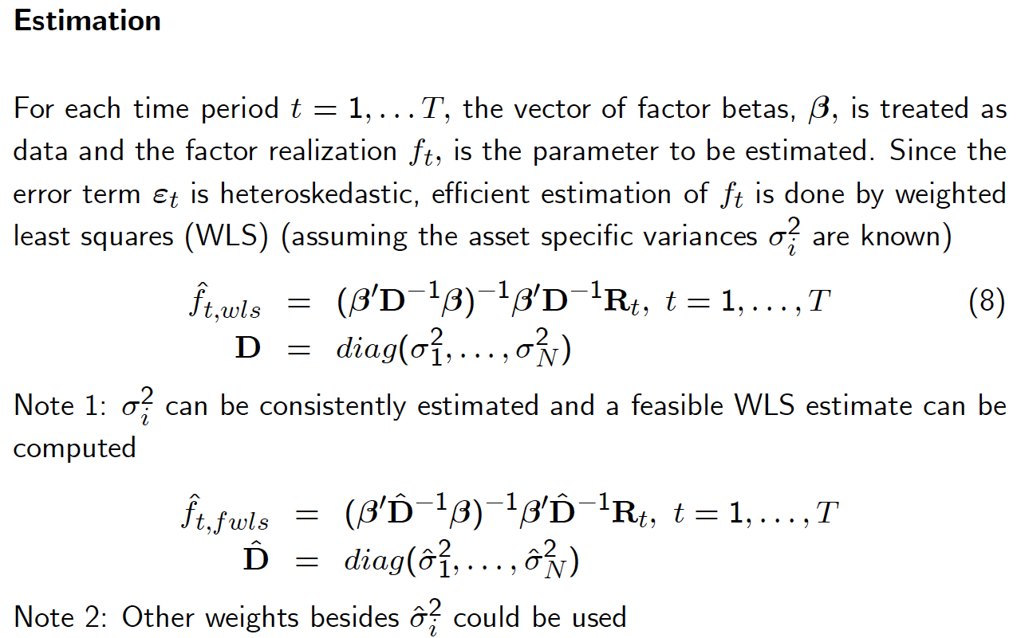
Multi-Factor Portfolios
Use Gauss Jordan elimination instead of matrix inversion

Slide 23
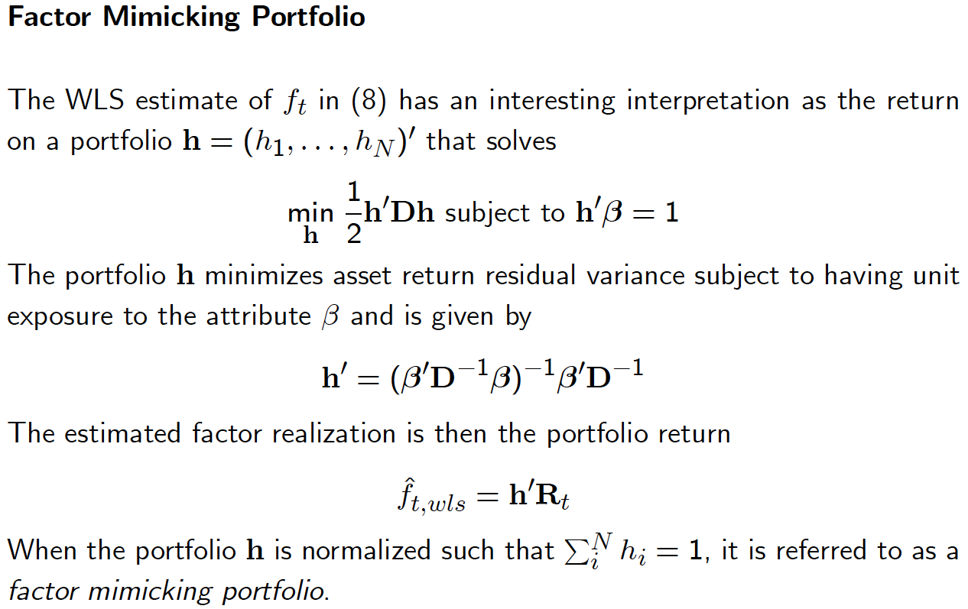
Multi-Factor Portfolios

Slide 24



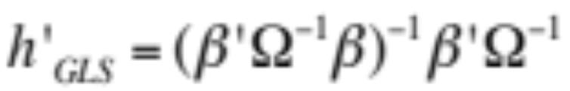



Combining with Risk Model
Using daily estimates for factor returns compute GARCH(1,1) factor volatilities
Compute EWMA for factor correlations (typically 6-12mos half-life)
Consider shrinking off-diagonal elements
Calculate residual stock returns and fit GARCH(1,1) to these processes.
Full risk model is , where covariance matrix is estimated in steps A-C
Construct factor mimicking portfolios as
Using Woodbury matrix identity to avoid inversing ; inverse instead.
Covariance matrix of factor mimicking portfolios is naturally

Slide 25
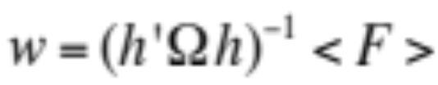


Combining Factors
Optimal factor weights:
Combining into portfolio of factors:
Implied stock-level alphas:
Sometime alphas are rescaled such that portfolio of factors had certain level of IR consistent with historical observation

