Slide 1
KKBox‘s Churn (or lost, 流失) Prediction Challenge
106356013
游達 （Ta Yu)
Notes:
\

Slide 2
Input
Data source: Kaggle
Input format: csv
Any preprocessing?
Scale value :
isn't required for logistic regression. The main goal of standardizing features is to help convergence of the technique used for optimization. For example, if you use Newton-Raphson to maximize the likelihood, standardizing the features makes the convergence faster.
Handle missing data

Slide 3
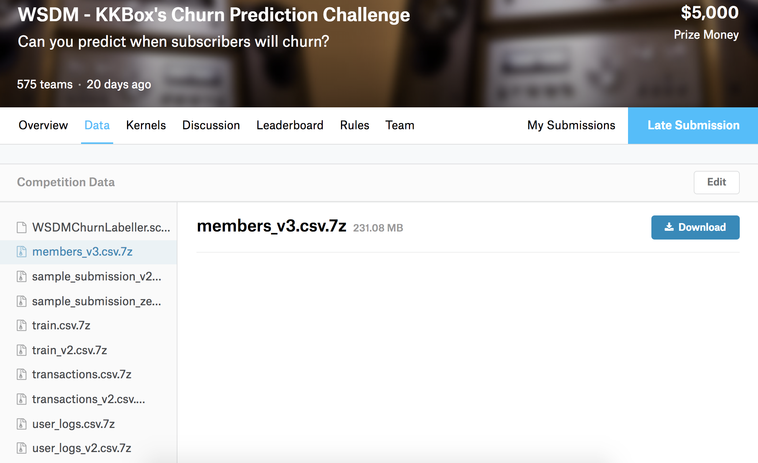
Input
https://www.kaggle.com/c/kkbox-churn-prediction-challenge/data

Slide 4
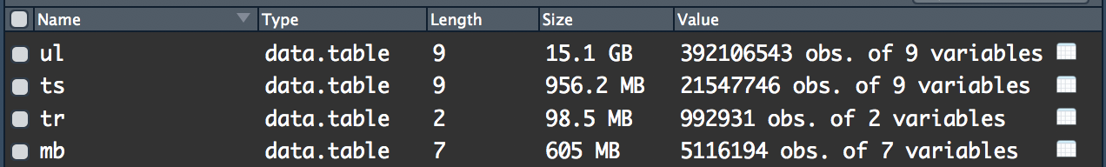
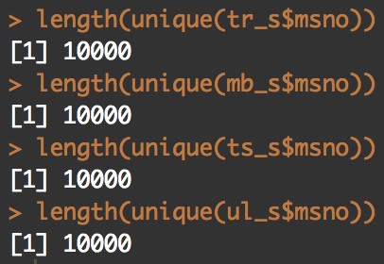
Input
4.User logs
3.Transaction
2.train
1.member
Notes:
Age, gender, how to register, how to pay
One members actually churn or not after their last transaction in march 20 17
How munch one members pay, when is the first payment, have the member canceled auto renew
Every day, total time did one member play in seconds , how many songs did one member play, how many songs did one member just play for 25%, 50%, 75% length...etc
Sampled 10 thousand member for quickly computing

Slide 5
Scale value
No, Scaling isn't required for logistic regression and random forest
The main goal of standardizing features is to help convergence of the technique used for optimization. For example, if you use Newton-Raphson to maximize the likelihood, standardizing the features makes the convergence faster.

Slide 6
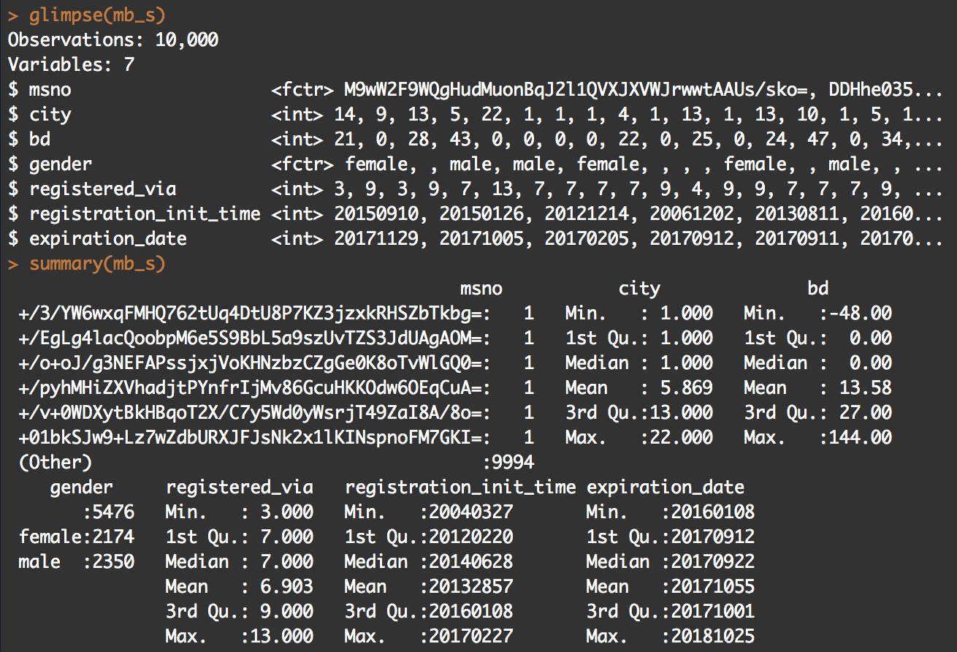
Handle missing data

Slide 7
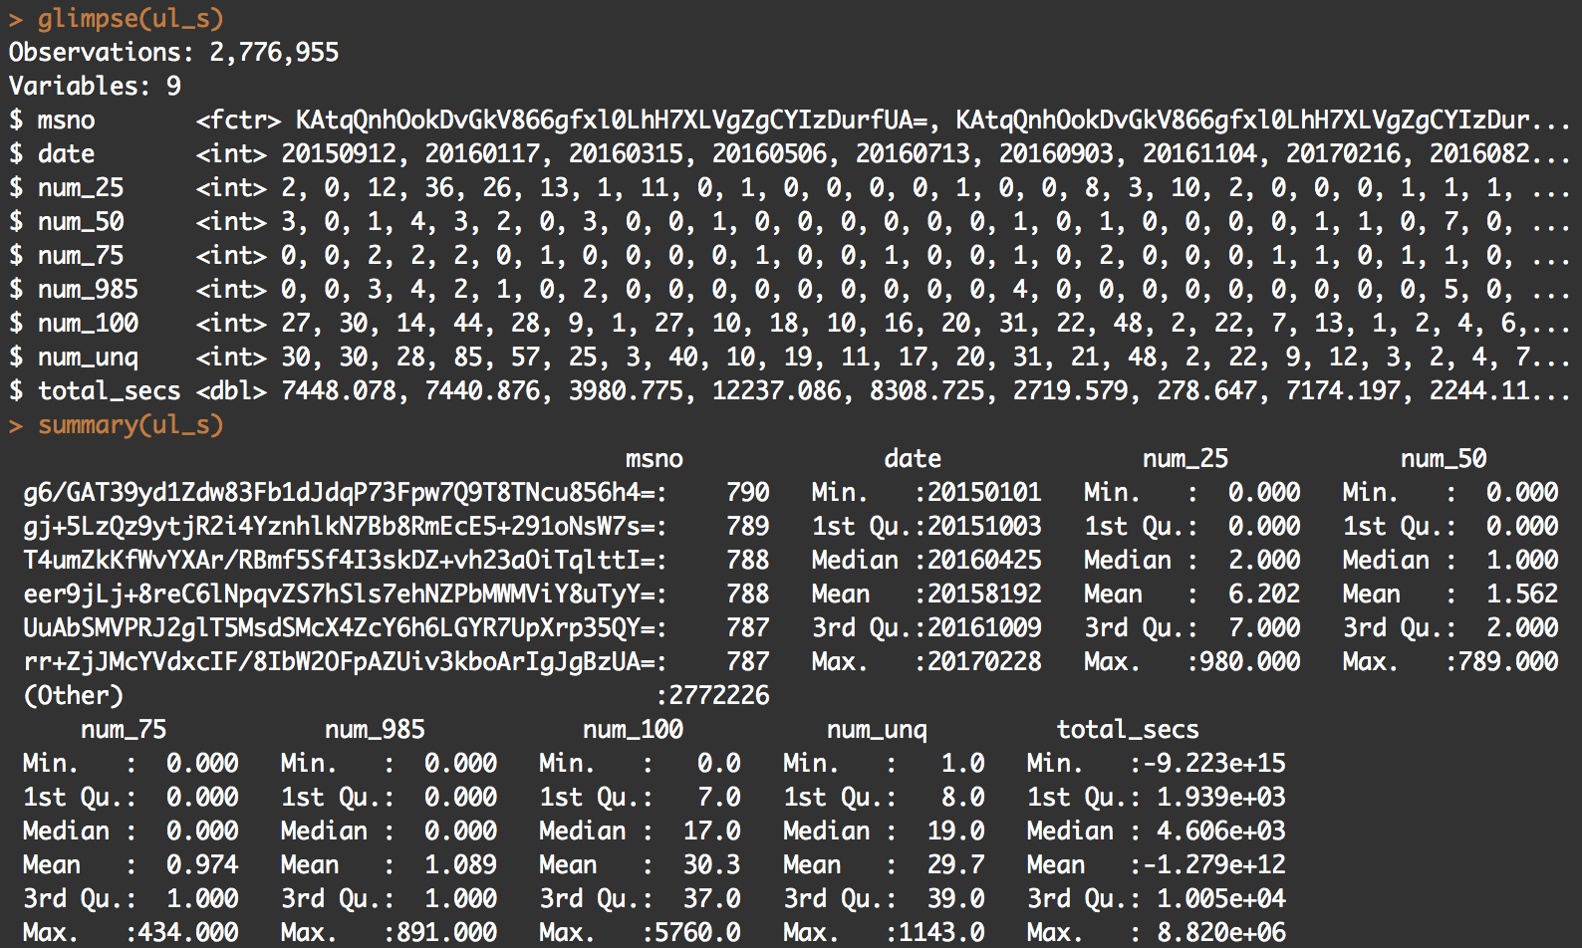
Handle missing data
Notes:
8.64 by 10 to the 4

Slide 8
Modeling
Which method do you use?
What is a null model for comparison?
How do your perform evaluation?
K fold cross valid / split out. / over fitting problem
Is your improvement significant?

Slide 9
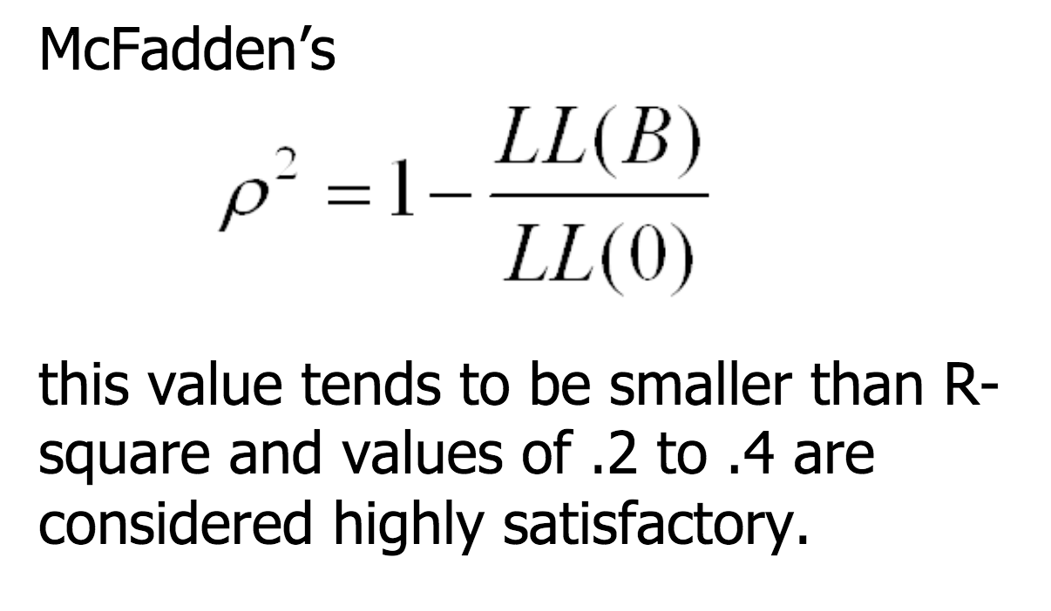
null model
m_null <- glm(is_churn ~ 1 , data = train, family=binomial(link="logit"))

Slide 10
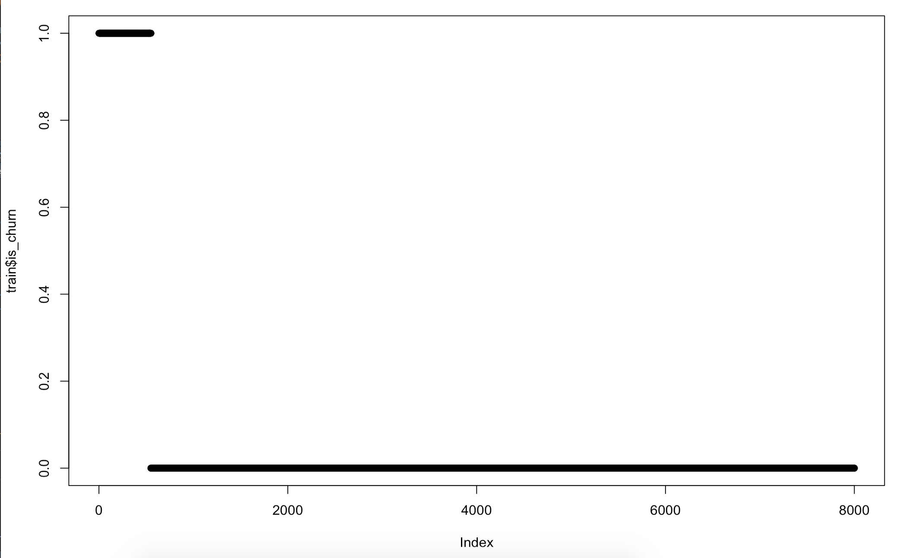

Slide 11
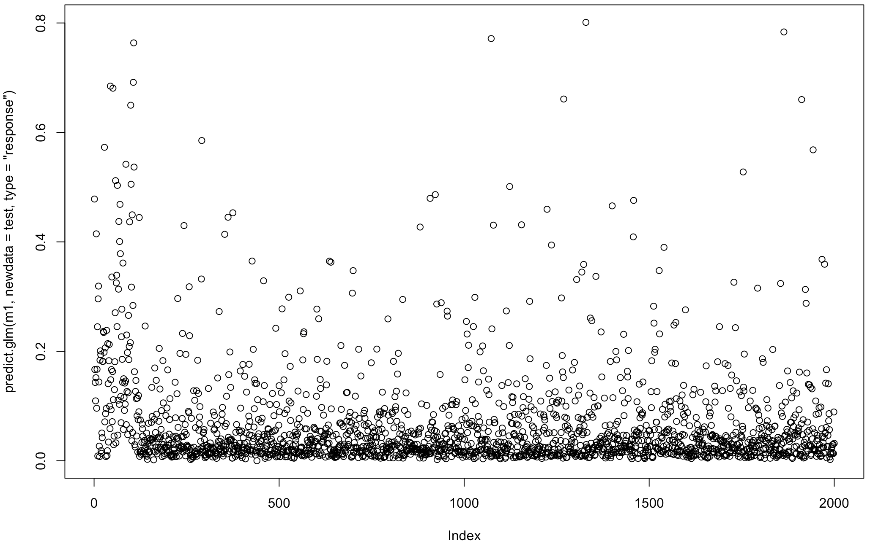

Slide 12
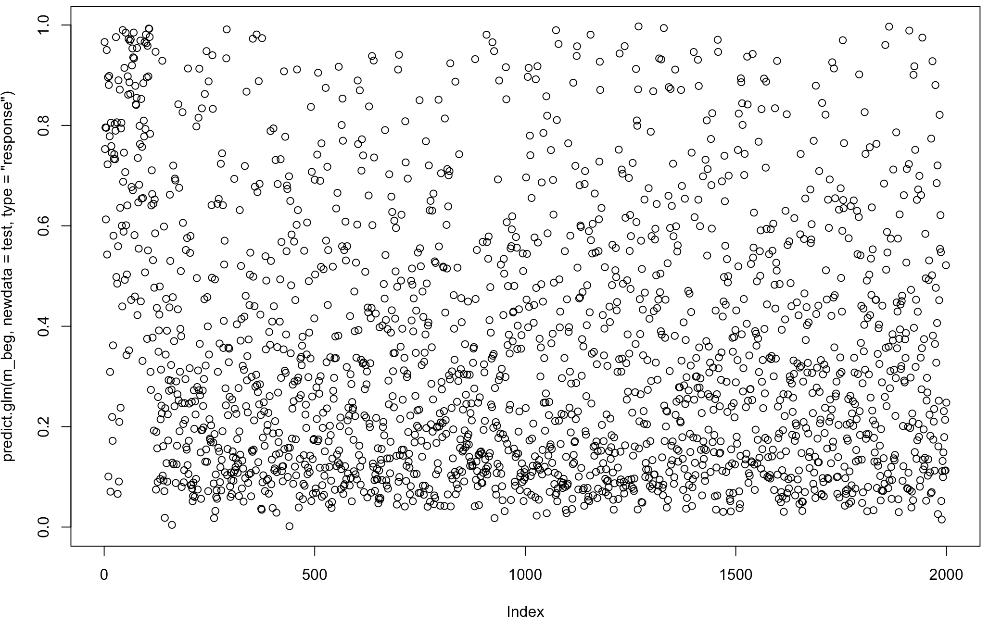
Using begging for unbalanced data

Slide 13
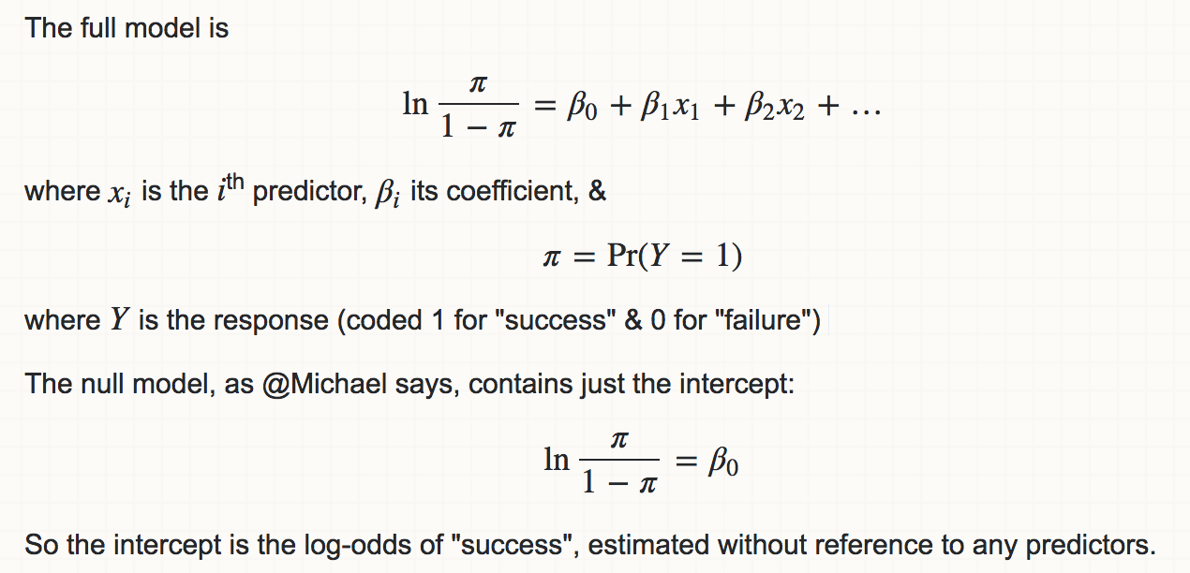
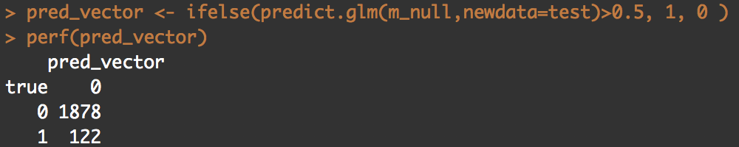
The full model is
lnπ1−π=β0+β1x1+β2x2+…ln⁡π1−π=β0+β1x1+β2x2+…
where xixi is the ii^{th} predictor, βiβi its coefficient, &π=Pr(Y=1)π=Pr(Y=1)
where YY is the response (coded 1 for "success" & 0 for "failure")The null model, as @Michael says, contains just the intercept:
lnπ1−π=β0ln⁡π1−π=β0
So the intercept is the log-odds of "success", estimated without reference to any predictors.

Slide 14
The full model is
lnπ1−π=β0+β1x1+β2x2+…ln⁡π1−π=β0+β1x1+β2x2+…
where xixi is the ii^{th} predictor, βiβi its coefficient, &π=Pr(Y=1)π=Pr(Y=1)
where YY is the response (coded 1 for "success" & 0 for "failure")The null model, as @Michael says, contains just the intercept:
lnπ1−π=β0ln⁡π1−π=β0
So the intercept is the log-odds of "success", estimated without reference to any predictors.

Slide 15
Goal / Output
How about performance?
precision, recall, R-square

Slide 16
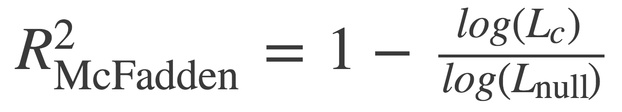
http://thestatsgeek.com/2014/02/08/r-squared-in-logistic-regression/

Slide 17
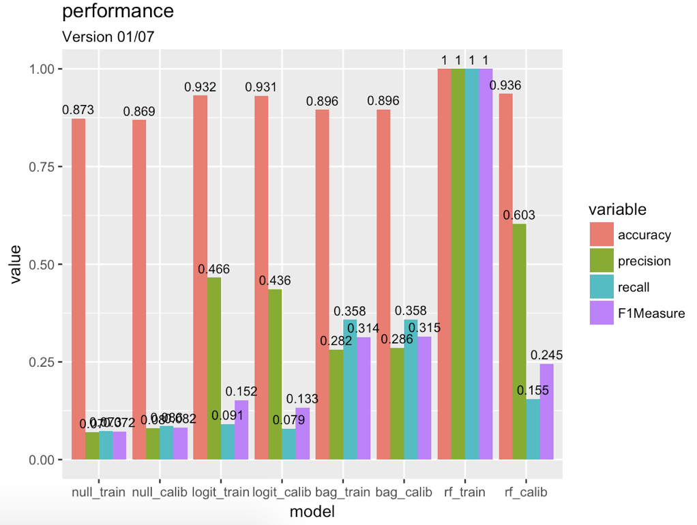
fmodel <- randomForest(is_churn ~ ., data = x_rf , importance=T )

Slide 18
Goal / Output
Demo
On-line visualization(optional)
How do you document your project (code)?
github
How to reproduce your result?
comment
What is the challenge part of your project?

Slide 19
Final Project Presentation
1061. Data Science in Practice
Jia-Ming Chang
http://www.changlabtw.com/1061-datascience.html
The slide isonly for educational purposes. If any infringement, please contact me, we will correct immediately.

Slide 20
Content
Prepare a presentation & send me by 01/09
Content
Input
Modeling
Your goal/output
Demo

Slide 21
Input
Data source
Input format
Any preprocessing?
Handle missing data
Scale value

Slide 22
Modeling
Which method do you use?
What is a null model for comparison?
How do your perform evaluation?
K fold cross valid / split out. / over fitting problem
Is your improvement significant?

Slide 23
Schedule
14 presentations
each presentation
8 mins
1~2 mins Q&A
Random Order
Send me your presentation by Jan. 09
Email: chang.jiaming@gmail.co
Title: 1061 Data Science final presentation <yourID>
File: 1061_datascience_FP_<yourID>.ppt/pptx/pdf

Slide 24
Grading
25%
Presentation
Content
Oral communication
Code

