Slide 1
Input
Data source: Kaggle
Input format: csv
Any preprocessing?
Scale value :
isn't required for logistic regression. The main goal of standardizing features is to help convergence of the technique used for optimization. For example, if you use Newton-Raphson to maximize the likelihood, standardizing the features makes the convergence faster.
Handle missing data

Slide 2
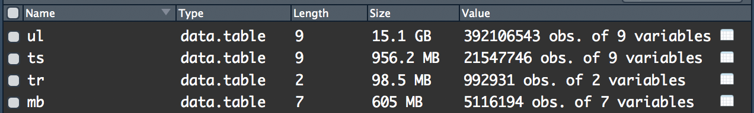
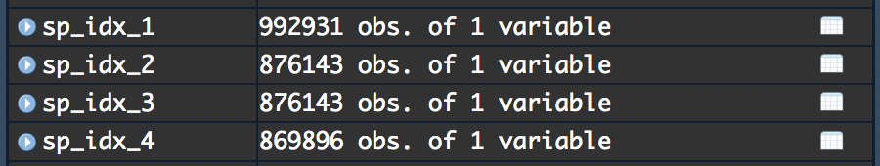
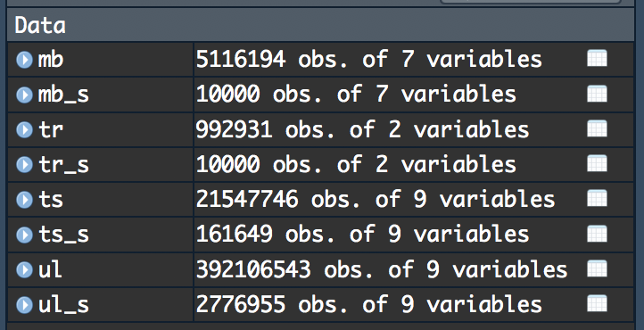
Input

Slide 3
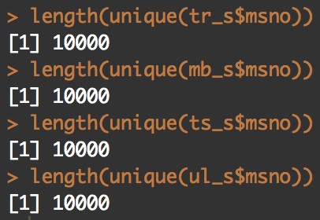
Input

Slide 4
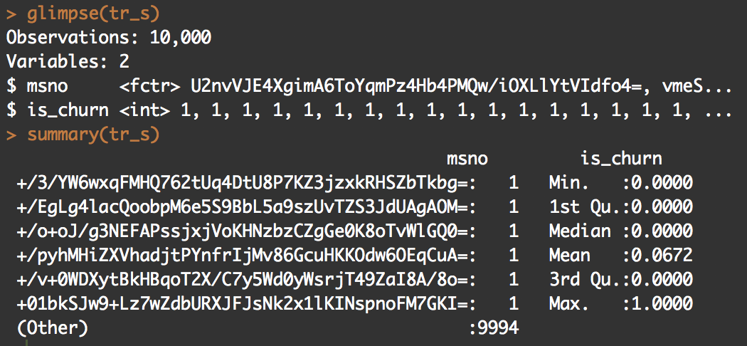
Handle missing data

Slide 5
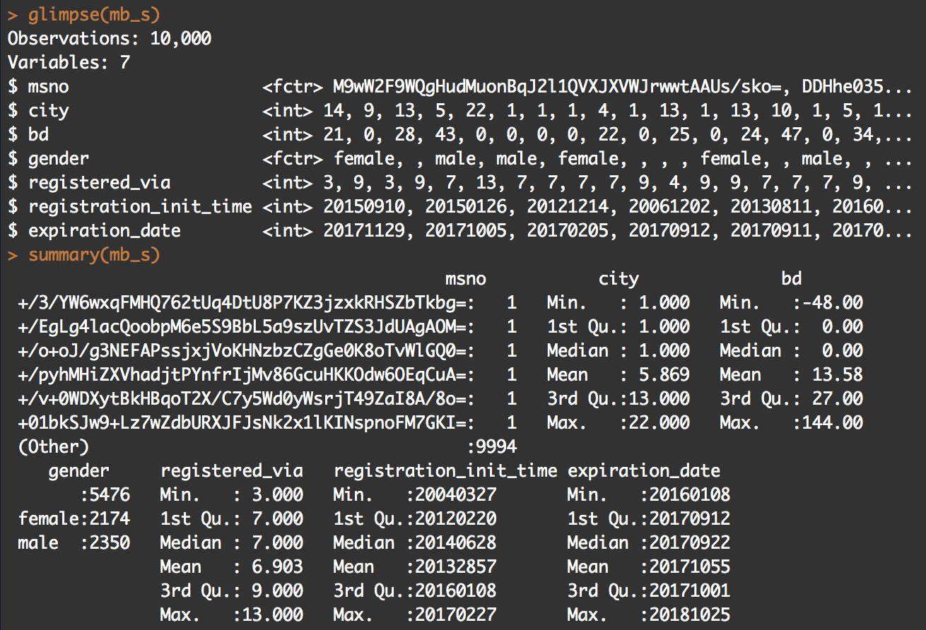

Slide 6
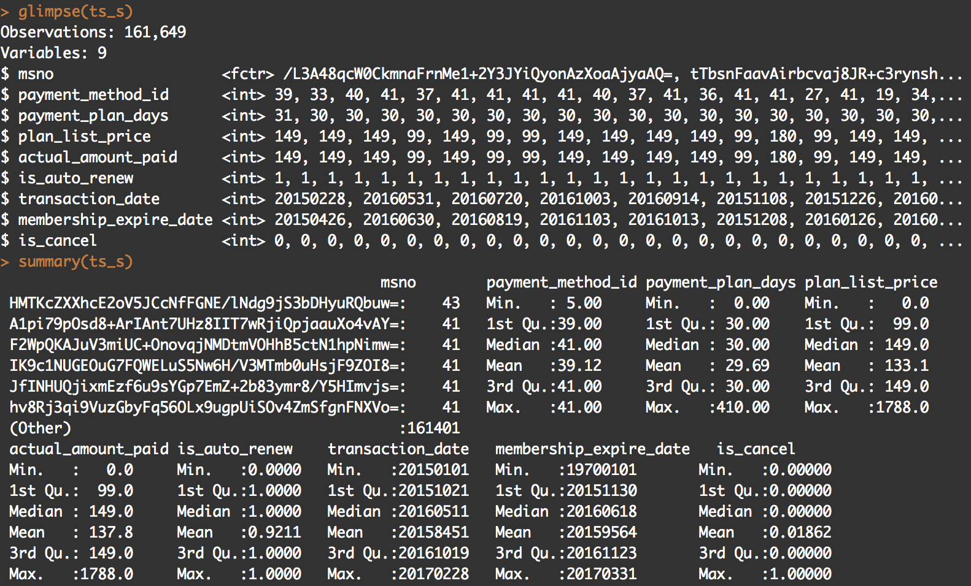

Slide 7
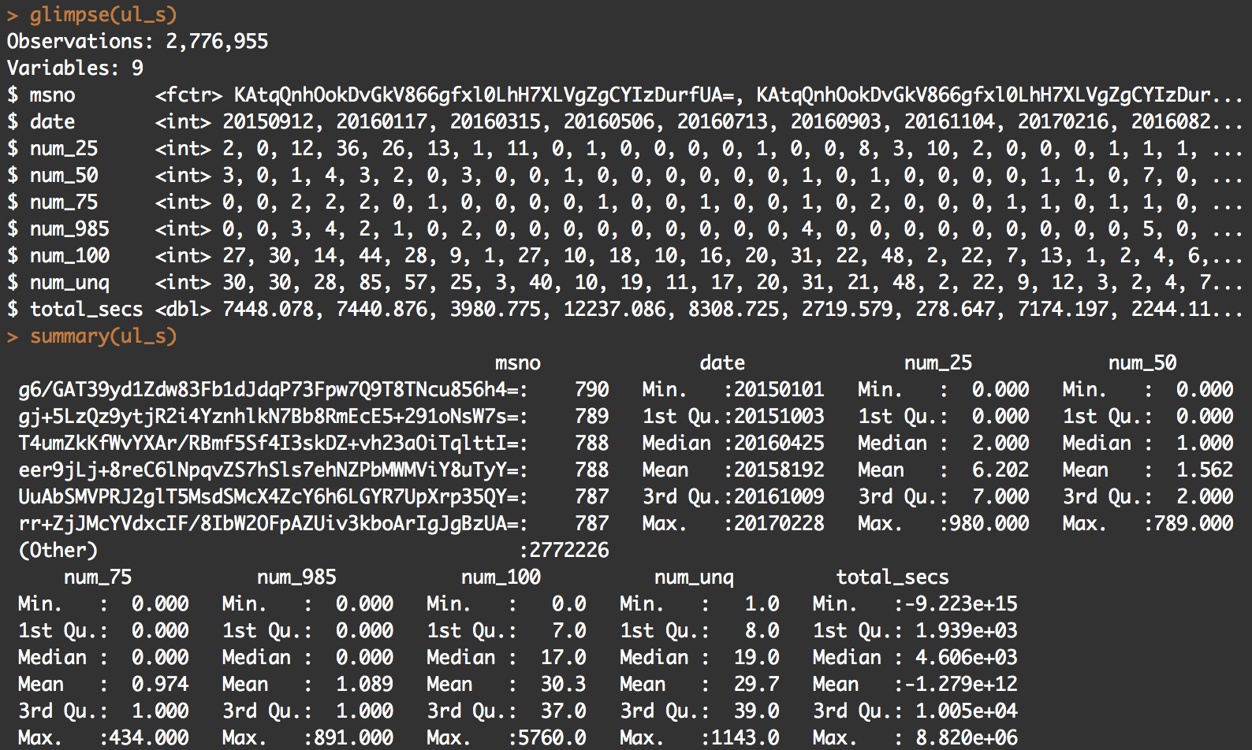
Notes:
8.64 by 10 to the 4

Slide 8
Modeling
Which method do you use?
What is a null model for comparison?
How do your perform evaluation?
K fold cross valid / split out. / over fitting problem
Is your improvement significant?

Slide 9
Goal / Output
How about performance?
precision, recall, R-square
Demo
On-line visualization(optional)
How do you document your project (code)?
github
How to reproduce your result?
comment
What is the challenge part of your project?

Slide 10
Final Project Presentation
1061. Data Science in Practice
Jia-Ming Chang
http://www.changlabtw.com/1061-datascience.html
The slide isonly for educational purposes. If any infringement, please contact me, we will correct immediately.

Slide 11
Content
Prepare a presentation & send me by 01/09
Content
Input
Modeling
Your goal/output
Demo

Slide 12
Input
Data source
Input format
Any preprocessing?
Handle missing data
Scale value

Slide 13
Modeling
Which method do you use?
What is a null model for comparison?
How do your perform evaluation?
K fold cross valid / split out. / over fitting problem
Is your improvement significant?

Slide 14
Schedule
14 presentations
each presentation
8 mins
1~2 mins Q&A
Random Order
Send me your presentation by Jan. 09
Email: chang.jiaming@gmail.co
Title: 1061 Data Science final presentation <yourID>
File: 1061_datascience_FP_<yourID>.ppt/pptx/pdf

Slide 15
Grading
25%
Presentation
Content
Oral communication
Code

