Slide 1
Boolean Relation Determinization

Slide 2
Outline
Introduction
Problem Formulation
Preliminaries
Proposed Method
Conclusion

Slide 3
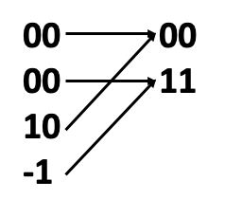
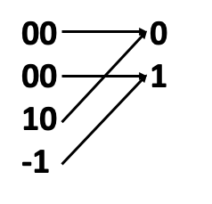
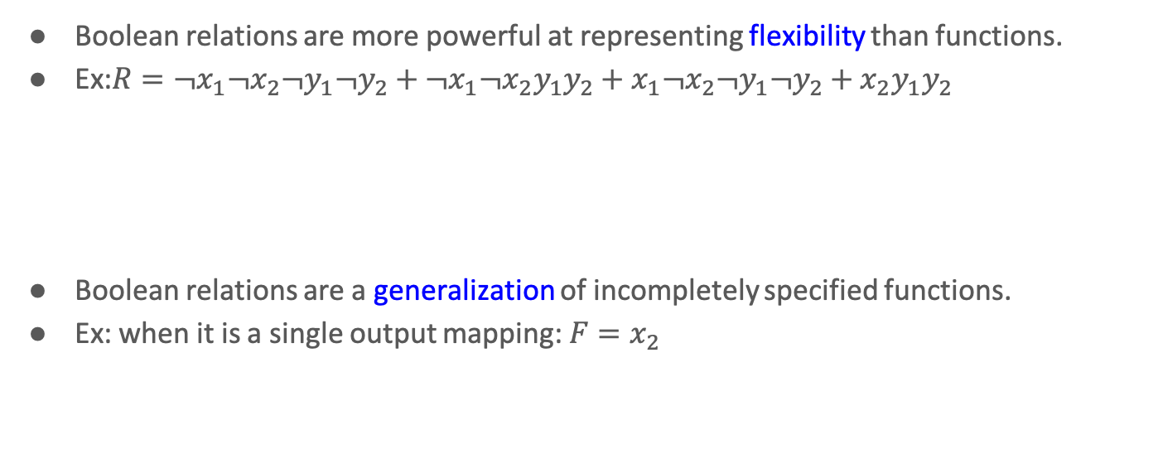
Introduction
Boolean relations are more powerful at representing flexibility than functions.
Ex:$R={¬x}_{1}¬x_{2}¬y_{1}¬y_{2}+¬x_{1}¬x_{2}y_{1}y_{2}+x_{1}¬x_{2}¬y_{1}¬y_{2}+x_{2}y_{1}y_{2}$
Boolean relations are a generalization of incompletely specified functions.
Ex: when it is a single output mapping: $F=x_{2}$

Slide 4
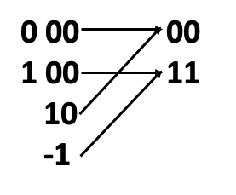
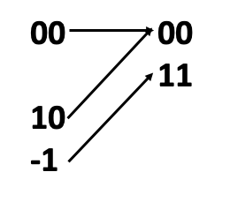
Introduction (cont’d)
Determinize by introducing parametric parameters
Range-preserving
Determinize by choosing one-to-one mapping among one-to-many mappings.
Deterministically reducing

Slide 5
Problem Formulation
Given a multi-output relation R, where non-determinism exists, what is the minimum number of variables needed to be additionally introduced to determinize R?
It is NP-Complete

Slide 6
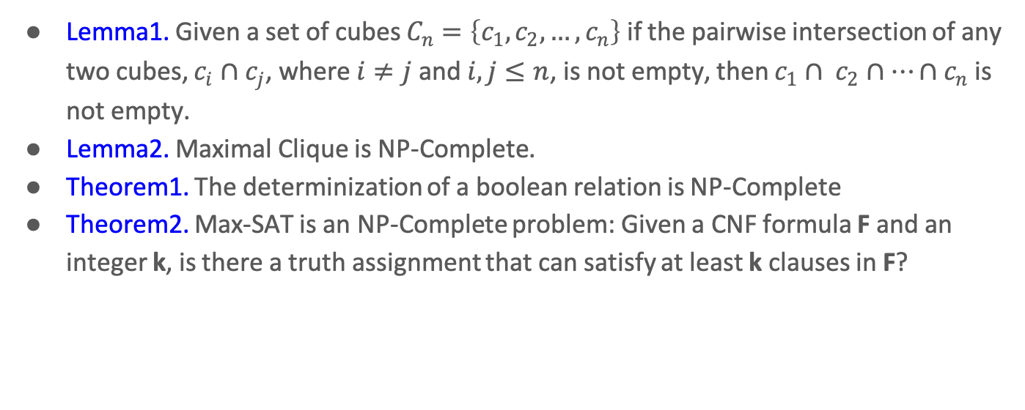
Preliminaries
Lemma1. Given a set of cubes $C_{n}=\left\{c_{1},c_{2},…,c_{n}\right\}$ if the pairwise intersection of any two cubes, $c_{i}∩c_{j}$, where $i≠j$and $i, j≤n$, is not empty, then $c_{1}∩ c_{2}∩…∩c_{n}$is not empty.
Lemma2. Maximal Clique is NP-Complete.
Theorem1. The determinization of a boolean relation is NP-Complete
Theorem2. Max-SAT is an NP-Complete problem: Given a CNF formula F and an integer k, is there a truth assignment that can satisfy at least k clauses in F?

Slide 7
Proposed Method
Conversion to Undirected Graph
Conversion to Max-SAT Problem
Unate Recursive with Branch and Bound

Slide 8
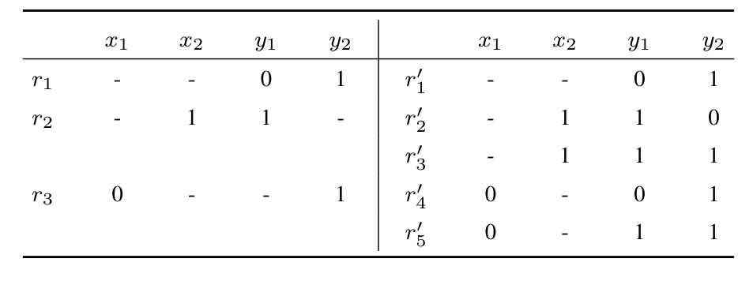
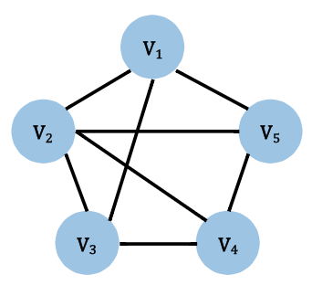
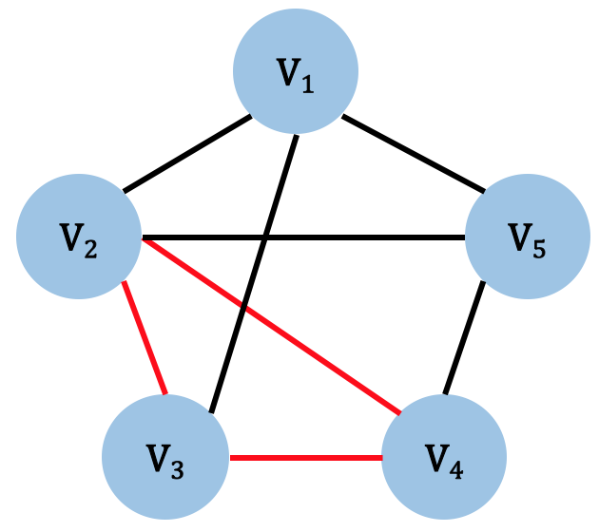

Conversion to Undirected Graph
A relation R can be converted into a graph G
Expand the output part until no don’t care bits
Construct a vertex for each row
An edge is inserted if two rows conflict
Find maximum-clique Q by Bron-Kerbosch algorithm
The minimum number of variables should be $\log_{2}⁡(|Q|)$

Slide 9
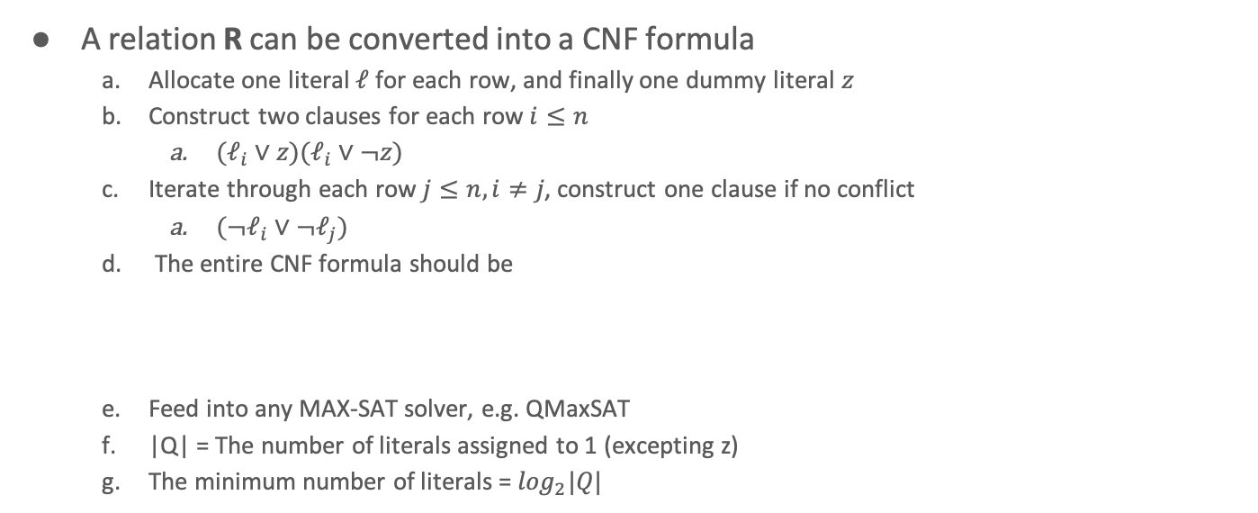

Conversion to Max-SAT
A relation R can be converted into a CNF formula
Allocate one literal $ℓ$ for each row, and finally one dummy literal $z$
Construct two clauses for each row $i≤n$
$(ℓ_{i}∨z)(ℓ_{i}∨¬z)$
Iterate through each row $j≤n, i≠j$, construct one clause if no conflict
$(¬ℓ_{i}∨{¬ℓ}_{j})$
The entire CNF formula should be
Feed into any MAX-SAT solver, e.g. QMaxSAT
|Q| = The number of literals assigned to 1 (excepting z)
The minimum number of literals = $\log_{2}|Q|$
$${(ℓ}_{1}, ℓ_{2},ℓ_{3},ℓ_{4},ℓ_{5}, z)=(0, 1, 1, 1, 0, 0)$$

Slide 10
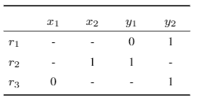



Unate Splitting with Branch and Bound
Idea: Prevent exponential time output expansion.
Max-Output Clique:
Construct graph G without expanding the output part
Find the clique in which has the maximum number of output minterm
$$r_{1}$$
01
$$r_{2}$$
1-
$$r_{3}$$
-1

Slide 11
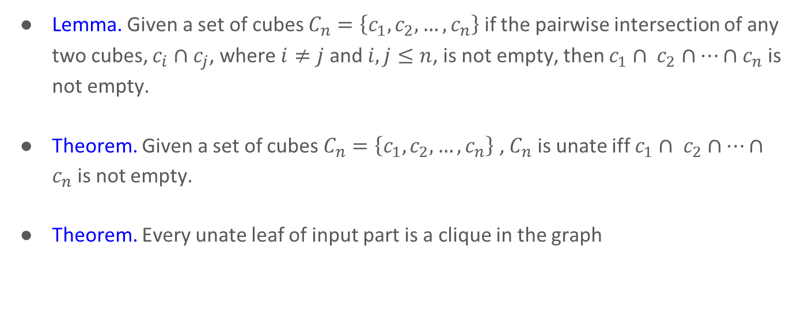
Unate Splitting with Branch and Bound
Lemma. Given a set of cubes $C_{n}=\left\{c_{1},c_{2},…,c_{n}\right\}$ if the pairwise intersection of any two cubes, $c_{i}∩c_{j}$, where $i≠j$and $i, j≤n$, is not empty, then $c_{1}∩ c_{2}∩…∩c_{n}$is not empty.
Theorem. Given a set of cubes $C_{n}=\left\{c_{1},c_{2},…,c_{n}\right\}$ , $C_{n}$ is unate iff $c_{1}∩ c_{2}∩…∩c_{n}$is not empty.
Theorem. Every unate leaf of input part is a clique in the graph

Slide 12
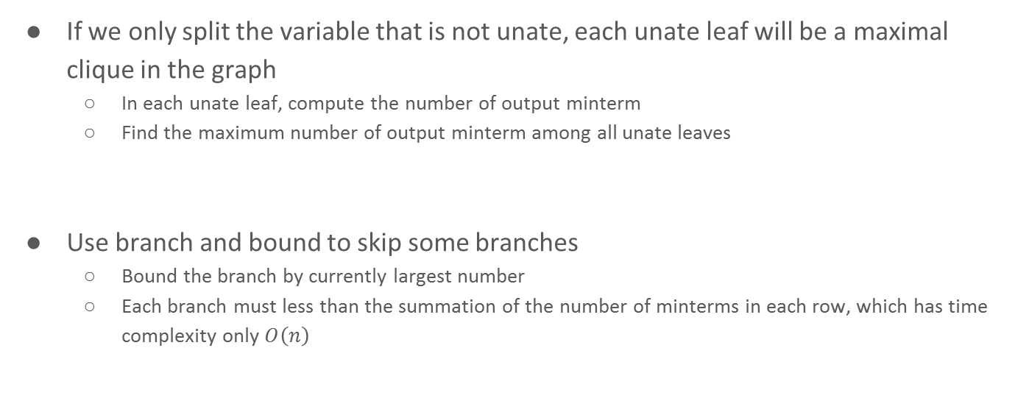
Unate Splitting with Branch and Bound
If we only split the variable that is not unate, each unate leaf will be a maximal clique in the graph
In each unate leaf, compute the number of output minterm
Find the maximum number of output minterm among all unate leaves
Use branch and bound to skip some branches
Bound the branch by currently largest number
Each branch must less than the summation of the number of minterms in each row, which has time complexity only $O\left(n\right)$

Slide 13
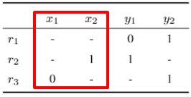
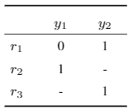
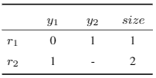
Unate Splitting with Branch and Bound
Example
This example is already unate in input
Find the number of literals needed
Make the output cubes orthogonal to count the number of output minterms
Compute the summation of number of minterms in each cube
3 minterms
Unate leaf
Output cubes
(Orthogonalized)

Slide 14
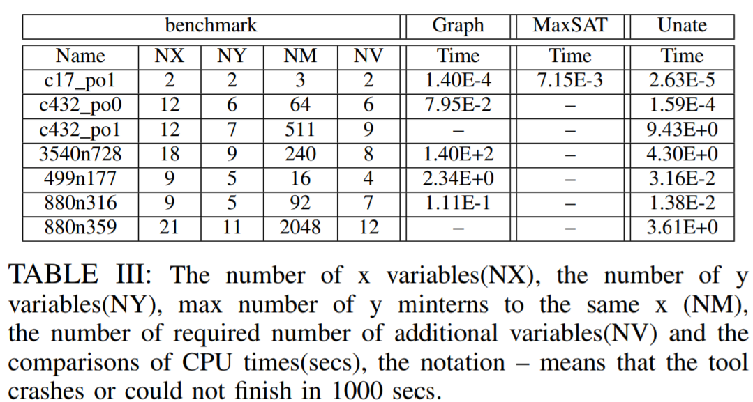
Experimental Result
Unate splitting method outperformed all other methods

