Slide 1
projet8
File created on: 2/7/2023 11:57:50 AM
Le lien: https://public.tableau.com/app/profile/yuting.huang6321/viz/projet8_16757669898230/Story

Slide 2
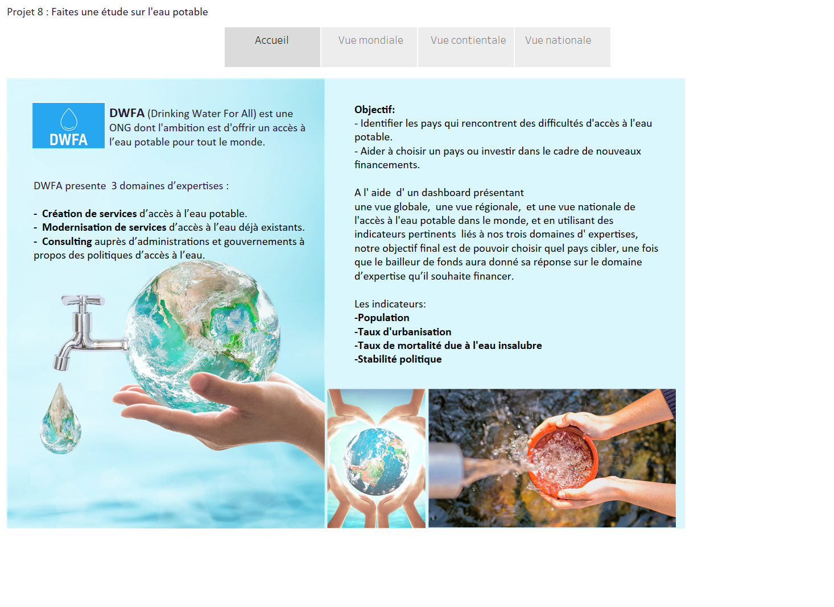

Slide 3
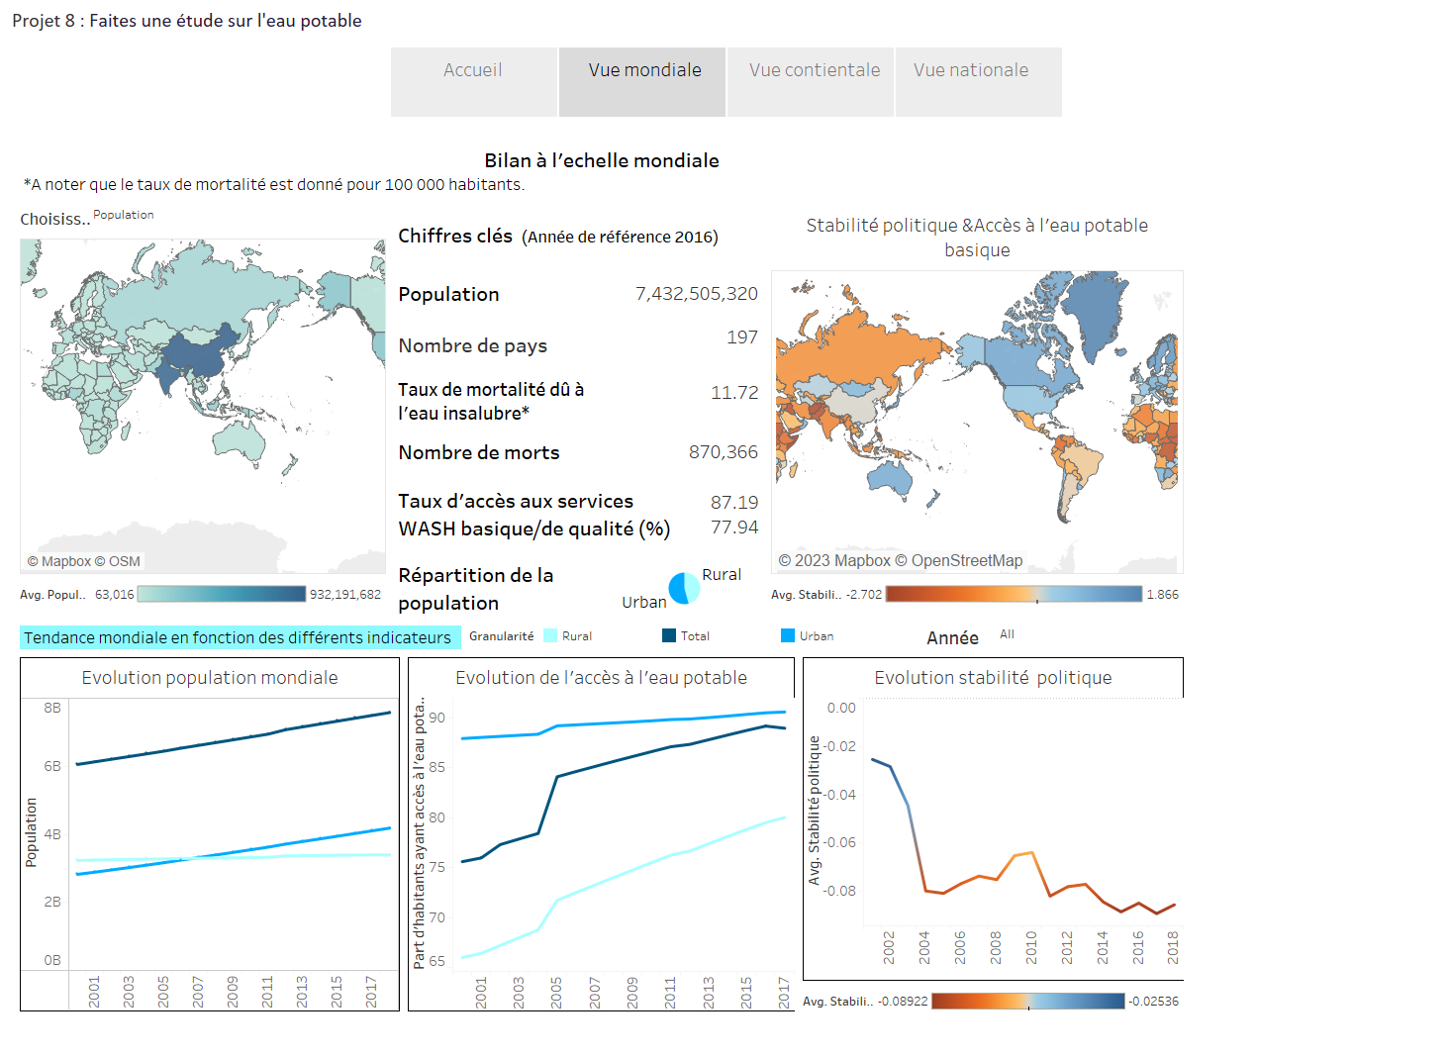

Slide 4
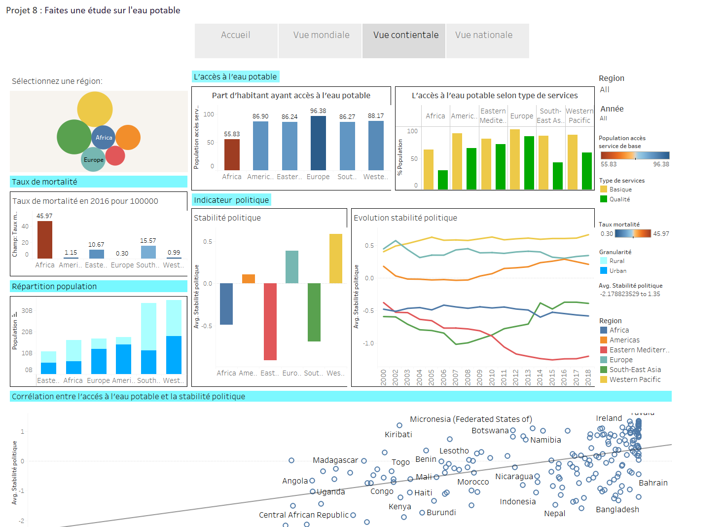

Slide 5
