Slide 1
Top Video Game 1995-2021
BDAT 1004-21F-10885 Data Programming
Final Presentation
Instructor: Mohammed Jibran
Speaker: Vivianne Wang

Slide 2
Introduction
Release Date
Meta Score
User Review
Platform
Summary
Release Date :
from 1995-04-30 to 2021-10-15
Kaggle :
The top rated video games from 1995 to 2021
Link: https://www.kaggle.com/deepcontractor/top-video-games-19952021-metacritic
Factors
Data Time
Total Rows : 18800
Resource
Data volume

Slide 3
Reasons for choosing this dataset…
Topic
Quantity
Quality
Game industry is a huge market, and I have been teaching students how to make games, in order to know better about the factors that impact user experience for game
Useful categorical variable such as platform and game name.
Essential numeric variables such as release dates, user review rating, and critic review rating.
This dataset contains a list of video games dating from 1995 to 2021, it should show a certain period of game history. Also it has more than 10,000 rows data.

Slide 4
Question
What is the trend for game releasing in platforms yearly? And which top 5 year has the most release games? Which top 5 month has the most release games?
1
3
2
4

Slide 5
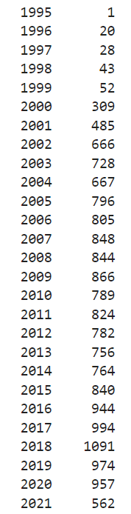
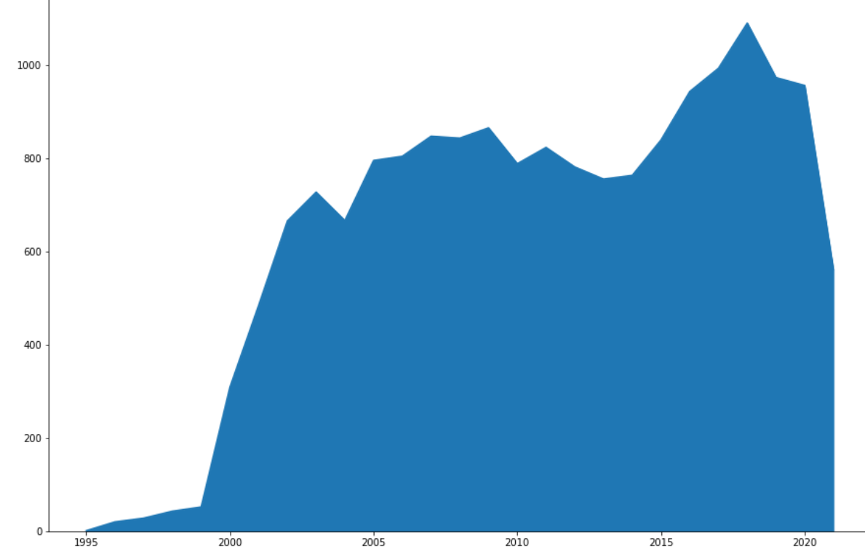
The trend of Game Producing from 1995 to 2021

Slide 6
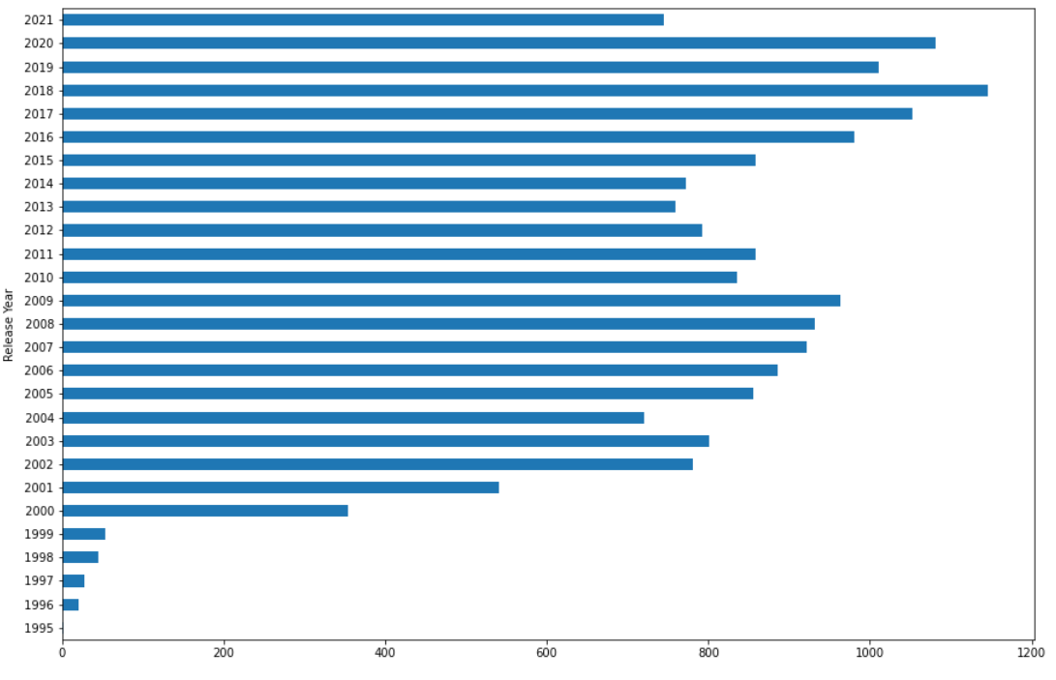
Top 5 Year for Game Release

Slide 7
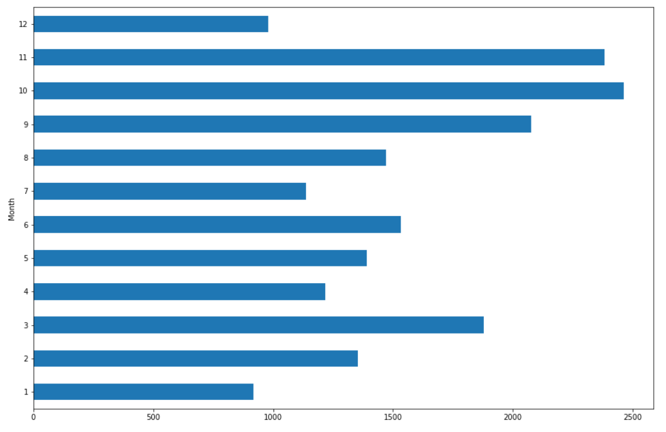
Top 5 Month for Game Release

Slide 8
Question
Venus has a beautiful name, but it’s hot, even hotter than Mercury
1
3
2
4
What platforms have more games to release? What are the top 3 company to release the most games?

Slide 9
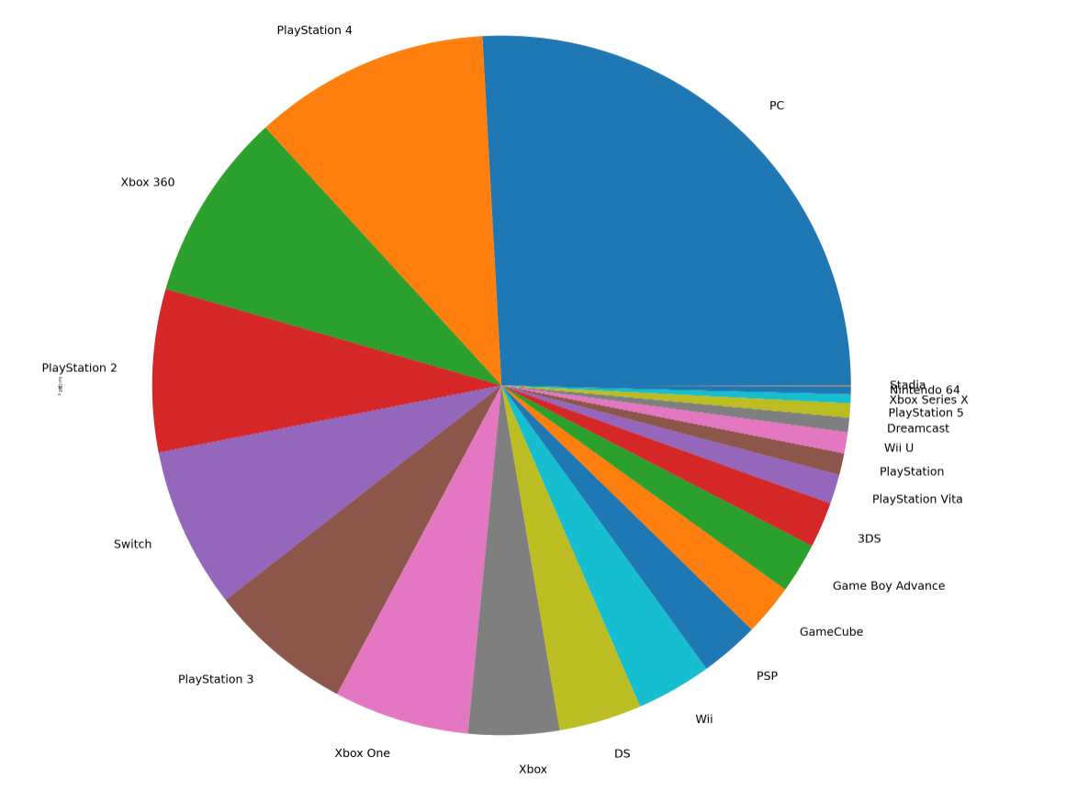
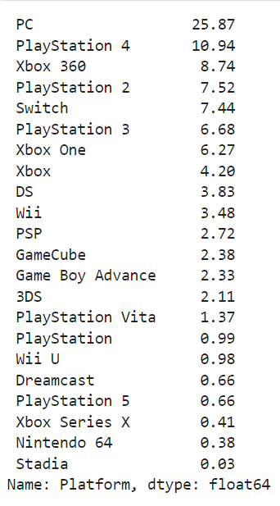
Top 5 Game Platform
10.94%
8.74%
25.87%
7.52%
7.44%

Slide 10
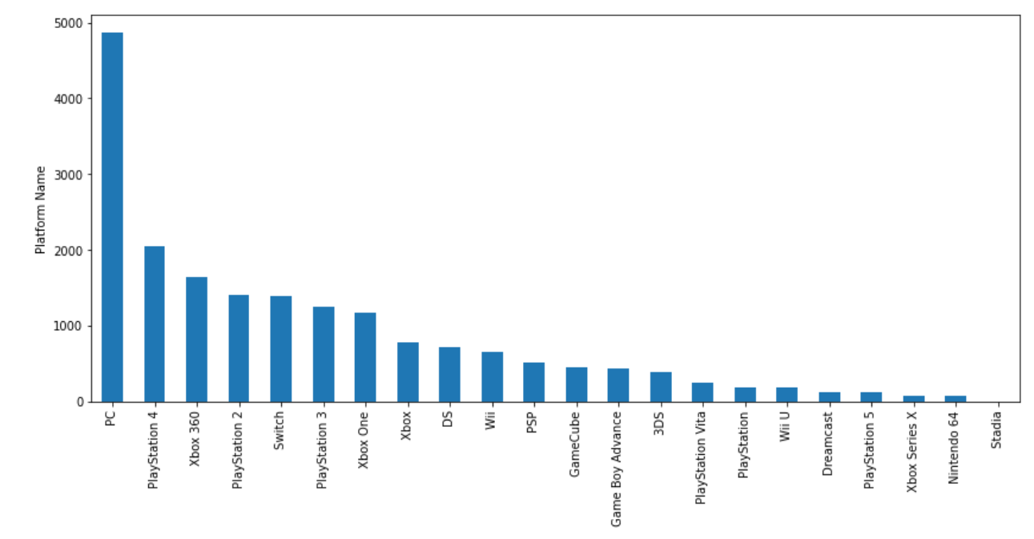
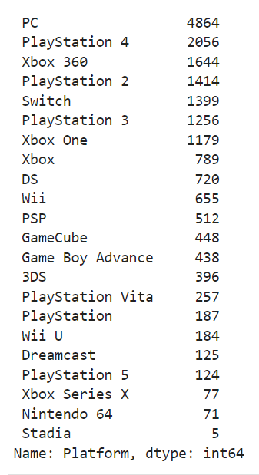
Top 5 Game Platform for the Total of Game Release
4864
2056
1644
1414
1399

Slide 11
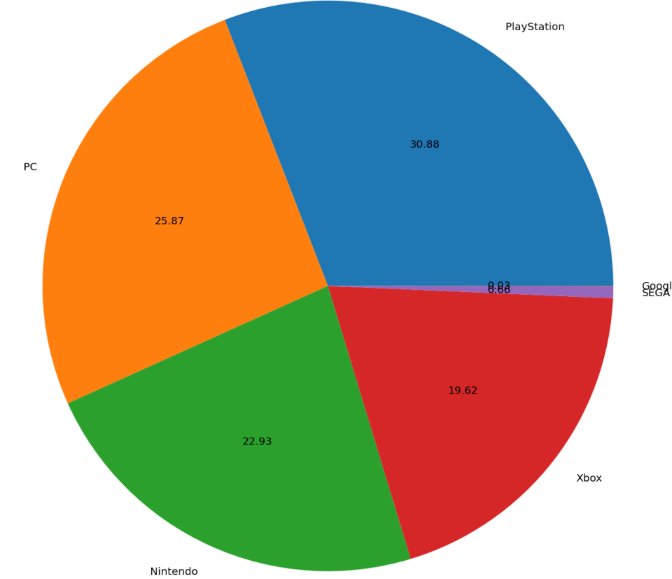
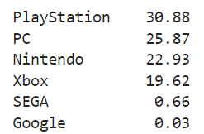
Top 3 Game Company
30.88%
25.87%
22.93%

Slide 12
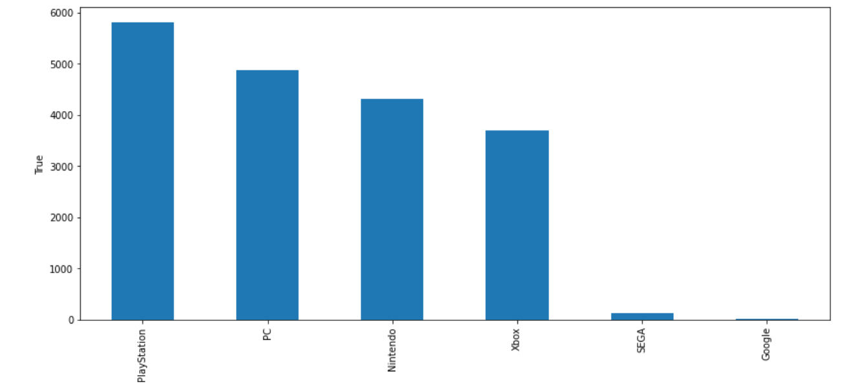
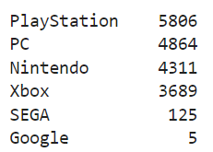
Top 3 Game Company for the Total of Game Release

Slide 13
Question
What top number game platforms for meta score of critic review rating? And What top number game companies for meta score of critic review rating?
Venus has a beautiful name, but it’s hot, even hotter than Mercury
1
3
2
4

Slide 14
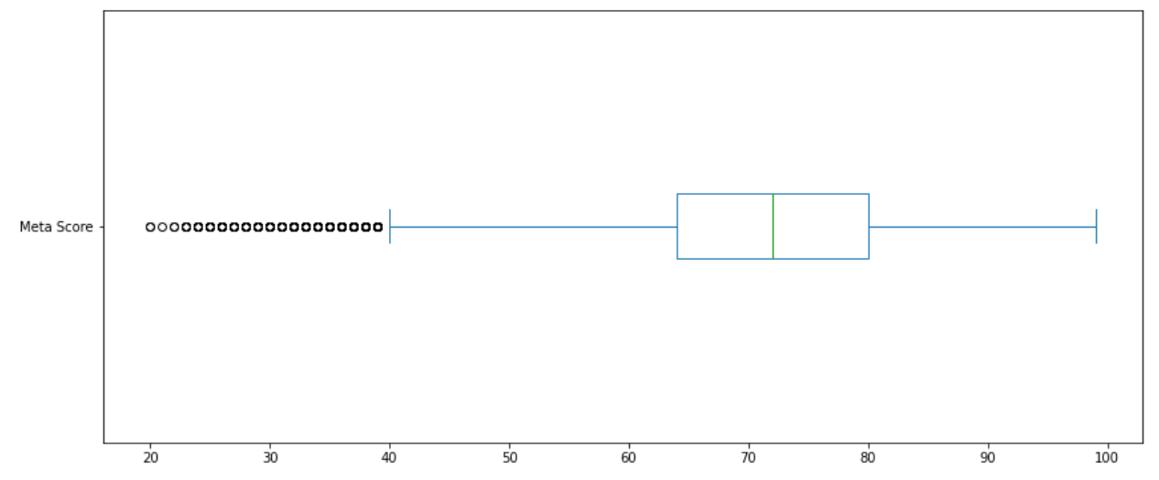
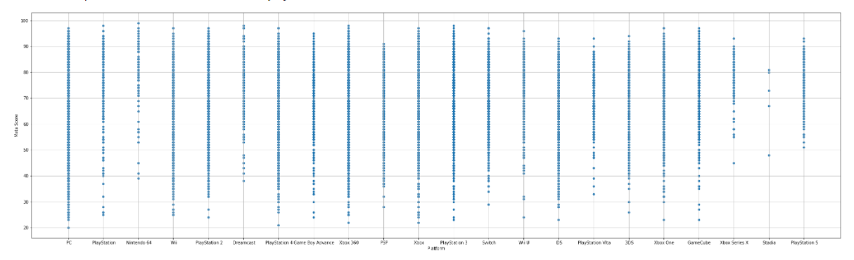
Meta Score Performance
of
Game Platform
Mean 70.65

Slide 15
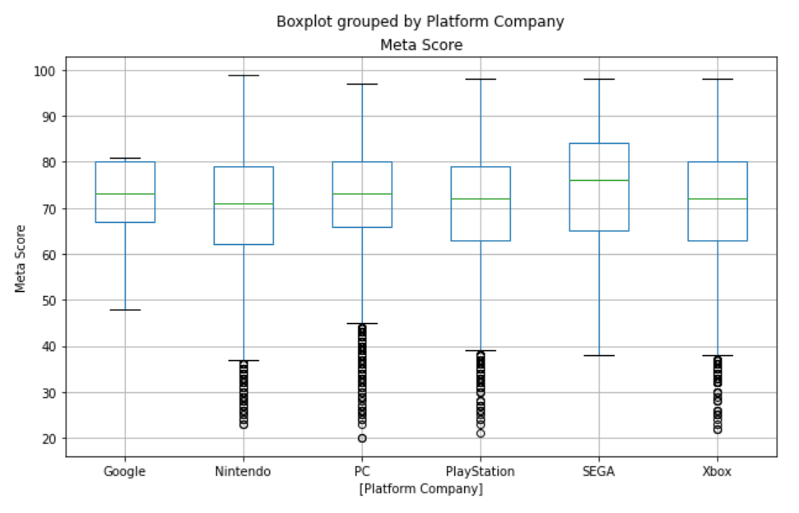
Meta Score Performance Of Game Company

Slide 16
Question
Venus has a beautiful name, but it’s hot, even hotter than Mercury
1
3
2
4
What top number game platforms for user review rating? And What top number game companies for user review rating?

Slide 17
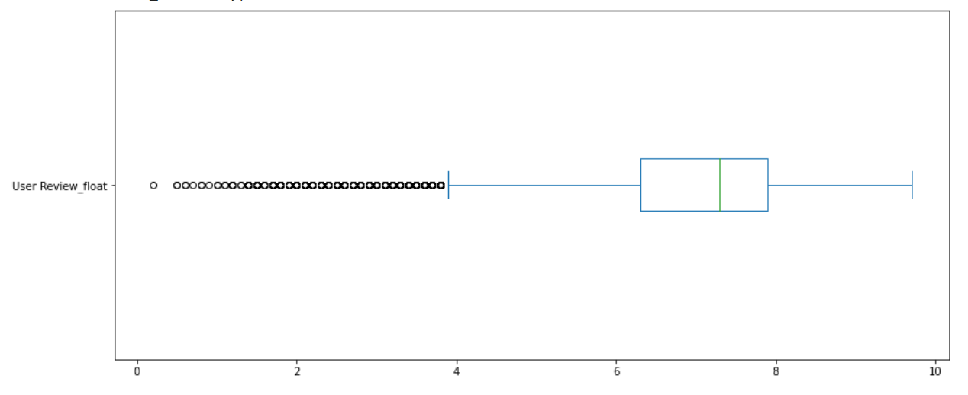
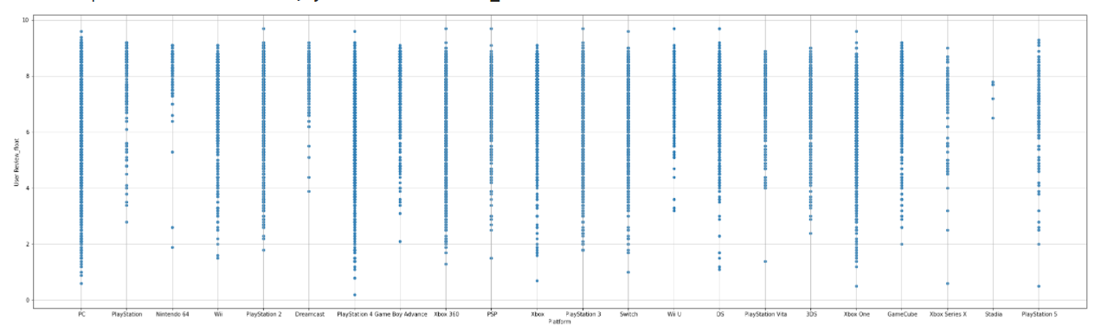
User Review Performance
of
Game Platform
Mean 6.99

Slide 18
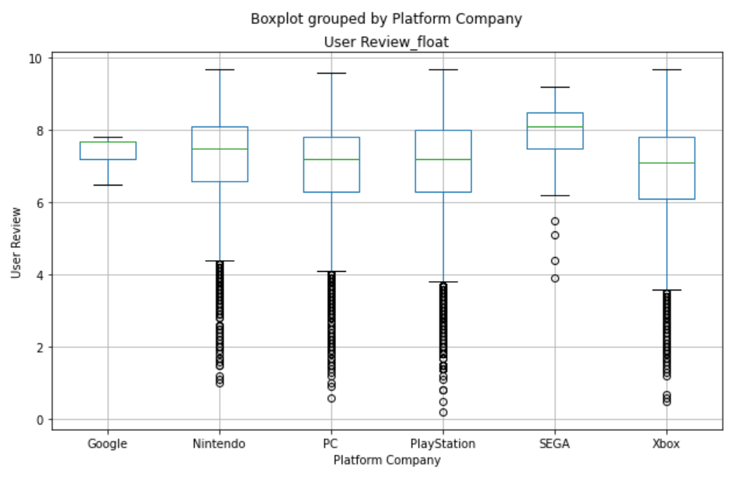
User Review Performance Of Game Company

Slide 19
Conclusion
Nowaday, Game releasing keeps increasing. And fall time seems to have more game to release.
1
PC could be considered as a potential platform to release game. However, for game company, Playstation has the bigger portion.
2
Based on meta score and user review, SEGA has the better performance in both parts. Also, Nintendo may be another considered option.
3

Slide 20
Thank you for your time
Class: Data Programming BDAT 1004-21F-10885
Student Name: Vivian Wang (Yu Tseng Wang)
Student Number: 200490882
Student Email: Vivian.Wang@MyGeorgian.ca

