Slide 1
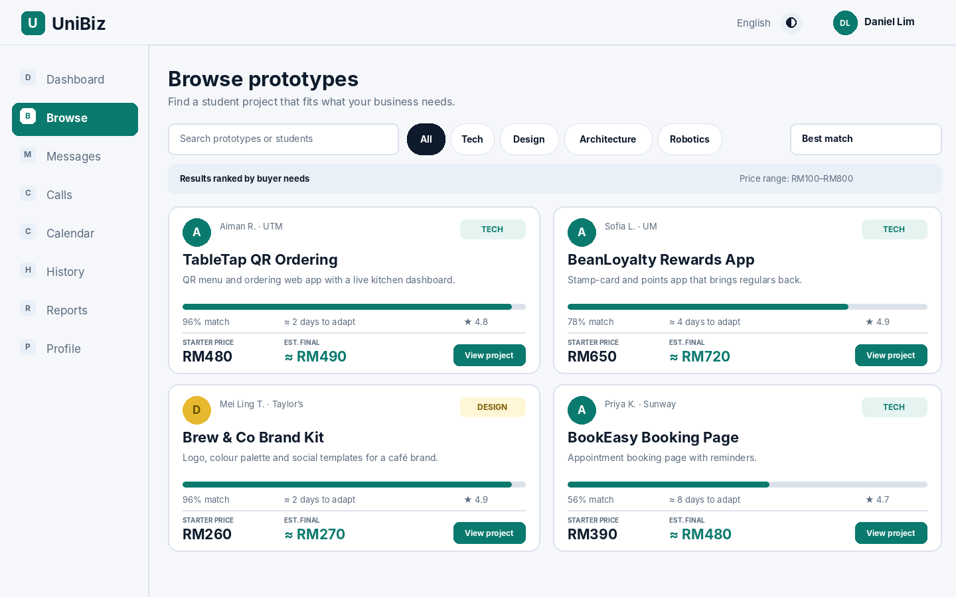
U
UniBiz
STUDENT PROJECTS × REAL-WORLD USE
Your school project
shouldn’t end at
submission.
UniBiz helps students sell and adapt school-made projects and Final Year Projects (FYPs) for real users.
From coursework to real-world use.
BROWSE STUDENT PROJECTS
A second life for work already done.
UNIBIZ · CAMPUS TO COMMERCE
1 / 5
Notes:
PRESENTATION TIMING: 0:00–0:30
Hi everyone. Think about the time you spend on a school project or your Final Year Project. You research, design, code, test and improve it for weeks or months. But after you submit it and receive your grade, it may never be used again. UniBiz is built to solve this gap: help students give the projects they have already created a second life in the real world.

Slide 2
THE APP
Here’s what UniBiz looks like.
A marketplace for student-made projects and Final Year Projects.
01
Browse projects
Apps, designs, robots and more.
02
Compare options
See price, match score and estimated changes.
03
Contact the student
Discuss what needs to be customised.
Made for existing student work — not just freelance jobs.
UNIBIZ · CAMPUS TO COMMERCE
2 / 5
Notes:
PRESENTATION TIMING: 0:30–1:10
UniBiz is a marketplace made specifically for student-made projects, coursework prototypes and FYPs. This is what the browsing page looks like. A student can list an existing app, design, robot or other prototype, along with its features and starting price. A business can browse categories, compare projects, check an estimated match and adaptation time, then contact the student. So we are not just matching a business with a freelancer; we are helping an existing project find a user.

Slide 3
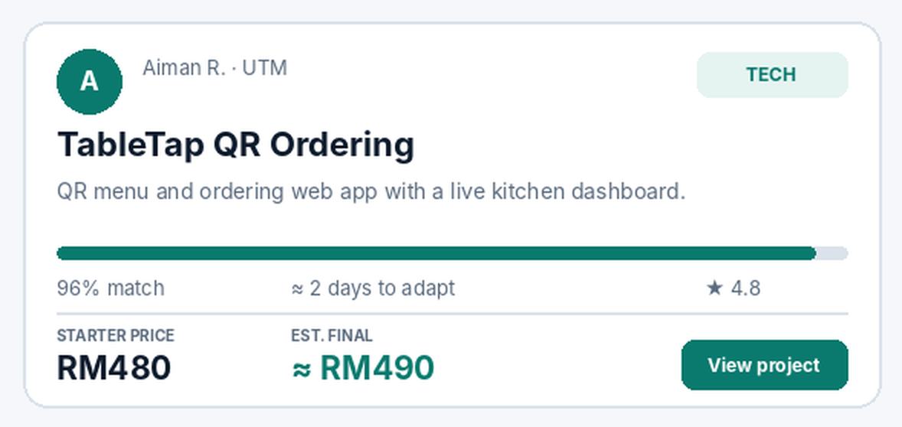
EXAMPLE
One project. A new real-world use.
Example listing from the UniBiz website demo.
HOW IT WORKS
1
A student lists a project
They show the demo, features and starter price.
2
A business finds a match
For example, a café needs an ordering tool.
3
They agree on changes
The student adapts the project for that buyer.
TableTap QR Ordering · RM480 starter price shown in the demo
No need to start from a blank page.
UNIBIZ · CAMPUS TO COMMERCE
3 / 5
Notes:
PRESENTATION TIMING: 1:10–1:50
Here is an example from the website demo: TableTap QR Ordering. It is a student-built QR menu and ordering app with a kitchen dashboard. The listing shows a starting price of RM480. A café may need its own menu, branding or payment setup. Instead of starting with a blank page, the café can message the student, discuss the changes and agree on scope and timing. The student can build on work they have already done, and the business gets a more practical starting point.

Slide 4
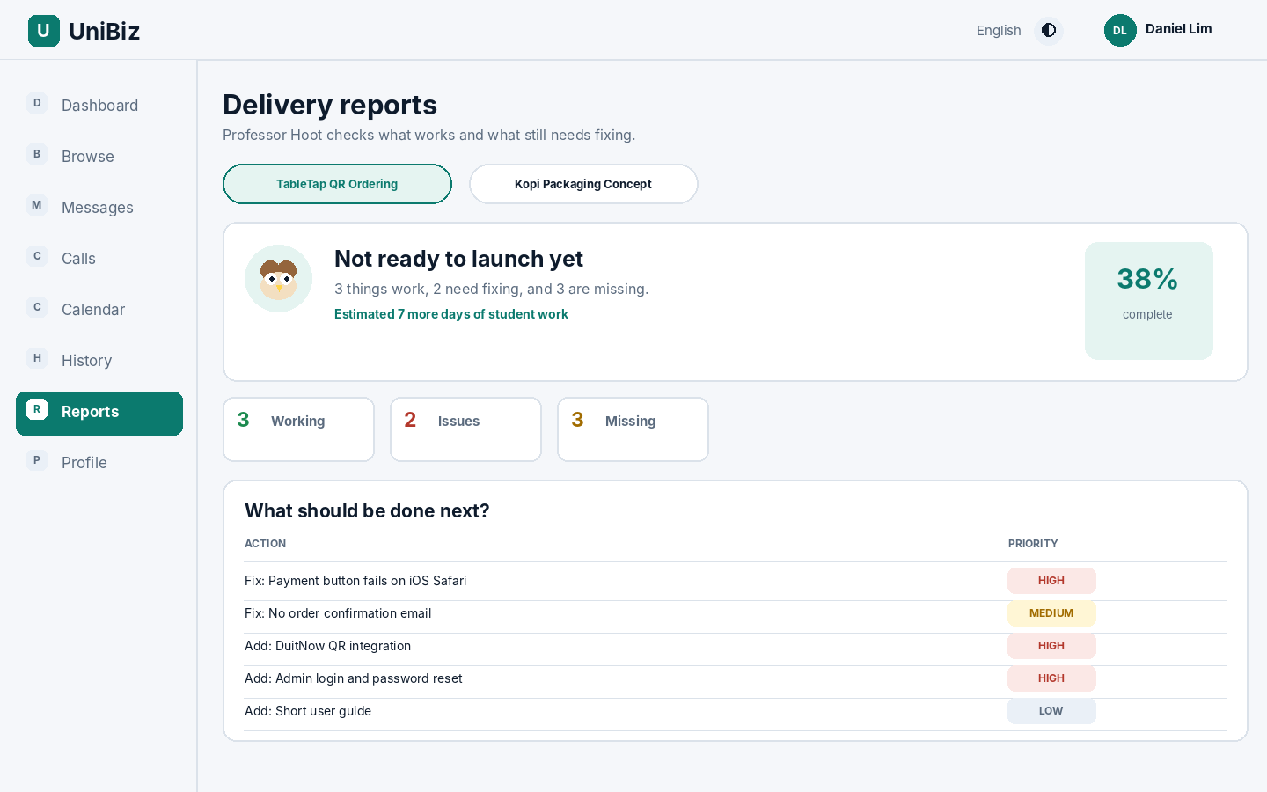
SMARTER COLLABORATION
Professor Hoot helps with the next steps.
UniBiz supports buyers and students after they find a project.
PROFESSOR HOOT
Find matches
Recommends projects based on buyer needs.
Draft messages
Helps start a conversation; the buyer can review it first.
Review delivery
Shows what works, what is missing and what to fix next.
Keep things organised
Supports call summaries, calendar tasks and project history.
Clearer next steps for both sides.
UNIBIZ · CAMPUS TO COMMERCE
4 / 5
Notes:
PRESENTATION TIMING: 1:50–2:35
UniBiz also supports the process after someone finds a project. Professor Hoot is our built-in AI assistant. It can recommend projects that fit the buyer’s needs, help draft a first message, and prepare summaries from calls. The delivery report screen helps a buyer and student see what is working, what is missing and what should be fixed next. Chats, calls, calendar events and project history are also available in one place. The aim is to make collaboration clearer, not leave people guessing about the next step.

Slide 5
WHY UNIBIZ MATTERS
Good work deserves
a second life.
Turn school projects into something people can actually use.
S
FOR STUDENTS
B
FOR BUSINESSES
Show your work. Keep building. Earn from your skills.
Find useful starting points without building everything from scratch.
UniBiz
CAMPUS → COMMERCE
Don’t let good work end at submission.
UNIBIZ · CAMPUS TO COMMERCE
5 / 5
Notes:
PRESENTATION TIMING: 2:35–3:00
Our goal is simple: good school work should not end with a grade. Students can show and continue developing what they have built, while businesses can discover useful ideas without starting from scratch. UniBiz connects campus projects with real-world needs. Thank you.

