Slide 1

T
E
M
P
L
A
T
E
Students performance in exams
42054047 Xinglan Yu
42054044 Xiaoman Li

Slide 2
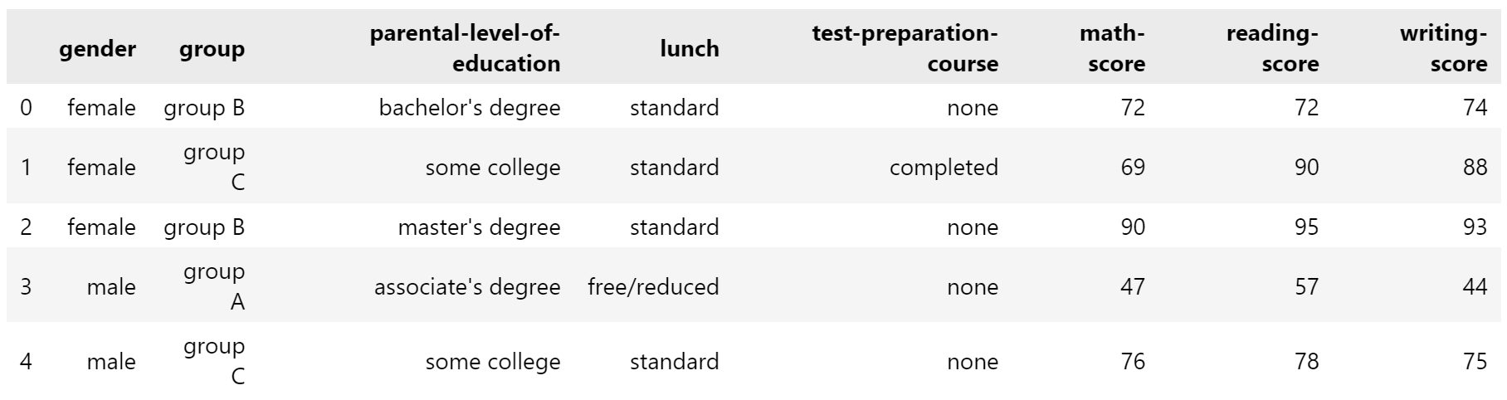
Dataset
Group:
Parental level of education :
Lunch:
Randomly divide the 10,000 data into five groups of ABCDE.
Categories: standard and free/reduced
Based on the information(Eligibility Requirements Set for School Lunch Program), we can know that there are corresponding requirements to qualify for free/reduced price lunch:
-Family size
-Income criteria
Categories:
master's degree
bachelor's degree
associate's degree
some college
high school
some high school

Slide 3

PREFACE
Two questions:
What factors have an impact on student performance?
Is there a correlation between different students' respective math, reading, and writing scores?

Slide 4

1
Influencing Factors
1-1 Gender 1-2 Parental level of Education
1-3 Lunch (economic situation) 1-4 Preparation

Slide 5
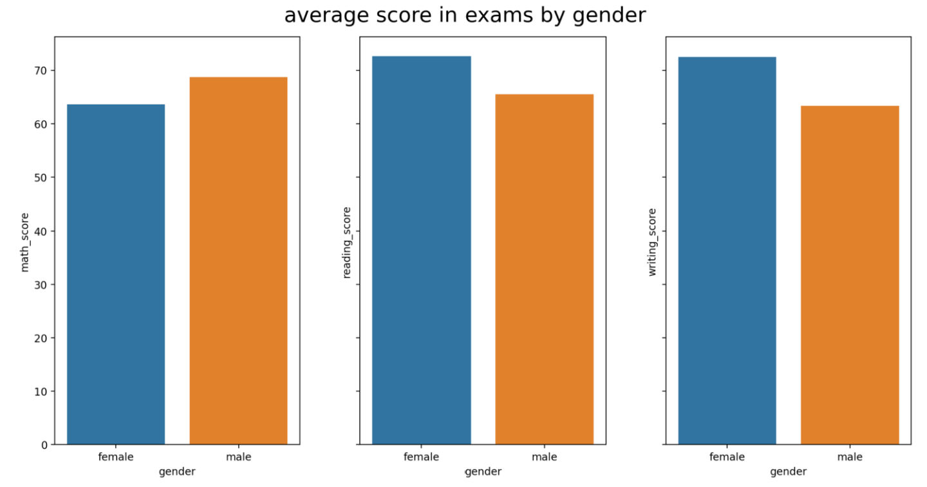
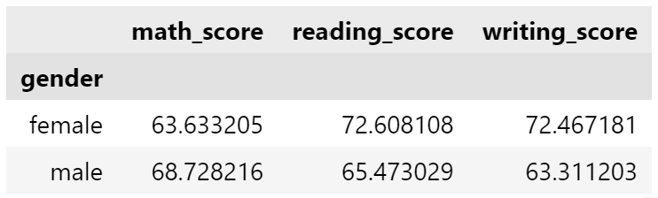
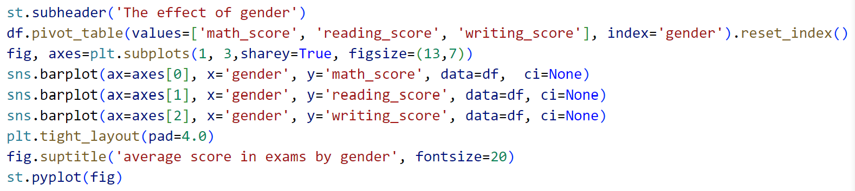
1-1 Gender

Slide 6
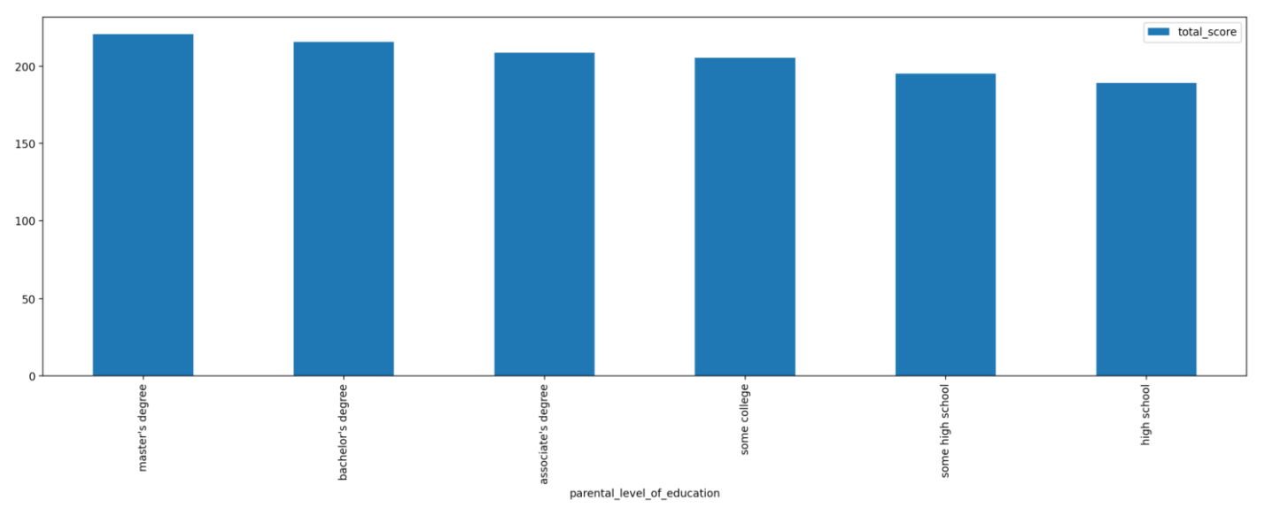
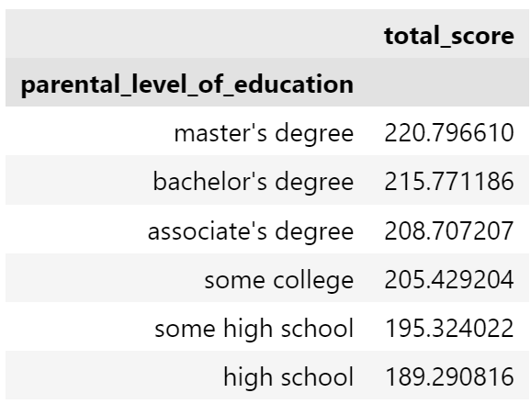
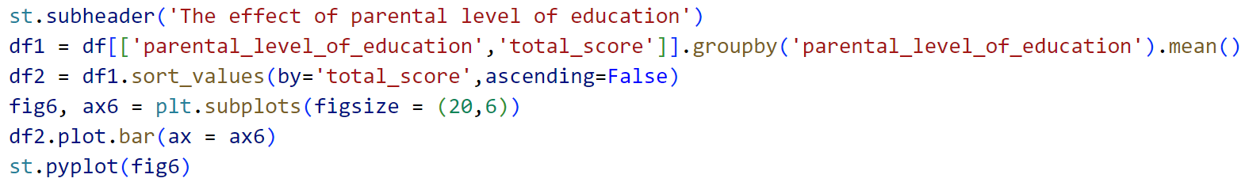
1-2 Parental level of Education

Slide 7
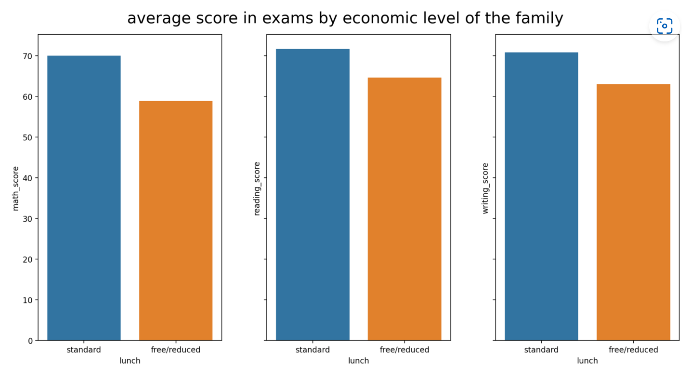
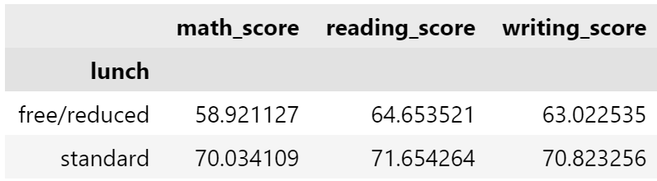
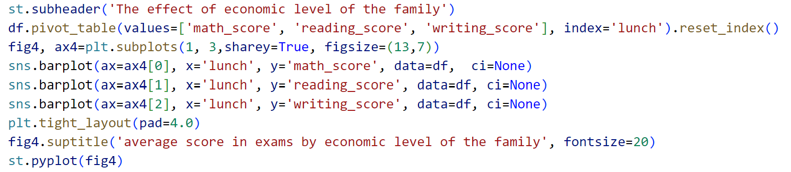
1-3 Lunch (economic situation)

Slide 8
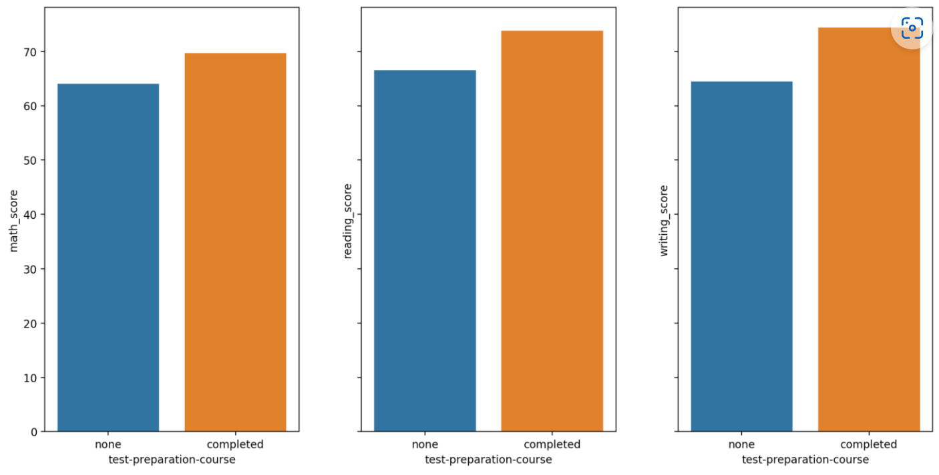
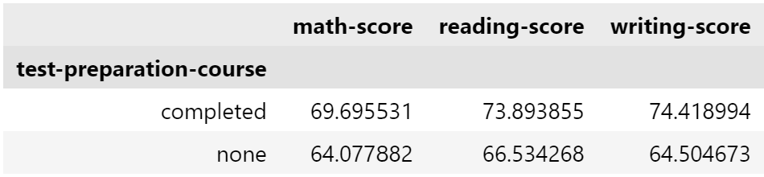
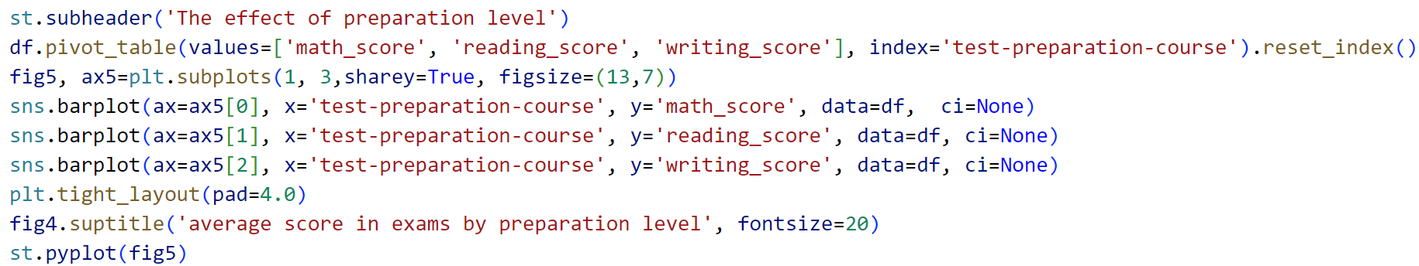
1-4 Preparation

Slide 9
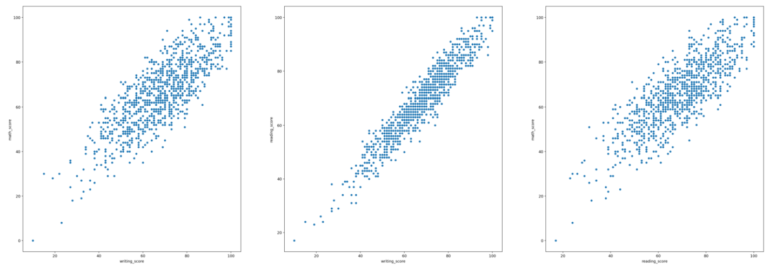
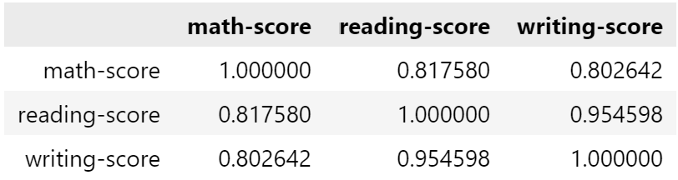
2
Correlation analysis
writing--math writing--reading reading--math

Slide 10
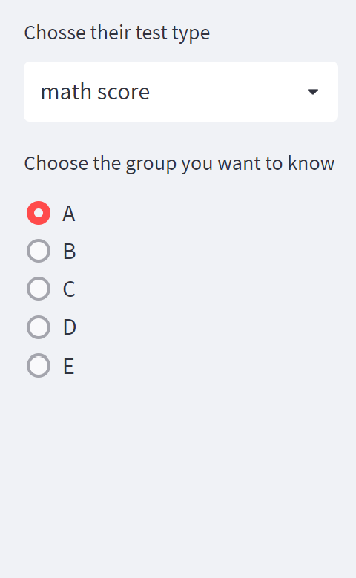
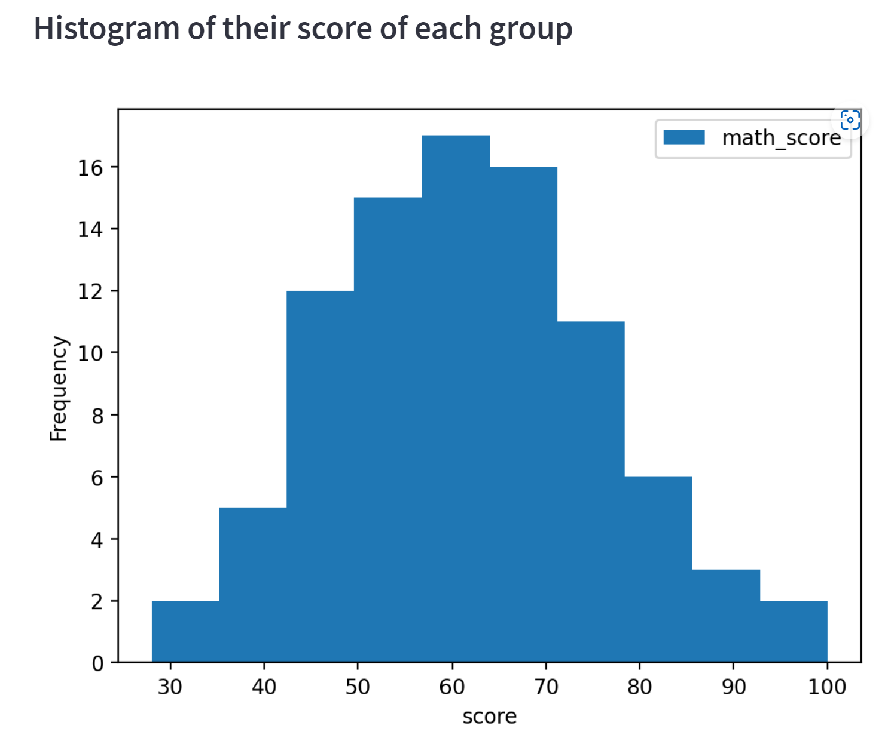
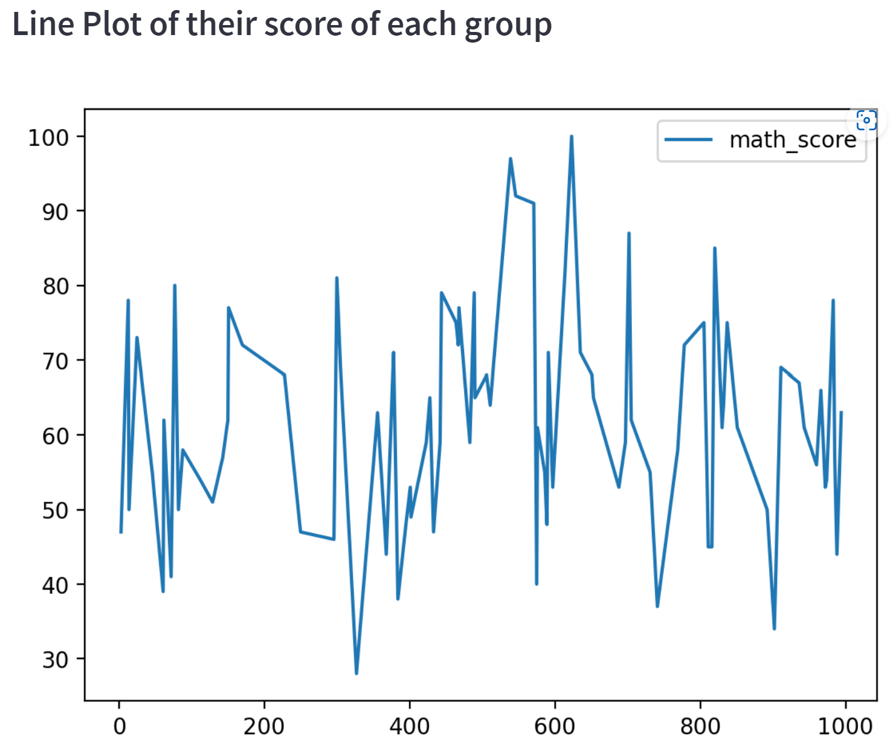
3
Widget function

Slide 11


Thanks for your listening

