Slide 1






Homework II 說明
Instructor：Lih-Yih Chiou TA : Simon 林軒宇
Date : 10/01/2025

Slide 2
Outline
Advanced VLSI System Design(Graduate Level) Fall 2025
作業內容說明
Problem 1
➔ 作業驗證說明
Problem 2
➔ 作業驗證說明
作業繳交注意事項

Slide 3
作業內容說明
Advanced VLSI System Design(Graduate Level) Fall 2025

Slide 4
Bus Architecture
Advanced VLSI System Design(Graduate Level) Fall 2025
Enable communication and data exchange between various hardware components, ensuring their co-operation
Various protocols depends on the specific hardware design
➔ APB
➔ AHB
➔ AXI (main focus)
Master1
Master2
Master3
Interface
Interconnect
Interface
Slave1
Slave2
Slave3

Slide 5
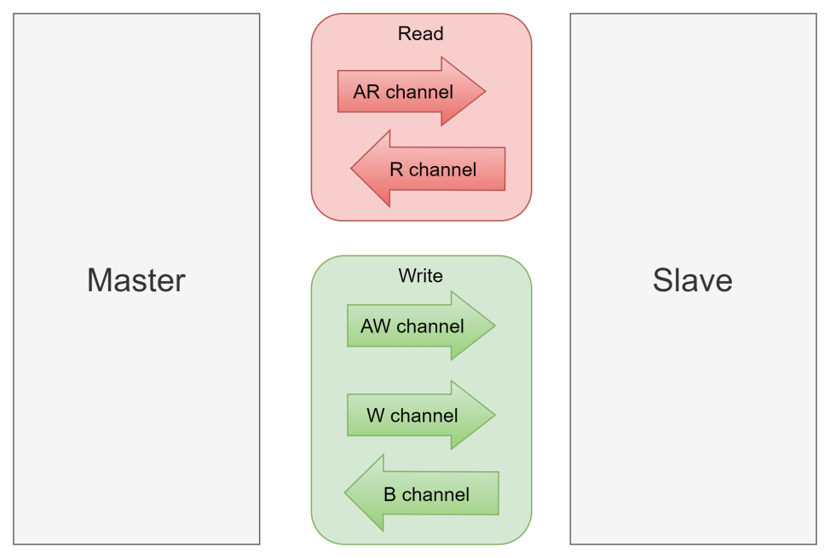
AXI4 introduction
Advanced VLSI System Design(Graduate Level) Fall 2025
Advanced bus communication protocol developed by ARM, widely used in System-on-Chip (SoC) and FPGA-based system designs.
Feature
➔ Separated channels
➔ Burst transfer
➔ Support multiple outstanding transactions
➔ Support out-of-order transactions

Slide 6
Handshake process
Advanced VLSI System Design(Graduate Level) Fall 2025
Each channel uses VALID/READY handshake process to transfer address, data, and control information.
Transfer occurs only when both the VALID and READY signals are HIGH
SOURCE
VALID
DESTINATION
READY

Slide 7
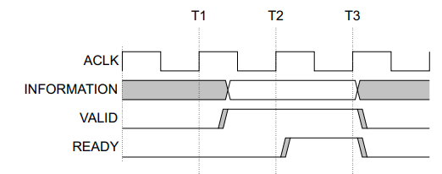
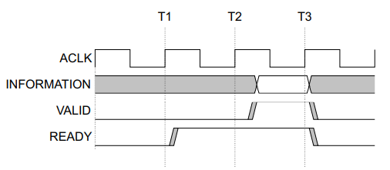
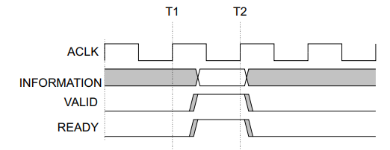
Handshake process
Advanced VLSI System Design(Graduate Level) Fall 2025
Case1 : Valid before Ready
Case2 : Ready before Valid
VALID signal must not be dependent on the READY signal in the transaction!!
Case3 : Valid with Ready

Slide 8
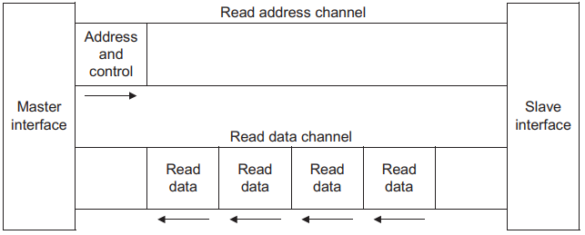
Read Transaction
Advanced VLSI System Design(Graduate Level) Fall 2025
Two channels for read process
➔ Read Address Channel (AR)
➔ Read Data Channel (R)
Each channel has valid and ready signal for HS process

Slide 9
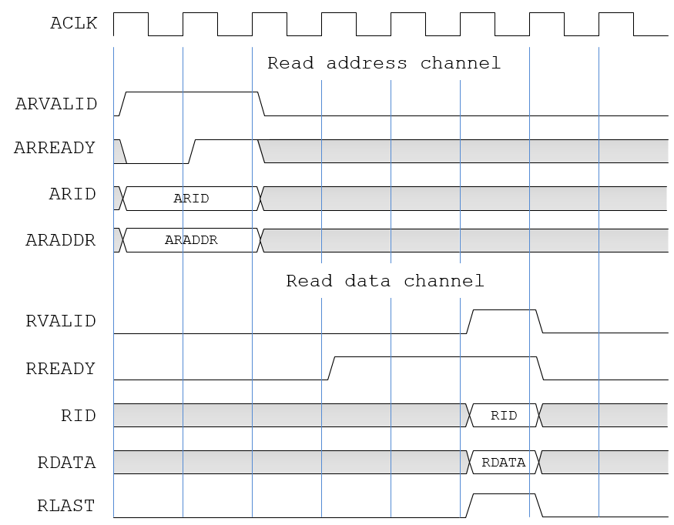
AXI Read Transfer (Burst length = 1)
T1 T2
Advanced VLSI System Design(Graduate Level) Fall 2025

Slide 10
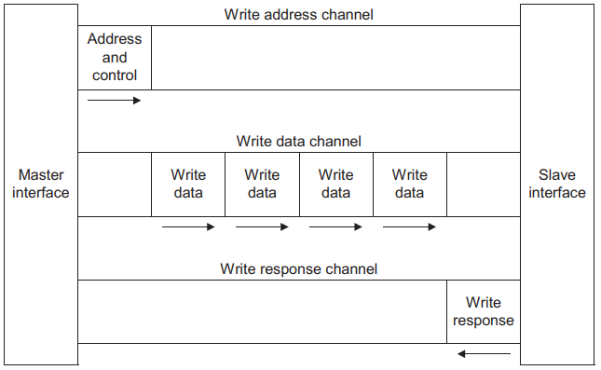
Write Transaction
Advanced VLSI System Design(Graduate Level) Fall 2025
Three channels for write process
➔ Write Address Channel
➔ Write Data Channel
➔ Write Response Channel
Each channel has valid and ready signal for HS process

Slide 11
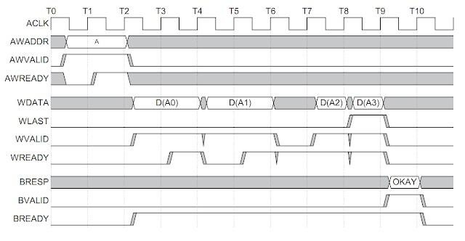
AXI Write Transfer (Burst length = 4)
Advanced VLSI System Design(Graduate Level) Fall 2025

Slide 12
AXI ordering
Advanced VLSI System Design(Graduate Level) Fall 2025
AXI protocol enables out-of-order transaction with multiple outstanding addresses.
address
a1 |  | a2 |  | a3
In order and outstanding=1
data
 | d1 |  | d2 |  | d3
address
a1 | a2 | a3
In order and
outstanding>1
data
 | d1 |  | d2 |  | d3
address
a1 | a2 | a3
Out of order and outstanding>1
data
 | d1 |  | d3 |  | d2

Slide 13
AXI ordering
Advanced VLSI System Design(Graduate Level) Fall 2025
AXI has ID signals to support out-of-order and outstanding transactions.
IDs are only unique within the context of a single master
Master1
Master2
ID1
ID0
Interconnect
ID0
Slave1
Slave2
Slave3

Slide 14
AXI ordering
Advanced VLSI System Design(Graduate Level) Fall 2025
Transactions from different masters have no ordering restrictions.
Transactions from same master, but different ID, have no ordering restrictions.
The data for a sequence with same AWID or same ARID must complete in same order even if they are aiming at different slaves.
There are no ordering restrictions with same AWID and ARID.
For masters that only support single ordered interface, we can tie the ID to a constant number.

Slide 15
AXI Interconnect
Advanced VLSI System Design(Graduate Level) Fall 2025
AXI Bridge
➔ Crossbar
➔ Slave Interface
➔ Master Interface
Master(s)
Slave(s)
wrapper
wrapper
master
Slave interface
AXI Bridge (Crossbar)
Master interface
slave

Slide 16
AXI Arbiter
Advanced VLSI System Design(Graduate Level) Fall 2025
In AXI systems, multiple Masters may need access to the
same Slave
Arbitration Strategies
Fixed Priority Arbitration
➔Each master is assigned a fixed priority level.
Round-Robin Arbitration
➔Masters are served in a cyclic order.
Weighted Round-Robin Arbitration
➔Similar to Round-Robin, but each master is assigned a weight

Slide 17
Port List in this Lab – Global Signals
Advanced VLSI System Design(Graduate Level) Fall 2025
Signal | Bits | Source | notes
ACLK | 1 | Clock source | Global clock signal
ARESETn | 1 | Reset source | Global reset signal, active LOW
--- 詳細的訊號說明請參照spec

Slide 18
Port List in this Lab – Read Address Signals
Advanced VLSI System Design(Graduate Level) Fall 2025
Signal | Bits | Source | notes
ARID | 4/8 | Master | Bits of master is 4 and for slave is 8, see A5-80 in spec
ARADDR | 32 | Master
ARLEN | 4 | Master | Burst length.
ARSIZE | 3 | Master | Burst size. (2^n)
ARBURST | 2 | Master | Burst type. Only need to implement INCR type.
ARVALID | 1 | Master
ARREADY | 1 | Slave

Slide 19
Port List in this Lab – Read Data Signals
Advanced VLSI System Design(Graduate Level) Fall 2025
Signal | Bits | Source | notes
RID | 4/8 | Slave | Bits of master is 4 and for slave is 8, see A5-80 in spec
RDATA | 32 | Slave
RRESP | 2 | Slave | Read response. This signal indicates the status of the read transfer.
RLAST | 1 | Slave | Read last. This signal indicates the last transfer in a read burst.
RVALID | 1 | Slave
RREADY | 1 | Master

Slide 20
Port List in this Lab – Write Address Signals
Advanced VLSI System Design(Graduate Level) Fall 2025
Signal | Bits | Source | notes
AWID | 4/8 | Master | Bits of master is 4 and for slave is 8, see A5-80 in spec
AWADDR | 32 | Master
AWLEN | 4 | Master | Burst length.
AWSIZE | 3 | Master | Burst size.
AWBURST | 2 | Master | Burst type. Only need to implement INCR type.
AWVALID | 1 | Master
AWREADY | 1 | Slave

Slide 21
Port List in this Lab – Write Data Signals
Advanced VLSI System Design(Graduate Level) Fall 2025
Signal | Bits | Source | notes
WDATA | 32 | Master
WSTRB | 4 | Master | Write strobes. 4 bits because 32/8 = 4
WLAST | 1 | Master | Write last. This signal indicates the last transfer in a write burst.
WVALID | 1 | Master
WREADY | 1 | Slave

Slide 22
Port List in this Lab – Write Response Signals
Advanced VLSI System Design(Graduate Level) Fall 2025
Signal | Bits | Source | notes
BID | 4/8 | Slave | Bits of master is 4 and for slave is 8, see A5-80 in spec
BRESP | 4 | Slave | Write response. This signal indicates the status of the write transaction.
BVALID | 1 | Slave
BREADY | 1 | Slave

Slide 23
Specification (1/2)
Advanced VLSI System Design(Graduate Level) Fall 2025
Master : Single Transfer.
➔ Burst length = 1
Bridge and Slave : Burst transfer.
➔ Burst length up to 4
2 masters and 2 slaves

Slide 24
Specification (2/2)
Advanced VLSI System Design(Graduate Level) Fall 2025
Slave
➔ Slave 1: 0x0000_0000 – 0x0000_ffff
➔ Slave 2: 0x0001_0000 – 0x0001_ffff
➔ Default slave: 0x0002_0000 – 0xffff_ffff
Default slave
➔ Response ERROR when masters access (RESP == DECERR) it
Default master
➔ Always execute, valid = 0 in the transfer
➔ You don’t need to create a default master module

Slide 25
Module
Advanced VLSI System Design(Graduate Level) Fall 2025
Module names and module ports of AXI are defined. DO NOT modify them. The definition of Module ports can be checked in AXI spec.
Ignore the signals that are not in this homework requirement.

Slide 26
Problem 1
Advanced VLSI System Design(Graduate Level) Fall 2025
作業驗證說明

Slide 27
Verification(1/3)
Advanced VLSI System Design(Graduate Level) Fall 2025
利用JasperGold的Verification IP分別去驗證CPU Wrapper, AXI, SRAM Wrapper
Master DUV Slave DUV
top.v
top.v
Master(CPU Wrapper)
Slave(SRAM Wrapper)
Slave monitor
Slave monitor
Master monitor
Bridge DUV
top.v
Bridge
Master monitor
Master monitor
Slave monitor
Slave monitor

Slide 28
Verification(2/3)
Advanced VLSI System Design(Graduate Level) Fall 2025
請不要更改.tcl
Assertion應全數通過才算完整
請 top.v的parameter
勿更動

Slide 29
Verification(3/3)
Advanced VLSI System Design(Graduate Level) Fall 2025
Table B-1: Simulation commands
Situation | Command
Run JasperGold VIP on AXI bridge without file pollution (RTL only) | make vip_b
Run JasperGold VIP on AXI master without file pollution (RTL only) | make vip_m
Run JasperGold VIP on AXI slave without file pollution (RTL only) | make vip_s
Delete built files for simulation, synthesis or verification | make clean
Check correctness of your file structure | make check
Compress your homework to tar format | make tar

Slide 30
Problem 2
Advanced VLSI System Design(Graduate Level) Fall 2025
作業驗證說明

Slide 31
Architecture
Advanced VLSI System Design(Graduate Level) Fall 2025
CPU Wrapper
➔ Instruction fetch (read only interface)
➔ Load or store
AXI
SRAM Wrapper
TOP
SRAM
Wrapper
IM1
top_tb
CPU
Wrapper
AXI
i_SRAM
CPU
SRAM
Wrapper
DM1
i_SRAM

Slide 32
Program
Advanced VLSI System Design(Graduate Level) Fall 2025
prog0
➔ 測試45個instruction (助教提供)
prog1
➔ Sort Algorithm
Prog2
➔ 不使用MUL/MUL[[S]U] instructions 完成Multiplication (助教提供)
prog3
➔ Greatest common divisor
prog4
➔ 使用階乘c code測試rdinstret, rdinstreth, rdcycle, rdcycleh(助教提供)
Prog5
➔ 使用MUL/MUL[[S]U] instructions實現Multiplication (助教提供)
prog6
➔ 使用floating point instructions進行運算(助教提供)

Slide 33
Specification
Advanced VLSI System Design(Graduate Level) Fall 2025
Don’t modify any timing constraint except clock period in
DC.sdc. Maximum clock period is 10 ns.
Design the master wrapper between CPU and AXI.
➔ Transfer Signals between CPU and AXI
Modify SRAM_wrapper to be compatible with AXI.
CPU has two masters
➔ Instruction
➔ Data
IM (Slave 1)
➔ 0x0000_0000 – 0x0000_ffff
DM (Slave 2)
➔ 0x0001_0000 – 0x0001_ffff

Slide 34
Module (1/2)
Advanced VLSI System Design(Graduate Level) Fall 2025
Module name須符合下表要求
Category | Name
 | File | Module | Instance | SDF
RTL | top.sv | top | TOP
Gate-Level | top_syn.v | top | TOP | top_syn.sdf
RTL | SRAM_wrapper.sv | SRAM_wrapper | IM1
RTL | SRAM_wrapper.sv | SRAM_wrapper | DM1
RTL | SRAM_rtl.sv | TS1N16ADFPC LLLVTA512X45 M4SWSHOD | i_SRAM
Gate-Level | TS1N16ADFPCLL LVTA512X45M4S WSHOD.sv | TS1N16ADFPC LLLVTA512X45 M4SWSHOD | i_SRAM
以上module name助教均已提供或已定義好，請勿任意更改，以免testbench抓不到正確的名稱

Slide 35
Module (2/2)
Advanced VLSI System Design(Graduate Level) Fall 2025
Module port須符合下表要求(同HW1)
Module | Specifications
top | Name | Signal | Bits | Function explanation
 | clk | input | 1 | System clock
 | rst | input | 1 | System reset (active high)
TS1N16ADFPCL LLVTA512X45M 4SWSHOD | Memory Space
 | MEMORY | logic | 32 | Size: [512][32]
紫色部分為助教已提供或已定義好，請勿任意更改
其餘部分需按照要求命名，以免testbench抓不到正確的
名稱

Slide 36
Simulation
Table B-1: Simulation commands (Partial)
Advanced VLSI System Design(Graduate Level) Fall 2025
Simulation Level | Command
Problem1
RTL | make rtl_all
Post-synthesis (optional) | make syn_all
Table B-2: Makefile macros (Partial)
Situation | Command | Example
RTL simulation for progX | make rtlX | make rtl0
Post-synthesis simulation for progX | make synX | make syn1
Dump waveform (no array) | make {rtlX,synX} FSDB=1 | make rtl2 FSDB=1
Dump waveform (with array) | make {rtlX,synX} FSDB=2 | make syn3 FSDB=2
Open nWave without file pollution | make nWave
Open Superlint without file pollution | make superlint
Open DesignVision without file pollution | make dv
Synthesize your RTL code (You need write synthesis.tcl in script folder by yourself) | make synthesize
Delete built files for simulation, synthesis or verification | make clean
Check correctness of your file structure | make check
Compress your homework to tar format | make tar

Slide 37
作業繳交注意事項
Advanced VLSI System Design(Graduate Level) Fall 2024

Slide 38
Report
Advanced VLSI System Design(Graduate Level) Fall 2025
請使用附在檔案內的Submission Cover
請勿將code貼在.docx內
➔ 請將.sv包在壓縮檔內，不可截圖於.docx中
需要Summary及Lessons learned

Slide 39
繳交檔案(1/2)
Advanced VLSI System Design(Graduate Level) Fall 2025
依照檔案結構壓縮成 “.tar” 格式
➔ 在Homework主資料夾(N260XXXXX)使用make tar產生的tar檔即可符合要求
檔案結構請依照作業說明
請勿附上檔案結構內未要求繳交的檔案，斟酌扣分
➔ 在Homework主資料夾(N260XXXXX)使用make clean可刪除不必要的檔案，但仍需再確認是否有多餘檔案沒有刪除
請務必確認繳交檔案可以在SoC實驗室的工作站下
compile，且功能正常
無法compile將直接以0分計算
請勿使用generator產生code再修改
禁止抄襲

Slide 40
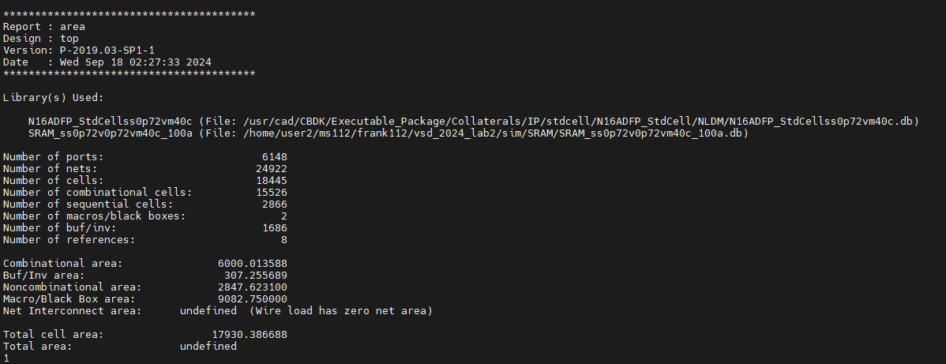
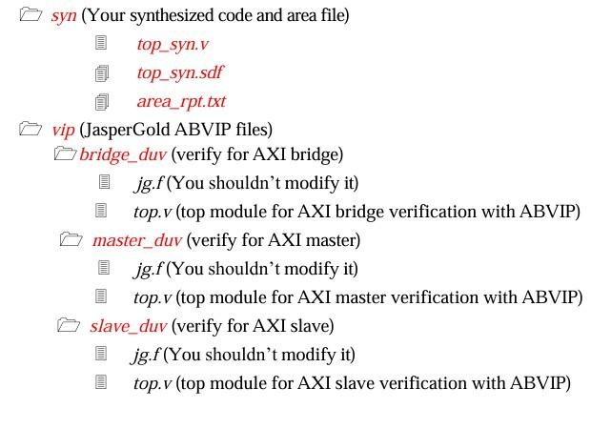
繳交檔案(2/2)
Advanced VLSI System Design(Graduate Level) Fall 2025
請在合成資料夾(syn)中留下area_rpt.txt檔案

Slide 41
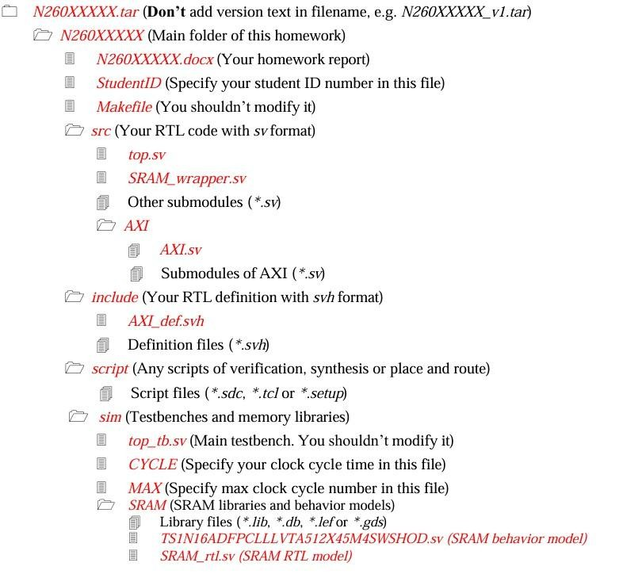
檔案結構(1/2)
Advanced VLSI System Design(Graduate Level) Fall 2025
N26XXXXXX.docx
➔ Your report file
src
➔ Your source code (*.sv)
include
➔ Your definition code (*.sv
StudentID
➔ Specify your Student ID number
sim/CYCLE
➔ Specify your clock cycle time
sim/MAX
➔ Specify max clock cycle number
h)

Slide 42
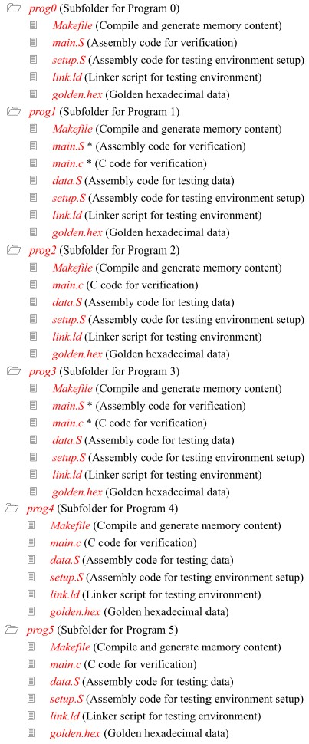
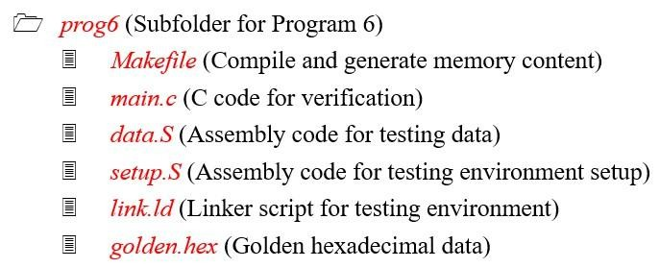
檔案結構(2/2)
Advanced VLSI System Design(Graduate Level) Fall 2025
sim/prog0、prog2、 prog4、prog5 、prog6
➔ Don’t modify contents
sim/prog1、prog3
➔ main.S
➔ main.c
Submit one of these
Don’t modify Makefile

Slide 43
繳交期限
Advanced VLSI System Design(Graduate Level) Fall 2025
2025/10/22 (三) 15:00前上傳
➔ 不接受遲交，請務必注意時間
➔ Moodle只會留存你最後一次上傳的檔案，檔名只要是
「N26XXXXXX.tar」即可，不需要加上版本號
43

Slide 44
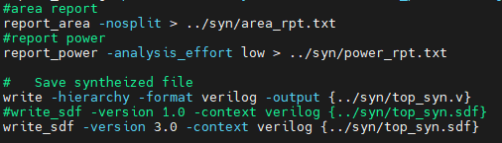
注意事項
Advanced VLSI System Design(Graduate Level) Fall 2025
本次作業合成的部分有計入PA(Performance & Area)，表現較為優異者將有較高的評分
作業部分有任何問題請在moodle上的作業討論區發問並可參考其他人是否有類似的問題，助教信箱恕不回覆。
在Script/DC.sdc中，可以更改clk period範圍，請注意最大的接受值為 10.0，超過此範圍者恕不納入計分。此外，若是有更改預設clock period者，請務必更改set_input_delay –max至1/2 clk period，以利後續作業的合成及模擬。
如有需要可以更改synthesis.tcl的合成指令來達到timing要求，但不
可更改產生合成檔案的指令
本次作業需在SoC環境下模擬，請同學務必在SoC教室執行模擬，若是助教在評分作業時於SoC無法成功模擬則以0分計算。
43

Slide 45
Grading

Slide 46
Grading
JasperGold VIP: 21%
Master: 7%
Slave : 7%
Bridge : 7%
Simulation: 42%
Program | RTL | SYN
Prog0 | 3% | 3%
Prog1 | 3% | 3%
Prog2 | 3% | 3%
Prog3 | 3% | 3%
Prog4 | 3% | 3%
Prog5 | 3% | 3%
Prog6 | 3% | 3%
Report: 17%
Design report, explanations, summary, lesson learned…

Slide 47
Grading
Performance & Area: 20%
PA score = Prog0 Simulation Time * Total Cell Area (Synthesized)
Note: Only those who passes all SYN programs are allowed to compete in the PA ranking.
Rank | Credit
Top 5% | 20
Top 10% | 18
Top 20% | 16
Top 30% | 14
Top 40% | 12
Top 50% | 10
Top 60% | 8
Top 70% | 6
Top 80% | 4
Under 80% | 2

Slide 48





Advanced VLSI System Design(Graduate Level) Fall 2025
Thanks for your participation and attendance !!
44

