Slide 1
网络与信息安全
关键互联网基础设施安全
DNS安全
张宇 副教授
网络与信息安全实验室
哈尔滨工业大学
yuzhang@hit.edu.cn

Slide 2
带有DNSSEC的域名解析示意图：
(root)
root key
DNSKEY通过另外独立的方式获取与验证，
那么应如何做？
com
.com DS
.com key
verisign.com
DS
DS
RRSIG
DO
2~7步迭代解析：
递归服务器负责验证，
权威服务器不负责验证
DS
RRSIG
DO
3 .com NS
VeriSign
2 www.versign.com A
verisign.com key
4 www.verisign.com A
5 .verisign.com NS
www
DO
1，8步，无DNSSEC；
若设置CD标记，则递归服务器不做检查，而由stub resolver检查
www.verisign.com
A
RRSIG
6 www.verisign.com A
7 www.verisign.com A
DO
递归
服务器
1 www.verisign.com A
用户主机
stub resolver
8 www.verisign.com A
AD

Slide 3
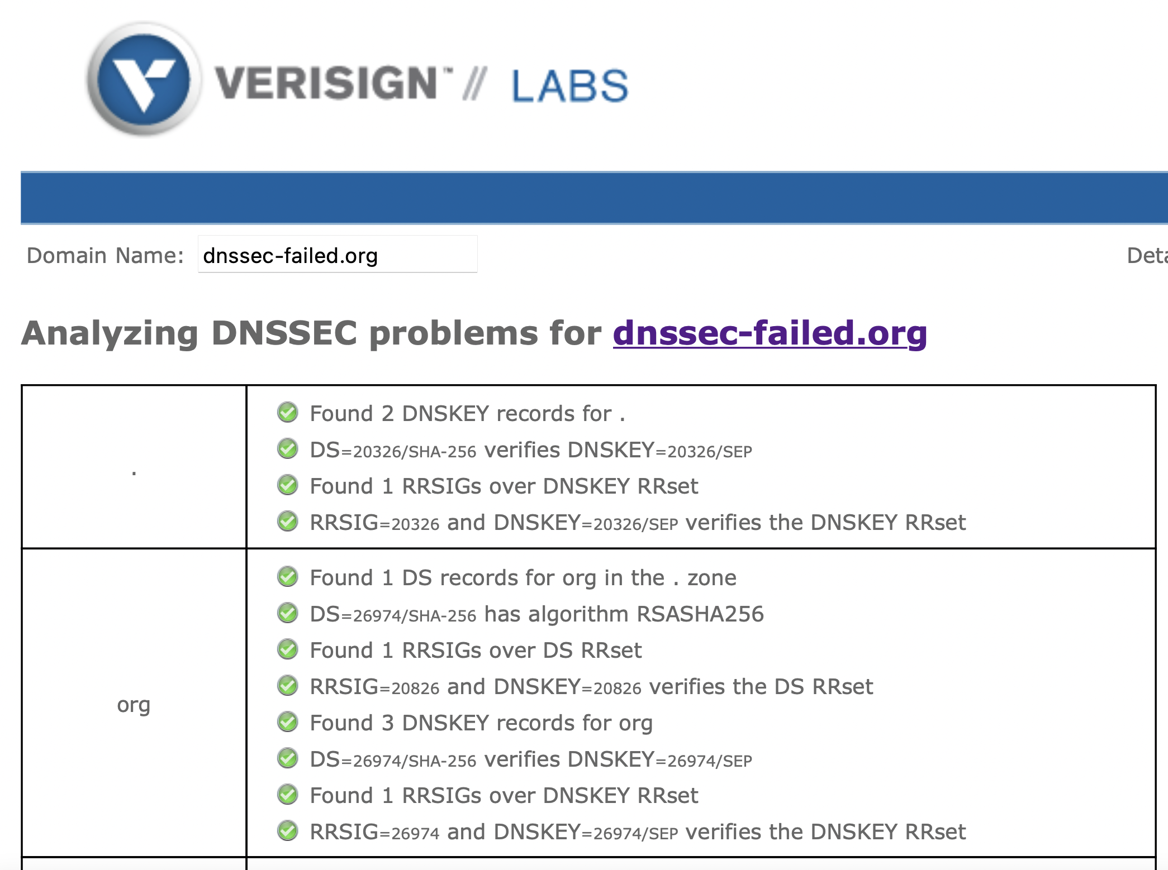
例子
一个DNSSEC验证失败的例子：
https://dnssec-analyzer.verisignlabs.com/dnssec-failed.org

Slide 4
迭代查询示例：www.verisign.com
; <<>> DiG 9.9.5-3-Ubuntu <<>> @localhost +dnssec +trace +all www.verisign.com
;; ->>HEADER<<- opcode: QUERY, status: NOERROR, id: 13093
;; flags: qr ra ad; QUERY: 1, ANSWER: 14, AUTHORITY: 0, ADDITIONAL: 1
;; OPT PSEUDOSECTION:
; EDNS: version: 0, flags: do; udp: 4096
;; QUESTION SECTION:
;. IN NS
;; ANSWER SECTION:
. 500724 IN NS d.root-servers.net.
. 500724 IN NS l.root-servers.net.
…省略…
. 500724 IN NS k.root-servers.net.
. 508448 IN RRSIG NS 8 0 518400 20150215170000 20150205160000 16665 . I7VZjRYmj1Co/I/bcT5XYQr+g6XC87Vscb3XrfZLWRIKQtKS9tK+n45R aVSK1UoHBlnQ4OrFKWuZ9dLZIpE6A1dwvb3OMOEV6PaHNnCE7rBdj6jg +dw4nWILEaXm1GLQJUvpPgkgowUqW9l6FCC3FqYcVxX4RYTUTyxfuFFb pmA=
…省略…
;; SERVER: ::1#53(::1)
AD，通过验证
本地递归服务器
DO，DNSSEC OK
从根开始，查询根服务器是什么？
key id，标识验证该签名的KEY，本例是
root ZSK
Label：域名中label数，root为0
原始TTL与当前TTL值不同
类型
算法：8
起始时刻
超时时刻
签名 Base64 编码
签名者
本地递归服务器

Slide 5
;; Got answer:
;; ->>HEADER<<- opcode: QUERY, status: NOERROR, id: 11815
;; flags: qr; QUERY: 1, ANSWER: 0, AUTHORITY: 15, ADDITIONAL: 16
;; OPT PSEUDOSECTION:
; EDNS: version: 0, flags: do; udp: 4096
;; QUESTION SECTION:
;www.verisign.com. IN A
;; AUTHORITY SECTION:
com. 172800 IN NS a.gtld-servers.net.
;省略
com. 172800 IN NS m.gtld-servers.net.
com. 86400 IN DS 30909 8 2 E2D3C916F6DEEAC73294E8268FB5885044A833FC5459588F4A9184CF C41A5766
com. 86400 IN RRSIG DS 8 1 86400 20150215170000 20150205160000 16665 . xGJbHfOj20fariNatsfpTl0Jcg4dt4PRVeIYCFQcH3Nf5GKjmOCIL5Yl ENjKv1cLBLIyVZoQltmJSMBBn2bEdpirkskAcvA0ykybCGgZbCfWwcBE svlZphIsNRIf12JzykhYz0CXNlEbTFfzpzMQclZ/YgBknjQXq3lCuYd1 f04=
;; ADDITIONAL SECTION:
a.gtld-servers.net. 172800 IN A 192.5.6.30
; 省略
b.gtld-servers.net. 172800 IN AAAA 2001:503:231d::2:30
;; Query time: 300 msec
;; SERVER: 192.203.230.10#53(192.203.230.10)
无AD，权威服务器不做验证
DO，DNSSEC OK
在父zone的NS“胶水”记录属于子zone,
禁止签名
key id，指向子zone的KSK
摘要类型
2：SHA256
[RFC4509]
DS记录，指向子zone KSK
签名算法
label数，com为1
签名 Base64 编码
key id，本例是root ZSK
原始TTL与当前TTL值相同
“胶水”记录属于子zone, 不做签名
E根(镜像)

Slide 6
无AD，权威服务器不做验证
;; Got answer:
;; ->>HEADER<<- opcode: QUERY, status: NOERROR, id: 54405
;; flags: qr; QUERY: 1, ANSWER: 0, AUTHORITY: 13, ADDITIONAL: 14
;; OPT PSEUDOSECTION:
; EDNS: version: 0, flags: do; udp: 4096
;; QUESTION SECTION:
;www.verisign.com. IN A
;; AUTHORITY SECTION:
verisign.com. 172800 IN NS a2.nstld.com.
…省略…
verisign.com. 172800 IN NS m2.nstld.net.
verisign.com. 86400 IN DS 9186 8 2 01A9FEBECE5772785696886A0B0BC756BDC86537F6423612821891FE 2D61D48A
verisign.com. 86400 IN RRSIG DS 8 2 86400 20150212051526 20150205040526 13787 com. yMJCUoIuHVI23/6Dsd3yRobus958t+IAWJSs5pFdM5QuAdL4+iYeL1Wt o1faA4iIfAlOz4BIRIYRNpLjiuTFKLF2WsQHzU9uU93i6Da0S2nfFvfR 8vJtTLHbYett+UfMRj1DpRksGS7JNgVn3eIHncYU3KSIRVQRotGLFplx eqg=
;; ADDITIONAL SECTION:
a2.nstld.com. 172800 IN A 192.5.6.31
f2.nstld.com. 172800 IN A 192.35.51.31
…省略…
m2.nstld.net. 172800 IN A 192.55.83.31
;; Query time: 2854 msec
;; SERVER: 192.26.92.30#53(192.26.92.30)
;; WHEN: Fri Feb 06 12:47:45 CET 2015
;; MSG SIZE rcvd: 690
指向verisign.com域名服务器
verisign.com的DS
label数为2
com ZSK
.com服务器c.gtld-servers.net.

Slide 7
;; Got answer:
;; ->>HEADER<<- opcode: QUERY, status: NOERROR, id: 46172
;; flags: qr aa; QUERY: 1, ANSWER: 4, AUTHORITY: 12, ADDITIONAL: 14
;; OPT PSEUDOSECTION:
; EDNS: version: 0, flags: do; udp: 4096
;; QUESTION SECTION:
;www.verisign.com. IN A
;; ANSWER SECTION:
www.verisign.com. 60 IN CNAME www-ilg.verisign.net.
www.verisign.com. 60 IN RRSIG CNAME 8 3 60 20150219084825 20150205084825 12632 verisign.com. MqEyZMhlr/Xg3qytm8o0KB5baCUeumaUENCQvG6Fae14kyzUfjhlSN1q 14ns7Py5Pm+f+88dhQuktzAIcA1eScJJXPRNA2/81lBKSe2ihNuDTCF/ Y01SwZEO1iFT0Z6XcjEZOAn8Q1FL8dIU/BEnrhv6DING1IefvJhVmhj6 sgU=
www-ilg.verisign.net. 60 IN A 69.58.181.89
www-ilg.verisign.net. 60 IN RRSIG A 8 3 60 20150218080903 20150204080903 28718 verisign.net. JB4tEO7ylq/1gMmwyl1Gazh2SMqROhJtHs+nGV12r7LydGVSPSaKxoCv G97ATsONZc3iAZkvPRVGo57n/RA75YFs+MIuUAm856f/GakLXSSY/HNh n0q9rnf45237zH7AyFu74KWUsIAJIk8T8Wy75hIej0MAh0AgVJHbecGK Bbw=
;; AUTHORITY SECTION:
verisign.net. 900 IN NS f2.nstld.com. ；省略
verisign.net. 900 IN RRSIG NS 8 2 900 20150218080903 20150204080903 28718 verisign.net. nNtS4HbYRXOLOcUR6p5q9SChbEFjBXJ47/PdCVVzYZdHFxll+B+YeLUy 0kW/LzfTcVNW+ZfXIxIHbXWlzkzdcwLlrPWAFcmOZxjUDMx5lmIDtycn ZB8qNUmtbCO1HwuRUqo5x23wnK4sLeZRqHVt5XpmCdyWSMtWI2SUTCO/ YgI=
;; ADDITIONAL SECTION:
a2.nstld.com. 172800 IN A 192.5.6.31；省略
;; SERVER: 192.35.51.31#53(192.35.51.31)
AA，权威答案
无AD，权威服务器不做验证
别名属于不同的zone
verisign.net
为什么TTL只有1分钟？
答案RR
必须签名
Label数3
verisign.com
ZSK 12632
verisign.net
ZSK 28718
当前zone的NS RR必须签名
verisign.net
ZSK 28718
verisign服务器f2.nstld.com.

Slide 8
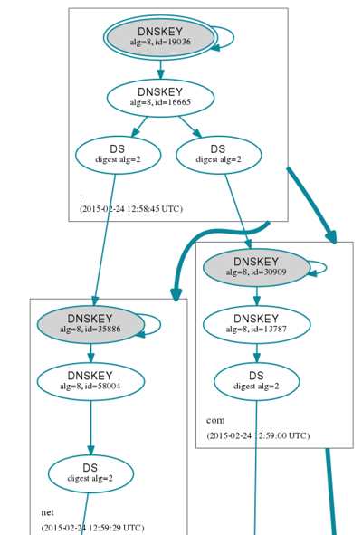
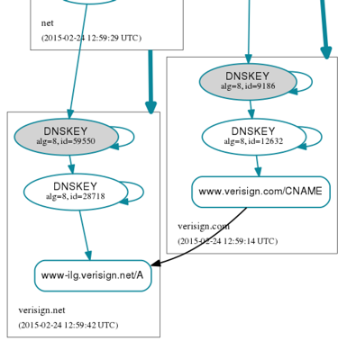
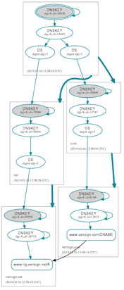
dnsviz.net

Slide 9
验证通信示意图：根据tcpdump输出
(root)
root key
可见通信过程是自底向上的(bottom-up)
com
.com DS
.com key
verisign.com
DS
所有查询带有DO标志；
所有应答带有RRSIG
8 .com DS
7 .com DS
VeriSign
5 .com DNSKEY
6 com DNSKEY
3 verisign.com DS
4 verisign.com DS
verisign.com key
www
www.verisign.com
无DNSSEC验证
1 verisign.com DNSKEY
递归
服务器
2 verisign.com DNSKEY
用户主机
stub resolver

Slide 10
验证过程分析：根据BIND日志
根据dig @127.0.0.1 +dnssec www.verisign.com产生的BIND日志
validating @0xb5401378: www.verisign.com A(实际是CNAME): starting
validating @0xb5448a98: verisign.com DNSKEY: starting
validating @0xb4bbf610: . NS: starting
validating @0xb4bbf610: . NS: verify rdataset (keyid=16665): success
validating @0xb4bbf610: verisign.com DS: starting
validating @0xb4bc0088: com DNSKEY: starting
validating @0xb4bc0b00: com DS: starting
validating @0xb4bc0b00: com DS: verify rdataset (keyid=16665): success
validating @0xb4bc0088: com DNSKEY: verify rdataset (keyid=30909): success
validating @0xb4bbf610: verisign.com DS: verify rdataset (keyid=13787): success
validating @0xb5448a98: verisign.com DNSKEY: verify rdataset (keyid=9186): success
validating @0xb5401378: www.verisign.com A: verify rdataset (keyid=12632): success
接着需要对www-ilg.verisign.net A验证，过程与上面类似
可见验证过程是自顶向下的(top-down)
root ZSK
.com KSK
.com KSK
.verisign.com KSK
verisign.com ZSK

Slide 11
问题：
请大家按照前面的例子，用dig查询一个部署了dnssec的域名，并添加注释
请分析DNSSEC验证过程中“自顶向下方式”（BIND缺省行为）和“自底向上方式”两种方案有什么优缺点？

